Slide 1


Ancient Signs, Symbols, and Incident Response
As seen through the eyes of GDPR
TF-DPR, April 2018
Nicole Harris, GÉANT
www.geant.org

Slide 2

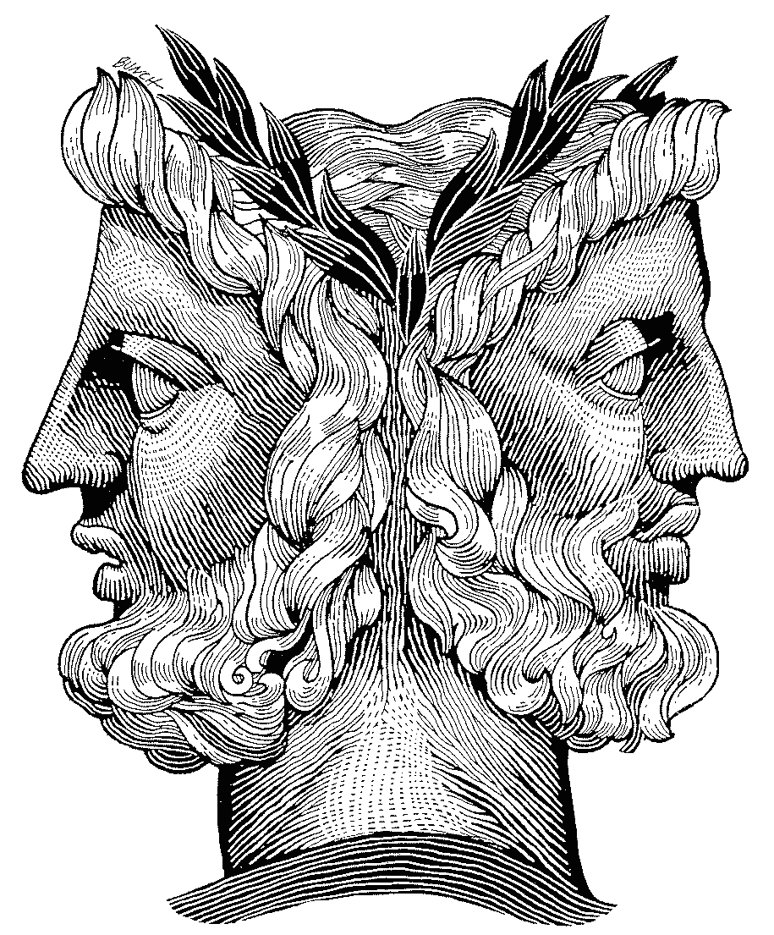
What do we need to worry about?
Requirements created by GDPR for Incident Response
Data breaches as an incident

Slide 3


Community Join-up (1)
ISM
Incident Response
Data Protection

Slide 4
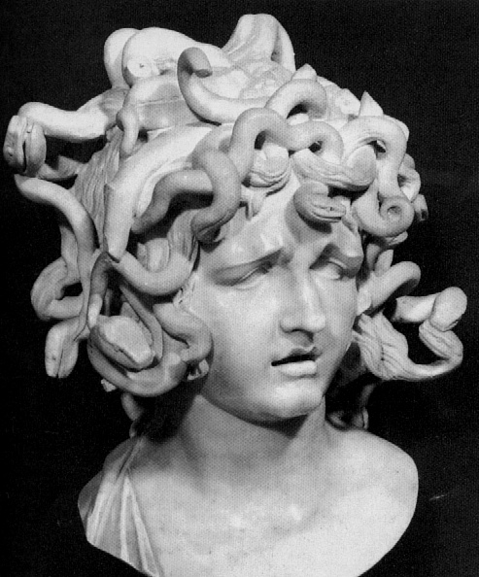
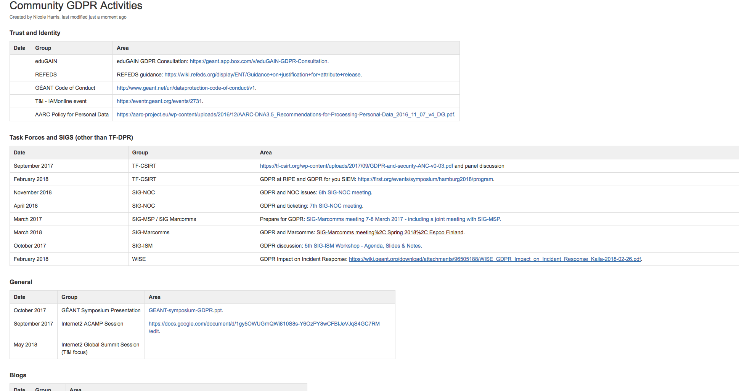
Community Join-Up (2)

Slide 5

What does the GDPR say? (thanks Andrew!)
  Breach: Unauthorised/accidental loss, alteration, disclosure or access to personal data
  Loss includes temporary: e.g. DDoS, Ransomware
  Record all of these
If it creates risk to rights and freedoms of data subjects, inform ICO (Art.33)
  Within 72 hours of “becoming aware”
    Can investigate (briefly, ~24hr) to confirm breach, before clock starts
    But starts immediately if notified by a data processor
If it creates high risk to rights and freedoms, inform data subjects (Art.34)
  Either individually, or by public notice
  Without undue delay, so can consult ICO if unsure

Slide 6

Who
DPO
CSIRT
Who informs the regulator?
Who informs users?
Who hears from users? (right to complain)
Joined up process?
Joined up people?
Joint controllers / processors?

Slide 7
What?
Logs.
Ticketing system (see SIG-NOC presentation).
Breach notification.
Vulnerability reports.
Communication channels / press?
Crisis management!

Slide 8
Where?
Secure communication channel?
  Example: eduGAIN incident response.
Can staff send encrypted mail?
Which trust circle?
Disclosure processes:
  TLP
  Responsible disclosure etc

Slide 9
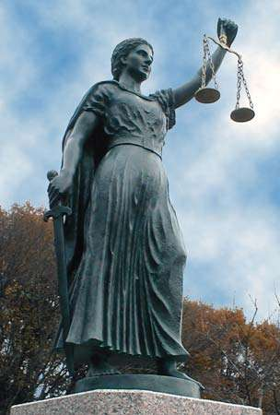

Slide 10

Thank you
www.geant.org
© GEANT Limited on behalf of the GN4 Phase 2 project (GN4-2).
The research leading to these results has received funding from the European Union’s Horizon 2020 research and innovation programme under Grant Agreement No. 731122 (GN4-2).

