Slide 1
TF-DPR Meeting 4, Barcelona
Welcome again!

Slide 2
Agenda
Time | Session
9.45 - 10.00 | Arrival and Start of the Day
10.00 - 10.45 | Update GÉANT services - Nicole Harris, GÉANT and Ana Alves, GÉANT
10.45 - 11.15 | Discussion on relationship with the DPA - Lead by Charlie van Genuchten, SURFnet
11.15 - 12.00 | Tools To Help GDPR Compliance - Albert Portugal, CSUC
12.00 - 13.00 | Roundtable on Implementation Practices - Lead by Morten Eeg Ejrnæs Nielsen, DeiC
13.00 - 13.15 | Closing Remarks
13.15 - 14.00 | Lunch

Slide 3
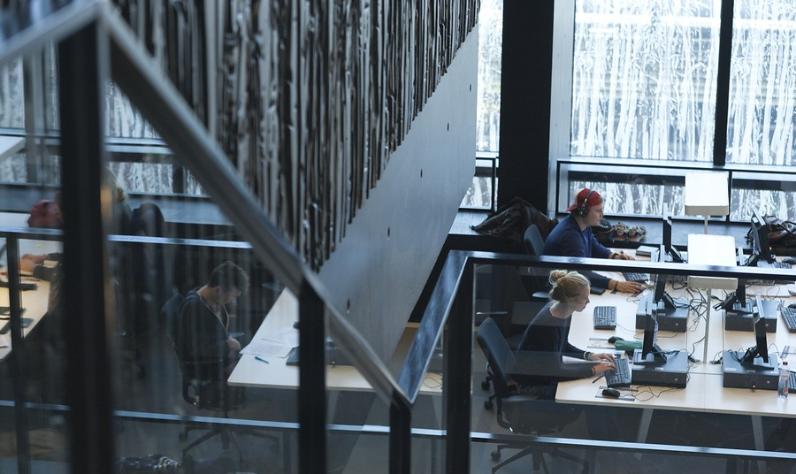
Relationship with DPA
Just a fling or something serious?
Charlie van Genuchten, SURFnet, GÉANT

Slide 4
In NL
Signals at community meeting: a lot of the same questions and concerns for the DPA (ranging from the very practical about the form to report data breaches to the more strategic questions how to deal with certain things in R&E context)
End of June: meeting with our DPA to deal with these questions and see about intermediary function of SURFnet.
Want to find out how other sectors are doing this, how to find balance between helping and supervising/monotoring etc.

Slide 5
Questions
How do you guys do this?
How does your DPA work?
Does your DPA approach you about certain questions?
Do you take on an intermediary function for the R&E sector?

