Slide 1
TF-DPR Meeting 4, Barcelona
Welcome!

Slide 2
Agenda
Time | Session
12.00 - 13.00 | Arrival - Sandwiches
13.00 - 13.15 | Welcome by CSUC and Steering Committee
13.15 - 14.00 | Report on Jisc DPIA - Andrew Cormack, Jisc
14.00 - 15.00 | Discussion on how to deal with Research Data - Marlon Domingus, Erasmus University Rotterdam
15.00 - 15.15 | Coffee
15.15 - 15.45 | Impact of Data Breaches: Crisis Management needed? - Charlie van Genuchten, SURFnet
15.45 - 16.15 | Discussion on Incident Management Process – Nicole Harris, GÉANT Marcel Breuer, Leibniz Supercomputing Centre
16.15 - 16.30 | Closing Remarks
16.30 - 20.00 | Enjoy the Ramblas for La Diada de Sant Jordi
20.00 | Dinner at La Taberna Gallega de Marcos (at own expense)

Slide 3

Impact of Data Breaches
Crisis management needed?
Charlie van Genuchten, SURFnet, GÉANT

Slide 4
How many?
How many data breaches in R&E sector?
How many within our NREN community?
Since last time: any fines or warnings yet?

Slide 5
Impact Data Breach
Fines of up to 20.000.000 euro or 4% of the organisation’s worldwide annual revenu
An increasing amount of bad press
Consequence: strategic level becoming more privacy and security aware (and sometimes freaking the hell out)

Slide 6
What can we do to prepare?
All the things we’ve been talking about to prevent and mitigate
Plus: make sure escalation of a data breach is known and tested
So: crisis management exercises!

Slide 7

National Level: OZON2016
Background and purpose
Crisis exercises within institutions are mostly fysically oriented (i,e, fire, evacuation, drills)
The need to practice with cyber crisis / IT security and data breaches
Inspiration by participating in other big cyber exercise
Purpose;
Increase awareness and resilience
To test the internal and external information chain
To test internal communication, processes, and testing protocols
To increase knowledge and understanding of the development of a cyber crisis
Notes:
At a conference with our members, much like this conference, some people had a lot of beers and decided that it was time to organize a big exercise. They went to the CISO of SURFnet and got together with a few people, asked for around 50.000 euro’s to get the ball rolling and then just didn’t stop.

Slide 8
Scenario and exercise
Multilayer attack, with ethical and criminal component;
Strategic and technical dilemmas to encourage cooperation between strategic, operational and tactical levels
Both technical and strategic challenges; leakage of researchdocuments, business data, manipulating data, mirror sites, simulation of productionenvironments
Big challenge to find compelling case for bridging the gaps between technical and strategic level
DPA agreed to take part in a small role
Notes:
Continuation:
Studies are being conducted on a follow-up of both large-scale exercises (OZON 2018) and small-scale exercises (NOZON 2017) at strategic and operational level.
Involved people and costs:
OZON's practice preparation has involved about 30 people, 10 for general design, the central scenario and the technique, 20 as practice preparatory and scenario writer for the participating institutions. The exercise totaled around 200 people, including all players.
Calculation of spent days for preparation:
Organization and advice: 50 days
Guidance settings: 40 days
Project leader: 16 days
Technology: 24 days
Project Secretary: 20 days
Exercise preparers of the institutions: 80 days (20 times 4 days)
Total preparation: 230 days
Spent days execution:
Exercise of the exercise (28 settings)
400 days (200 participants take 2 days)
Total performance: 400 days
In addition to time spent there were also out-of-pocket expenses for external project guidance, technology, gifts and goodies and travel and accommodation costs for about 40,000 euros. OZON is funded from the SURF Innovation Program Reliable and Safe Environment, the participating institutions have taken into account the dedication of their own employees.

Slide 9

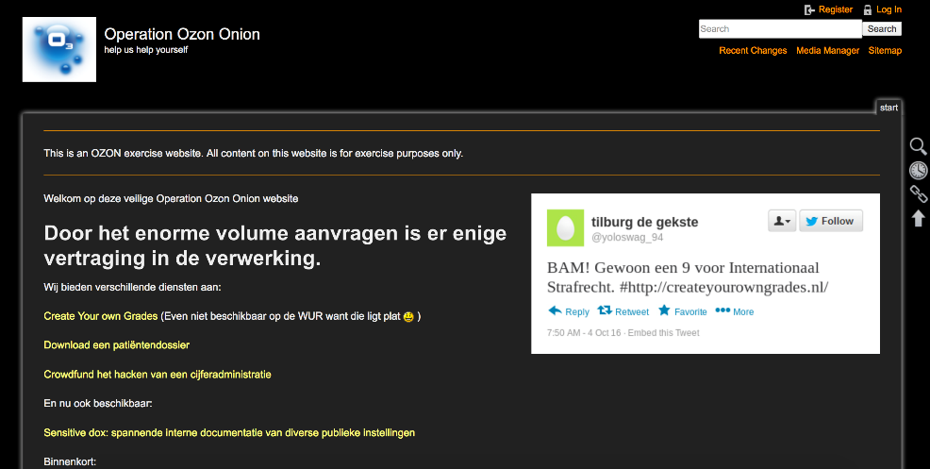
Scenario
Disclosing critical research and business information on a prepared website
Offering ”create your own grades” through websites

Slide 10
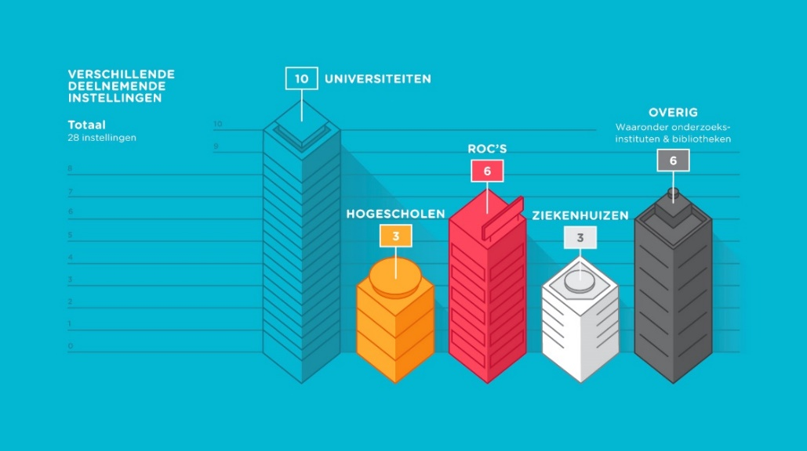
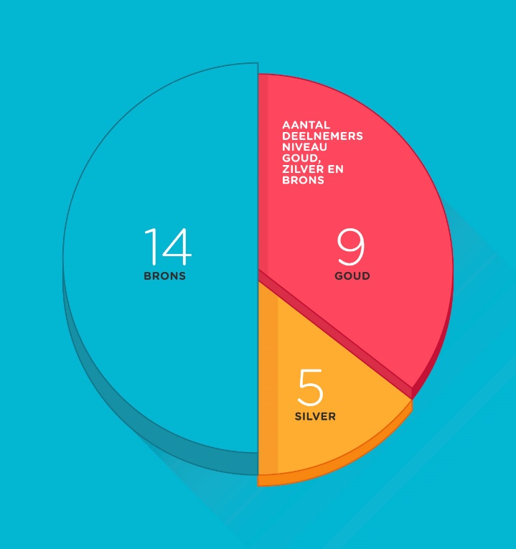
Participants
Participating institutions
Other:
Including research institutions and libraries
Universities
Regional Teaching Centres
Total: 28 institutions
Number of participants Gold, Silver and Bronze
Tertiary Education
Institutions
Hospitals
Bronze
Gold
Silver
Notes:
28 participating institutions ; 10 Universities, 3 Tertiary Education Institutions, 6 Regional Teaching Centres, 3 Academic Hospitals, 2 Libraries and 2 research institutions
And SURFnet
3 levels of participation;
Gold (they played a complete simulation with their own institution scenario on strategic, tactic and operational level),
Silver (they played at tactic and operational level, the strategic level was simulated)
Bronze (observing role and a small game element, capture the flag exercise whereby an infiltrant was at the institution
with a laptop with installed software
Which should be found by the IT department)
9 institutions played at Gold level
5 at Silver and
14 at Bronze
At first when we started we thought that we would play with about 5 to 10 institutions, but the enthousiasm was massive, so we had to close the registration
Earlier than expected and we played with far more participants than expected.

Slide 11
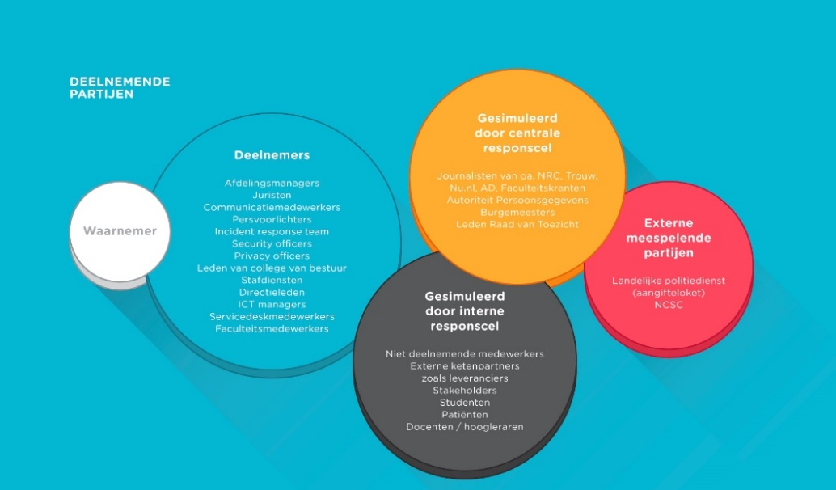
Participating roles
Participating roles
Simulated by
Responscel
Journalists, including NRC, Trouw, Nu.nl, AD, (national (online) newspapers)
Dutch Data protection Authority
Mayors
Members of the Supervisory Board
Participants
Department managers
Lawyers
Communication
Press Officers
Security Officers
Privacy Officers
Members of the Executive Board
Staff services
Board Members
ICT managers
Service employees
Faculty Staff
Observers
Contributing
External Partners
National Police,
(digital declaration
counter)
NCSC
Simulated by
internal responscel
Non-participating employees
External supply chain partners such as suppliers
Stakeholders
Students
Patients
Teachers
Professors
Notes:
For the exercise we developed a realistic scenario involving a hackergroup that had both sympathetic ideals and a criminal purpose. To make the
exercise scenario realistic for participating organisations they had to develop their own “implementation” of the scenario, tuned to their own, specific
exercise goals and tuned to their own situation.
Participants will be drawn into the crisis more quickly and will therefore react to the crisis realistically.
As the exercise was targeted at both technical levels and board levels we had to prepare plausible
Evidence of hacked systems and leaked information. This is where the customisation of the exercise
scenario came in play.
Scenario:
We used a central scenario whereon the institutions had based their own specific scenario with specific elements for their institution.
Central scenario:
A idealistic hackers collective states that too much information is not disclosed for economic reasons. They threat the institutions with disclosing very specific and sensitive information. Each institution determined what information is relevant to making the scenario institution-specific. A criminal component such as numerical manipulation has also been introduced.
By deploying both technology and ethics, we have succeeded in initiating cooperation between the different teams and not solving a problem with a simple referral. Consultation and coordination needed.

Slide 12
Results and Recommendations OZON2016
Make cybersecurity integral part of crisis management
Sharing information earlier in crisisprocess between organisations
Research into form of national coordination in a sector-wide cyber threat. To define autonomy and mandate of the institutions
To practice more large- and small exercises, sectoral- and/or topic specific. Preparation and execution of exercise together to achieve economies of scale
To share the outcomes, conclusions and recommendations of exercises to create more awareness and to create support of cyber threats and exercises.
Outcomes, lessons learned and recommendations stipulated in whitepaper, script for cybercrises exercise and video impression
10 data leaks reported as part of the exercise
Notes:
Continuation:
Studies are being conducted on a follow-up of both large-scale exercises (OZON 2018) and small-scale exercises (NOZON 2017) at strategic and operational level.
Involved people and costs:
OZON's practice preparation has involved about 30 people, 10 for general design, the central scenario and the technique, 20 as practice preparatory and scenario writer for the participating institutions. The exercise totaled around 200 people, including all players.
Calculation of spent days for preparation:
Organization and advice: 50 days
Guidance settings: 40 days
Project leader: 16 days
Technology: 24 days
Project Secretary: 20 days
Exercise preparers of the institutions: 80 days (20 times 4 days)
Total preparation: 230 days
Spent days execution:
Exercise of the exercise (28 settings)
400 days (200 participants take 2 days)
Total performance: 400 days
In addition to time spent there were also out-of-pocket expenses for external project guidance, technology, gifts and goodies and travel and accommodation costs for about 40,000 euros. OZON is funded from the SURF Innovation Program Reliable and Safe Environment, the participating institutions have taken into account the dedication of their own employees.

Slide 13

European Level: CLAW
Distributed table top exercise, stress management workshop and working sessions
Exercise set-up:
During this exercise, you are the NOC, CSIRT, ISM and Communication team of the organisation CLAW.
You will be responsible for the image, network stability and security of the whole NREN community.
You don’t have a crisis management plan, and you don’t have a crisis management team.
Your CEO is Inigo Montoya, he will be out of the country for the duration of the week.
This exercise is a simulation of one week of events: when we start the exercise it will be Monday and when we end it will be Friday.
Each day will take approximately 20 minutes.
Information sheet each day

Slide 14
CLAW Scenario
What was going on?
Crises during the week: Ariane Rocket does not launch because of a zero day bug and Guilder’s border is altered in the (supposedly immutable) European Open Science Cloud.
In detail:
A hacker group from Florin wants to get access to land sensing data from ESA to alter the map from neighboring Guilder, with which their country has had a border dispute for decennia. This group unintentionally triggers a multicast bug on Monday, when they are hiding their tracks. This first takes Florin off the network and could compromise an Ariane rocket launch on Wednesday if a software update with a bug fix is not installed in time.
Even if the Ariane rocket gets launched on the Wednesday, the hackers still are able to compromise a highly privileged admin account of the EOSC, with which they are able to alter the Guilder map on the EOSC on Thursday. To make matters worse, the newly appointed European Commissioner for the Digital Agenda is from Guilder, and when he receives a tweet congratulating him with a link to the altered map of Guilder, he is not amused in the slightest. The Florin hacker group claims victory for their alteration on Friday, which leads to a huge amount of traffic to the EOSC, as everyone wants to see what the fuss is about.

Slide 15
What started happening
Quite quickly: some emails between teams (which didn’t arrive…)
It took a few ‘days’ before someone picked up a phone
Teams created a very fixed idea of what was going on and didn’t verify this whith each other (tunnel vision)
Outside sources (simulated) were not consulted a lot; simulated DPA was not contacted at all
A lack of process and mandate created a lot of confusion and friction
Emotions got heated
But also: a sort of crisis management team was created during the ‘Wednesday’
Journalists were being deferred to Marcomms
It could have been much worse: communication between CSIRT, ISM and NOC worked enough to prevent problems with the rocket launch

Slide 16
Questions for CLAW 2018
Are you part of your NREN’s crisis management process?
What kind of scenario would be interesting to test?
Are there European risks for data breaches?

