Slide 1
The challenges of practicing what you preach
Sustainable procurement at GÉANT
Joost van Kessel
Brighton, United Kingdom
June 13, 2025

Slide 2
Agenda
What is sustainable procurement?
Why do we practice it?
Current sustainable procurement practices at GÉANT
Roadmap & goals for the coming years
Challenges we face
Next steps?

Slide 3
What is sustainable procurement?
Socially responsible purchasing
  Environmental criteria (sustainable/green, innovative, circular)
  Social criteria (social return, inclusivity and diversity, SME, international social conditions)
Embedded in all phases of the purchasing process
Goals
  Stimulating sustainable production
  Contributing to a ”better world”
Must be tailored to own organization’s needs and align with these principles
Notes:
Embedding procurement into all phases
Social return
Inclusivity and diversity
Sustainability - green
SME friendly
International social conditions
Innovation

Slide 4
The 7 steps of the procurement process
1
Procurement preparation
2
Specifying
3
Selecting
4
Contracting
5
Ordering
6
Delivery, use
and admin
7
Aftercare
Strategic
Procurement
Tactical Procurement
Operational Procurement
Notes:
As mentioned, it is applicable to all steps of the process.
I’d like to get out of this session: how to embed best practices in the strategic part of procuring.
Creating good basis there will lead to snowball effect that the process profits from.

Slide 5
Embedding sustainability into strategic procurement
Bringing sustainability into the conversation at strategic stage
Procurement contributes to organisation’s strategic goals
  Sustainable procurement should be aligned with an organisation’s sustainability policy
What do we need and how do we want to sustainably purchase that?
  Identify possibilities
  Market engagement
  Internal customer engagement
  Common trends
  Finding the balance
Notes:
Market engagement, question/challenge for suppliers to think about the subject – not just share a procurement policy but actually link it to the specific project for tangible results → how is this project going to benefit from that policy?
Question/engage own internal customers, how do they perceive sustainability in what they’re trying to achieve? Is it feasible? We cannot depend on suppliers to initiate the topic
Common trends in the form of requirements that actually force suppliers to re-consider their practices, influence the market and force them to include best practices if they are common market practice. First identify common market practice.
Balance between sustainability / potential financial or qualitative implications created by requesting it – how to determine that balance is key

Slide 6

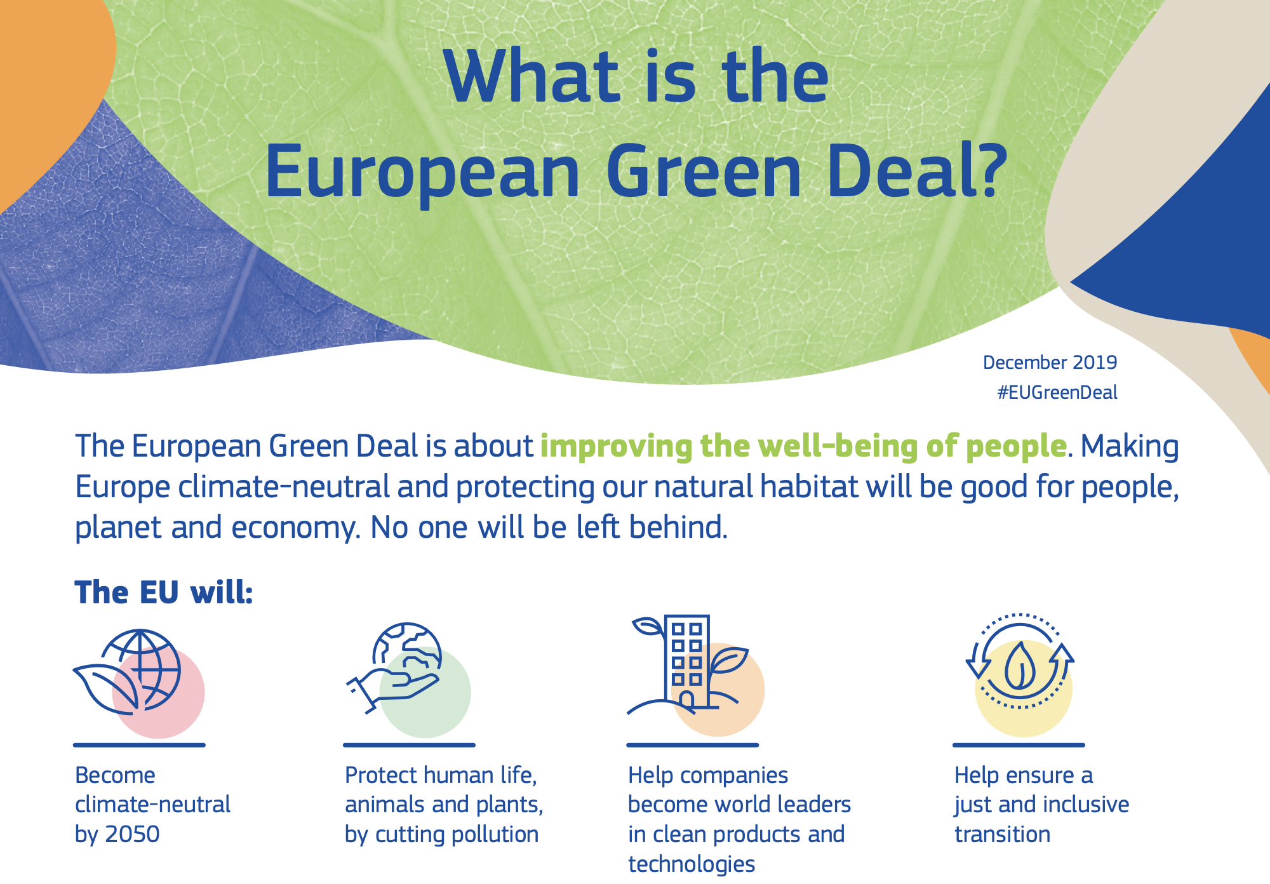
Why sustainable procurement?
GÉANT Project is intertwined with EU
We commit ourselves to contribute to a more sustainable world
Notes:
We must comply with EU Green Deal, net zero emissions by 2050 → our goal is 2035, very ambitious. Too ambitious?
GÉANT policy prescribed to contribute to the global Sustainable Development Goals (SDGs) of the United Nations, in particular to the goals of ‘Quality Education’ (SDG 4), ‘Gender Equality’ (SDG 5), ‘Industry, Innovation and Infrastructure’ (SDG 9), ‘Climate Action’ (SDG 13), ‘Peace, Justice and Strong Institutions’ (SDG 16), and ‘Partnership for the Goals’ (SDG 17), in addition to the EU Fundamental Rights Charter and the EU Green Deal.

Slide 7
It is happening all around us
Corporate Social Responsibility
  Environmental: focus on preservation of natural resources
  Ethical: ensures fair and honest business operations
  Economic: promotes the fiscal support of above goals
Having such policy makes GÉANT accountable to itself, its members and the R&E community.
Spending power as a tool to incentivize suppliers to contribute to sustainability goals
Start with small steps, it is a long journey
Notes:
The field opened when the CSR-term was coined, including ethical and economic aspects.
Point 2: indirectly the public. This policy must reflect that responsibility.
Point 3: must not underestimate our influence and be aware of our responsibility.
Point 4: no big ambitions, look at own processes first.

Slide 8
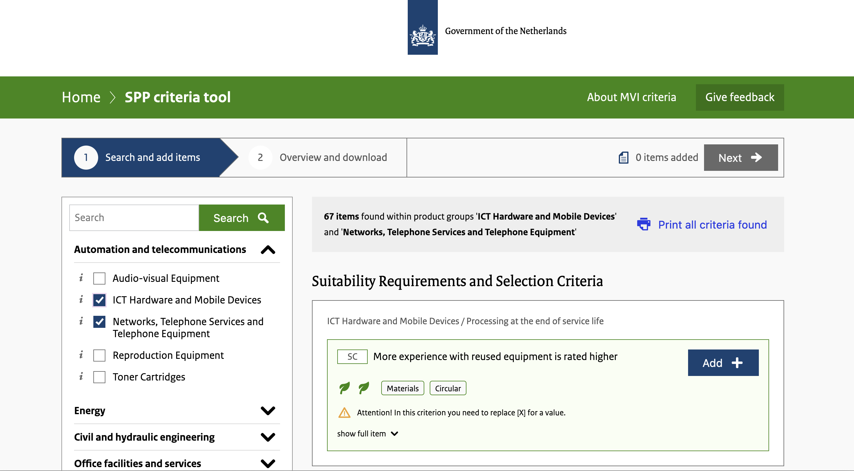
Current practices at GÉANT
Sustainability Committee
  Representatives from different workstreams
Work in progress: official sustainable procurement policy
Constructing a sustainable procurement measurement tool
  Measure development and maturity
  Quantifying ambition and progress
Creation of document with widely applicable criteria
  Policy must affirm obligatory use of tool
Creating more internal awareness
Creating external awareness in the community
  Collaborate / share best practices
Notes:
For those that attended Sustainable NREN presentation, I would like to hear your opinions.
Hoping this session can give me some tools to develop it further.
Criteria document:
Energy efficiency
Life cycle assessment
Hardware management -> waste processing, circularity
Social return
International social conditions

Slide 9
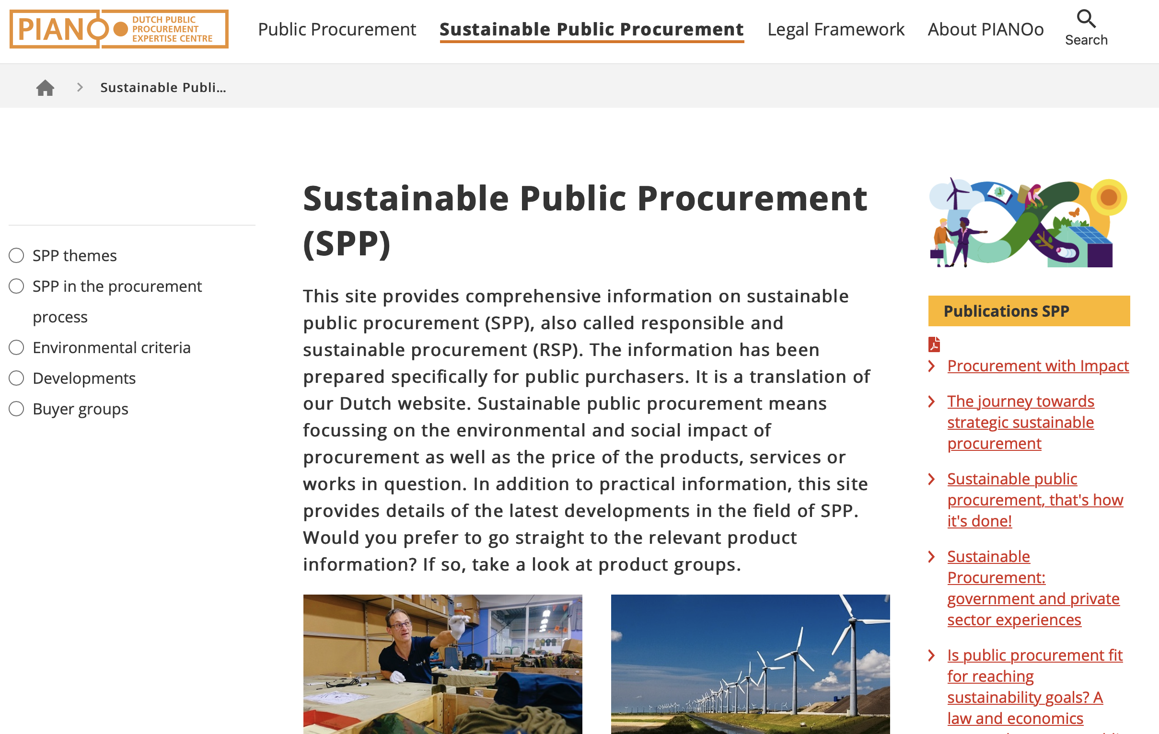
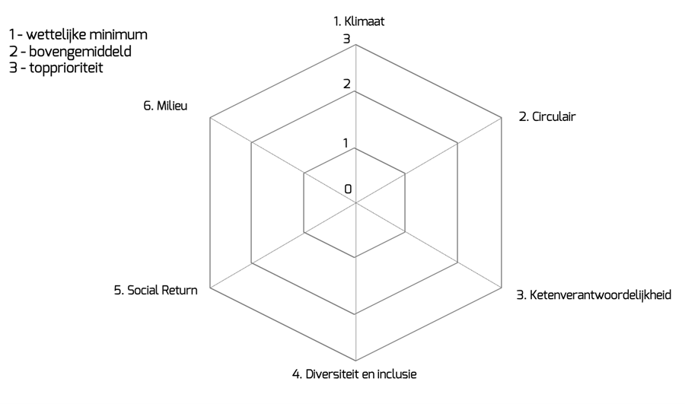
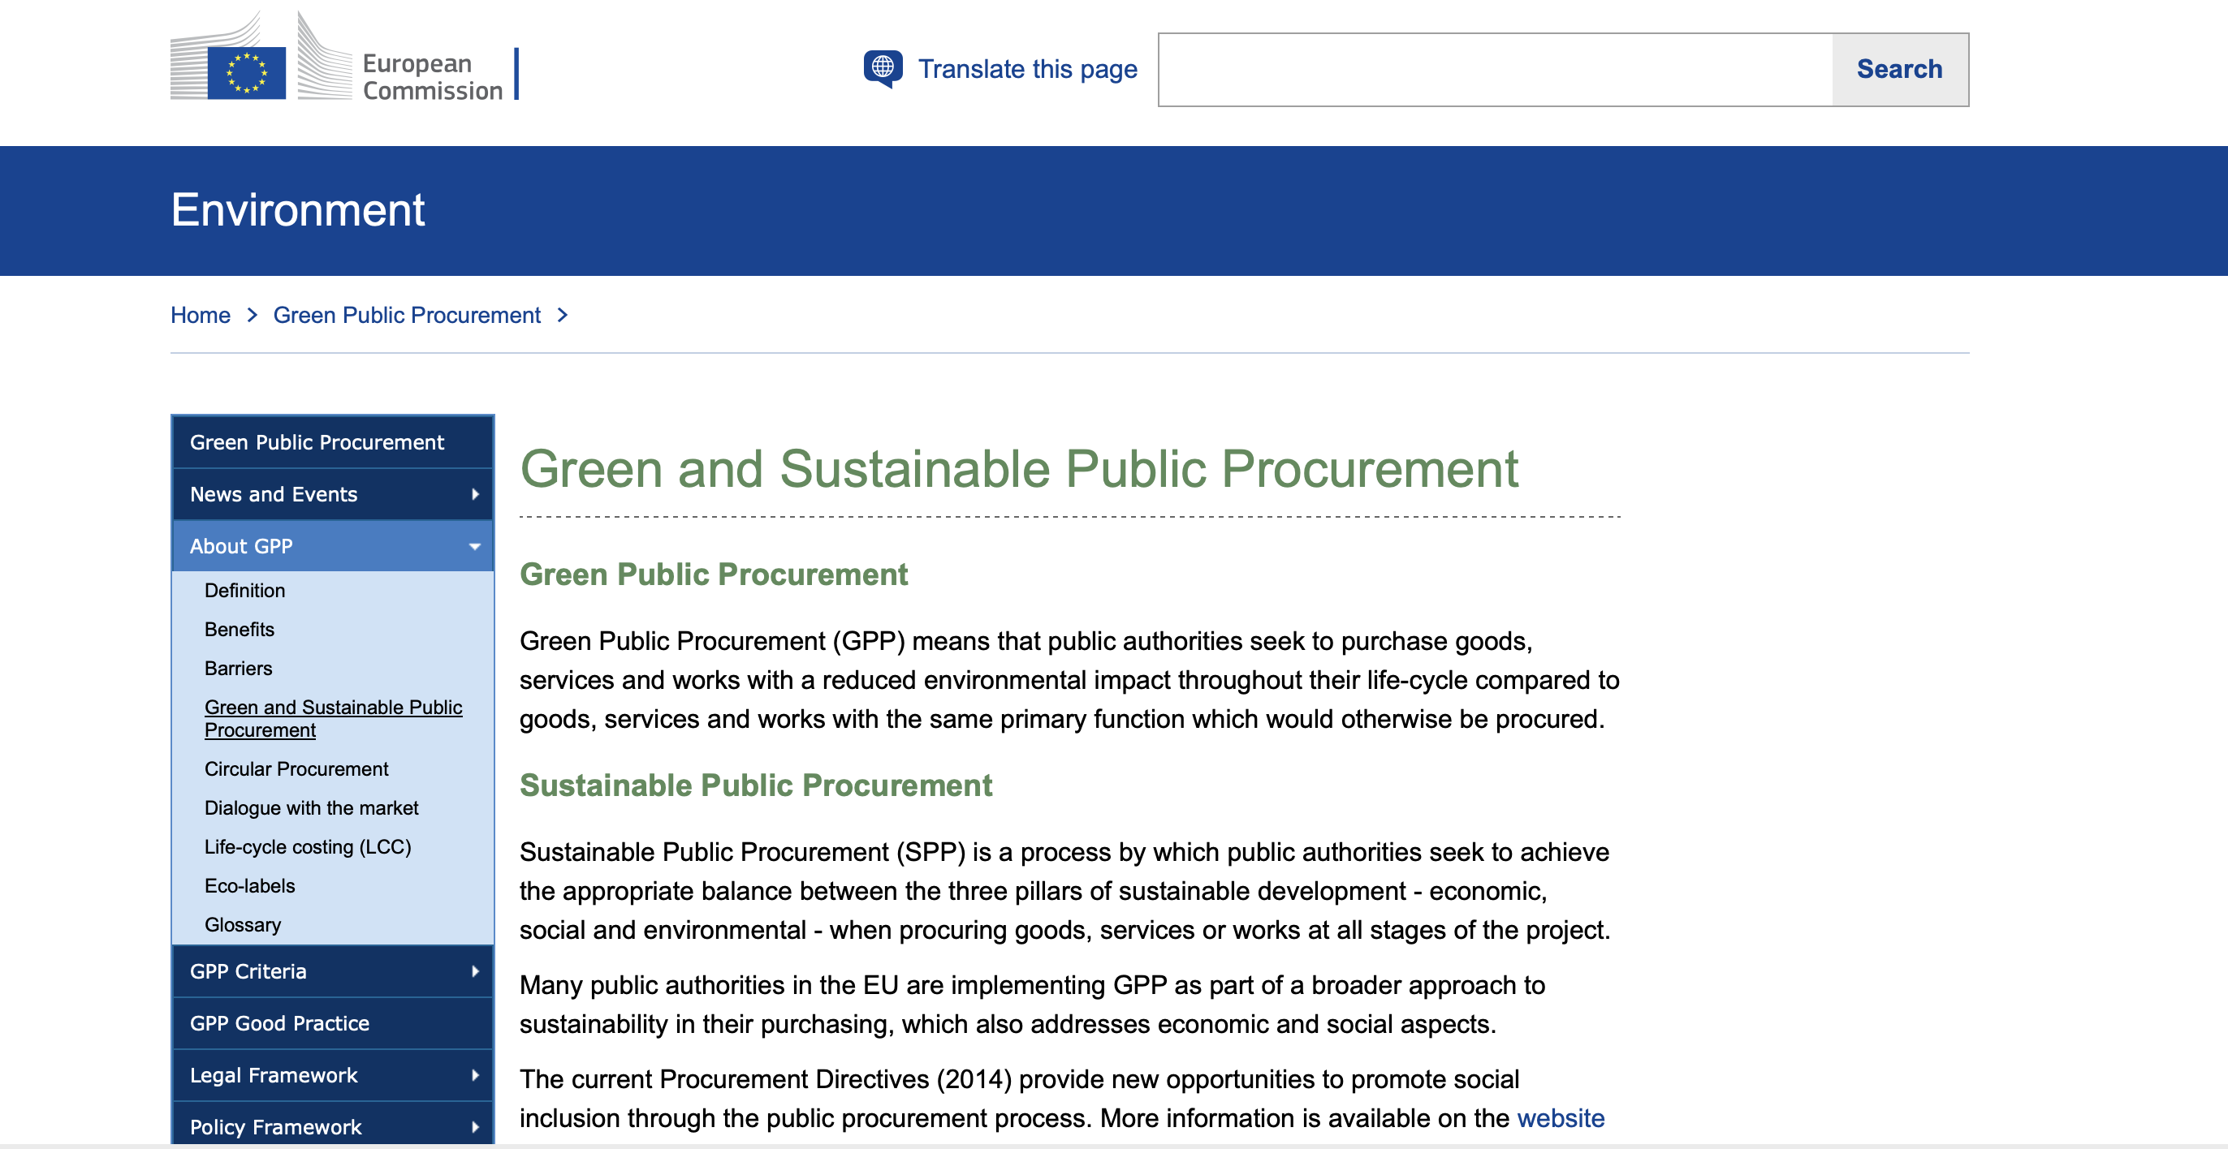
Tools and Resources
PIANOo: SPP Criteria Tool
European Commission
Ambition Web
Notes:
Pianoo: government endorsed procurement knowledge centre – lots of guidance on sustainability.
EC: webinars and documents.
AW: measure sustainability priorities per project or the organisation as a whole.
Level 1, basic, allows buyers to quickly and easily carry out a sustainable procurement process by setting requirements.
Level 2, significant, entails formulating stricter requirements and challenging the market to improve their sustainability performance by applying performance-related award criteria.
Level 3, ambitious, goes beyond the ambitions corresponding to level 2. Purchasing officers and clients are expected to show more involvement with the procurement project and the implementation of the contract. All steps of procurement must include sustainability.

Slide 10
Roadmap (short term)
Q1/2
2024
Q3/4
2024
Q1/2 2025
Q3/4 2025
Opening market dialogue with suppliers
Resource & staff allocation to sustainability committee
Actively Embedding sustainable criteria into procurement processes
Finalize internal Green Procurement policy

Slide 11
Roadmap (mid-long term)
2026
2027
2028
2029
Creation of an ambition web tool to measure maturity
Expand activities to NRENs + R&E community
Have an Established sustainability framework that actively contributes to organizational goals
Reporting on tangible and measurable progress
Engage with external counsel?
Notes:
2027: we must first finalize own policy before being able to engage with NRENs about it.
2029: using the tools we are hoping to implement to measure this.

Slide 12
Challenges
Lack of uniformity and expertise at GÉANT
Little direct incentive to actively embed sustainability criteria into processes → no active procurement policy
Committee goals and procurement goals not aligned → therefore also organisational goals and procurement goals
Public procurement tools are focused on councils and government institutions
Notes:
Anke does good job, but in general we lack decisiveness and expertise to move towards a clear direction. Very CO2 focused, I believe scope should be wider, no governance structure such as JISC and SURF, projects not clearly defined.
No procurement policy to support practices
Public proc is written from council and govt POV and it is challenging to dilute what is practical for us to use.

Slide 13
Embed best practices in ALL the steps of procurement
1
Procurement preparation
2
Specifying
3
Selecting
4
Contracting
5
Ordering
6
Delivery, use
and admin
7
Aftercare
Socially Responsible Procurement

Slide 14
Next steps?
Gain more understanding of sustainable procurement best practices in the community
  What do / don’t you do?
  Best practices?
  Sustainable procurement maturity in your organization?
How is this topic perceived in the community?
  Balance between budget/quality/sustainability?
Other challenges?
How could we collaborate more?
Further comments?

Slide 15
Thank you
Any questions?
joost.vankessel@geant.org

