Slide 1
Sig-Procurement Side-Meeting
Open dialogue
Badreddine Ajbar el Gueriri
Friday 13th of June

Slide 2

Agenda
Focus topic: Sustainability in Procurement
Suggested side topic 2
(Optional) demo of AI tool
Upcoming meetings

Slide 3
Focus Topic: Sustainability
Blank

Slide 4
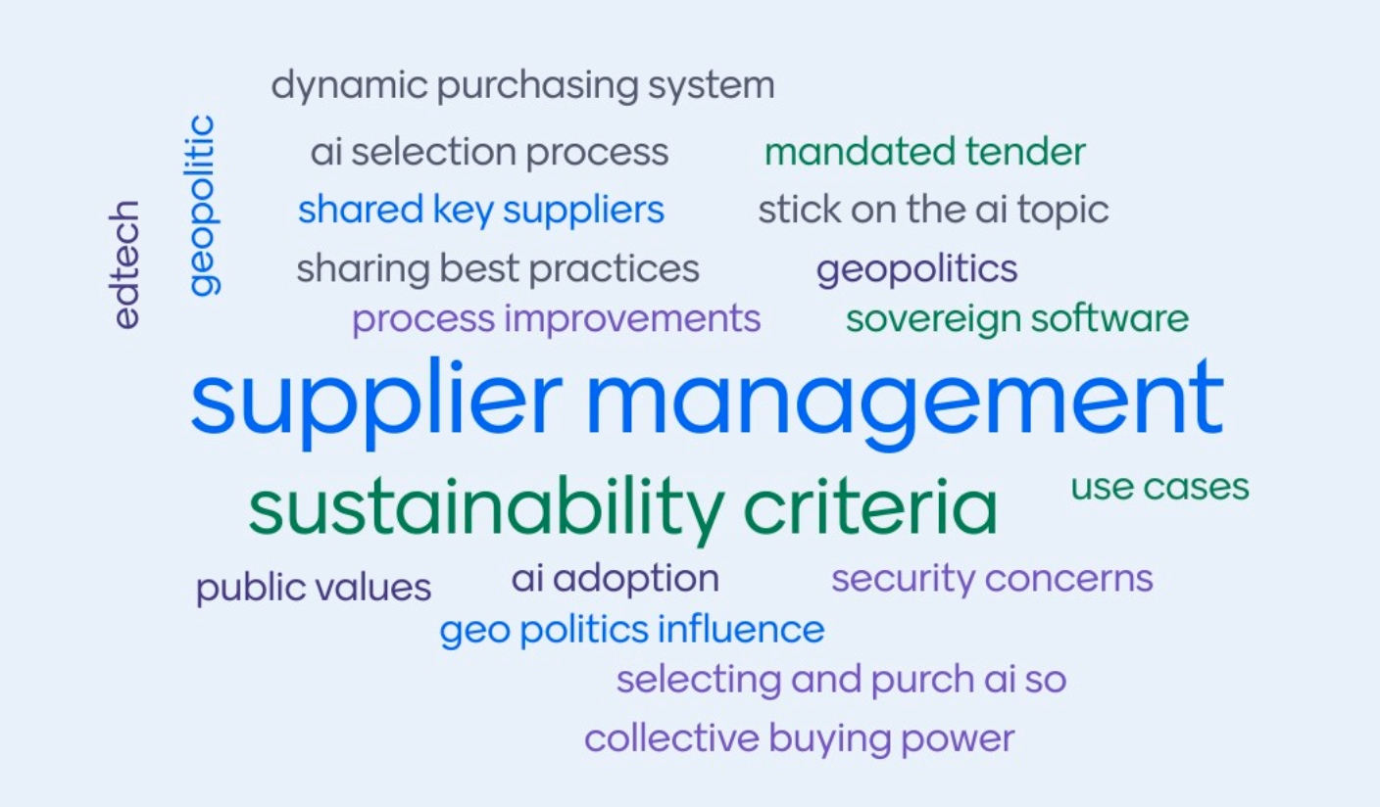
Free topic space

Slide 5
AI in Procurement
Benefits not only in the outcome
Link…
Question: "Annex 3: Article 19. Security Procedures and internal rules
Article 19.3 We would like to add that such a security investigation will be conducted in consultation with the Counterparty. It is understandable that the Customer wishes to conduct a security investigation, and we are happy to cooperate. However, we do not subject our personnel to investigations without being informed of the nature of the investigation."

Slide 6
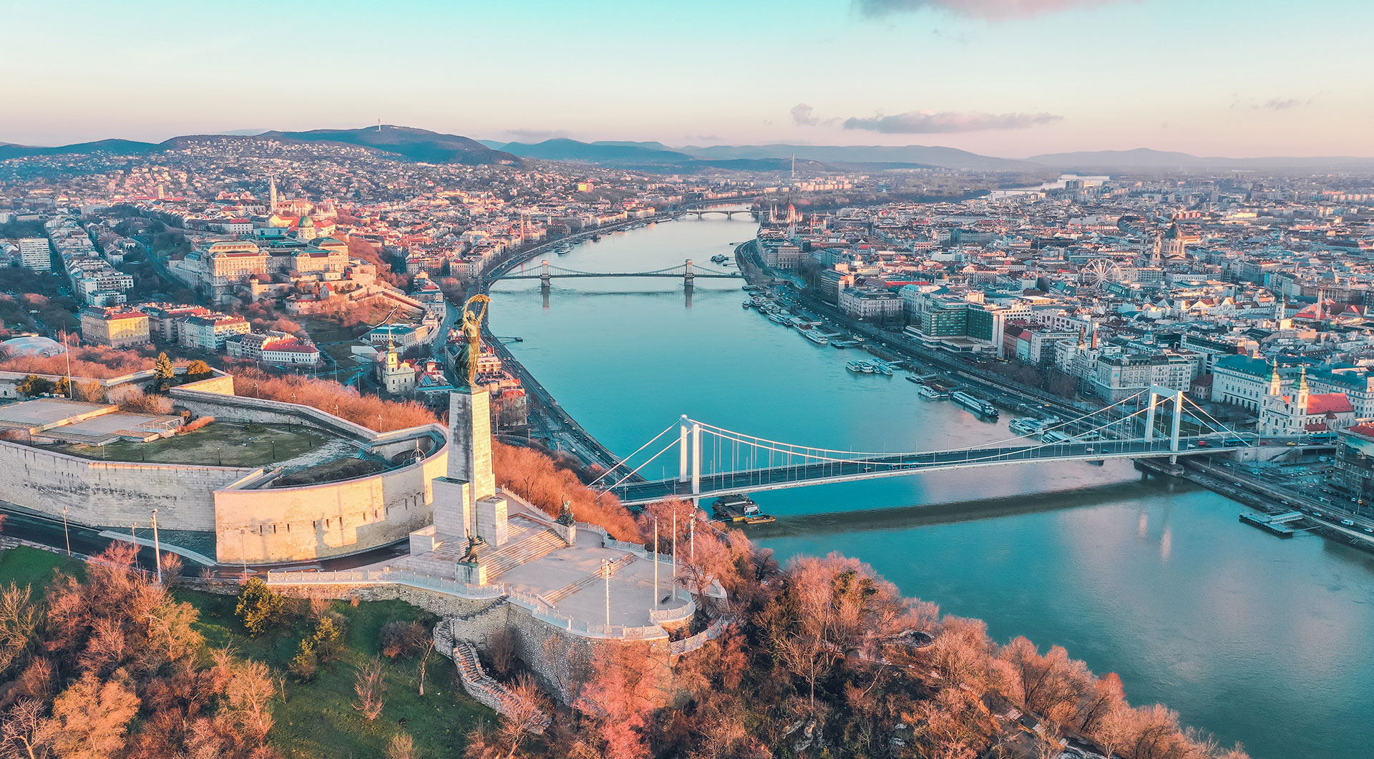
Upcoming news
Face 2 face meeting opportunities with SIG-MSP
Stay engaged in the discussions, let yourself be heard in the SIG

Slide 7
Thank you
Safe travels!
Sig-procurement@lists.geant.org
Badre.ajbar@geant.org

