Slide 1


GÉANT Community Programme
Communications Activities
Rosanna Norman, Communications Officer
Amsterdam, 24th October 2017
www.geant.org

Slide 2
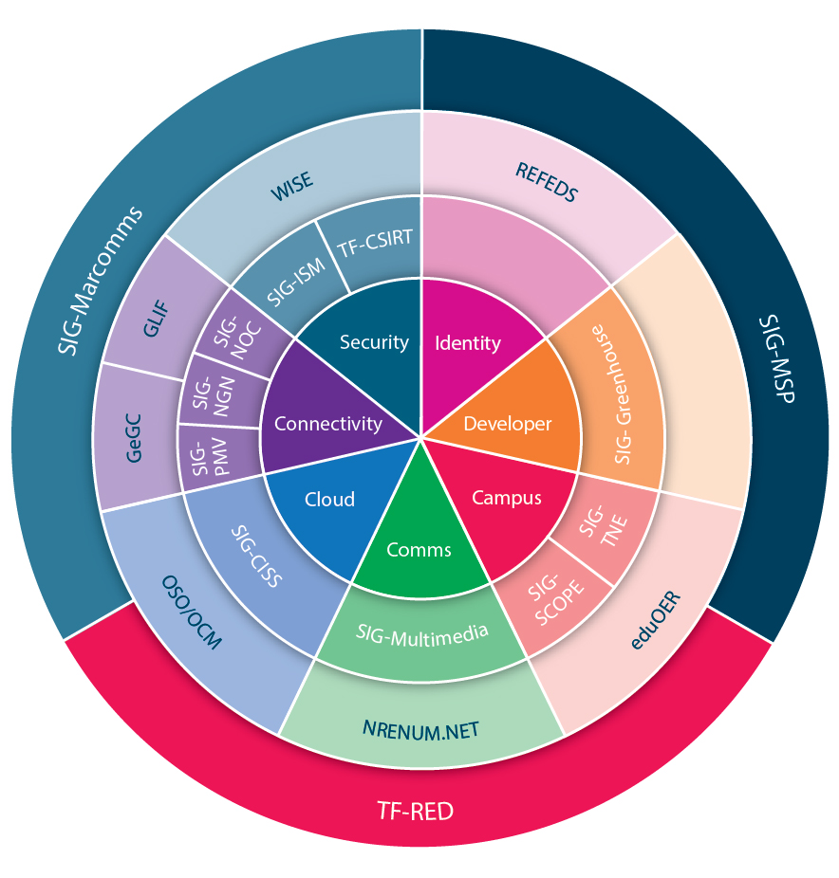
OBJECTIVES
WHAT
Raise profile of SIGs and TFs
Increase visibility of activities and outcomes
WHY
Divulge, generate & stimulate sharing & collaboration
WHERE
Within and Outside Community
WHO
Rosanna Norman – dedicated communications resource
Working closely with Nicole Harris & team

Slide 3
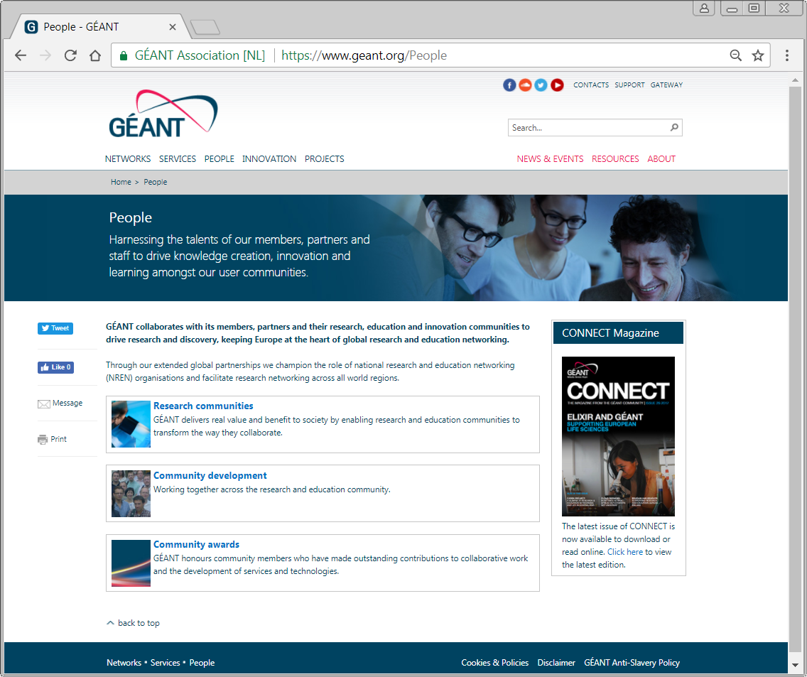
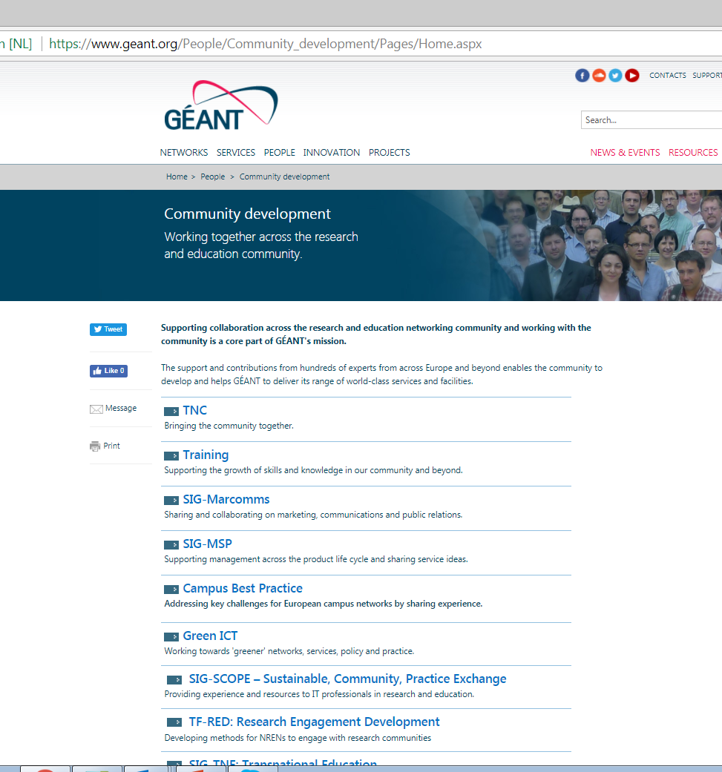
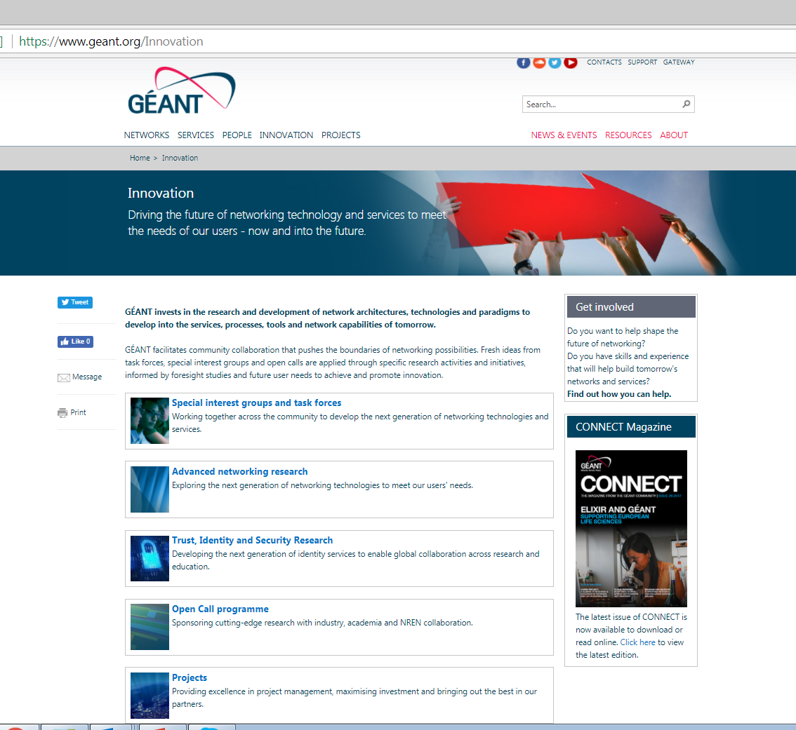
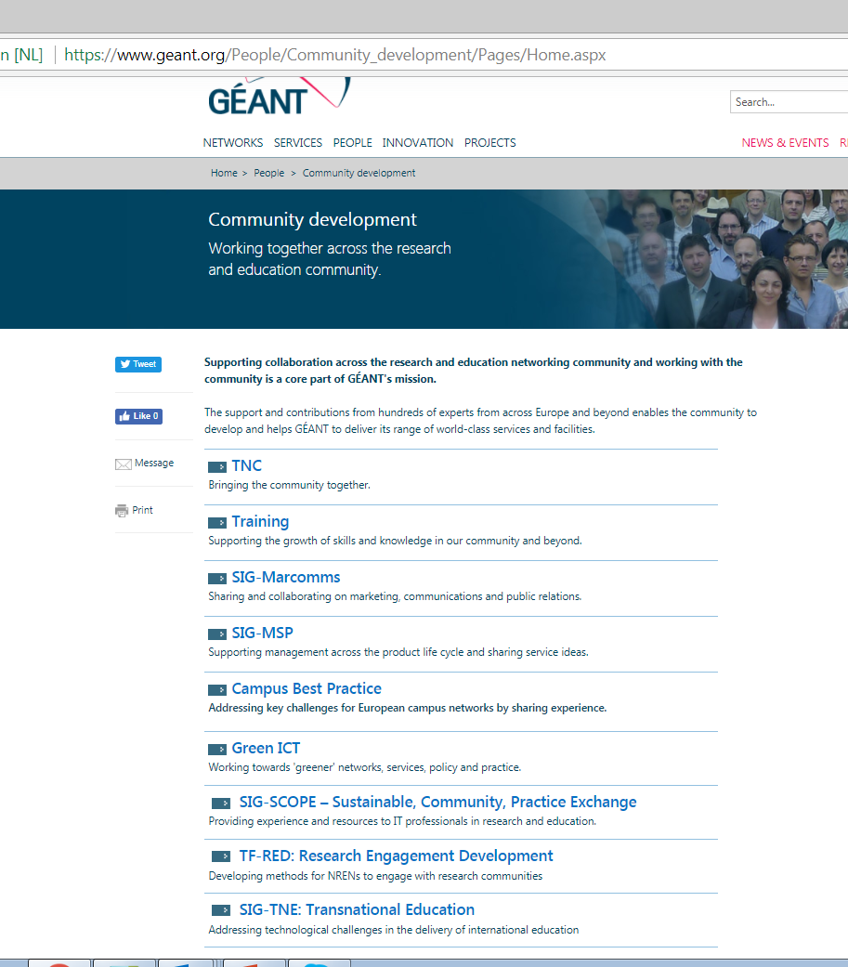
TACTICS - Reorganise content www.geant.org
Duplication under People and Innovation
Community Development to become GÉANT Community Programme
SIGs and TFs from Innovation to People under GÉANT Community Programme
  Campus Best Practice and Green ICT become subsections of SIG SCOPE
All other sections remain untouched
Reorganise TFs and SIGs
  Themes on wheel
  Make the wheel interactive

Slide 4
TACTICS - Update SIGs and TFs page content
Every page standardised
  Intro text
  Event/date of next meeting (including link to eventr to facilitate registration)
  Deliverable that can be published and shared: e.g. white paper, blog posts
  Steering committee names
  Secretary contact details
Create in the back-end a central repository for all materials and presentations

Slide 5
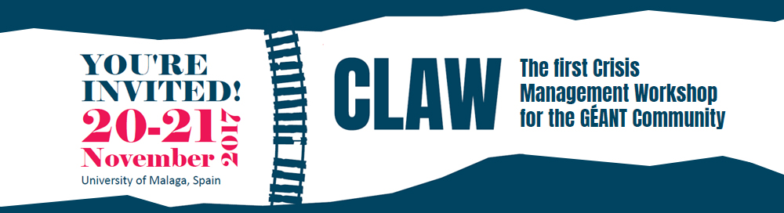
TACTICS - Further regular and new promotion
Blog posts on planned & attended events
PeaR weekly newsletter
GN4 weekly updates
CONNECT articles
Social media
Quarterly newsletter (NEW)
European Journal of Higher Education (NEW)
More specific marcomms support for larger events: e.g. CLAW workshop, TF-CSIRT logo creation

Slide 6
WHAT NEXT?
Next steps
Discuss and agree suggested www.geant.org changes
Brief design team and agree on timescale for delivery
Announce changes to the Community
Monitor web traffic and report analytics on a regular basis
Ongoing promotion
Blog, social media (Facebook, LinkedIn, Twitter), PeaR
Changes and ongoing promotion progress in parallel

Slide 7

Any Questions?
www.geant.org
© GEANT Limited on behalf of the GN4 Phase 2 project (GN4-2).
The research leading to these results has received funding from the European Union’s Horizon 2020 research and innovation programme under Grant Agreement No. 731122 (GN4-2).

