Slide 1
Insight Portal
Demo
Silvie Francisci, Daniel Soroczak
GÉANT
Amsterdam
23-10-2018

Slide 2
Background and Objectives
The current GEANT Information ecosystem is diverse with a wide variety of different platforms and information sources available
The objective is to address these issues and develop an easy accessible and transparent single access point for all GEANT ecosystem related information for external and internal users
The aim is to simplify the user experience by bringing together information from various GEANT platforms and places, create a tailored view of the GEANT world and provide quick access to the different sources for more details as needed
Leading developing guidelines are: easy navigation, transparency, modern and consistent interface
A modular approach and scalable set up will allow to start with combining few information sources and adding new ones at later stages
One-stop shop approach

Slide 3
Business Case
Currently a multitude of platforms (for specific activities, topics or services) are in place with different content, scope and purposes fulfilling functions for the organisation, GN4-2 project or the wider community.
Navigation across these platforms as it is now is cumbersome and information can easily be missed.
The current set up leads to:
  Intransparency – difficult to track down and combine information across different platforms
  Errors and duplication– as many sources contain similar information while needed to be maintained manually.
This is backed up by NREN feedback gathered through the annual Satisfaction Survey and Partner Relations Meetings.

Slide 4
Project scope and exclusions
The Insight Portal will act as Dashboard and Interface to the different platforms and information sources in the GEANT ecosystem. Raw data from the different platforms will be accessed via APIs and displayed in a consistent and intelligent manner.
The existing platforms will not be impacted through this development and remain in their functions as they are. All maintenance and edits will continue to be done on each respective platform
First Release by Dec 2018
  Eventr
  Services
  Membership and finance
  …

Slide 5
Team Structure
Name | Abbreviation | Area | Role in Project | Responsibilities | Funding via
Cathrin Stover | CS | CCO | Sponsor | oversight and assurance of approval on exec level | GEANT Ltd
Silvie Francisci/Sabrina McCollum/Beatrix Weber | SF | BD | Product Owner | provision of user requirements, writing and prioritisation of user stories, data preparation and mapping | NA3 T1
Daniel Soroczak | DS | PMO | Project Manager | coordinate activities, stakeholder engagement | NA1T2
Mandeep Saini | MS | SW | Technical Lead, Development | assess technical requirements and feasibility, responsible for data visualisation and overall development | NA3 T1
Mark Golder/Erik Reid/Christian Gijtenbeek | MS | SW | Development | Flask Development, Front End Framework Development | NA3 T1
Paul Hasleham | PH | Marcomms | Design | UI and Graphic Design | NA2 T2
Robert Kozlowski | RK | SW | SharePoint | SharePoint Integration | GEANT Ltd

Slide 6
Project Constraints
Project is delayed due to several constrains:
Changes in the team: main developer of Insight Portal left GÉANT and another developer moved to a different project. New developer had to learn a language for creating charts (D3) and to follow up (2-3 months)
Agile methodology (estimates) not reflected in the development work (JIRA)
Plenty of overlapping priorities and conflicting projects (i.e. OpsDB) that made Software Development team disengage from Insight-related work for weeks (critical for Network)
Challenges with ‘unstructured’ source data (lots of unexpected manual pre-work had to be completed to make data ready for extraction and filtering)
Notes:
- Erik left project
Mark to understand the code and learn new language
SW - not fully dedicated resource
Data mapping needed to be done (i.e. GEANT)

Slide 7
Insight Portal Project
Overall RAG Status
Justification – RAG Status Amber – Due to OpsDB bugs caused by its recent upgrade the assigned developer was devoting less time to working on Insight Portal over last weeks
Project Manager- Daniel Soroczak
Date: 18 October 2018
Latest Achievements
Major Milestones
Eventr module functionality completed Services module in progress Latest release of Insight Portal available online
# | Short Description | Status | Owner | Due Date
1 | Eventr Module | Complete | Daniel, SIlvie | Complete
2 | Services Module | In Progress | Daniel, SIlvie | Nov 23
3 | Membership and Finance | Planned | Daniel, SIlvie | TBD
4 | Traffic Statistics | Planned | Daniel, SIlvie | TBD
Major Issue or Risk (I – r)
# | Short Description | Owner | Target Close
I1 | Inconsistent source data requires manual pre-work to make it exportable to Insight | SIlvie, Mark | 22 Dec
I2 | Software Developer is taken away from the project whenever ‘higher-priority’ work comes up (i.e.fixing major bugs in Networking Database -OpsDB) | MandeepDaniel | 22 Dec
R1 | End of year ‘Inisght full scope’ deadline is at high risk due to inconsistencies in internal data sources and due to resource constrains | SIlvie, Daniel | 22 Dec
Major Dependencies
# | Description | Status | Owner | Date
Upcoming Activities
SIlvie to provide Insight demo in Amsterdam on Oct 23rd Mark and Paul to work towards improving visuals Mark to work with Robert to complete Service Module
Escalated Resource Constraints
Major Decisions Required
# | Role Description | Date Required

Slide 8
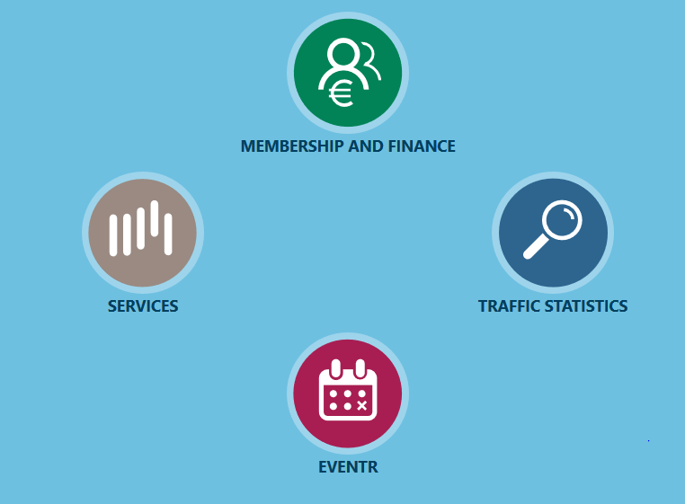
Link to Demo
Please click on this link to start the demo: https://test-insight.geant.org/ui/
Notes:
- Scope of this – MPV thank you for noticing this. I would like to remind you that this is a minimum viable product. Effectively we have been working for couple of months

Slide 9
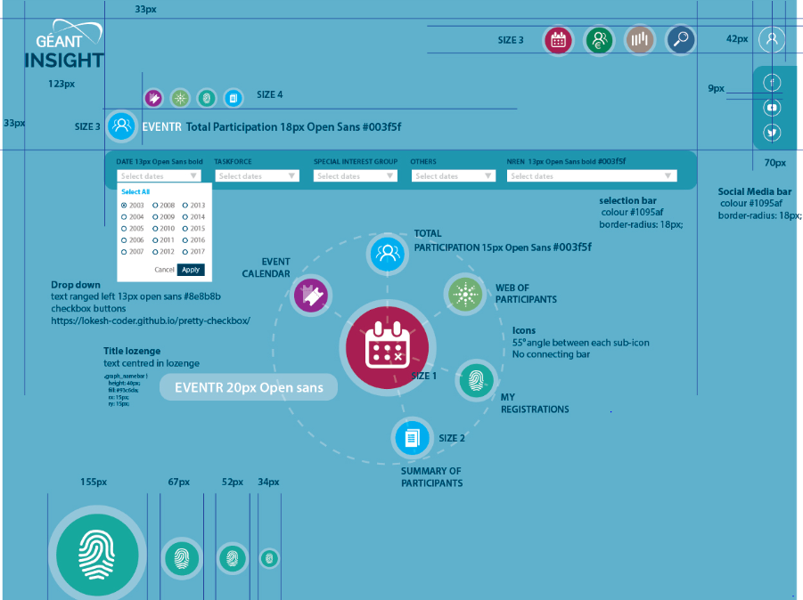
Front-End Design
Design by Paul Hasleham and document for reference: https://geant.box.com/s/vefg74onuxai8g3ocmrjtzygxjyvge0z

Slide 10
Thank you!

