Slide 1
Introduction to Up2U
Peter Szegedi - GÉANT

Slide 2
Motivations
The “Opening Up Education” policy of the European Commission was announced in 2013 to boost innovation and digital skills in schools and universities.
  The major statement of the policy was that about 63% of nine year olds in the EU are in schools that are still not digitally equipped although 90% of jobs will require digital skills by 2020.
The Net Children Go Mobile project study, funded by the Commission, concluded that, in all the European countries asked, daily Internet access is strongly differentiated by age, with older children having more access everywhere.
  Age differences, however, are more pronounced for private or mobile Internet use with teenagers aged 15-16 years old far more likely, about 84%, to access the Internet in their own bedroom.

Slide 3
In a nutshell
EC Call ICT-22-2016: Technologies for Learning and Skills
  easy creation, mix and re-use of content, services, applications and contextual data for interactive learning processes
  environments for new learning experiences and experimentation
  educational support services
The key objective of our project is to bridge the gap between secondary schools and higher education and research by better integrating formal and informal learning scenarios and adapting both the technology and the methodology that students will most likely be facing in universities.
Innovation Action getting 5ME funding from the EC for 3 years

Slide 4















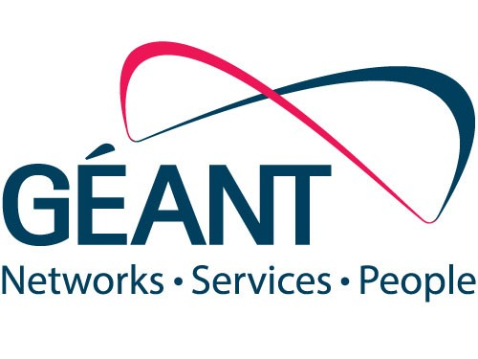


Partners

Slide 5
Target
Secondary schools, often referred to as high schools, which provide secondary education between the ages of 11 and 19 depending on the country
Intersection of formal and informal spaces, a dynamic hybrid learning environment where synchronous activities meet in both virtual and real dimensions
Develop an innovative Up to University (Up2U) ecosystem – based on proven experiences in higher education and big research
  open, more effective and efficient co-design, co-creation, and use of digital content, tools and services adapted for personalised learning and teaching
  address project based learning and peer-to-peer learning scenarios.

Slide 6










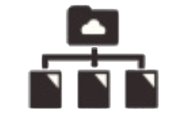







Up2U ECOSYSTEM
FORMAL LEARNING SPACE
INFORMAL LEARNING SPACE
LOR
Attend
INTERACTIVE LEARNING PATH
Search
LMS
Create
SIS
Assessment
Share
INFRASTRUCTURE
eduOER aggregation
WiFi eduroam
TO UNIVERSITY
Sync&Share ownCloud
’Always-on’ education
at school
in library
in museum
at home
on the go

Slide 7
Objectives
To assess the use of public and private cloud-based infrastructure services with proven track records in higher education and research, integrating and adapting them to the specific learning context of schools.
To design and develop a scalable and flexible integrated “application toolbox”, which supports student-driven, personalised, dynamic learning path creation with social sharing and interactions (i.e. project-based and peer-to-peer learning and assessment) on top of the abovementioned cloud-based service infrastructure.
To build and train the learning community for the specific learning context
To propose an executable roadmap for ensuring security and privacy.
To roll out and test the infrastructure service components and the application toolbox through very large-scale pilots
To develop, establish and operate a continuous risk assessment function
To define an effective sustainability and exploitation framework

Slide 8
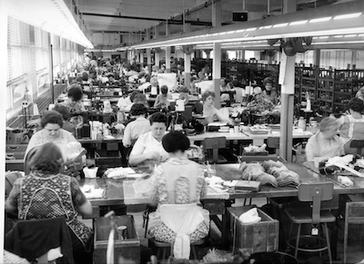

Standard movement

Slide 9

Organic Education

Slide 10
Organic Education
Personalized
Strong teacher support
Close community links
Broad and diverse curriculum
Outside and inside school involvement
Create the right conditions and children will learn!

Slide 11
Statement
”We strongly believe that all the tools and services the project is going to use and/or make available (i.e. incorporate, design, develop and test) must be sustainable after the lifetime of the project.”
  business plans and investigate appropriate business models using the expertise of the Small Medium Enterprise and National Research and Education Network partners and their contacts with third-party business actors
  make it easy for new schools to join the Up2U infrastructure and ecosystem that will form a federated market-place for the learning community

Slide 12
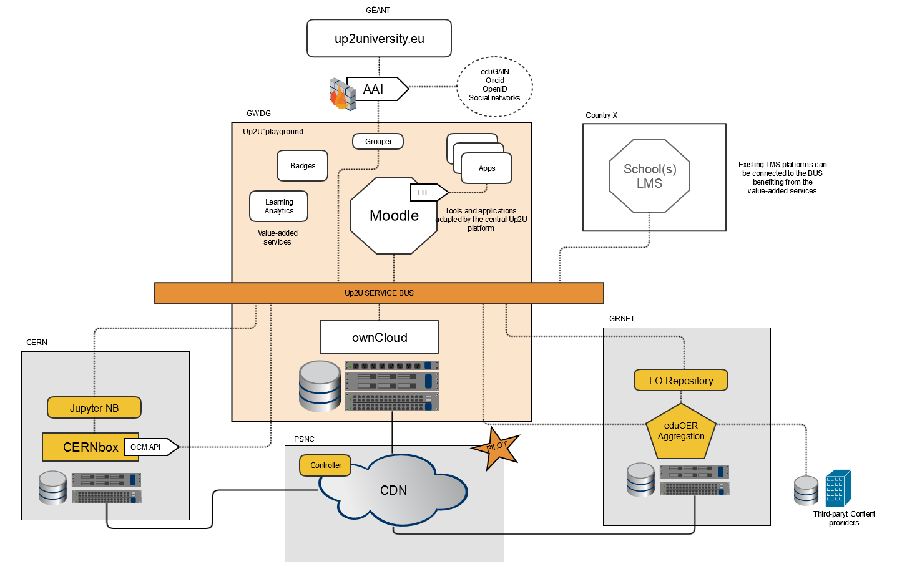

Slide 13
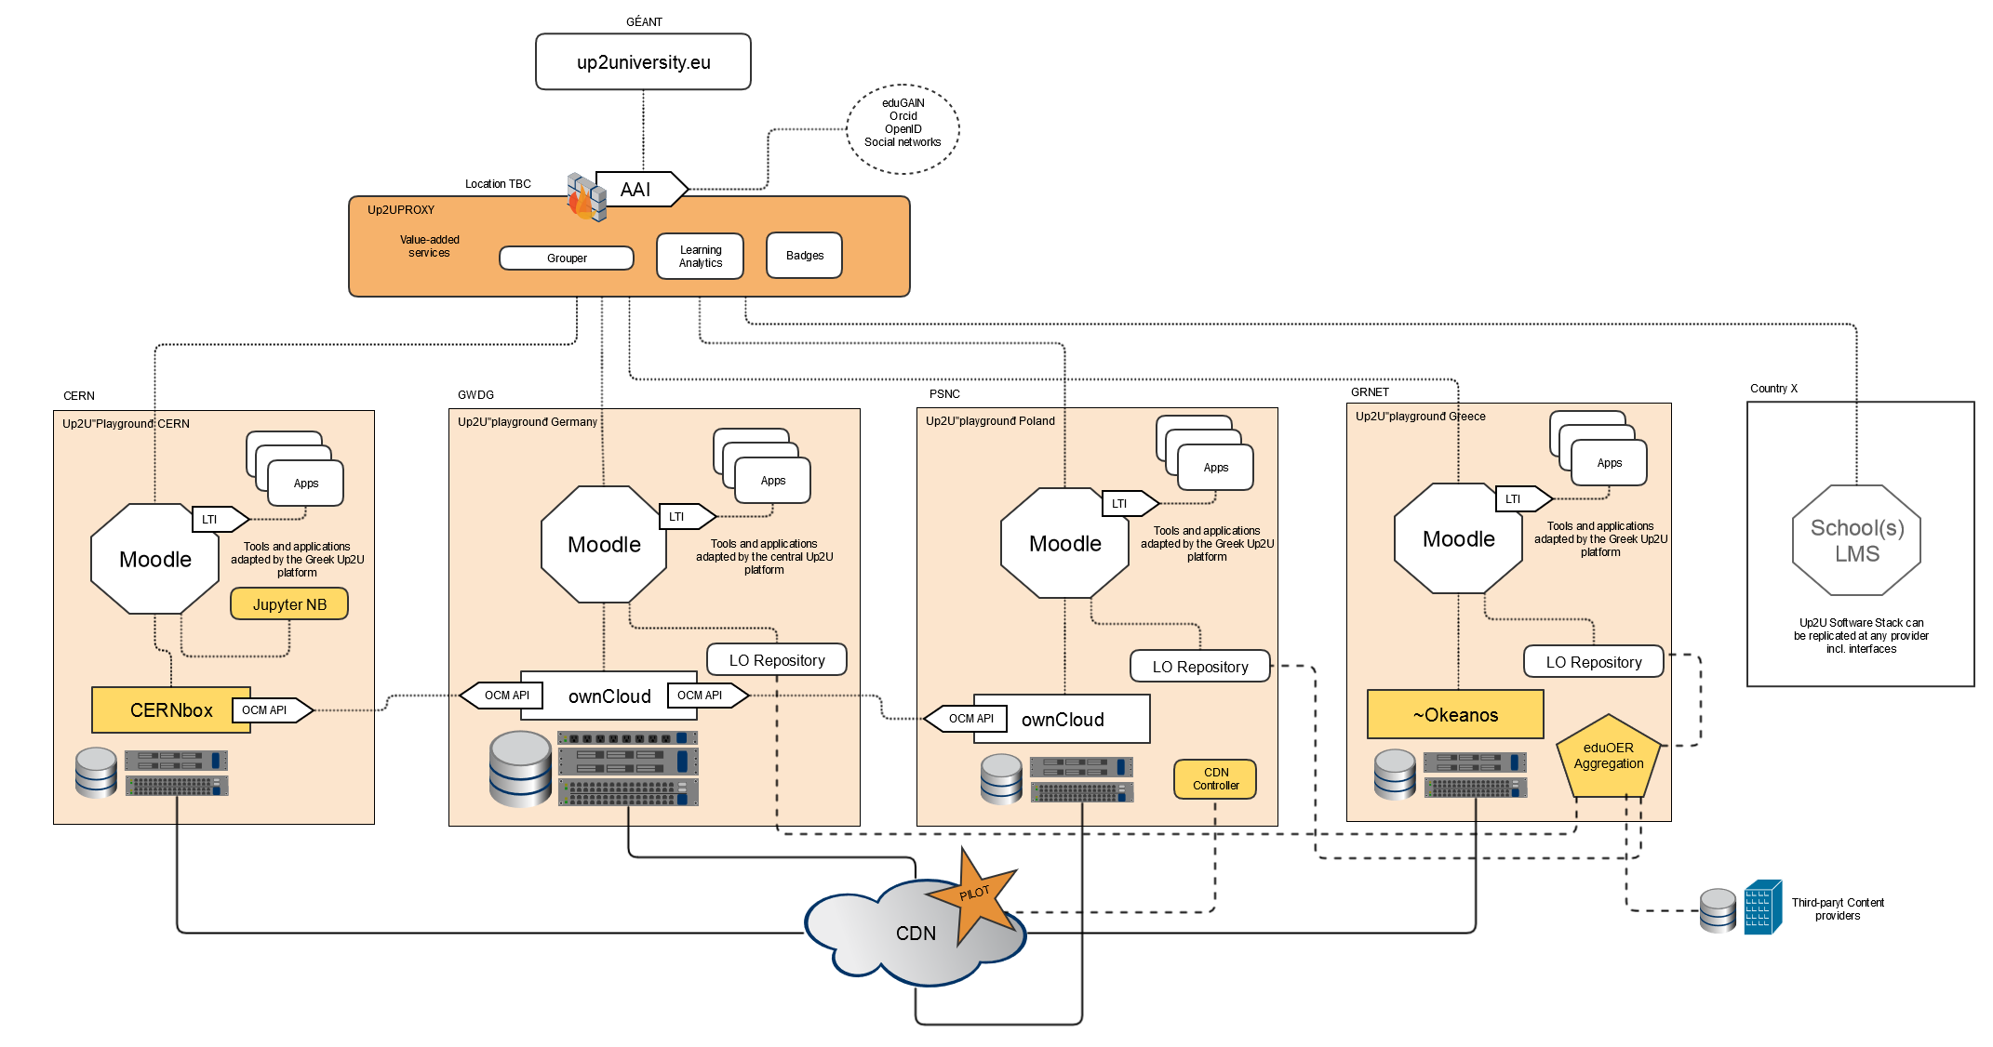

Slide 14
Thank you!
Q&A
Peter.Szegedi@GEANT.org

