Slide 1

Partnership for innovative technological solutions to ensure privacy & enhance trust for the human centric Internet
NGI TRUST

Slide 2





The consortium
European Future Innovation System Centre (EFIS) Belgium
European Business and Innovation Centre Network (EBN) Belgium
Kantara Initiative Europe (Kantara Initiative) Estonia
GÉANT Vereniging (Association) (GÉANT) 29PM Netherlands
Fraunhofer-Gesellschaft Institute for Industrial Engineering (Fraunhofer IAO) Germany
Tecnalia Research & Innovation Foundation (TECNALIA) Spain

Slide 3
Objectives
NGI TRUST will:
support the development of a human-centric Internet by developing a stronger European ecosystem of researchers, innovators and technology developers in the field of privacy and trust enhancing technologies.
Four main objectives:
Reinforce, structure and develop the community of researchers, innovators and technology developers in the field of privacy and trust enhancing tech.
Build on the state of the art in privacy and trust enhancing technologies: focusing support for third-party projects in a limited number of priority topics
Improve user trust and acceptance of emerging technology: using applications and solutions to develop a more open and reliable Internet + strengthen Internet Governance
Foster the exploitation and commercialisation of the results of selected third-party projects through a tailored process of coaching and mentoring

Slide 4
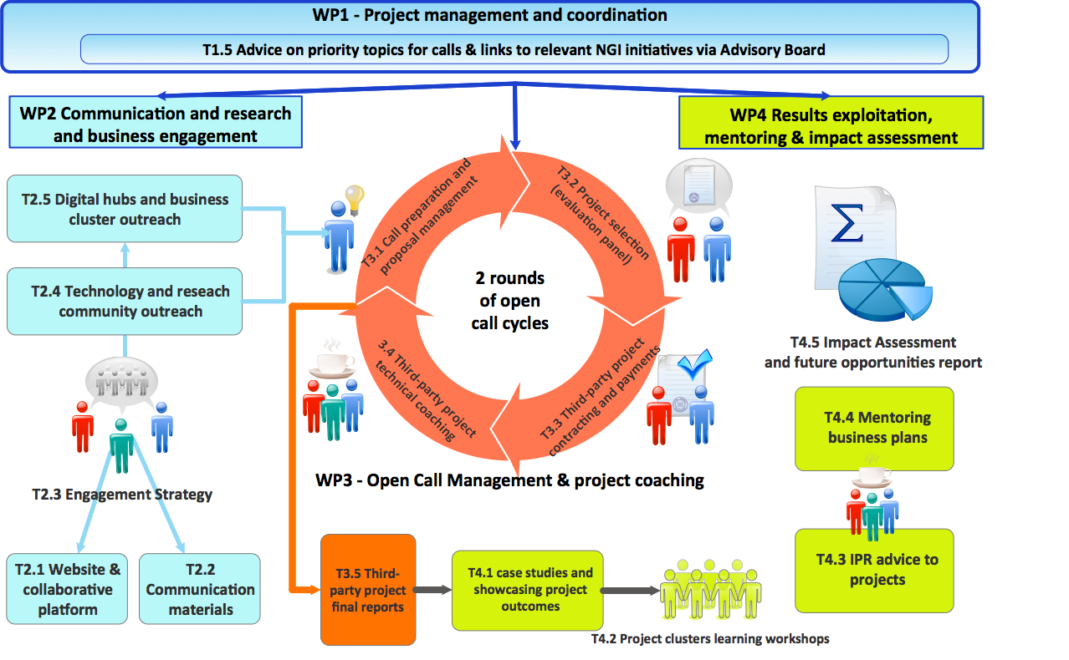
Overview of the project logic

Slide 5
Open calls methodology (1/2)
Open calls will seek to
engage a variety of players (not “usual H2020 suspects”);
working at various technology readiness levels (TRL)
to explore pre-selected topics that are critical to build a human centric NGI.
Two rounds of calls foreseen:
first call will seek to attract a broader mix of projects including a larger number of early-stage ‘feasibility’ studies; while
the second will aim to build on 1st phase projects (larger second round funded projects following on from smaller pilot/feasibility projects) but also, attract additional players with more scalable projects
Indicative budget allocation per call round:
1st call approx. 40%;
2nd call remaining 60%.

Slide 6
Pre-identified areas for the Open Calls:
Technical innovation in privacy enhancing technologies, such as crypto, federated identity, security and privacy for Internet of Things (IoT), distributed ledgers and privacy-enhancing data transports and data at rest
Ethical aspects, such as ways to use AI/ML/neural networks to serve the user’s interests, legal and best practices for policy makers to consider, impact of profiling and mass surveillance,
Bootstrapping trust at the protocol level, to maintain a decentralized Internet Infrastructure, for the establishment of trust, privacy (and security) between end-users and services
Ways for users to make more informed decisions on the relevance of information that they are asked to disclose when accessing services.

Slide 7
Open calls methodology (2/2)
We will classify the projects in three phases (depending on their TRL level):
  Phase 1 (viability) : up to € 75K from NGI_Trust - no matching funds;
  Phase 2 (execution) : up to € 200K from NGI_Trust -> matching funds up to € 100K (2/3 - 1/3 model);
  Phase 3 (transition to commercialisation) : up to €200K in NGI_Trust core funding -> equivalent in matching funds (50/50).
  Duration of third-party projects : from 9 to max 12 months.
  Technical evaluation procedure/criteria:
  Novelty/Innovation (40% weighting)
  Excellence (30% weighting)
  Quality, management and efficiency of implementation (30% weighting)

Slide 8
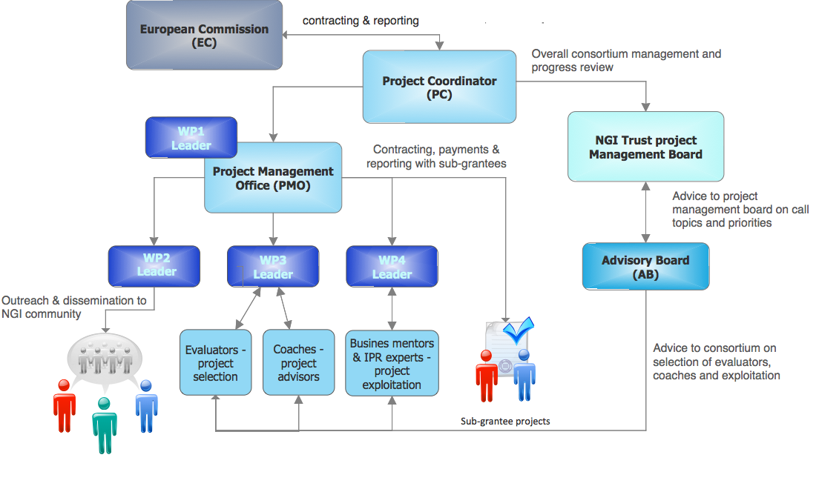
Coaching and mentoring
Coaching and mentoring activities overview
  Coach: hands-on technical project assistance.
  Mentoring: focus on what the projects can and should do with their results, should they introduce a 2nd stage project, develop a business plan, protect the IP, etc.
Roles of Advisory Board (AB) and external experts (EE)
  AB: advice at the key decision points of the project – notably call topics, ), support project selection and review project outcomes/identify future opportunities
  EE: support the selection of projects (evaluation), compliment consortium coaching and mentoring and IPR advice (exploitation and sustainability support).
AB members (indicative list)
  Robin Wilton - Technical Outreach Director (Identity and Privacy), Internet Society
  Stefan Winter - R&D Engineer, RESTENA
  Stephen Farell - Researchy Fellow, Trinity College Dublin
  Leif Johansson - Office of the CTO, SUnet
  Benno Overeinder - Managing Director, NLnet Labs
  Eliot Lear - Senior Internet and Policy Expert, Cisco Systems
  Nathan Faut - Manager, KPMG

Slide 9
KPIs
Project KPIs
  Penetration rates amongst target business and research community stakeholders
  % of organisations that attend an information day or webinar that after submit a proposal
  Share of proposal received per target group and by TRL level
  Rate of co-financing of sub-grantee projects
  Number of projects completing their project activities within the contractual time-frame
  Mentoring services provided
  Number of projects requesting and receiving IPR advice / taking protection measures
  Number of projects advancing to next stage of development
KPIs to evaluate sub-grantees success
  Common framework and then defined at project level with support of coaches/mentors
  External evaluation of results and final advisory board report on future opportunities

Slide 10
GEANT contribution
29 Person months over 36 months
Across all work packages
Most time in Communications workpackage (7.5PM) and Call management (8PM)

Slide 11



www.efiscentre.eu
twitter.com/EfisCentre
Email: reid@efiscentre.eu

