Slide 1
Privacy by Design tooling
(work in progress)

Slide 2
Goals
Design strategies
Risks
Easy to use
What are the possible risks for the data subject?
Do you need a DPIA?
Which design strategies can you use to make the processing more privacy friendly
Target audience: small businesses and educational institutions

Slide 3

Risk Mapper

Slide 4
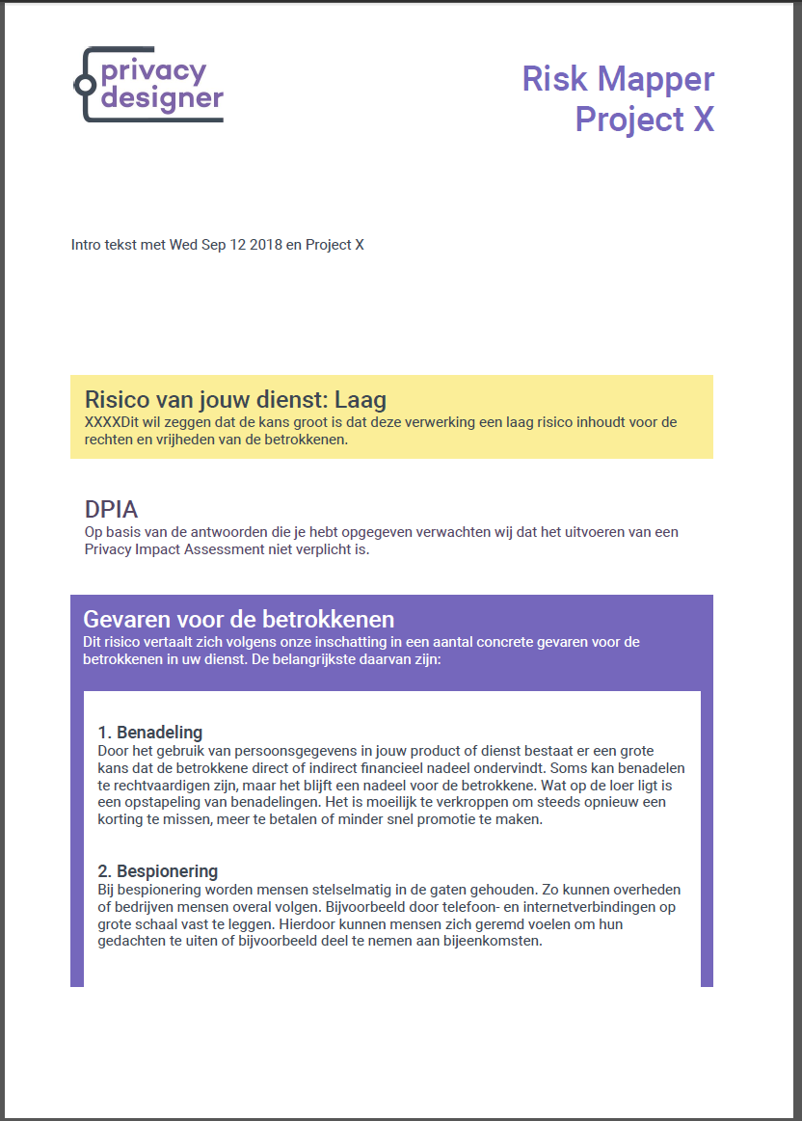
Risk Mapper
25 question about your project / application
Result: a report with:
Overall risk: low, medium, high, very high
DPIA yes or no
3 possible dangers for the data subject
Possible measures to take

Slide 5
Risk Mapper
Eight possible dangers
Spying
Influence
Exclusion
Prejudice
Stigmatization
Identity fraud
Blackmail
Stalking

Slide 6
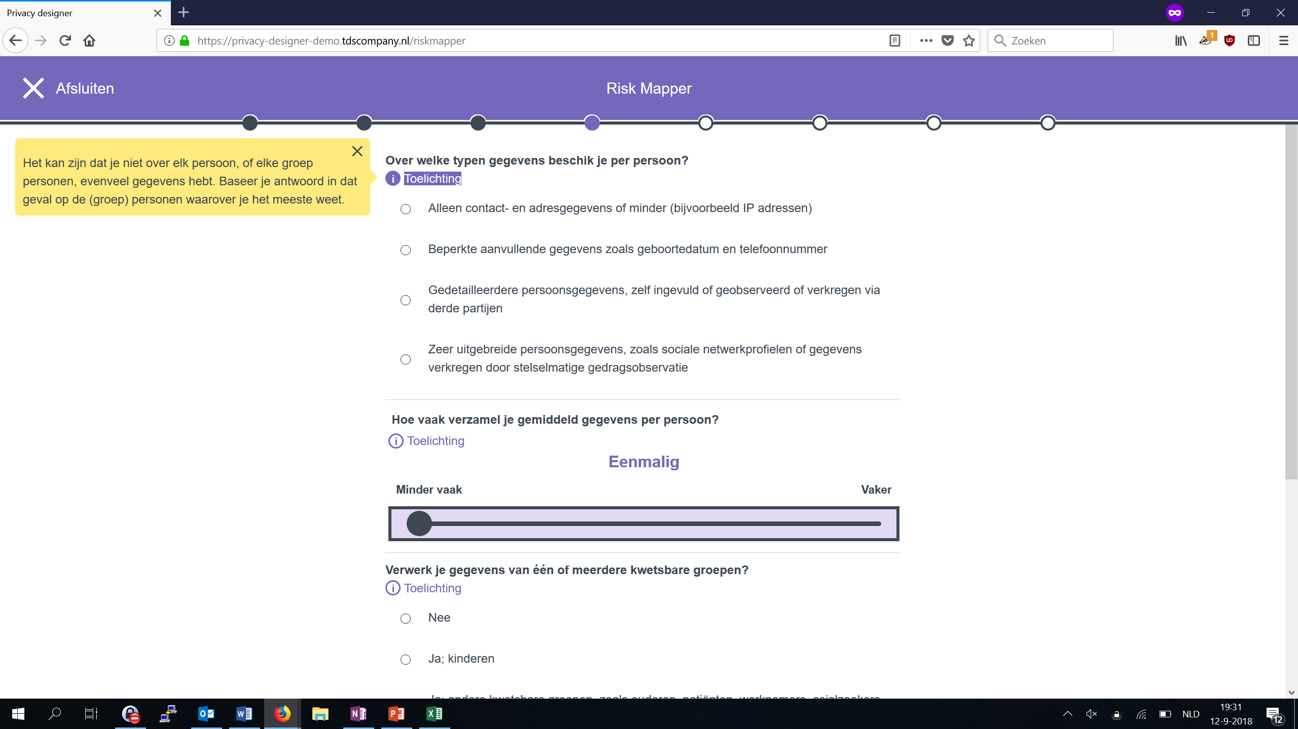

Slide 7
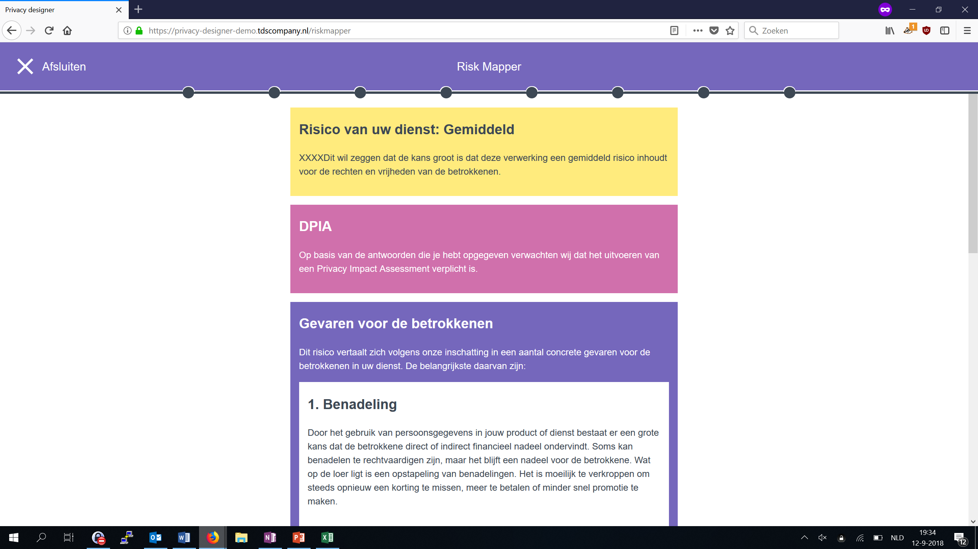

Slide 8
Design Builder

Slide 9
Design Builder
Nine strategies:
Collect less
Split
Make it abstract
Hide
Store less
Inform
Apply rights
Force
Demonstrate

Slide 10
Design Builder
Every strategy has some tactics (measures)
39 tactics in total
For each tactic you can indicate whether you could apply the tactics (or apply it better)

Slide 11
Design Builder
Report with mandatory and optional tactics
Some are explicitly mentioned in the GDPR

Slide 12
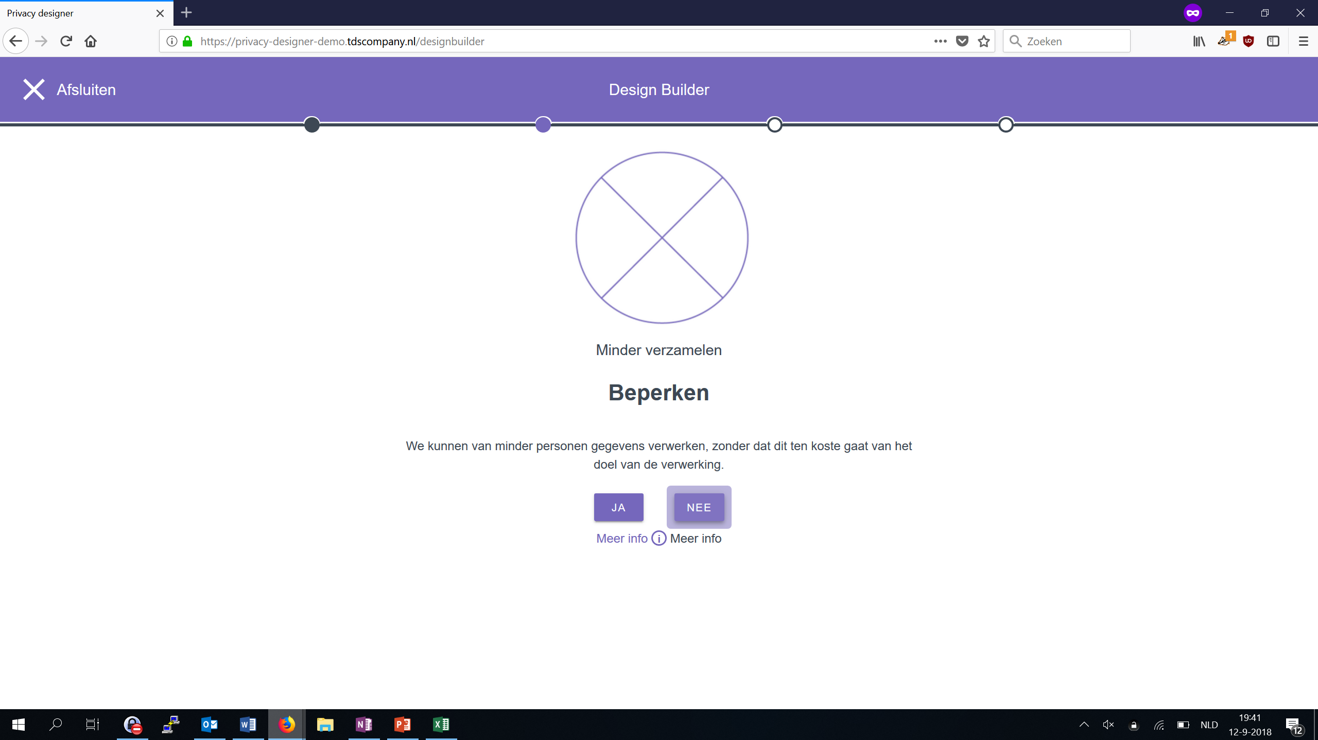
Notes:
We can process data from fewer people without compromising the purpose of the processing.
To limit

Slide 13
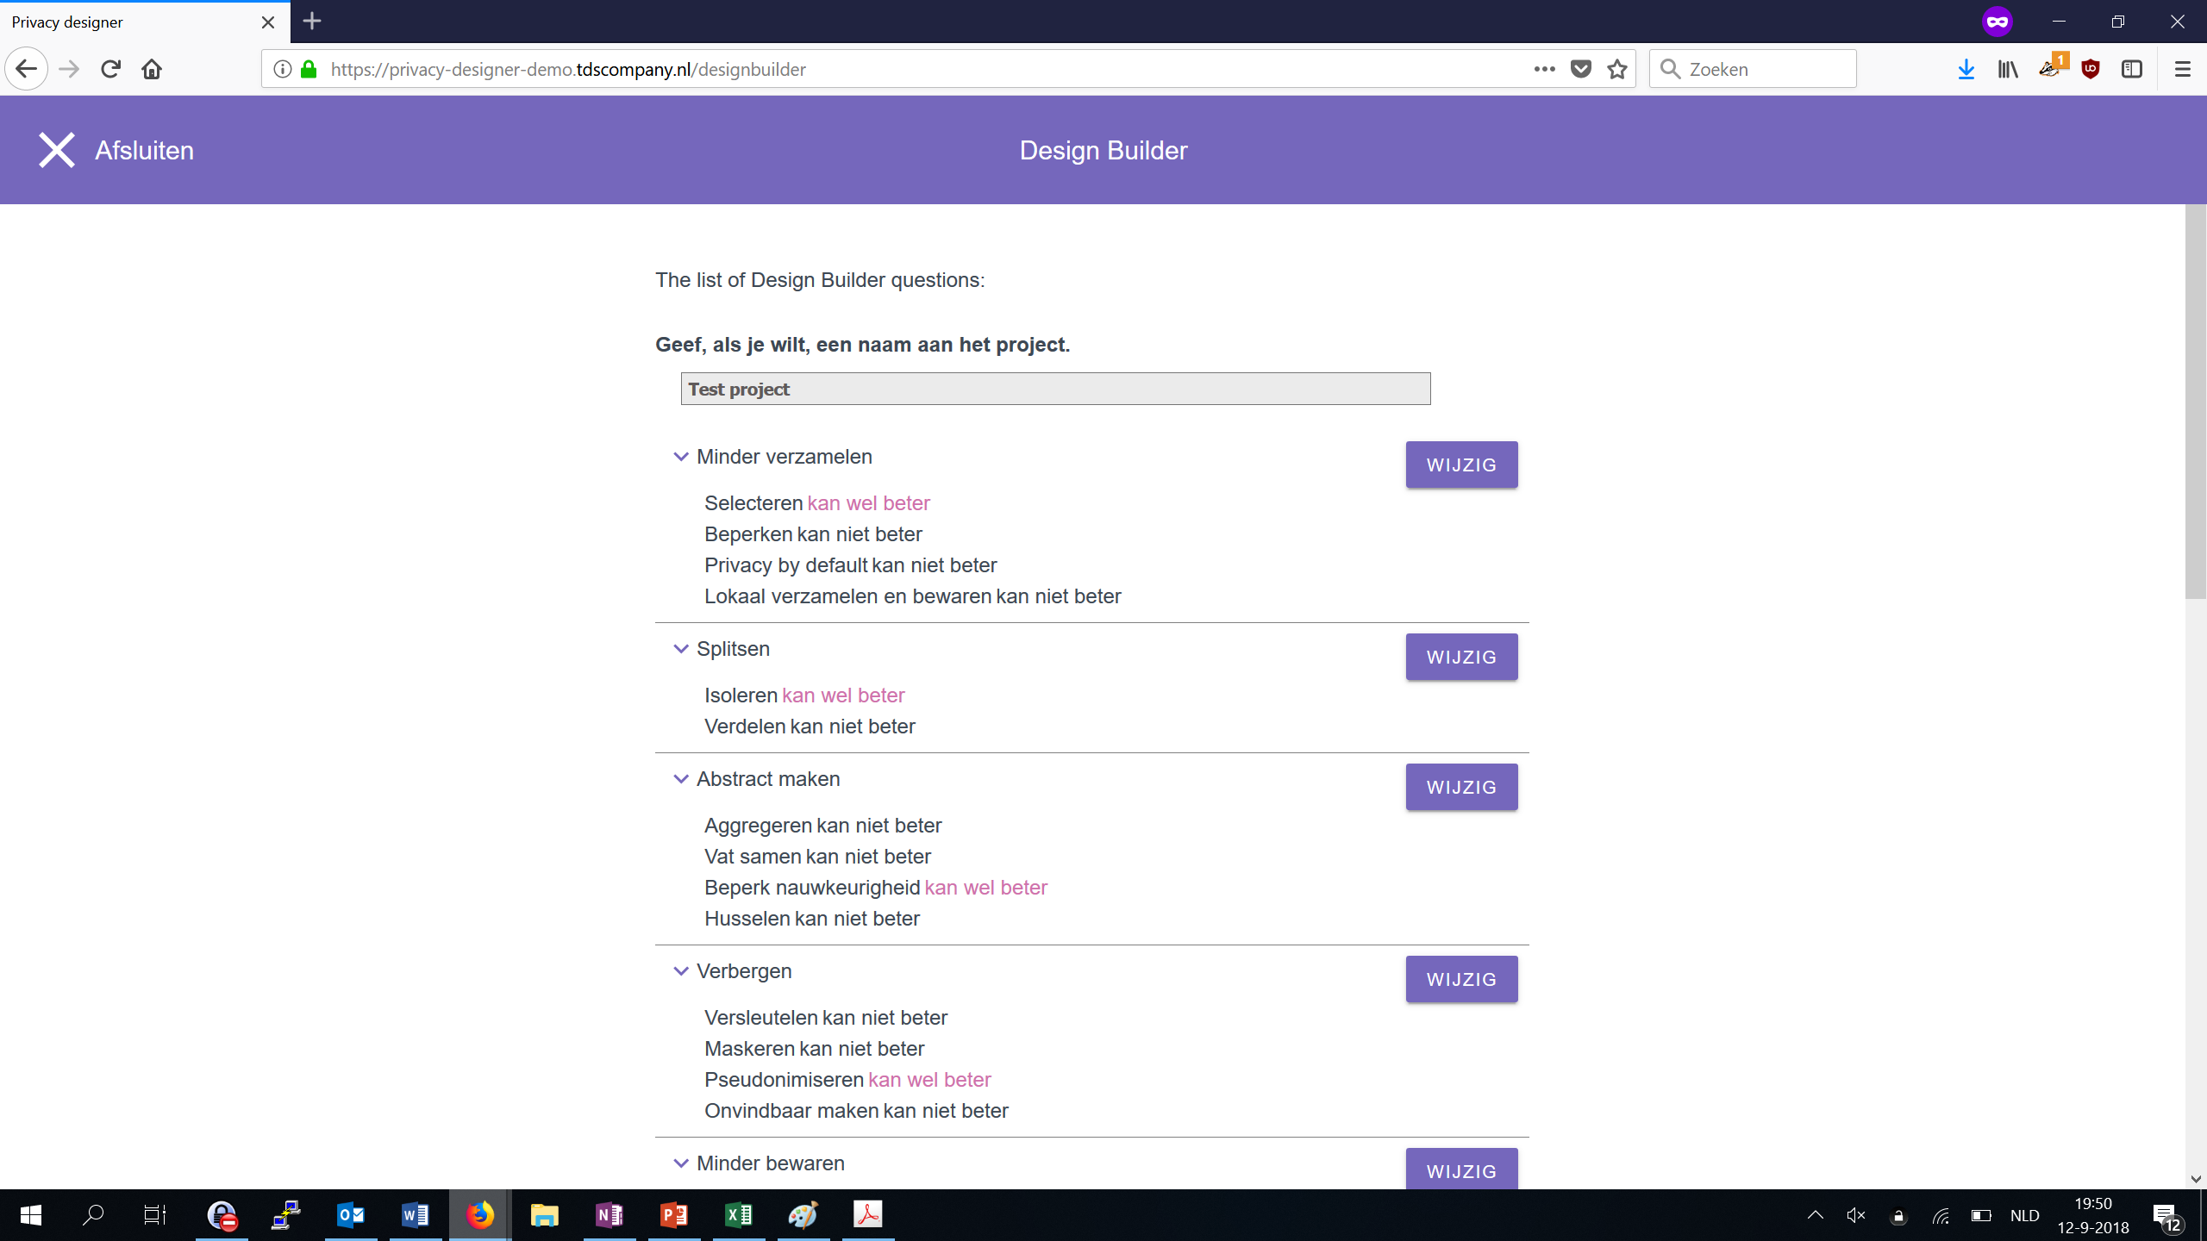

Slide 14
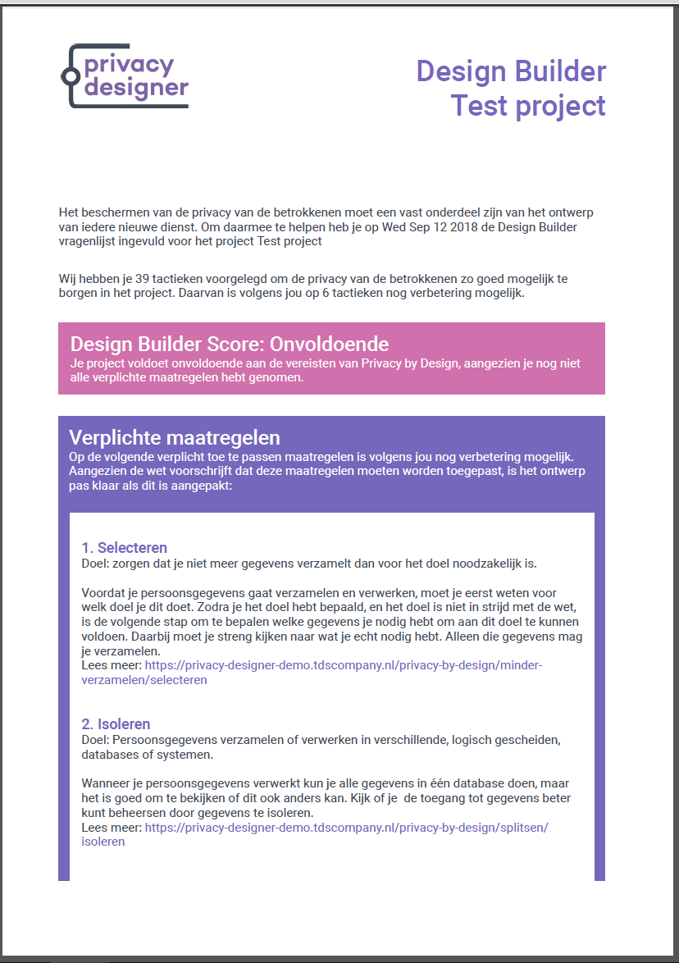

Slide 15
Easy to use

Slide 16
Easy to use
The tool must be useful if you don’t know much about privacy and data protection, but also if you do know more about the subject
Reference book:
Articles about privacy by design strategies, tactics and techniques
Articles about the dangers and opportunities
Dictionary

Slide 17
Next steps

Slide 18
Next steps
User tests
Stakeholder input
SURF look and feel
Adjust content
Translate to English

