Slide 1


SURF PRIVACY AWARENESS
Training General Data Protection Regulation with regard to research
Notes:
Notes to the entire slide deck:
Contents
These slides describe in general terms the aspects that play a role in safeguarding privacy in scientific research. We will look at the areas in research affected by the General Data Protection Regulation. This is during the design of the study, where you can apply the principles of Privacy by Design and Privacy by Default. And when you can/must perform a so-called 'data protection impact assessment' (DPIA); a structured way of determining for different types of processing of research data (collecting, cleaning, de-identifying, saving, analysing, enriching, removing, publishing and archiving personal data) how these processes relate to the privacy principles (the rules of thumb) in the GDPR, the risks that may apply to the participants in the study and possible suitable measures (both organisational and technical) to address these risks.
Form
Every institution is free to remove parts from and add parts to this slide deck and to include options specific to the institution. For instance for the appropriate organisational and technical measures; which directives apply to your institution, which instruments (for instance a Data Management Plan or ‘DMP’) and tooling are offered in your institution for which purpose and how does the researcher get access to these products and services to safeguard privacy in the study.
Logo
The CSY (CyberSaveYourself) logo has been included in all slides in this presentation. This service of SURF uses this logo and is co-initiator of this training. You may replace this logo with the logo of your organisation.

Slide 2


URGENCY
Notes:
Purpose
The purpose of this slide is to introduce the first section, 'Urgency'. The purpose of this section is to make the researcher aware that privacy and taking the right measures regarding the processing of personal data is key for research. This goes hand in hand with offering a safe environment for participants in the study in relation to the reliability and validity of the research.
Work format
Give a brief introduction of the content of the chapter (for instance referring to a recent hack or data leak at a university of applied sciences, university or other public organisation).
Indicate the sections in this chapter that are covered (changes in research in the past 20 years and the discussion of a number of model cases)
Duration of the slide
1 minute
Notes
None

Slide 3
Do you have something to hide?
?
Are you happy with a camera
in the changing room?
Notes:
Purpose
With this and the following slide, we offer an accessible introduction to discuss privacy and personal data. The purpose of these two slides is to explain to researchers that privacy is not only important for everyone, but that the context in which we want to give up our privacy (partly and temporarily) may differ greatly. This and the following slide address the much heard argument 'I have nothing to hide'.
Work format
Ask the researchers the first question. Often some people will answer this with 'no'.
Show the second question and repeat the first question to the person who said 'no' to the first question. Have the responses changed?
Duration (slide 2 and 3 together)
4 minutes
Notes
For people who are not yet very familiar with the various aspects of privacy, the subject seems simple. Are you happy with cameras registering you in town? Yes, because I have nothing to hide. With the example of the changing room - there is a curtain and we do not want a camera in the changing room - it is easy to see that privacy has various aspects. Privacy often seems to deal with data about a person (personal data), but in a wider sense it also concerns physical integrity and the right to do what you want in your own home without being watched, and the right that you have to not allow uninvited third parties to intrude into your house or remain there without permission.

Slide 4
May Customs at Schiphol Airport hand search you prior to a flight?
?
May a baker hand search you
before you enter the shop?
Notes:
Purpose
Same as slide 3
Work format
Same as slide 3
Duration (slide 2 and 3 together)
3 minutes
Notes
With these questions, we address the privacy in context introduced by Helen Nissenbaum. Without having to dwell too much on the various aspects, people can already identify the difference between the two described situations. We find it acceptable at Schiphol Airport that our bags are being checked, that we have to take off our shoes and that we are searched by Customs. At the baker's we find this inappropriate. On persistent questioning, arguments come up that undoubtedly fit the substantive aspects of privacy - for instance that privacy is not absolute, yet in certain cases it is; for instance when this is in our view a justifiable measure to safeguard our safety (necessity/proportionality/subsidiarity priciples GDPR), given the fact that flying involves certain risks, in particular when there is an increased threat level in the relevant country. A search done at the baker's, however, does not serve a justifiable purpose.
Privacy in context is also a factor in the previous slide, as with the way in which you are informed about this or in which it is brought to your attention or not. The changing room has a curtain so that you cannot be seen in your underwear in a shop where everyone else is dressed. In the context of, for instance, the beach, it is, however, not strange that we bare almost all and would not wear much more than when we would be wearing underwear only.

Slide 5
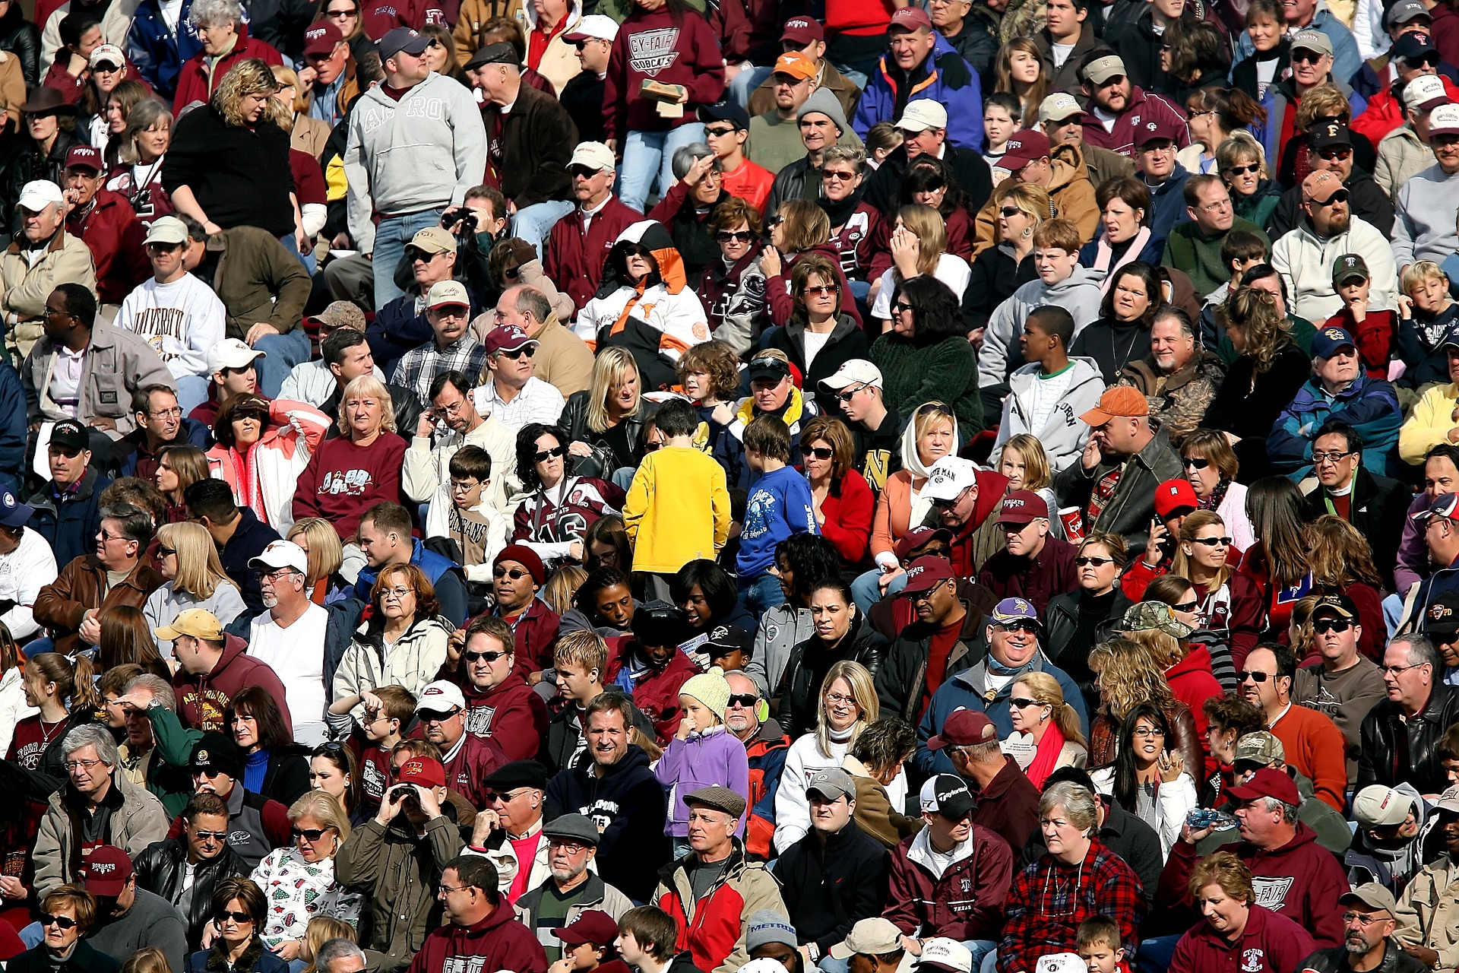
Everything you do revolves around
the persons involved
!
Incorrect handling of their data can even result in the
discontinuation of the research!
Notes:
Purpose
The purpose of this slide is to be able to make clear what the slide deck, the training, the GDPR and all other activities surrounding privacy are about: the persons involved in the study, including the head and other researchers! They should be the first consideration when assessing the privacy aspects of the research. This is the reason why they are right at the front in this slide deck. Therefore, not primarily the convenience of the researcher to collect as many data as possible from the research subjects in the most efficient manner.
Think for instance: would I want to participate in this study myself or would I have my child participate in this study? This slide also offers the opportunity to indicate that the GDPR is only applicable to research in which personal data is processed. If you do not use personal data in your research, then the GDPR is not applicable to the study. Regardless of the type of personal data you process in your research, ensure that as a researcher you always anonymise and pseudonymise your data as soon as possible.
Work format
Show the first sentence. Then ask the researchers whether they agree with this.
Now show the second sentence. Ask the researchers about experiences with regard to having to change or discontinue their research in connection with incorrect handling of personal data.
Emphasise that discontinuation of a study is the ultimate consequence, however, that they will probably not experience this after this course, as the course provides them with all of the tools needed to prevent this type of situation.
Duration
3 minutes
Notes
"Personal data": Any information relating to an identified or identifiable natural person (‘data subject’); an identifiable natural person is one who can be identified, directly or indirectly, in particular by reference to an identifier such as a name, an identification number, location data, an online identifier or to one or more factors specific to the physical, physiological, genetic, mental, economic, cultural or social identity of that natural person. [GDPR, Article 4]
“Special categories of personal data”: Data revealing racial or ethnic origin, political opinions, religious or philosophical beliefs, or trade union membership, genetic data, biometric data for the purpose of uniquely identifying a natural person, or data concerning health, or data concerning a natural person's sex life or sexual orientation. [GDPR, Article 9] Processing this is prohibited, unless....

Slide 6


What has changed in research in the last 20 years?
Technology
Globalisation
…
?
Notes:
Purpose
Why are privacy and the GDPR 'suddenly' playing such an important role? What has changed in the last few years that this has suddenly become such a 'hot' topic? The purpose of this slide is to determine with the researchers which factors play a role in this change, in order to be able to better clarify the specific moment.
Work format
Ask which technological changes have taken place in the last 20 years and which of them have been of great importance in terms of privacy. For answers, refer to the ‘Notes’ at the foot of the speaker notes.
Ask which changes have taken place in the last 20 years with regard to globalisation and which of them have been of great importance in terms of privacy? For answers, refer to the ‘Notes’ at the foot of the speaker notes.
Then ask the researchers which other changes they identify that have had a great impact on privacy in research in the last 20 years.
Duration
4 minutes
Notes
Technological developments that can be identified:
The arrival of social media and their very fast spread of (privacy sensitive) information.
The arrival of internet in almost every household, on every telephone and tablet. This makes information available anytime and anywhere and therefore also sensitive to fraud, loss, manipulation / hacking.
Global developments that can be identified:
Research is becoming increasingly more international, with greater complexity of international agreements governing the handling of personal data within collaborative activities.
People are traveling ever more, are more mobile in their work, can be contacted anytime and anywhere. As a consequence, people no longer only work behind a desk but virtually anyplace in the world. This also results in new privacy challenges.
Other developments that are worth mentioning:
Pressure on researchers to deliver fast or spectacular results?
Changing sector-specific legislation and changes in policy (of publishers, institutions, etc.)

Slide 7

Research into bullying among 4-year olds
special personal data
principle of processing: permission, importance of society or research
vulnerable natural persons
IN THE GDPR:
CASE:
The Netherlands
Permission from parents, school and teachers
Insight into behaviour, but preventing stigmatisation
Notes:
Purpose
This and the following slides offer various cases to illustrate the challenges in research and the associated regulations. The purpose is to use this case to make researchers aware that the GDRP is not a simple 'checklist', however a set of criteria and principles which for a large part will have a specific interpretation for each study. The message of these 'case slides' is that the GDRP is different for each study. As soon as the DPO or data steward in your organisation knows the set-up of the study, he/she can specify which rules apply according to the GDPR.
Work format
Show the three circles one by one and give a short explanation for each circle (refer to the ‘Notes’ for more information)
Ask the students, without them knowing the GDPR, to reason what a privacy law such as the GDPR would dictate about this case. What elements in this study would the GDPR provide for in any event?
Let the GDPR card appear and discuss the answers with the researchers.
Duration (slide 2 and 3 together)
3 minutes
Notes
This involves a study of bullying among 4-year olds. The school, parents (in respect of children younger than 16) and teachers had to give 'informed consent' before their child could participate. Not every child 'was allowed' to not participate by one of these parties. Because the researchers wanted to film in the classroom, a green (‘may be filmed') or a red (‘may not be filmed') sticker was stuck on the chest of the children. This made it easy for the researcher to discern which data of which children he could use. The challenge for the researcher in this study was to arrange timely and correct coordination with all of the parties. In other words, the researcher wanted to start immediately, while coordination with parents/pupils can take a long time.
"Special categories of personal data": Data revealing racial or ethnic origin, political opinions, religious or philosophical beliefs, or trade union membership, genetic data, biometric data for the purpose of uniquely identifying a natural person, or data concerning health, or data concerning a natural person's sex life or sexual orientation. [GDPR, Article 9] Processing these is prohibited, unless....

Slide 8
data protection impact assessment (DPIA)
lawful further processing
storage outside of the EU
IN THE GDPR:
CASE:
Study of genetical aspects of successful entrepreneurs
The
Netherlands
Linking of various data files including genetical data
Large-scale processing with innovative techniques
Notes:
Purpose
Same as slide 7
Work format
Same as slide 7
Duration (slide 2 and 3 together)
3 minutes
Notes
In this study, the researchers wanted to examine the extent to which genetical aspects impact on an entrepreneur being successful or unsuccessful. To this end, various existing data sets were linked, both data sets with family ties (for family businesses) and business data. The challenge for the researcher in this study was to link the large quantity of existing data files (for 'further processing') securely and in conformity with the GDPR.

Slide 9
special personal data
principle of processing special sensitive data: importance of society or research
vulnerable natural persons
IN THE GDPR:
CASE:
Dissidents who have staged coups
South
America
Chain of events?
Don't write anything down, otherwise execution
Notes:
Purpose
Same as slide 7
Work format
Same as slide 7
Duration (slide 2 and 3 together)
3 minutes
Notes
In this study, the researchers wanted to get socially relevant insights by way of interviews with a group of vulnerable persons. The purpose of this study was to describe the chain of events in a coup, not only from a historical but also from a social perspective. The challenge for the researchers in this specific study was the careful handling of special categories of personal data of vulnerable persons. An additional challenge was the question where to store the data: if you put the data in the wrong place in the beginning (so that undesired persons have access) the research subjects run a great personal risk.
Coup plotters from a South American country do not come under the GDPR. However, the Association of Universities in the Netherlands Scientific Integrity Code that applies to every researcher, states in general that care has to be taken during research, irrespective of the geographical location of the research subjects.

Slide 10
IN THE GDPR:
CASE:
Africa
Notes:
Purpose
Same as slide 7
Work format
Same as slide 7
Duration (slide 2 and 3 together)
3 minutes
Notes
This slide can be used at one's own discretion with a study from the own organisation. The icon for the geographical interpretation may be changed at one's own discretion.

Slide 11
IN THE GDPR:
CASE:
India
Notes:
Purpose
Same as slide 7
Work format
Same as slide 7
Duration (slide 2 and 3 together)
3 minutes
Notes
This slide can be used at one's own discretion with a study from the own organisation. The icon for the geographical interpretation may be changed at one's own discretion.

Slide 12

QUIZ
Notes:
Purpose
In the first part, the researchers have been introduced to the GDPR by way of the cases and the introductory questions. Before the GDPR, DPIA and Privacy by Design are discussed in more detail in the next chapters, they will do a short (formative) quiz in this section. This quiz is intended to give them confidence by showing that with 'common sense' they can give quite a few good answers about the GDPR.
Work format
Show the question, have the researchers select or formulate an answer and then show the correct answer. Discuss this briefly with the researchers afterwards. Possible ways of having researchers give answers is by way of:
Showing of hands, putting cap on/taking cap off, standing up/sitting down.
Thinking, sharing, doing. Start by asking the researchers to think individually for a few moments. Subsequently, in turn, the researchers share their answers with a colleague. Together they agree on a joint answer, with the trainer hearing a number of pairs.
A digital application. Answers to multiple-choice questions can be given digitally very well in applications such as www.mentimeter.com, www.kahoot.com, www.quizlet.com or www.plickers.com. On YouTube various instruction videos can be found in which the operation of these applications is shown.
Duration (total quiz)
5 minutes
Notes
None

Slide 13

QUESTION 1
What is the difference between personal data and special (categories of) personal data?
Data that directly or indirectly
identify a person.
Data that could seriously harm a person when they end up in the wrong hands.
Notes:
Notes
In Articles 4 and 9, the GDPR gives a definition of personal data and special personal data. It is therefore a matter of definition. The exact difference between personal data and special personal data is set out in this slide; it is not described as such in the GDPR.
For further explanation refer to slide 12

Slide 14
QUESTION 2
Are you allowed to process (special categories of) personal data for research?
'No, unless' or: 'Yes, provided that‘
is present: legitimate grounds and safeguarding of rights and freedoms of the research subjects.
Notes:
For an explanation refer to slide 12

Slide 15
QUESTION 3
Do you always have to ask permission in advance from the participants in your study for the processing of their personal data?
No. Permission is only one of the legitimate grounds; the public interest of
society, for instance, is another.
Notes:
For an explanation refer to slide 12

Slide 16
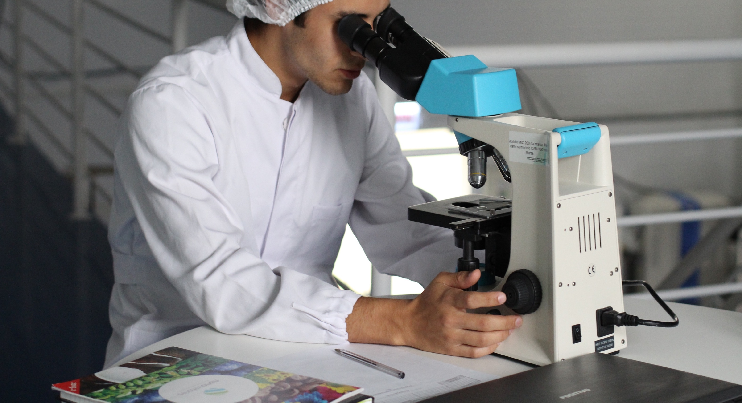
YOU AND THE GDPR
Notes:
Purpose
This slide is intended as an introduction of the second section: ‘You and the GDPR'. The purpose of this section is to make the researcher aware that the GDPR is not a simple checklist, but a set of criteria and principles that partly also depends on context (for instance the traceability of data about a person). Moreover, we expand on the six privacy principles that constitute the basis for the GDPR, and we will discuss the shared responsibility within each organisation with regard to a correct handling of personal data.
Work format
Give a short introduction to the content of the chapter.
Describe the sections that will be discussed in this chapter (what is the GDPR? What principles is it based on and to which extent are you as a researcher already aware of and competent with regard to the GDPR?)
Duration of the slide
1 minute
Notes
None

Slide 17
General
Data Protection
Regulation
88
pages
100%
insight in the measures
you have to take
80%
20%
COLLABORATION
GEOGRAPHY
DATA
Funders' requirements
Institutional policy
Technical facilities
Intellectual property rights
Notes:
Purpose
The purpose of this slide is to make the researcher aware that the GDPR is not an unambiguous 'checklist' you can tick off. It is key for a researcher to have full insight into the measures to be taken to guarantee the correct handling of personal data. The GDPR contains 88 pages, 99 Articles, 173 considerations and added to this a GDPR Implementation Act (Implementation of 33 specific aspects for the Netherlands). In general, researchers will not read all of this themselves. To this end, we offer as a handle a split of approx. 80% and 20%; 80% of the measures that you have to take depend on three criteria:
The type of collaboration that takes place in your study (none, public-public, public-private)?
The countries that participate in the study and the location of the storage of the data (transfer)?
The type of data you use in the study (existing data set, new data set, procured data set. Additionally, the medium is important; video footage, for instance, will contain more personal data straight away. This means that you, already right from the onset, have to use additional measures when using video)?
The measures to be taken based on these three criteria will always be the same within the GDPR. In other words: the moment you do a study within the same criteria more often, you know which measures to take. In addition to these criteria, approx. 20% of the measures you must take arise from research-specific preconditions such as the technical facilities available in the organisation, requirements from any funders, the policy of the organisation etc., which, per study, constitutes a specific set of measures on a technical and organisational level to be able to work fully GDPR compliant.
We recommend that, for this slide, you state that working out precisely which measures should be taken is not solely the responsibility of the individual researcher. The researcher determines the measures to be taken jointly with a privacy expert in the organisation, such as a data steward and in specific cases the Privacy Officer or DPO. The instrument they use for this, is called the DPIA, a questionnaire that covers all aspects of the study and from which the measures to be taken can be distilled (on the basis of the advice from the PO/DPO).
Work format
The slide does not require a specific work format. You can use the visual elements in the slide to support the explanation of the measures to be taken for each specific study.
Duration
5 minutes
Notes
None

Slide 18
PRIVACY
Purpose and purpose limitation
Do I only use the personal data for the purpose of my study?
Principle
Does a minimal legal basis for the processing of personal data exist?
Data Minimisation
Do I only use those data that are necessary to realise the identified purpose?
RULES OF
THUMB
Transparency
Have I given the research subjects clear prior information about the purpose of the data processing?
Data Integrity
Are the personal data I use still correct?
Storage Limitation
Do I really need the data after a certain period?
Notes:
Purpose
The purpose of this slide is to explain the six principles the GDPR is based on. These principles, referred to here as 'rules of thumb', are important for every researcher to keep in mind in every phase of the study. The researcher must ask these six questions for every new step in the study. It concerns the principles of necessity, proportionality and subsidiarity.
Work format
The six circles containing the rules of thumb appear step by step. This makes it possible with each circle to briefly discuss with the researchers a specific rule of thumb. We recommend to ask the researchers for their own experience with each rule of thumb; which researcher would answer 'no' to one of the specific questions in a current study? And what is the consequence for the measures to be taken if the answer is 'no'?
Duration
5 minutes
Notes
We recommend for each rule of thumb to have a personal example available as an illustration if none of the researchers can answer 'no' to any of the questions. For instance, for the rule of thumb 'Data Minimisation‘, your own example could be:
'Suppose you are doing research into bullying among young persons. Would it be necessary to know the exact year of birth of the research subject, or would it be sufficient to only ask for an age range?

Slide 19
Purpose and purpose limitation
Principle
Data minimisation
Transparency
Data integrity
Storage limitation
Longitudinal research into health aspects.
CASE:
RULES OF
THUMB
You want to use data for a follow-up study: you are creating a data hub. Is that permitted?
May other researchers link their data sets to your data hub?
Notes:
Purpose
This 'case slide' aims to specify the information from the previous slide on the basis of an example. Using the information in the three circles, a specific study may be explained, to illustrate which rules of thumb/principles apply to it and what the consequences are of a 'yes' or a 'no' to the questions to every rule of thumb for the measures to be taken.
Work format
The three circles containing the specific criteria of this model study appear step by step. This makes it possible with each circle to discuss with the researchers the role the six rules of thumb play in each part of the study. Start by asking the researchers whether it concerns (special) personal data, then identify (for a 'YES') for every circle the rules of thumb that mainly apply to them and the impact of a 'yes' or a 'no' answer to the question associated with the relevant rule of thumb on the measure to be taken.
Duration
5 minutes
Explanation of the top circle
It concerns special personal data; the aspects of health (purpose and purpose limitation, principle, data minimisation) and possibly also children under the age of 16
The data must be reusable for follow-up studies as it is a longitudinal study (principle, data minimalisation and storage limitation)
Explanation of the circle on the left
Is it intended that someone is to do a follow-up study with the data? (purpose and purpose limitation, principle and transparency)
Have the research subjects given their permission for possible renewed use? (principle, transparency)
Explanation of the circle on the right
What is linked together and is this permitted both for the data set and the data hub? (purpose and purpose limitation, principle)

Slide 20
Purpose and purpose limitation
Principle
Data minimisation
Transparency
Data integrity
Storage limitation
CASE:
RULES OF
THUMB
Notes:
Purpose
Same as slide 20
Work format
Same as slide 20
Duration
5 minutes
Notes
This slide can be used at one's own discretion with a study from the own organisation.

Slide 21
TYPE OF RESEARCHERS
COMPETENT
Smart but ignorant
Master of the universe
"I have always done much to guarantee privacy in my people-related research; but am I doing the right thing in terms of the GDPR?"
“I have been ready for the GDPR for ages, as I already worked in conformity with the Personal Data Protection Act and the difference was not that substantive."
UNAWARE
AWARE
"GDPR? Meat and two veg? I may as well stop with research, because I feel that nothing is permitted anymore!"
"I do know that privacy is a bit of a big deal. Just tell me what I should do and what I can and must make use of."
Ostrich
Mister
Know It All
INCOMPETENT
Notes:
Purpose
The purpose of the last two slides in this chapter is to make the researcher aware that proper handling of personal data in research is a shared responsibility. Not only the researcher, but also disciplines like IT, legal and ultimately management are responsible for the privacy of the research subjects in a study. In the first slide, the researchers indicate in a quadrant how (un)aware and (in)competent they think they are with regard to the privacy measures to be taken in their research. The outcomes of this work format offer you the opportunity to point out to the researchers the steps they can take to become an aware and competent researcher in respect of privacy.
Work format
The slide starts by showing the quadrant that step by step shows the four 'types' of researcher. This offers the opportunity to briefly explain the four different types, possibly provided with an example for illustration ("An 'ostrich', for instance, would use... during data storage" etc.). After explaining the various types of researchers, ask the researchers to position themselves in the quadrant. This can be done for instance by drawing the quadrant on a flipchart and having the researchers choose a place in the quadrant using post-its, or by having researchers place themselves directly in the quadrant on the digi-board/screen using post-its.
On completion of the overview, you can ask a few researchers to explain why they think they are in the location in the quadrant chosen by them. Follow-up questions may deal with the steps they can take to become more aware and competent, or you can point out the opportunities offered by the organisation to become more aware and competent. It is also possible to link researchers in various quadrants and have them share with each other why they have positioned themselves in a certain location in the quadrant and how they both think (and act) in respect of privacy in their research.
Duration
8 minutes
Notes
None

Slide 22
WHERE ARE YOU?
SHARED
RESPONSIBILITY
And your organisation?
COMPETENT
CIO
Data
steward
Management Board
Legal
UNAWARE
AWARE
HR
IT
Researcher
Researcher
INCOMPETENT
Notes:
Purpose
Now that the researchers have placed themselves in the quadrant, this slide shows that proper handling of privacy of the research subjects is a responsibility of all roles within the organisation. The purpose of this slide is to briefly explain this shared responsibility using the visual elements in the slide.
Work format
The slide shows in two steps that all roles within an organisation to a greater or lesser extent are (in)competent and (un)aware. The purpose for the entire organisation is to make all roles both aware and competent in the proper handling of privacy in research; it is a shared responsibility for which, at all times, the ultimate responsibility lies with the management of the organisation.
Duration
2 minutes
Notes
None

Slide 23

PRIVACY BY DESIGN
Notes:
Purpose
The purpose of this slide is to introduce the third section, 'Privacy by Design'. The title of this section is 'Privacy by Design‘, however, 'Privacy by Default' will also be discussed in this chapter. The purpose of this section is to make the researcher aware that proper handling of personal data must not only be described in the research plan, but that it requires specific measures at each stage during the study. By considering as early as in the planning phase which measures these would be for each stage, you as a researcher will continue to be 'in control', which can save a lot of time during the study and can also prevent the risk of errors (data leaks etc.).
Work format
Give a short introduction to the content of the chapter.
Describe the sections that will be discussed in this chapter (three model cases in which we review for every step in the study the technical and organisational measures that are required for a proper dealing of privacy issues)
Ask researchers to set out their own research process in combination with data processing (what, where, when).
Duration of the slide
1 minute
Notes
None

Slide 24
STUDY IN SIX STEPS
CASE:
1
Planning
Data
collection
Data
structuring
Storage
Analysis
Publication & filing
(DPIA)
RDM
Ethical testing
Informed consent
Data Processing Agreements between research partners
Replacement of personal data by codes.
Encryption of key file and laptop hard drive
Storage in end to end encrypted online environment to enable collaboration with the research partners
Access and permission management with regard to data for analysis selection GDPR compliant analysis software (TOS).
Storing data in the data repository of the institute and/or in the NWO /KNAW data archive.
Access and permission management
University and knowledge centres
(Higher Professional Education > lectorships)
Research is taking place in the Netherlands
Video, audio, text, statistical data, database
COLLABORATION
GEOGRAPHY
DATA
Notes:
Purpose
The purpose of this slide is to make the researchers aware that each step within a study needs specific technical and organisational measures. This is done by using a specific example. The slide shows six phases within a study, showing at the bottom the context of a model case. Based on this context, this slide shows the measures to be taken for each step within the study.
Work format
This slide is aimed to provide researchers with the 'mindset' of Privacy by Design. The slide builds up in three steps, showing ultimately all three measures to be taken for each phase in the model case. First, you can start by briefly explaining the various steps in a study. Subsequently, the slide shows the outlines of the model case (refer to 'Notes' at the bottom for a description of this specific example). Now you can discuss step by step with the researchers the measures to be taken for each phase in the study . You may, prior to showing the measures per step, ask the researchers which measures they think they have to take.
Duration
5 minutes
Notes
The study we are presenting in this example is aimed at researching the experience of young persons with regard to sexuality:
Privacy by Design: in the design phase, you identify the risks with regard to each step within data processing and point out the measures to be taken for each step.
Privacy by Default: measures are becoming stronger when they are not ad hoc, but when they have been set up correctly by default. For instance, the standard setting for the online storage of data; in the example in this slide this is end-to-end encryption as standard with the (head) researcher being the only one who has the key to the pseudonyms.

Slide 25
STUDY IN SIX STEPS
CASE:
2
Planning
Data
collection
Data
structuring
Storage
Analysis
Publication & filing
DPIA
RDM
Ethical testing
Existing database
New measurements
Using pseudonyms, hashing, randomisation
Encryption
At the research partners
Online in an end-to-end encrypted document vault
With stand-alone software at the research partners
With online software
Data with magazines
Data in the NWO/KNAW DANSeasy data archive
Data on your laptop
Public - private
European research project
Databases: statistical data and kpi data located outside of the EU
COLLABORATION
GEOGRAPHY
DATA
Notes:
Purpose
Same as slide 25
Work format
Same as slide 25
Duration
5 minutes
Notes
The study presented in this example aims at demonstrating efficiency in health care by using big data: faster diagnosis, more effective logistics, shorter waiting times, less impact on patients.
Privacy by design: in the design phase, you identify the risks with regard to each step in data processing and point out the measures to be taken for each step.
Privacy by default: measures are becoming stronger when they are not ad hoc, but when they have been set up correctly by default. For instance, the default setting for the online data storage; in the example in this slide this is with end-to-end encryption as standard.

Slide 26
STUDY IN SIX STEPS
CASE:
3
Planning
Data
collection
Data
structuring
Storage
Analysis
Publication & filing
XX
XX
XX
XX
XX
XX
XX
XX
XX
XX
XX
XX
XX
XX
XX
XX
XX
XX
XX
XX
XX
COLLABORATION
GEOGRAPHY
DATA
Notes:
Purpose
If required, you can use this slide for another example from your own organisation, with which you can discuss the concepts of ‘Privacy by Design’ and ‘Privacy by Default’ with the researchers.
Work format
Same as slide 25
Duration
5 minutes
Notes
None

Slide 27

DPIA
Notes:
Purpose
The purpose of this slide is to introduce the fourth section 'DPIA' (Data Protection Impact Assessment). The purpose of this section is to make researchers familiar with a DPIA, to make them aware of the added value of the instrument and to inform researchers about the place of a DPIA within their study.
In general, A PIA a 'Privacy Impact Assessment'. The DPIA is a specific instrument for this as described in the GDPR, Article 35. In this chapter we will elaborate on the DPIA.
Before you show the following slide, you could ask a question to establish which researchers know what a DPIA entails.
Work format
Ask the researchers if they know what a DPIA actually is. Has any of the researchers performed a DPIA before? Who knows what the abbreviation DPIA actually stands for?
Give a short introduction to the content of the chapter.
Describe the sections this chapter will cover (the 'how and why' of a DPIA), the involvement of the PO/DPO and a possible consultation of the Dutch Data Protection Authority (DPA) prior to the actual study.
Duration of the slide
1 minute
Notes
None

Slide 28

Data
Protection
Impact
Assessment
WHY?
Are you in control?
Do you have a grasp of
your responsibilities?
Can you adequately meet your responsibilities?
Notes:
Purpose
The purpose of this slide is to briefly discuss the 'why' of a DPIA with researchers. The 'why' consists of three subquestions, which appear in three separate circles.
Work format
Using the three circles you can explain that carrying out a DPIA ensures that you as a researcher can answer 'yes' to all of the three questions. Also discuss the possible consequences if you as a researcher cannot answer 'yes' to these three questions; this may mean that you must (suddenly) take supplementary measures during the study, which takes time, or that there is a risk of leaking personal data. Also discuss the possible consequences for the study, the researcher and for the organisation in the case of a data leak.
Duration of the slide
3 minutes
Notes
None

Slide 29


Data
Protection
Impact
Assessment
WHEN?
New
technology
Big personal
data
Sensitive
data
Large-scale
processing
Notes:
Purpose
The purpose of this slide is to explain to the researchers when a DPIA is mandatory. The four situations in which this is the case can be briefly explained using this slide.
Work format
The four situations, possibly supplemented with an example from your own organisation, can be used to discuss when a DPIA is mandatory. We recommend you to explain that doing a DPIA is always valuable, even if the study does not fall under the four mandatory situations.
Duration of the slide
3 minutes
Notes
- New technology: 'new technology' exists when this technology stretches the existing concept of digital security. This requires additional measures regarding security. What we considered to be secure 10 years ago, we do not find secure anymore. In 10 years' time the same will apply again for our current state of the art.
Personal data: this means that it must be data that are traceable to a specific person.
Sensitive data: this means that there must be personal data and/or special personal data.
- Large-scale processing: for instance a study of hundreds of thousands persons at a time.

Slide 30
Data
Protection
Impact
Assessment
HOW?
Processing personal data?
Adjusting plan
Viewing research steps
Estimating risks at every step
DPIA
Notes:
Purpose
The purpose of this slide is to explain the role of a DPIA within a study. It shows the general steps the researcher has to take to include in the research plan any measures to be taken with regard to privacy. The slide shows that the first question is always whether there is any processing of personal data taking place at all. If this is not the case, a DPIA is not required. If, however, this is the case, you, as a researcher, must describe all of the steps in the study and perform a DPIA together with a privacy expert within the organisation (often the data steward). By doing so you asses the risks for each step/phase in the study, determine which measures are required and maybe even adjust the plan. The adjustment of the plan, may require a new DPIA to also again assess the risks in the adjusted plan (and where necessary take supplementary measures).
Work format
Using one by one the four circles to show the four different steps on the slide and give a brief explanation of each of the circles. Before showing a new circle, you could ask the researchers what they expect the next step to be.
Duration of the slide
3 minutes
Notes
None

Slide 31
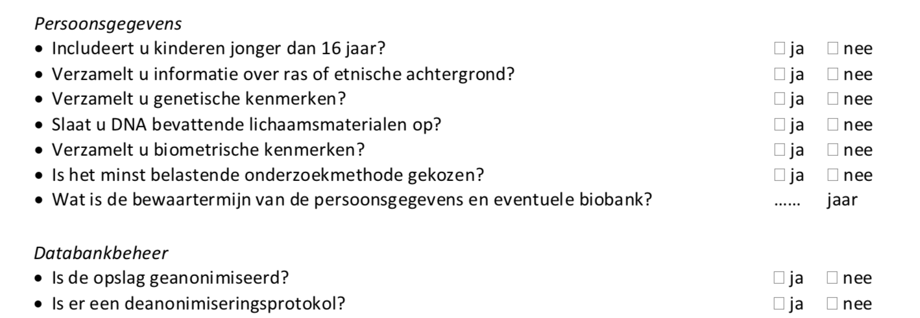
Data
Protection
Impact
Assessment
EXAMPLE
Notes:
Purpose
The purpose of this slide is to give researchers an impression of what a DPIA is; a questionnaire that the researcher goes through together with a privacy expert and that shows the technical and organisational measures to be taken. By visualising this for the researcher, the threshold to apply for a DPIA may be lowered.
Work format
Show a screenshot of a number of questions from the DPIA and ask the researchers to answer some of the questions shown. Subsequently discuss the possible measures resulting from their answers and explain that, after going through the questionnaire with the privacy expert, they will have an immediate overview of the possible risks in their study and the corresponding measures.
Duration of the slide
5 minutes
Notes
None

Slide 32
The Privacy Impact Assessment (PIA) Route Planner for Academic Research
Inspired by Harry Beck’s London Metro Map
No processing of personal data
in your research
Conduct Research
Demonstrate compliancy
with the GDPR
Processing (special categories of)
personal data of (vulnerable) individuals
in your research
Demonstrate compliancy
with the
privacy principles
No high risk
processing
Research Design
Legal ground
for processing
Address risks with
appropriate measures
Implement appropriate
technical and
organisational measures
High risk
processing
Prior consultation
with the national
supervisory authority
No legal ground
for processing
Re-design Research
Stop Research
Notes:
Purpose
The purpose of this slide is to give researchers an impression of what a Data Protection Impact Assessment (DPIA) is and how the process operates.
Work format
By way of this DPIA route planner you travel from the left ("Research Design") via the different stations to your final destination and address in a logical order the various aspects of a DPIA. In 'real life' you would perform a DPIA with a group of people from various lines of approach. We recommend to involve not only the researcher, but also a privacy officer, legal advisor, member of the ethical committee and a technical advisor. Obviously, persons can have multiple roles. By doing the DPIA in a so-called multi-stakeholder session, you learn from each other what it means to introduce the GDRP in a specific research project. In this way, a portfolio is built up in the institution whereby the researcher and the research supporting organisation develop a series of own issues and known best practices that may be used for comparable cases.
The questions of the decision tree are put in the same order on the following slide by way of explanation. This slide is 'hidden' so that it cannot be seen by the participants during the training, but only serves as a support and explanation for the trainer.
Duration of the slide
10 to 30 minutes.
Notes
Select a research project as a starting point and assume that the head researcher is the person who will map out the route for the research together with the persons from the research support.
Every 'station' is a step in a decision tree where the answer may be 'yes' or 'no'.
The first step (personal data or not) is a matter of definition. After that, an argument may be construed for every possible answer. Consider for the answer that you give whether you would feel comfortable if your answer and its justification would be in the newspaper tomorrow. The privacy rights of the individual are key in this assessment. At each station, try to actually only answer the relevant question, so without involving other decision points. This is the actual power of this route planner: making the route visible on the basis of the logic provided by the GDPR.
Documentation of the separate decisions is the reflection of a number of motivated considerations and may as such be submitted to the DPO for approval. With an approved DPIA, the researcher is in a strong position with regard to applications for data access and facilities or research funding, due to the application of the principle of 'Privacy by Design' in the study and the demonstrable (because documented) consideration of risks of the research subjects in conformity with the privacy principles, as set out in the GDPR.

Slide 33

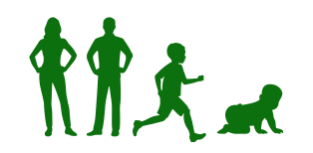
The Logic of a Data Protection Impact Assessment (DPIA) for Academic Research
Q1. Do you process (special categories of) personal data
of (vulnerable) individuals in your research?
YES
Q2. What is the legal ground for this processing?
NO
Lawfulness of Processing
(GDPR*, Article 6, 89):
The individuals participating in your research have freely given their explicit consent for one or more specific purposes.
Your research contributes to a legitimate interest, yet results in no high risks for the individuals participating in the research.
Your research has a scientific, historical or statistical purpose, yet results in no high risks for the individuals participating in the research.
YES
Q3. Is this processing a high risk processing?
Proceed - no measures required for safeguarding
privacy.
NO
YES
NO
Stop research or redefine research.
Criteria for high risk processing
(WP29 - DPIA Guideline**):
Evaluation or scoring
Automated-decision making with legal or similar significant effect
Systematic monitoring
Sensitive data or data of a highly personal nature
Data processed on a large scale
Matching or combining datasets
Data concerning vulnerable data subjects
Innovative use or applying new technological or organisational solutions
When the processing itself prevents data subjects from exercising a right or using a service or a contract
Proceed - measures required for safe-guarding privacy.
"Personal Data" (GDPR*, Article 4):
Any information relating to an identified or identifiable natural person: a name, an identification number, location data, an online identifier, one or more factors specific to the physical, physiological, genetic, mental, economic, cultural or social identity of that natural person.
Action
"Special Categories of Personal Data
(Sensitive Data)" (GDPR, Article 9):
Data revealing racial or ethnic origin, political opinions, religious or philosophical beliefs, or trade union membership, the processing of genetic data, biometric data for the purpose of uniquely identifying a natural person, data concerning health or data concerning a natural person's sex life or sexual orientation.
Data protection by design and by default
(GDPR*, Article 25):
Implement appropriate technical and organisational measures:
Individual participating in your research (data subject). Is the participant well informed, aware of possible risks for her/him and aware of the purpose of the research?
Data. Is the data de-identified and encrypted?
Access Management. How is access managed and controlled for the PI / team (expanded) / public?
Software / Platform. Are the Terms of Service for used software / platform checked (where is the data and who has access and has which usage rights)?
Devices. Are devices used safe? Encrypted drive, encrypted communication, strong password / two factor authentication.
Partners. Are the research partners / service partners trusted and are appropriate legal agreements made, with regards to roles, rights and responsibilities?
Safe and secure collaboration. Is the ((cross border) communication to, in and from the) collaboration platform end to end encrypted, are roles and permissions defined and implemented, is logging and monitoring implemented?
Risk definition and mitigation. Are risks defined and mitigated? Is a risk audit procedure started?
Action
Prior consultation
(GDPR*, Article 36):
The Data Protection Officer shall, on behalf of the researcher, consult the supervisory authority, prior to the processing (the research) when the processing would result in a high risk in the absence of measures to mitigate the risk.
Action
Records of processing activities
(GDPR*, Article 30):
The university shall maintain a digital record
of the processing activities in your research to
demonstrate compliancy to the GDPR.
This register contains:
The name and contact details of the researcher, the research partners and service providers;
The purposes of the processing;
A description of the categories of data subjects and of the categories of personal data;
The categories of recipients to whom the personal data have been or will be disclosed.
Action
Principles relating to processing of personal data (GDPR*, Article 5):
Demonstrate compliancy with the principles:
lawfulness, fairness, transparency, purpose limitation, data minimisation, accuracy, storage limitation, integrity, confidentiality and accountability.
Notes:
This slide illustrates the logic of the ‘DPIA route planner’ per ‘station’, using definitions or suggestions given by the GDPR or as set out in the ‘Opinion’ of ‘Working Party 29’ and accepted by the European Commission on the
Data Protection Impact Assessment (DPIA) - in Dutch: “gegevensbeschermingseffectbeoordeling”. The so-called WP29 is composed of the chairpersons of the ‘national supervisory authorities’ - in the Netherlands: the Dutch DPA.
* Regulation (EU) 2016/679 of the European Parliament and of the Council of 27 April 2016 on the protection of natural persons with regard to the processing of personal data and on the free movement of such data, and repealing Directive 95/46/EC (General Data Protection Regulation). Online available at: http://eur-lex.europa.eu/legal-content/EN/TXT/PDF/?uri=CELEX:32016R0679&from=EN
** Article 29 Data Protection Working Party: Guidelines on Data Protection Impact Assessment (DPIA) and determining whether processing is “likely to result in a high risk” for the purposes of Regulation 2016/679. Adopted on 4 April 2017. As last Revised and Adopted on 4 October 2017. Online available at: https://ec.europa.eu/newsroom/document.cfm?doc_id=47711

Slide 34
YOUR
DPIA
Q: How do you collect data?
A: You wish to make recordings of interviews in which personal data are discussed. You want to use Skype and use the option of Skype to record the interview.
Q: Is this allowed? What arrangements are required?
?
Notes:
Purpose
In order to make it more concrete which questions a DPIA entails and which measures may be required based on the answers, this slide offers a specific question from the DPIA. The purpose of this is to make the researcher aware that a DPIA is not a 'complex' instrument but only a one-off consultation with a privacy expert, in which the researcher can save a lot of time during the study and can reduce risks of data leaks.
Work format
Explain the question and answer on the slide and ask the researchers which measures they think they should take based on the answer. Reflect on their answers and identify the measures that may be required in this specific case.
Duration of the slide
2 minutes
Notes
Required measures in this example include:
Technical measure: find and use a technology that is GDPR compliant. For the processing of personal data Skype is not (because you do not know where the data are and who has access to them)
Organisational measure: for instance: record an interview with a memo recorder, so that the audio file does not end up in the cloud but on a local disk. Ensure the data is safe in the office and en route.

Slide 35
YOUR
DPIA
Q: How do you process the data?
A: You have interviewed a lot of people and want to have the audio recordings transcribed by a small and cheap agency.
Q: Is this allowed? What arrangements are required?
?
Notes:
Purpose
Same as slide 33
Work format
Same as slide 33
Duration of the slide
2 minutes
Notes
Required measures in this example include:
Technical measure: ensure safe transport of the data from your office to inside the company.
Organisational measure: the recorded interview may only be transcribed by persons/companies you have made proper arrangements with (have entered into a data processing agreement)

Slide 36
YOUR
DPIA
Q: Where do you process your data?
A: You are always travelling and want to be be able to work on the train as well. You mostly use the Wi-Fi in the train, but it sometimes does not work, so you are searching for an available public Wi-Fi.
Q: Is this allowed? What arrangements are required?
?
Notes:
Purpose
Same as slide 33
Work format
Same as slide 33
Duration of the slide
2 minutes
Notes
Required measures in this example include:
Technical measure: use a technology for working off-line, so that you avoid the risks of public Wi-Fi networks. You may also use technology of which the communication and storage are encrypted so that you can even use public Wi-Fi because what and to whom you communicate is safe. An example of this is ‘eduvpn’.
Organisational measure: use your own 4G network, for instance through a subscription from your organisation or through the own hotspot on the mobile phone. For instance via EDU-VPN from SURF.

Slide 37

WHAT DO YOU KNOW NOW?
Notes:
Purpose
The purpose of this slide is the introduction of the fifth section 'What do you now know?'. The purpose of this section is to offer the researcher by way of an exercise and a few plenary questions a summarizing activity covering all aspects of the course.
Work format
Give a short introduction to the content of the chapter.
Describe the sections that will be covered in this chapter (a 'mystery study' and a few closing questions about the GDPR)
Duration of the slide
1 minute
Notes
None

Slide 38
WHAT IS THE CONTEXT?
Planning
Data
collection
Data
structuring
Storage
Analysis
Publication & filing
XX
XX
XX
XX
XX
XX
XX
XX
XX
XX
XX
XX
XX
XX
XX
XX
XX
XX
?
?
?
COLLABORATION
GEOGRAPHY
DATA
Notes:
Purpose
This slide offers a 'mystery study' as a test for the researchers. In the previous sections of this course they have gathered all of the knowledge which they can now use to test what they know. The purpose of this test is to reason in which context (collaboration, geography and type data) the study shown has taken place on the basis of the measures taken per research phase.
Work format
Explain the exercise: “For each research phase, you will see here the various measures the researcher had to take on the basis of the outcomes of the DPIA. Based on these measures, what, according to you, are the collaboration form, the geographical context and the types of data within which this study has been set up and carried out?". Let the researchers think about this for a few moments individually. Subsequently, the researchers share their thoughts with a colleague and determine as a pair their final answer. You can now ask some pairs to explain their answers. The answers are then shown on the following slide.
Duration of the slide
7 minutes
Notes
As an example, you can use in this slide measures from a case in your own organisation. If you are looking for inspiration, the following examples may be interesting:
Open data requirement of American magazines such as Nature
Open data requirement of American funders such as the National Institute of Health

Slide 39
WHAT IS THE CONTEXT?
Planning
Data
collection
Data
structuring
Storage
Analysis
Publication & filing
XX
XX
XX
XX
XX
XX
XX
XX
XX
XX
XX
XX
XX
XX
XX
XX
XX
XX
XX
XX
XX
XX
XX
XX
XX
XX
XX
COLLABORATION
GEOGRAPHY
DATA
Notes:
Purpose
The purpose of this slide is to show the answers with regard to the 'mystery study', so that you can review it.
Work format
Show the answers in the slide and discuss them. Discuss to this end the answers given by the pairs and discuss any differences between their answers and the answers on the slide.
Duration of the slide
3 minutes
Notes
On this slide you can fill in the answers from your own case in the previous slide.

Slide 40
QUESTION 1
Does the GDPR fundamentally change scientific research?
No. You are taught a new routine by taking familiar steps in time and where necessary use available resources.
Notes:
Purpose
To conclude this course, a number of questions have been included. The content of the questions does not specifically deal with knowledge aspects regarding the GDPR but has the main purpose of making often-heard 'obstacles' for researchers regarding privacy open to discussion.
Work format
Show the question on the slide, ask researchers about their answers and subsequently show the answer in order to discuss this in the group.
Duration of the slide
3 minutes
Notes
None

Slide 41
QUESTION 2
There is still so little known about
this new legislation!
Indeed there is not one document that exactly states what everyone must do in every situation. But in terms of research much more is possible than you would expect.
Notes:
Purpose
Same as slide 39
Work format
Same as slide 39
Duration of the slide
3 minutes
Notes
None

Slide 42
QUESTION 3
All I do now is carry out administrative duties because of this GDPR!
It is true that work is duplicated temporarily during the launch phase; for privacy, ethical testing and research data management.
Notes:
Purpose
Same as slide 39
Work format
Same as slide 39
Duration of the slide
3 minutes
Notes
None

Slide 43
?
MORE
INFORMATION?
Links
GDPR Manual [Ministry of Security & Justice]
General Data Protection Regulation
Dutch Data Protection Authority
Association of Universities in the Netherlands Code of Conduct
Notes:
Purpose
On this slide you can include a number of links to additional training, more in-depth information regarding the GDPR or other relevant sources of information from your organisation.
Work format
You can show this slide and tell the researchers that you share the presentation with them. In this way they have immediate access to the links shown.
Duration of the slide
1 minute
Notes
None

Slide 44
SURF PRIVACY AWARENESS
Training GDPR & DPIA regarding research
This training was made possible by:
Marlon Domingus (RDM, Erasmus University Rotterdam)
Sander van Acht (Flooow, onderwijskundig concept)
Maarten van der Schaal (Nieuwbericht, slidedesign)
Notes:
Closing slide.

