Slide 2
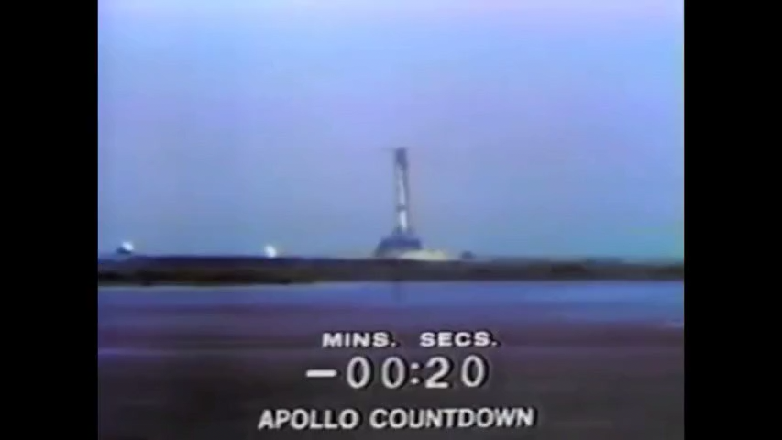

Slide 3


Slide 4
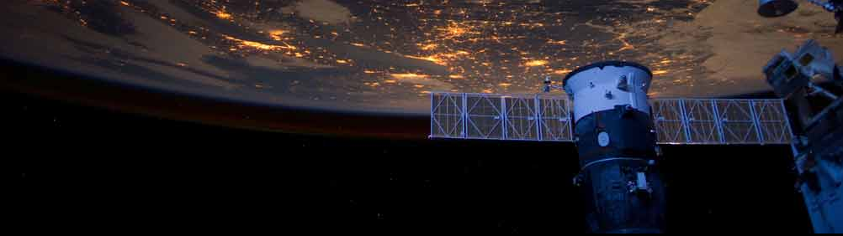
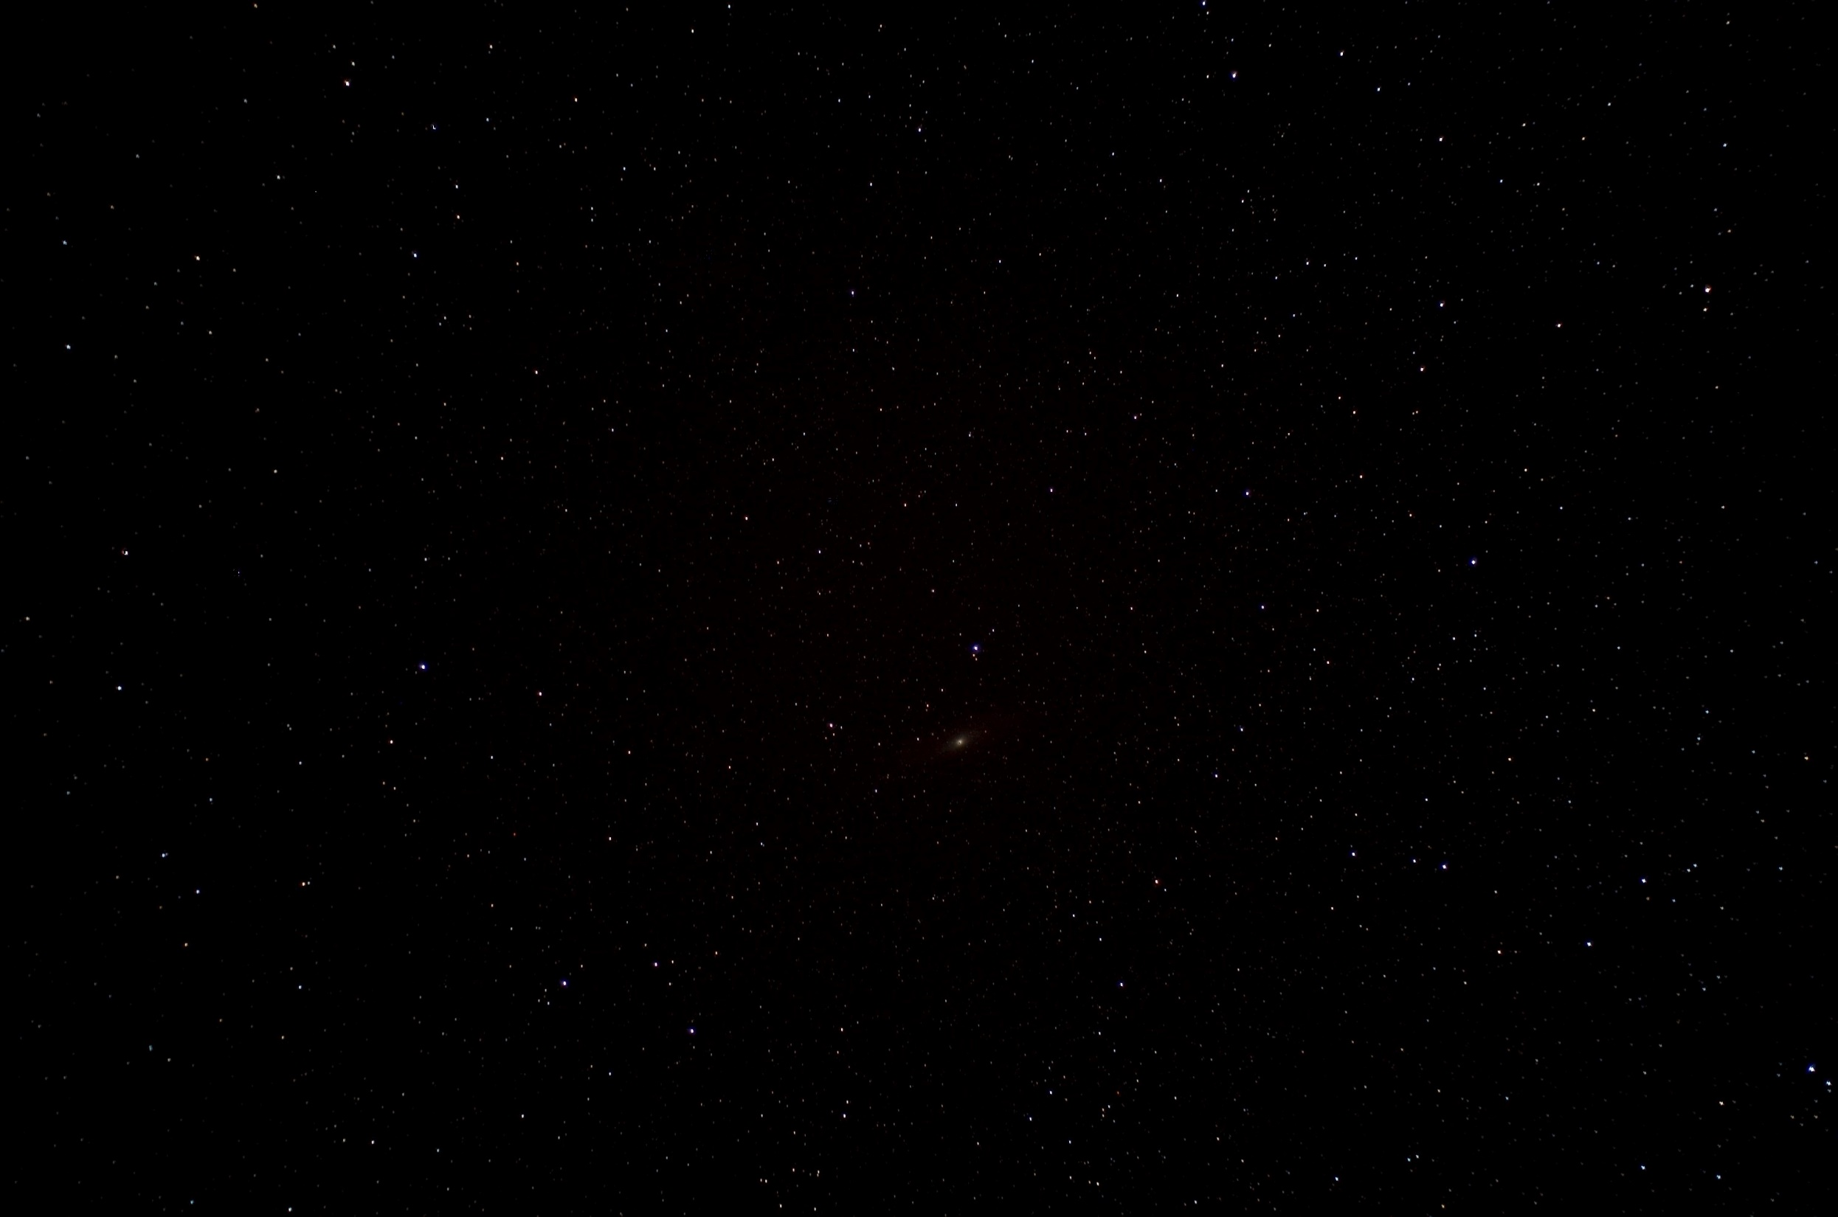
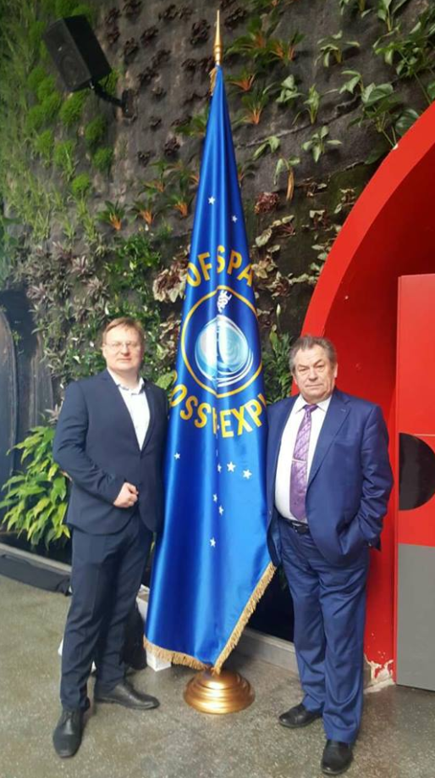
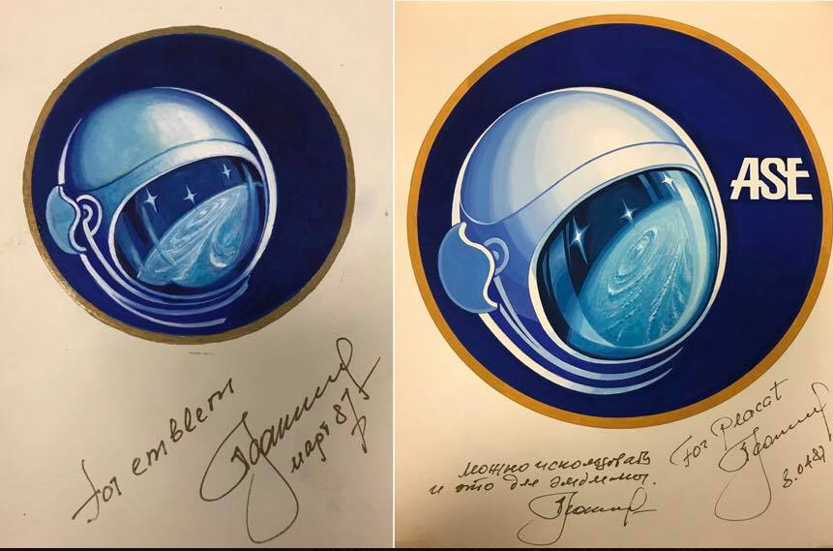
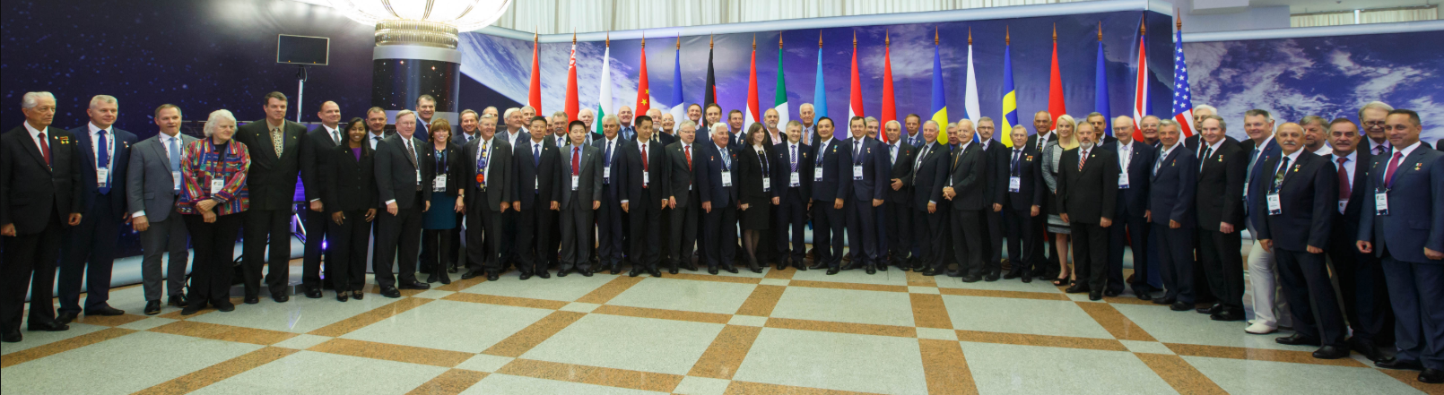
ASE International Executive Committee
Michael Lopez-Alegria (USA) – President
Alexander Alexandrov (Russia)
John-David Bartoe (USA)
André Kuipers (Netherlands)
Sheikh Muszaphar (Malaysia)
Soichi Noguchi (Japan)
Steve Oswald (USA)
Anton Shkaplerov (Russia)
Gerhard Thiele (Germany)
Michel Tognini (France)
Pavel Vinogradov (Russia)
Yang Liwei (China)
ASE2018 | Minsk - Belarus | BELEXPO, 10.09.2018
82 flyers

Slide 6
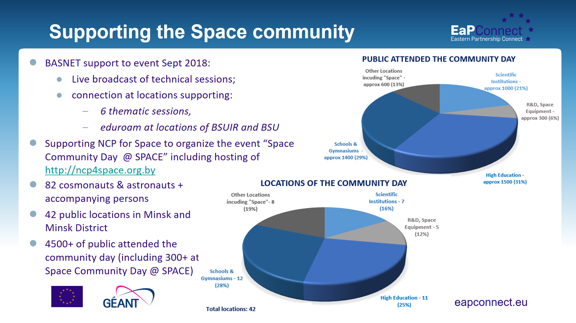


Slide 7







12 September 2018
Space NCP
B e l a r u s

Slide 8
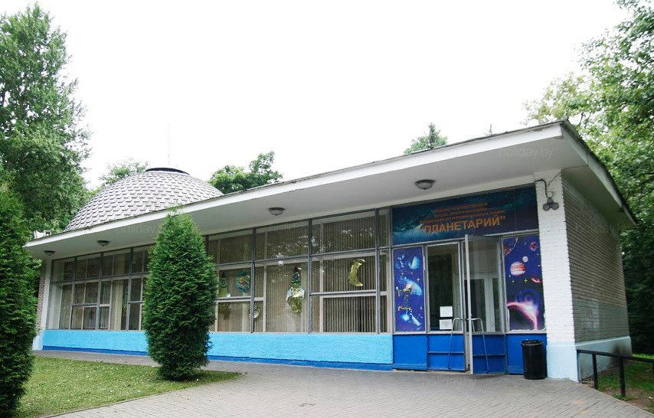
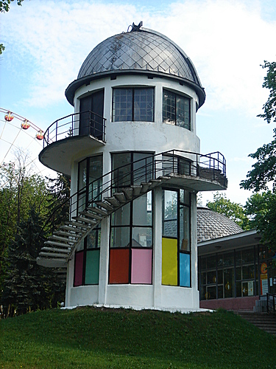
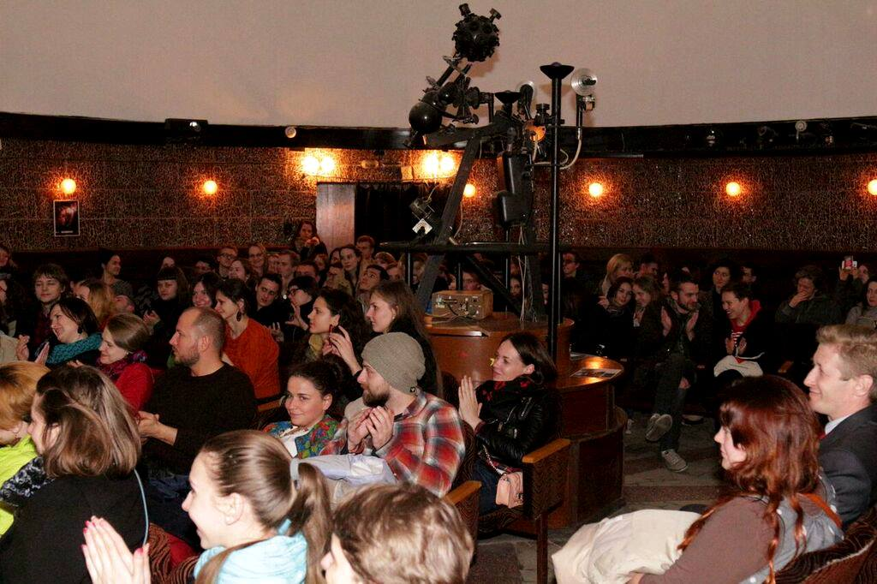

planetarium
LOCATIONS STRUCTURE
Location: heart of Minsk, placed in working (September as well) amusements’ park
Recognizability: well known for children, friendly atmosphere
Сapacity: up to 150 prs (120 comfortable)
Engagement: round a day till late evening
Target auditory: children
Space NCP
B e l a r u s

Slide 9

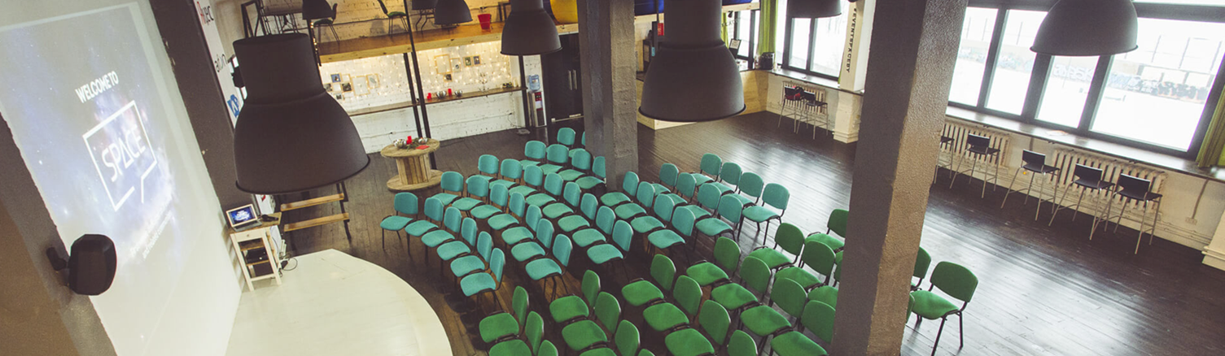
LOCATIONS STRUCTURE
Location: center of Minsk, close to “President Hotel” (official host partner)
Recognizability: well known for BY Communities
Сapacity: up to 350 prsn (300 comfortable)
Engagement: full day till late evening
Target auditory: engineers, developers, students interested in ICT, GIS & space technologies and other “inspired by space”
Space NCP
B e l a r u s

Slide 10
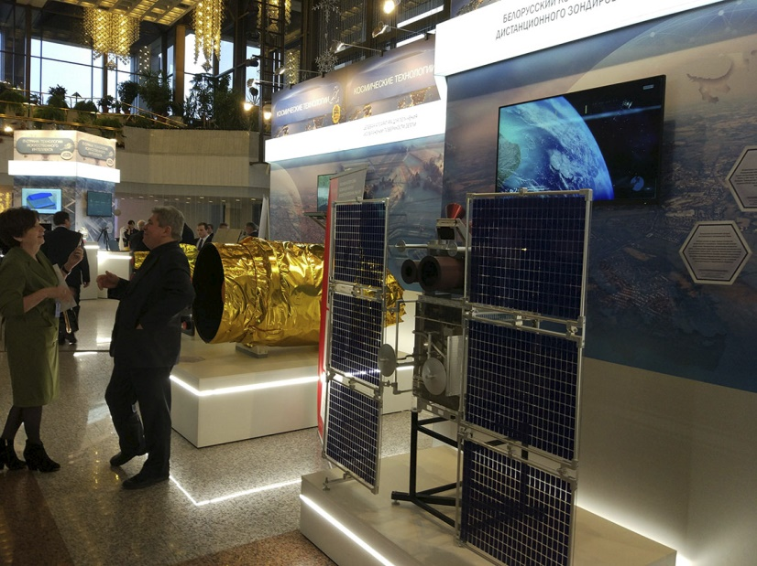
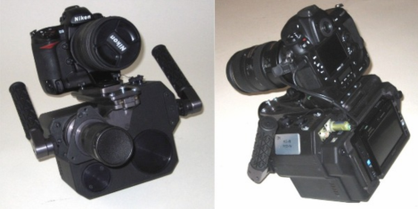
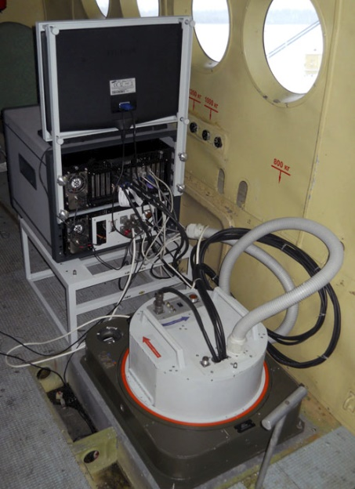
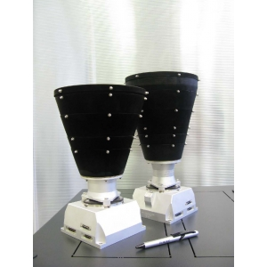
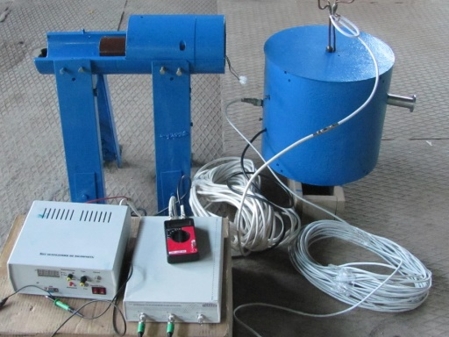
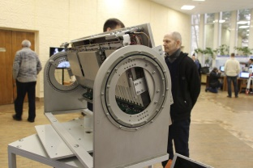



















spacetech @ SPACE
LOCATIONS STRUCTURE

Slide 11



DIGITAL ENGAGEMENT STRATEGY
Space NCP
B e l a r u s

Slide 12
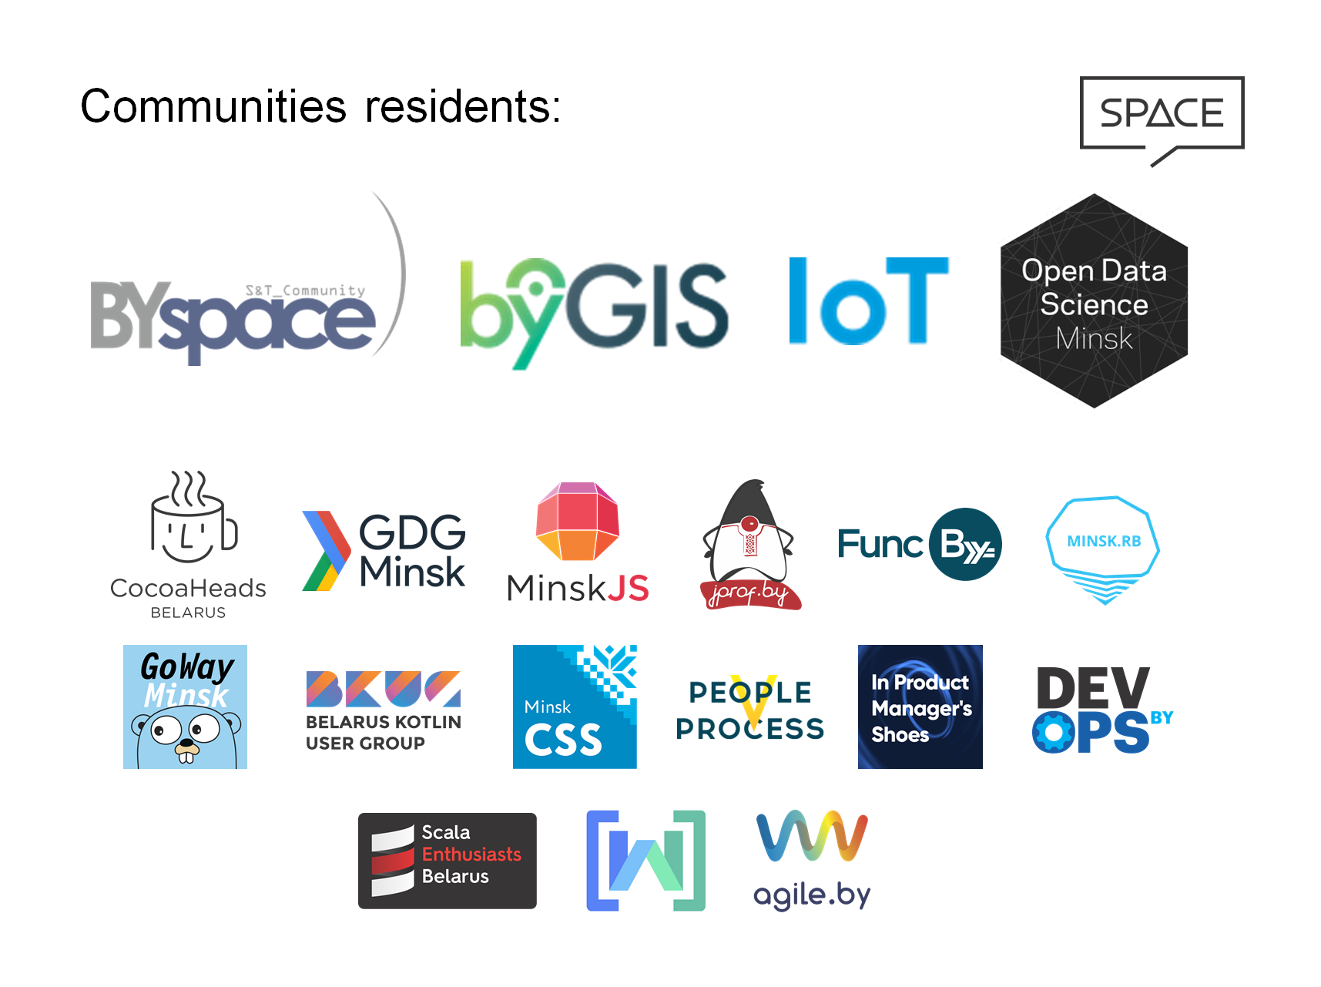



DIGITAL ENGAGEMENT STRATEGY
Social networks
Communities residents:
Space NCP
B e l a r u s

Slide 13
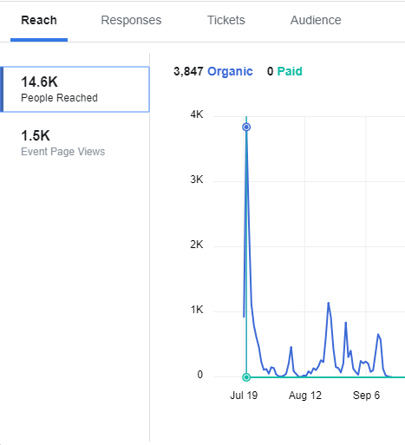
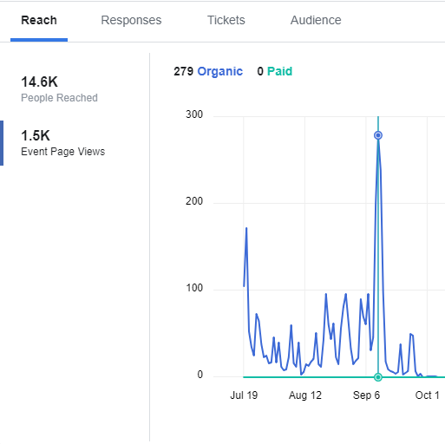
space community day | xxxi ase planetary congress
DIGITAL ENGAGEMENT WRAP UP
SPACE: Отличия, преимущества, публичность, открытость, регистрация, количество, время, формат (панель + spacetech)
Стратегия digital engagement (facebook, telegeram), вовлечение через сообщества . Не потрачено ни рубля!
Экспозиция (перечислить всех + Космопит)
Работа с регистрацией
Спонсоры – нашел на venture day
Wrap up Мониторинг активности : грамотное вовлечение и использование нужных ресурсов
Публикации

Slide 14
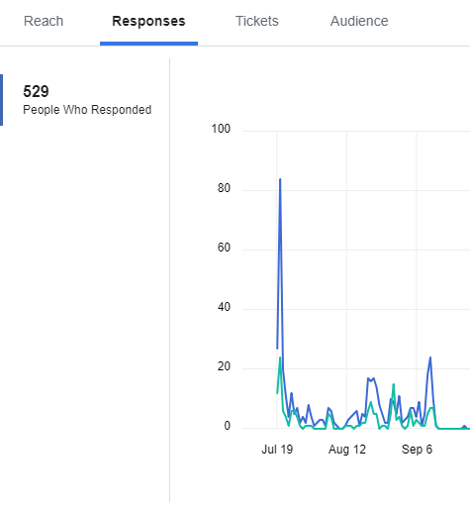
space community day | xxxi ase planetary congress
DIGITAL ENGAGEMENT WRAP UP
Live chat with questions to panelists:
free to use / more that 400 subscr.

Slide 15
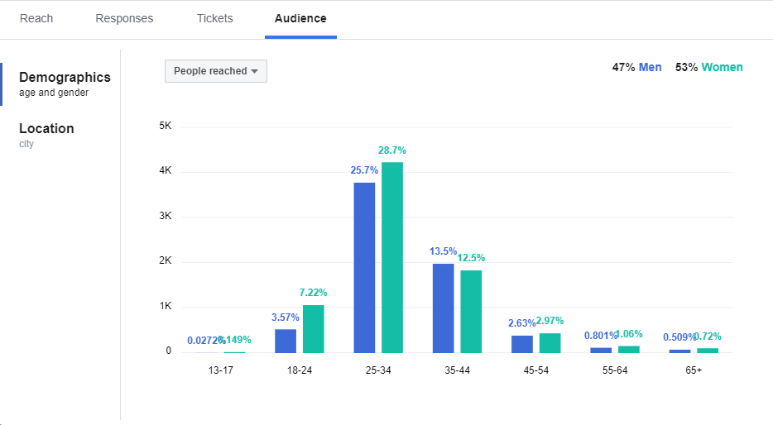
space community day | xxxi ase planetary congress
DIGITAL ENGAGEMENT WRAP UP

Slide 16
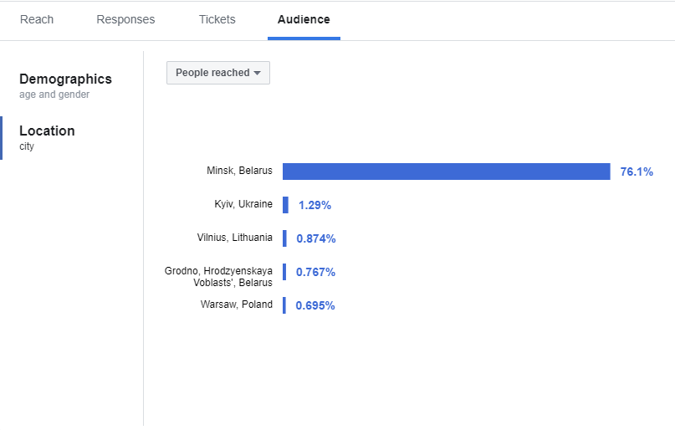
space community day | xxxi ase planetary congress
DIGITAL ENGAGEMENT WRAP UP

Slide 17
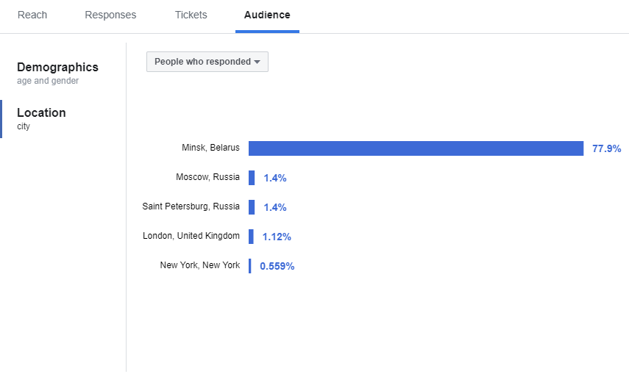
space community day | xxxi ase planetary congress
DIGITAL ENGAGEMENT WRAP UP

Slide 18
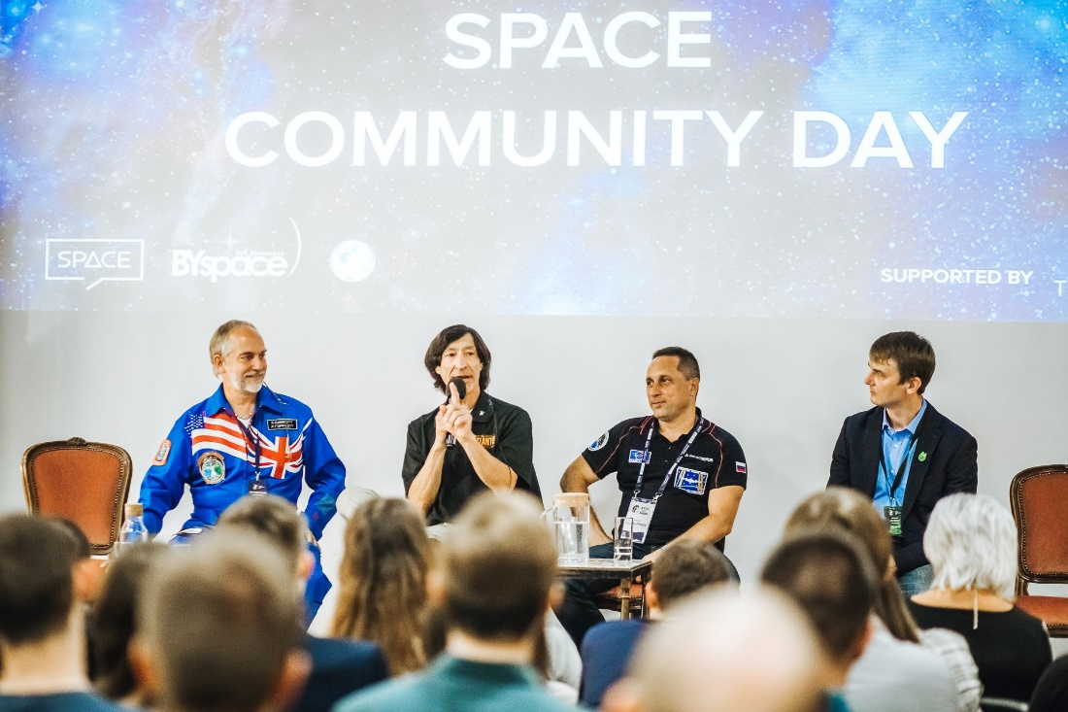
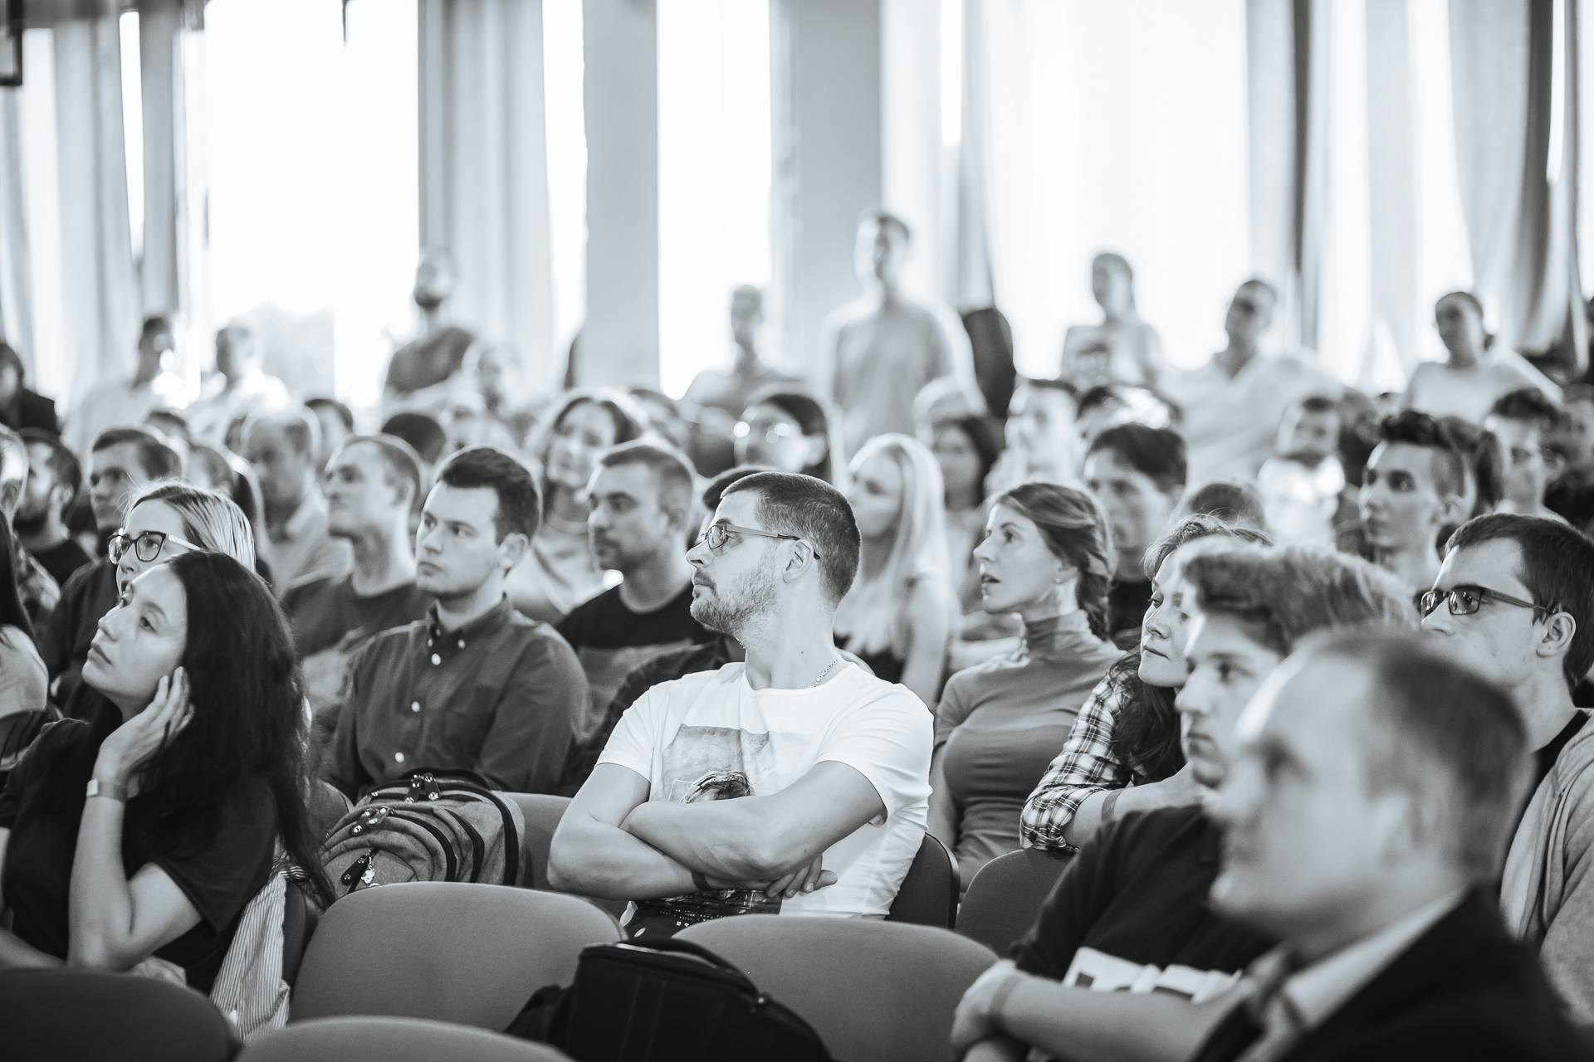
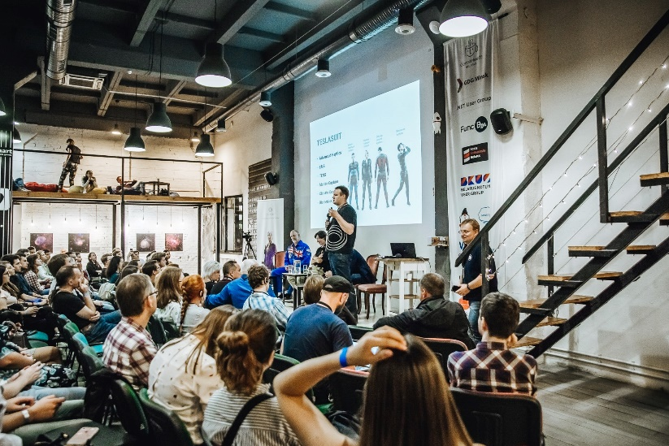
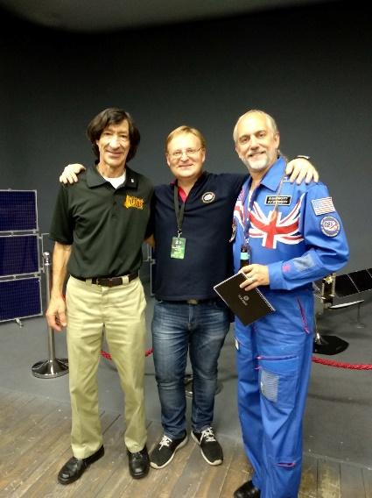
space community day | xxxi ase planetary congress
EVENT’S STATISTICS
Speakers: 3 flyers (Richard Garriott, Mario Ranko, Anton Shkaplerov) + Alexei Belotserkovsky, Sergey Ablameyko, Vitaly Egorov, Dmitry Mikhalchuk
People attended: 275 inside + 100 in the garden with live-screen
Money spent for print advertising : 0 BYN
Money spent for digital engagement : 0 BYN
Event’s duration in fact : 5 hours!
Catering : beer and snacks covered by partner, space food “COSMOPIT” gifted by NAUKA 0+ (Moscow State University)

Slide 19
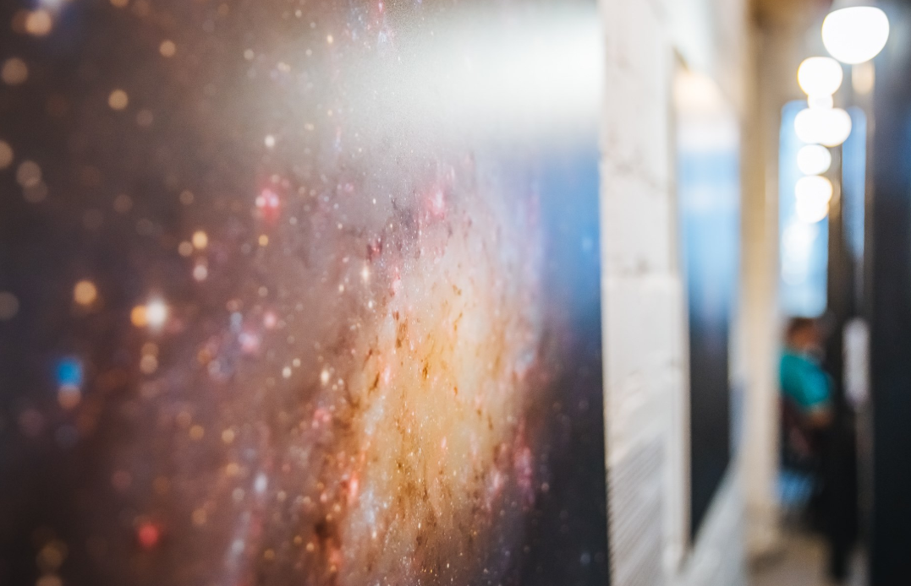
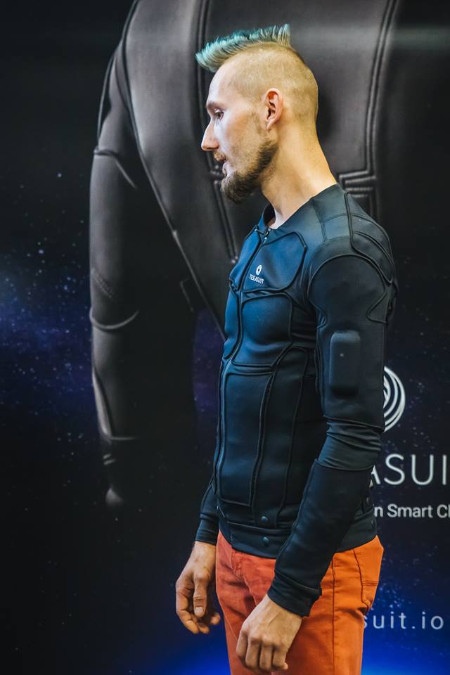
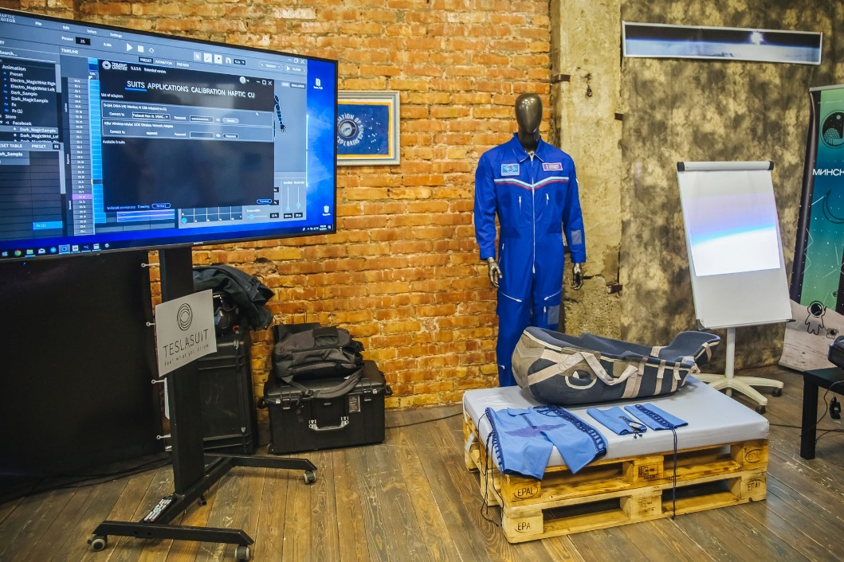
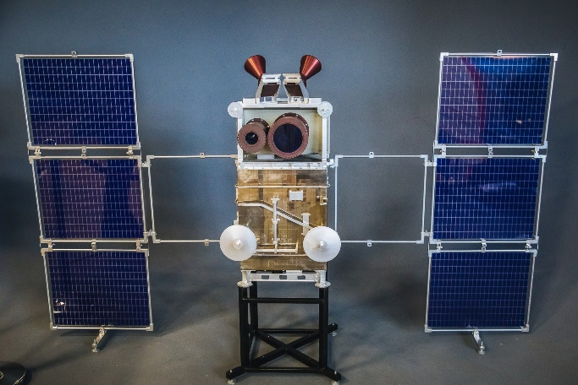
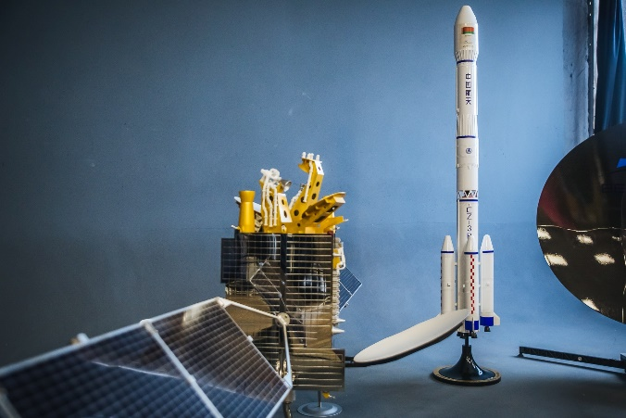
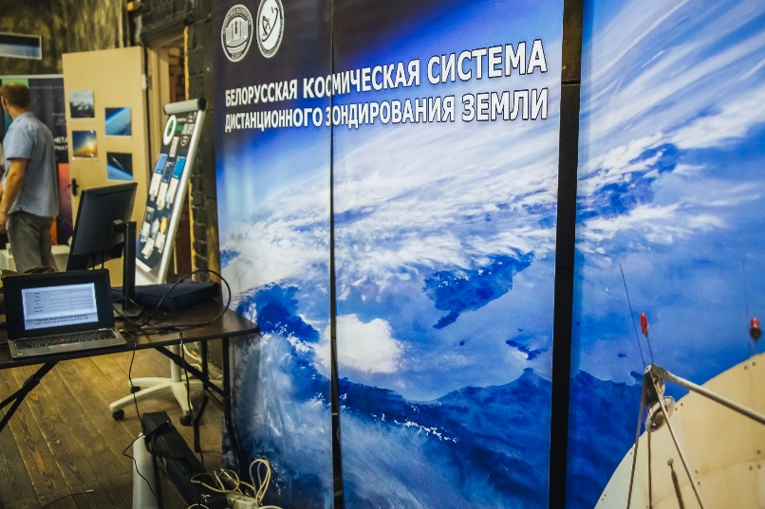
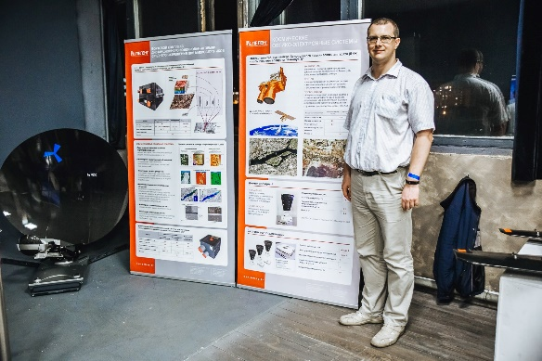
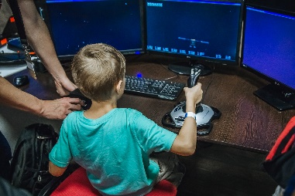
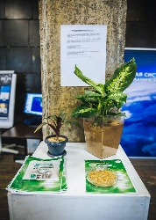
space community day | xxxi ase planetary congress
EVENT’S STATISTICS
SPACETECH:
  TESLASUIT – AR/VR
  OIKOUMENE SPACE – flight simulator, drones, cubesats
  GIS – Remote Sensing System
  NASB – Belarusian Space Sattelite “BKA“, “BIONA”
  Belintersat - broadcasting satellite “Belitersdat-1”, broadcasting equipment
  Aviation Association – Novitsky’s space inner-suit “Ketavr”, personal lodgment, Leonov’s painting
  HACKERSPACE – NASA Space APP Challenge Hackathon
  Minsk Planetarium – stratosphere experiments
  PELENG- space payload
  Astrophotography by Ioda
  NAUKA 0+ - MSU Festivals, COSMOPIT

Slide 20
