Slide 1
CLAW event 2019
Overview
Laetitia Lagneau
SIG-MARCOM
London 2019
Notes:
There are 3 different title slides. You can choose another one by clicking “Home” > “New Slide”
To insert a chapter slide, click ‘Home’ > ‘New Slide’ > section header green / fuchsia / yellow
- You can choose a different color for each chapter
- Or put every chapter in the same color
To insert a slide with a different composition, click ‘Home’ > ‘New Slide’ (title and content, two colums, chart and content, title only, etc.)
To insert a quote, click ‘Home’ > ‘New Slide’ > Quote

Slide 2

Context

Slide 3
Some figures
60+
2
21
100

Slide 4
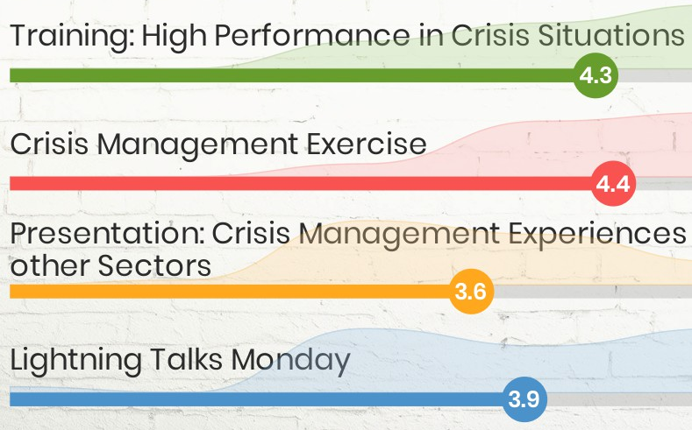

The event : Day 1
Charlie van Genuchten

Slide 5
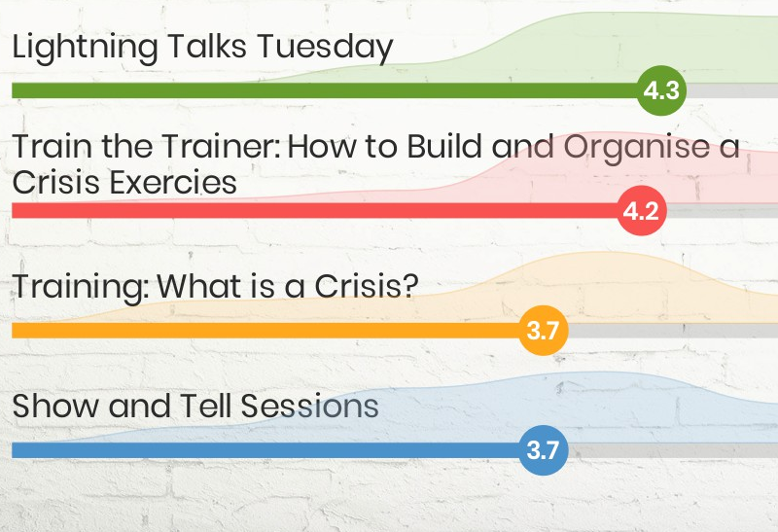
The event : Day 2
Charlie van Genuchten

Slide 6
What did I bring home ?
Roles and responsibilities
Training
Testing

Slide 7
Thank you
  for your attention
Notes:
There a different ‘thank you’ slides. To choose another one, click ‘Home’ > ‘New slide’

