Slide 1
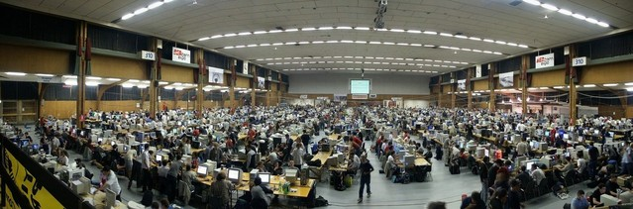
Webinars to reach and engage any type of audience
How do I deliver a great webinar?

Slide 2

Why is a webinar?
Webinars as a tool - What are they used for?
Distinguishing features (vs. other communication tools)
Name but a few webinar platforms …
How to choose the right one?
And the Big Question is …
How do I deliver a great webinar online to reach and engage “live” audience?
Notes:
Webinars is a tool for:
Group Meeting/Briefings/Broadcasts
Product/service launch
Training/Teaching/tutorial
What is special about webinars?
Adaptability: To any presentation format: interview, panel, group meeting, broadcast, training/tutorial. They allow to generate real time and delayed feedback
Versatility – they feature anything from live videos to pre-recorded videos, audios, slide deck, chat, images, animation – any media asset
Interactivity tools
Multiple webinar tools/software – what to look out for?
Security/privacy
How many attendees can a platform support?
What are the tools to ensure audience engagement and participation?
Is it possible to do a screen share?
Is it possible to record a session? How recordings can be accessed after a session?
Analytics
Technical support

Slide 3
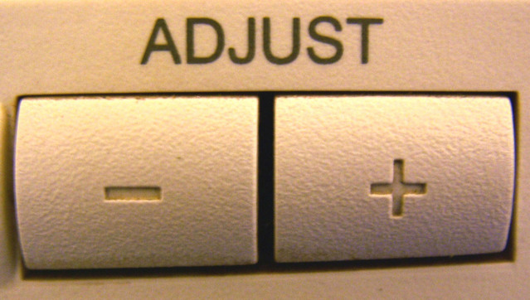

Delivering a great webinar: what is in the toolbox
Apply the same consideration as you would for any other type of communication:
Understanding challenges of working in a virtual space with a live audience.
Know you audience
Deliver relevant content
Plan and practice
Promote
Developing a set of specific skills and techniques of using the online platform
Notes:
To reach and engage – you apply the same consideration as you would for any other type of communication:
Focus on audience: what do you know about your audience? What do you want them to do? What do you want them to achieve? How will they experience … What it means to them?
Deliver relevant content
Plan and practice
Promote
The difference is that to deliver an effective/impactful webinar one needs to develop
1) Awareness and understanding of working in a virtual space with a live audience: implication and challenges.
Technology is the enabler and the barrier
Lack of physical presence of the audience: are they listening? Are they still engaged? Are they in front of the computer/laptop/device? How are they reacting? Are they happy or bored?
2) Set of skills and techniques of using the online platform:
Functionality and tools of a webinar platform: what they are and how they work
Monitoring the audience engagement
Using interactivity tools of a webinar platform to maintain the audience engagement and participation.

Slide 4
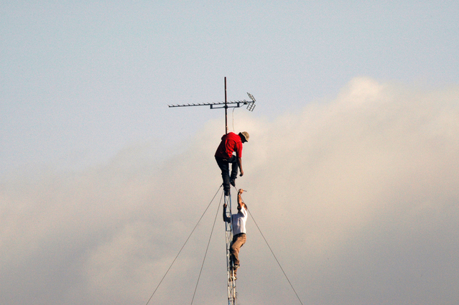

Delivering GREAT webinars – Next Steps:
Practice
Practice
Practice
Resources to help you further
Live practice sessions with GLAD
Peer-to-Peer support and training: experts among us
Get in touch: glad@geant.org

