Slide 1
Update on cloud adoption
Marketing & Comms aspects
Salomé Branco salome@fccn.pt
SIG-Marcomms spring meeting - 4-6 February 2019

Slide 2
Agenda
How to engage the Community?
The Problems ….……..

Slide 3
How to engage the community?
Create use cases: Fund Pilot Institutions
  Parameterization on Géant CAMS platform giving 5 pilot entities access to the Service Catalog and to the Contractual Repositories;

Slide 4
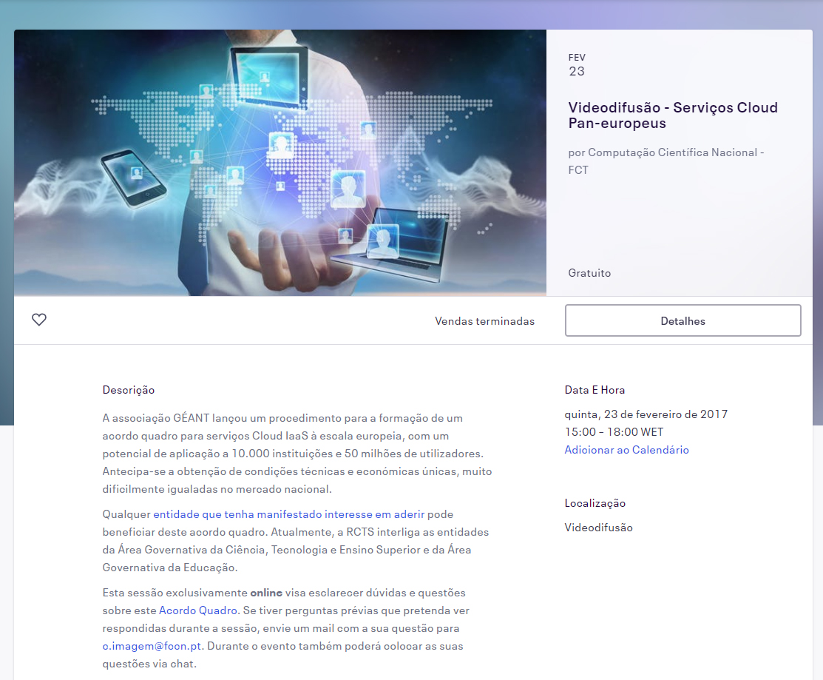
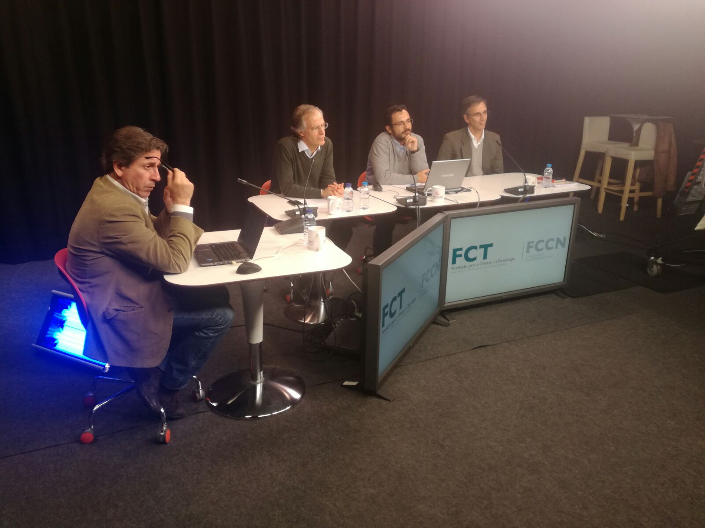
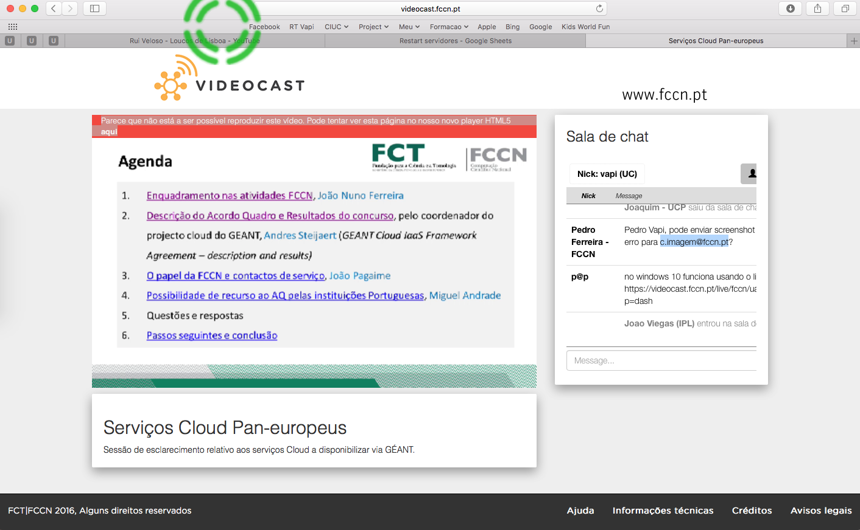

How to engage the community?
Webinars with different contents:
  GEANT cloud team: presentation of the Framework Agreement;
  Microsoft team: presentation of the Microsoft offer in the Framework Agreement;
  OIP team: presentation of the OIP offer in the Framework Agreement

Slide 5
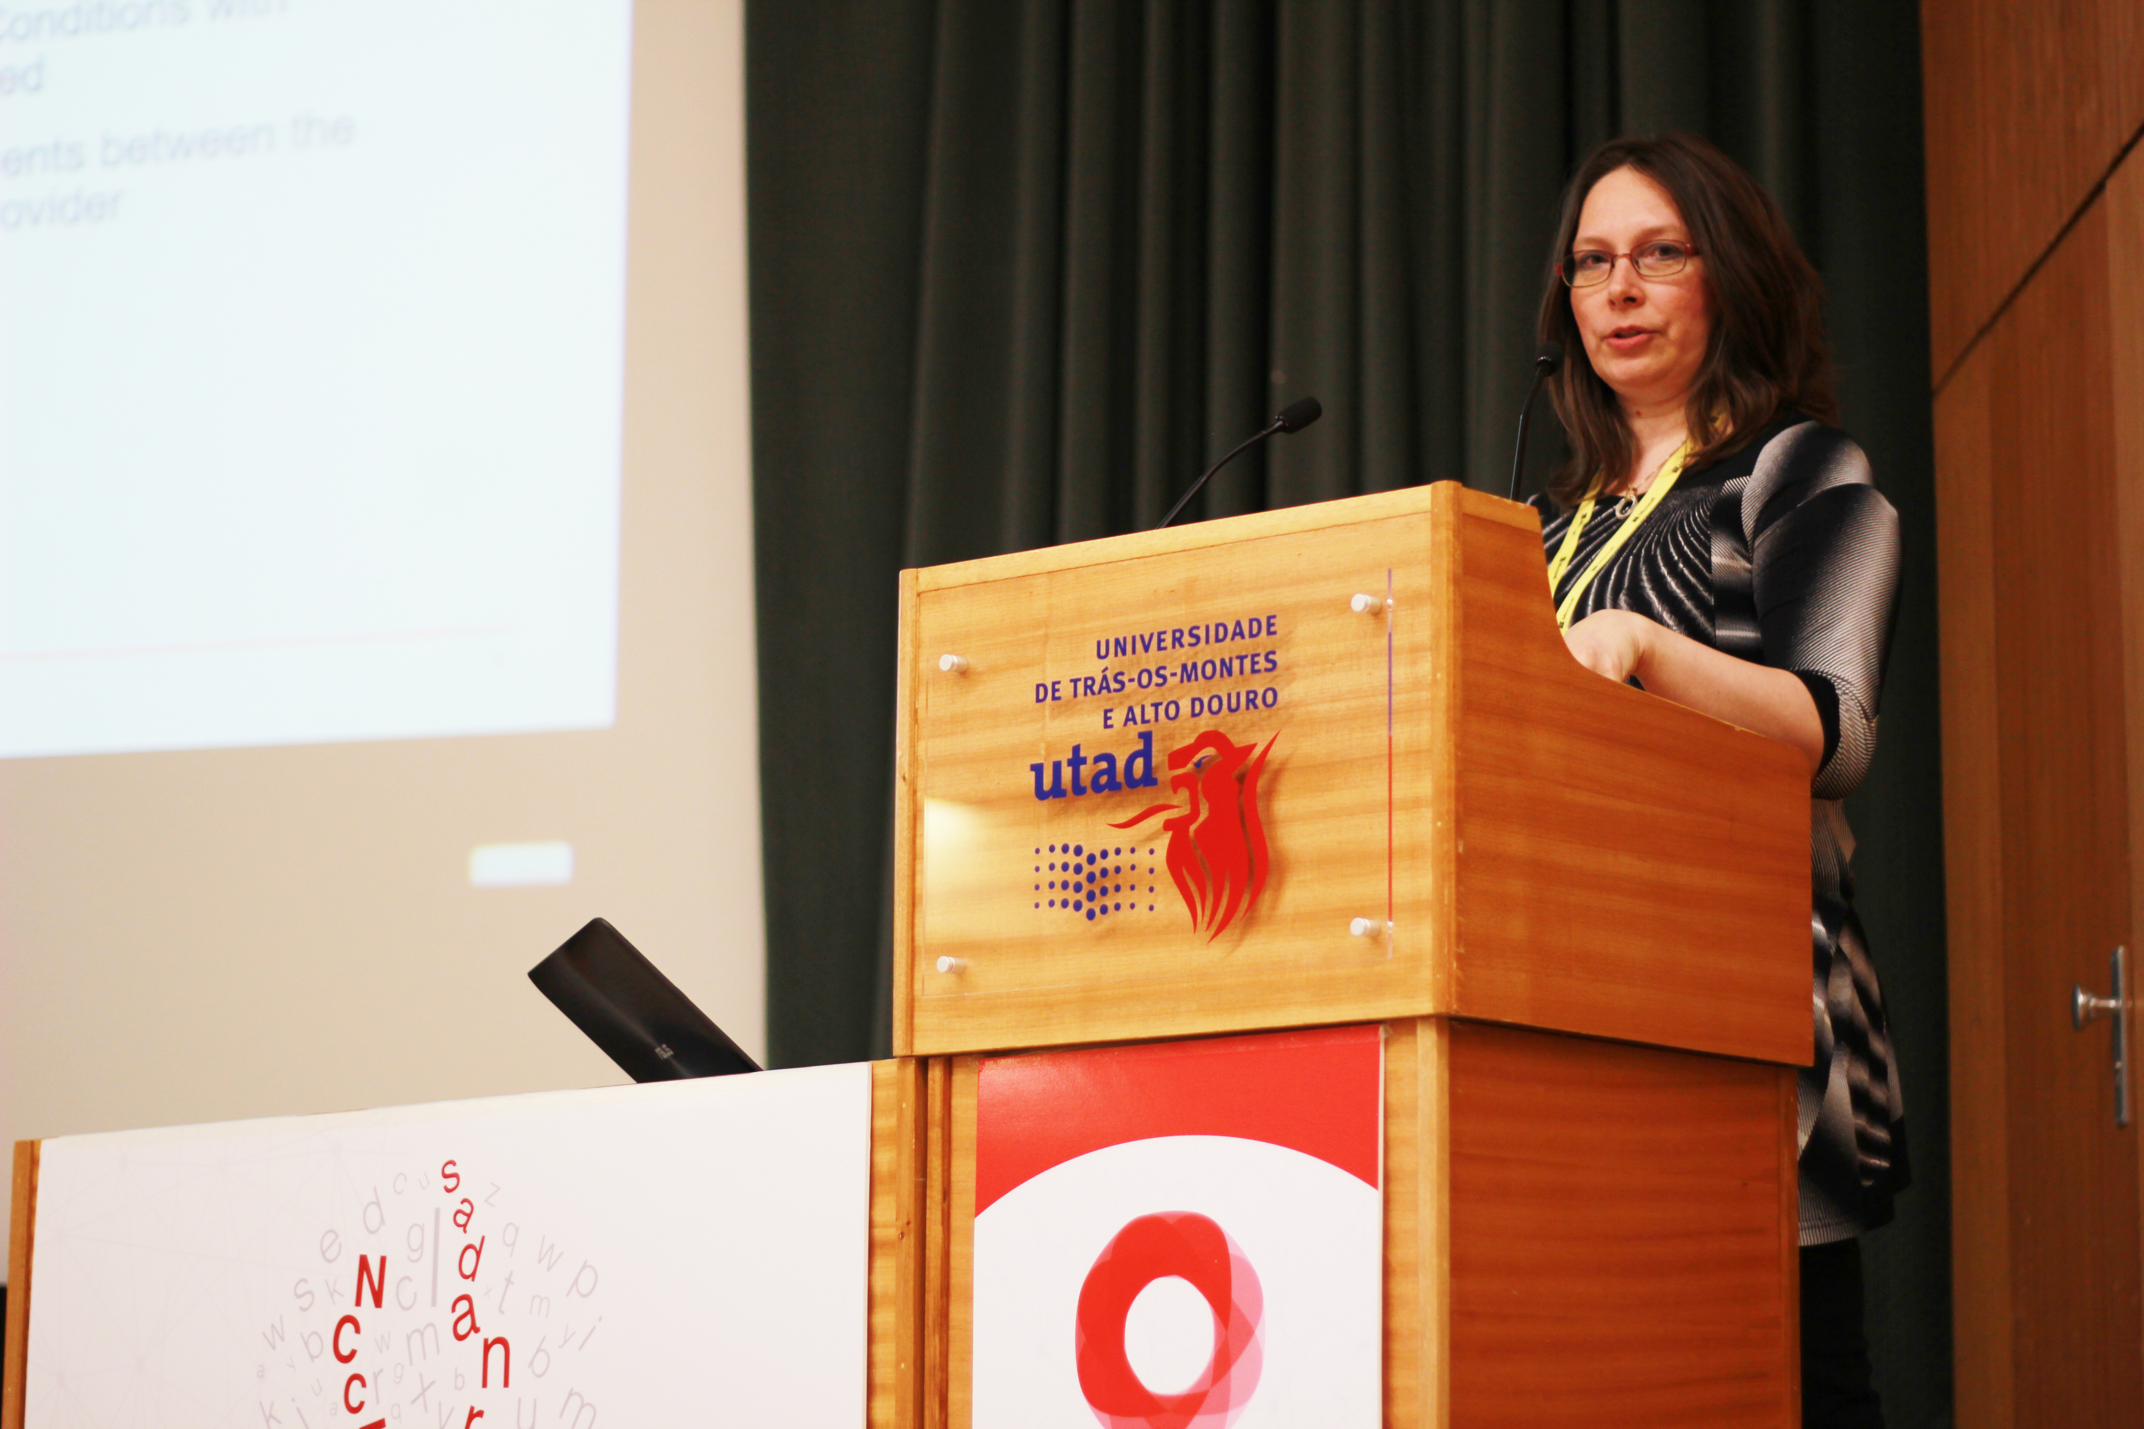

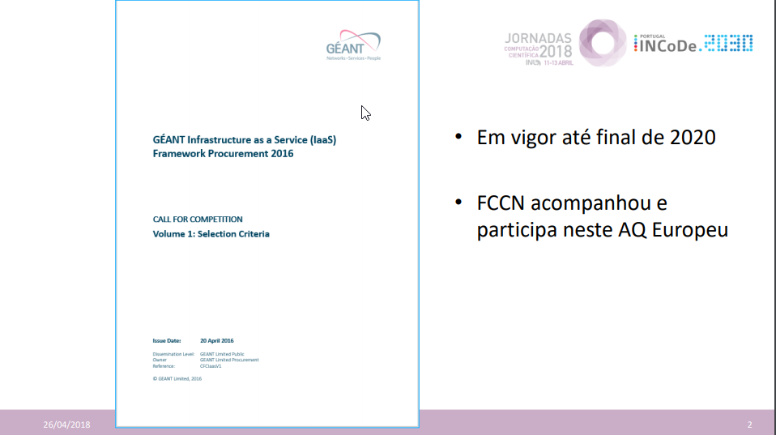

How to engage the community?
Events :
  2017 FCCN´s annual event: Presentation from Maria Ristkok at a plenary session with 300 attendees;
  Science 2017: Presentation and leaflets distributed on FCCN´s stand, Portuguese event with more than 1.500 participants;
  2018 FCCN´s annual event: Parallel session, with use cases (INCD, UTAD, Uévora), legal issues bringing together Portuguese law and AQ GEANT;

Slide 6
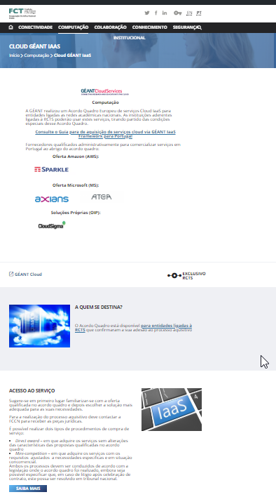
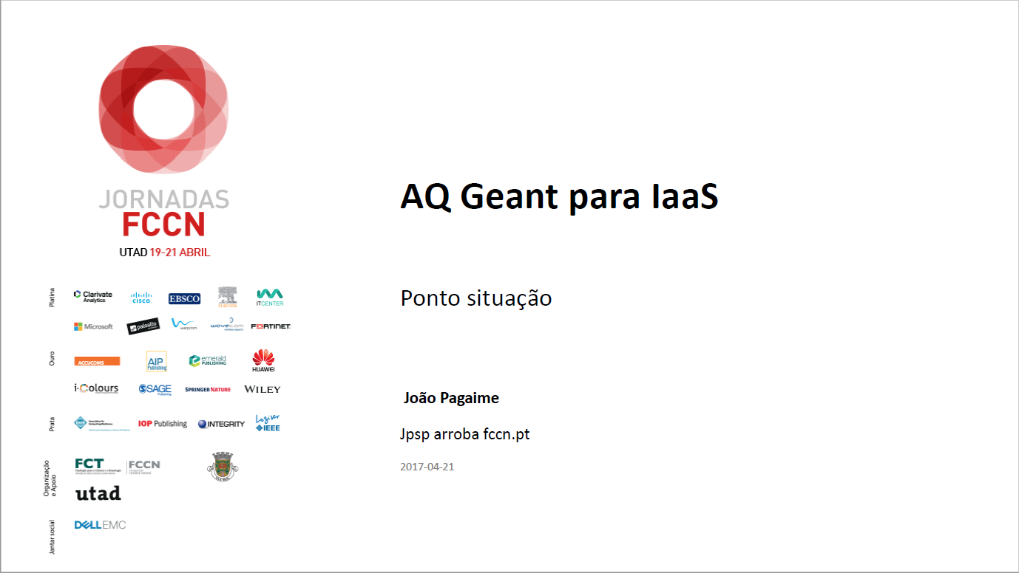
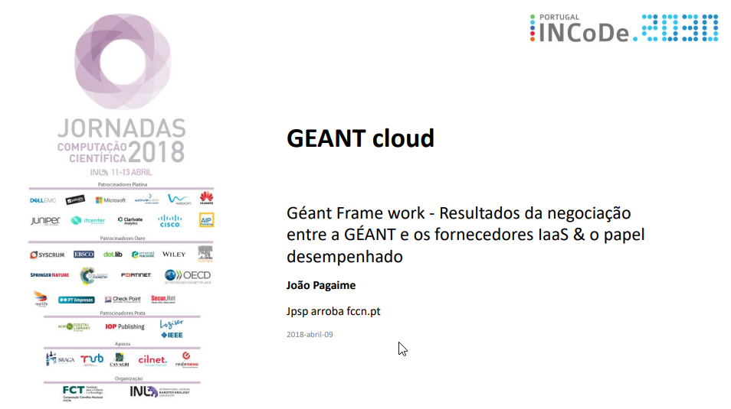
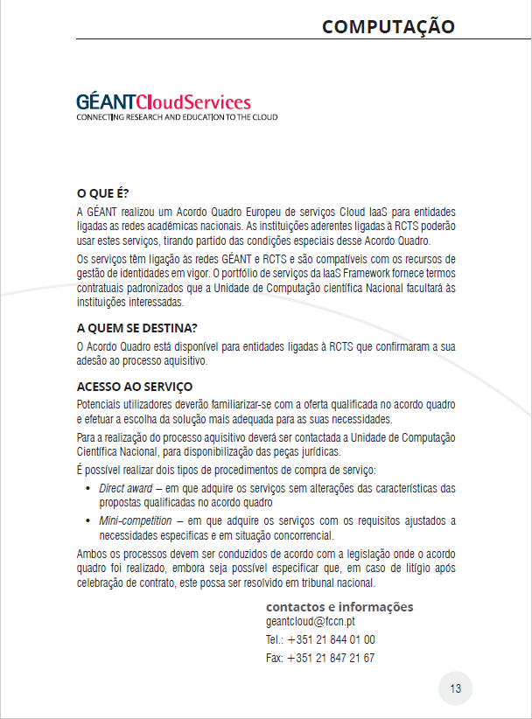
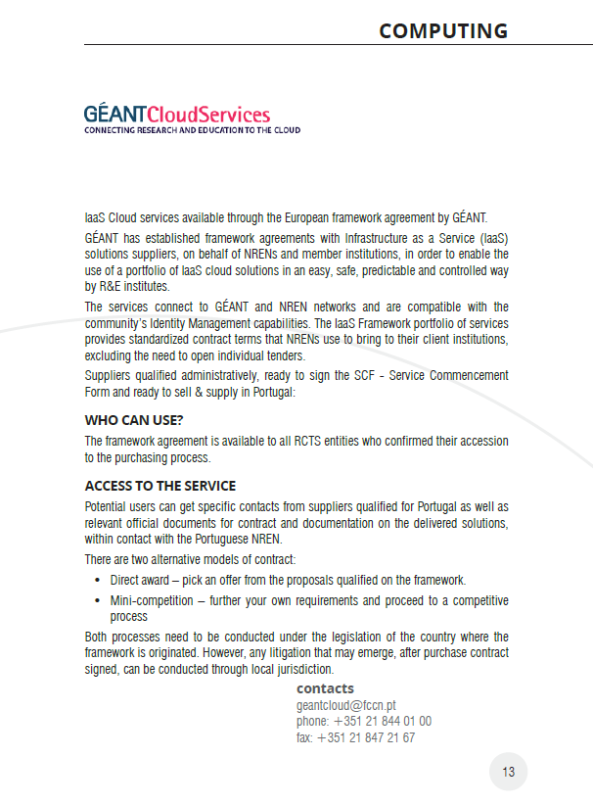
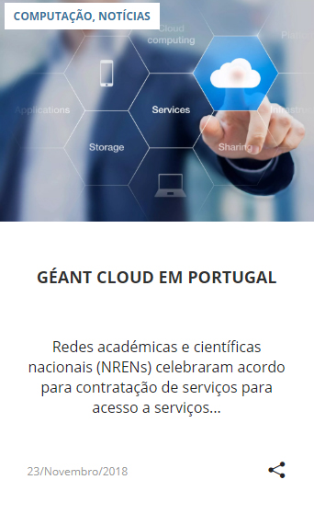
How to engage the community?
Adding Géant cloud in the portfolio:
  Website;
  Booklet;
  Presentations.

Slide 7
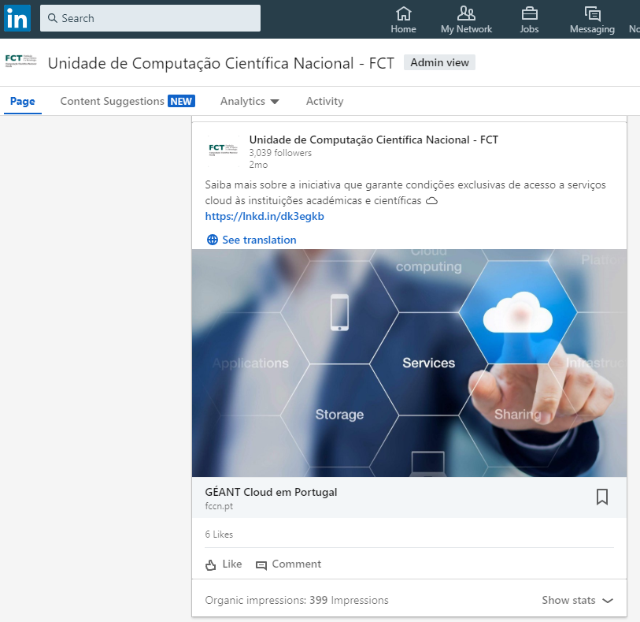
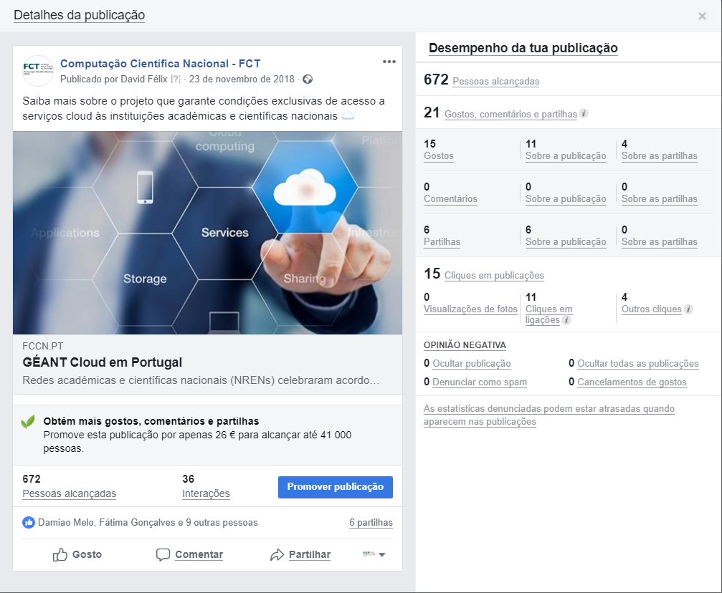
How to engage the community?
Digital Marketing:
  Facebook
  Linkedin
  eNewsletter
  Email

Slide 8
Problems
Legal/administrative :
  Contract drawn up in english language;
  National framework agreements;
  Lack of knowledge of the Procurement directive- 2014-24-EU;
  Internal procedures regarding public procurement;
  Some suppliers are having problems paying the fee to the NREN;
  Lack of communication between suppliers/entities and NREN;
Technical
  Some IES did not have access to the Service Catalog and Contractual Repositories (the problem was overcome with the integration of these IES in EduGain);

Slide 9

THANKS

