Slide 1


GN4-3/GN4-3N Project
Karl Meyer, GÉANT
January 2019

Slide 2

Third phase of GEANT2020 FPA
GN4-1
May 2015 – April 2016
GN4-2
May 2016 – Dec 2018
GN4-3
Jan 2019 – Dec 2022
GN4-3N
Jan 2019 – Dec 2022

Slide 3



GN4-3 in numbers
39 Partners, 42 Countries
157 FTEs (average per year over project duration)
500+ registered contributors
GN4-3/GN4-3N total EC funding: €128M
9 Activities, 34 Tasks
124 Deliverables
32 Milestones

Slide 4
GN4-3
Budget 77.5MEUR
4 years duration
GN4-3 – 77.5MEUR, 4 year duration
Maintain the operational excellence, while still achieving cost economies
10 activities ➔ 9 work packages
No separate ops and dev WPs
The whole lifecycle of a service in a single devOps WP
New security WP
Work is grouped into 3 Support, 5 Service DevOps and 1 Operations WP
PLM performs regular reviews of the services

Slide 5
From GN4-2 to GN4-3
WP1
WP8
WP2
WP3
WP4
WP5
WP6
WP7
WP9
NA1
JRA2
NA2
NA3
SA1
SA2
SA3
JRA1
JRA3
JRA4

Slide 6
GN4-3 Structure
Nine Support, Service DevOps, and Operations Work Packages
GN4-3 Service DevOps Work Packages
GN4-3 Operations Work Package
WP4 Online Services Development and Delivery
WP9 Operations Support
WP5 Trust & Identity
WP6 Network Technologies and Services
WP7 Network Core Infrastructure and Services
WP8 Security
GN4-3 Support Work Packages
WP1 Project Management
WP2 Marketing, Communications, Events
WP3 User/ Stakeholder Engagement
6

Slide 7
Work Package 2: Marketing, Communications and Events
Objective
WP2 provides a professional, integrated marketing communications and events service to the project, for outreach and promotion at national, European and international level. It also supports other Activities and project partners in their own communications with the project’s stakeholders and partners.
Tasks
Task 0: Work Package Leadership (Work Package Leader: Cathrin Stöver, GÉANT)
Task 1: Communications and Design (Task Leader: Paul Maurice, GÉANT)
Task 2: Services Marketing (Task Leader: Karl Meyer, GÉANT)
Task 3: Events (Task Leader: Steffie Bosman, GÉANT)
Work package | WP2 |  |  |  |  |  | Start date |  | 01-Jan-2019
Work package title | Communications
Participant number | 1 | 8 | 10 | 11 | 13 | 17 | 19 | 20 | 21 | 25 | 26 | 27 | 30
Shortname of participant | GÉANT Association | CARNet | CyNet | DFN | GARR | HITSA | IUCC | Jisc | KIFÜ | NORDUnet | PSNC | RASH | RENATER | TOTAL
Person/months per participant | 250.6 | 7.2 | 7.2 | 1.2 | 1.2 | 10.8 | 4.8 | 1.2 | 4.8 | 4.0 | 94.2 | 4.8 | 6.0 | 398.0
Key Performance Indicators
TNC attendance to increase by 3% year on year for the duration of GN4-3.
Grow digital and printed copies distribution by 5% year on year for duration of GN4-3.
Increase total visits to GÉANT community portal (connect.geant.org) by 10% year on year for duration of GN4-3.
Every CONNECT issue to provide thought leadership and promote the network’s features, technologies and importance to scientific research.
Increased collaboration with e-infrastructures through joint events (DI4R) and booths.
Increased provision of design elements to the stakeholder community.
50% of social media posts to generate >=2.0% engagement rate year-on-year.
Description of risk (indicate level of likelihood low-medium-high) | Proposed risk-mitigation measures
Lack of NRENs willing to host and/or contribute to TNC in the future (likelihood: MEDIUM; impact: MEDIUM) | Securing NREN locations up to 2023
NRENs not using Marketing output (Likelihood: LOW; Impact: MEDIUM) | Look at proposed KPIs and check risks of uptake

Slide 8
GN4-3N
Budget 50.5MEUR
4 years duration
GN4-3N – 50.5MEUR, 4 year duration
100% funding of IRUs and associated equipment
Improve the geographical coverage of the GÉANT backbone network using fibre optic technology, IRUs, CBF or spectrum sharing.
Ensure the upgradability of the complete optical infrastructure to Terabit speeds over the coming years at reasonable cost.
Limit the added operational and maintenance cost to a sustainable level for the cost-sharing mechanism between partners.
Be implemented in such a way that the continuity of reliable, secure, high-speed Internet access and all other GÉANT connectivity services are preserved throughout the project.

Slide 9
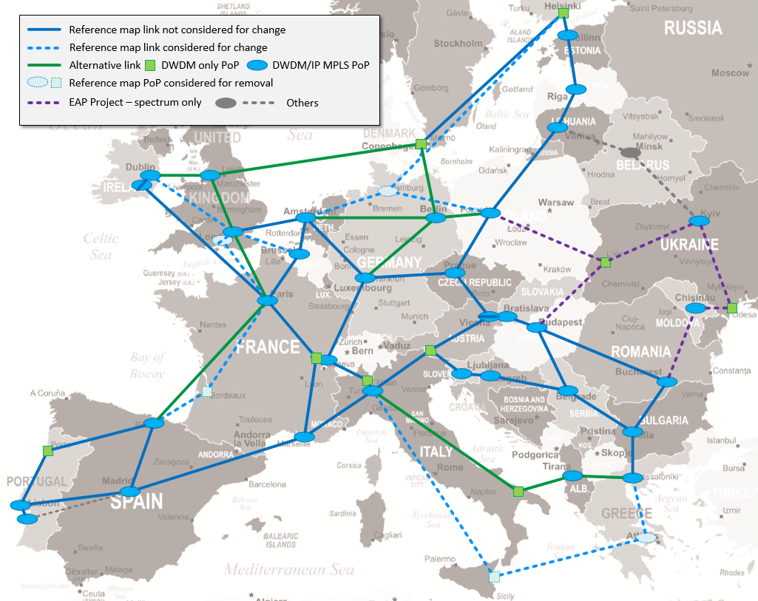
GN4-3N: Current View (Including some of EAP)
Other locations not on footprint
Location | Example Lease | Spectrum/Fibre
Israel | 2x 100G | YES
Cyprus | 2x x10G | YES
Malta | 1x x10G | YES
Turkey | 2x 100G | YES
Luxemburg | 2x 100G | YES
Montenegro | 2x x10G | NO
Macedonia | 2x x10G | NO
INDICATIVE
9
Notes:
As used at Capacity Europe
Different

Slide 10
Thank you
Any questions?

