Slide 1


GN4-3 WP4 / Task 4:
Community Programme
Gyöngyi Horváth, GÉANT
SIG-Marcomms Meeting
4 February 2019

Slide 2

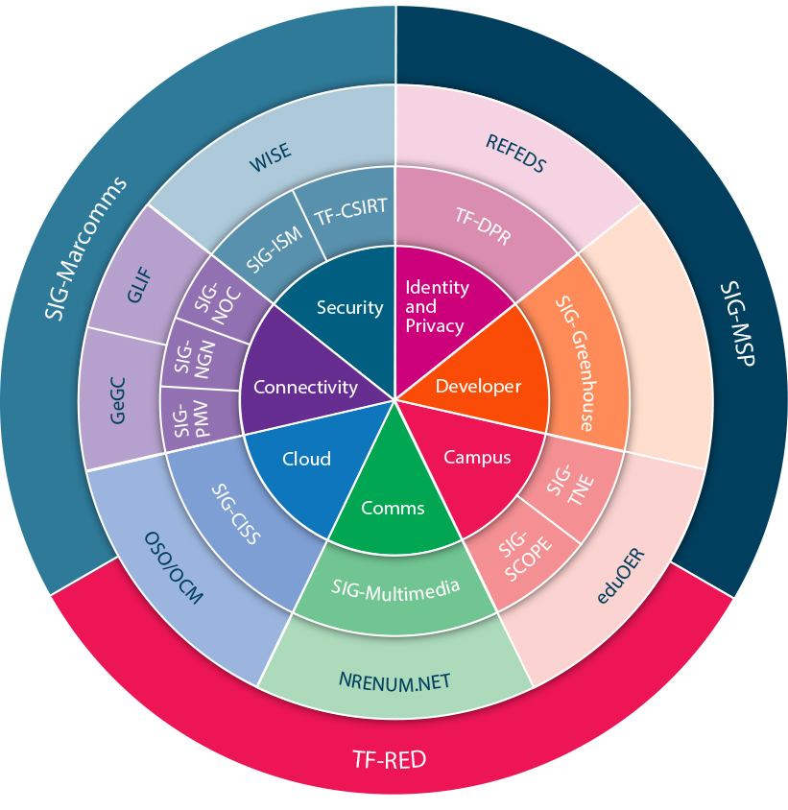
Community Programme Portfolio
(Including activities outside of the GÉANT Project)
  REFEDS (the Research and Education FEDerations group)
  GLIF (Global Lambda Integrated Facility)
  NRENum.net (end-user ENUM service)
  WISE (global trust community)
  Global eduroam Governance Committee
  Network Performing Arts Production Workshop (NPAPW)
  OCM developments
  eduOER (Open Educational Resource Hub and Portal)
  GÉANT STUN/TURN pilot service (WebRTC)
Notes:
Task 4 supports the GÉANT Community Programme, that is overseen by the GÉANT Community Committee (GCC). The SIGs and the TFs act as a platform to discuss and promote project work to a wider audience beyond project participants and to provide a forum to discuss new and innovative ideas that may become future work items.

Slide 3
Connectivity & Cloud
Connectivity
SIG-PMV: Performance Monitoring and Verification - Identifying and establishing best practices for wired/wireless networks
SIG-NGN: Next Generation Networking - knowledge exchange and collaboration on developments in networking technologies.
SIG-NOC: Network Operations​ Centres​ - Sharing and creating common best practices for the organisation and management of Network Operations Centres
Cloud
S​IG-CISS: Cloudy Interoperable Software Stacks​ - Sharing and collaborating on cloud infrastructure software stacks, platforms and research workflows

Slide 4
Security & Identity and privacy
Security
SIG-ISM: Information Security Management - Developing security expertise and excellence within the NREN community​
TF-CSIRT: Computer Security Incident Response Teams - Coordinating training, services​​​ and knowledge-exchange for security teams worldwide
Identity and privacy
TF-DPR: Data Protection Regulation​​ - Working with NRENs to meet data protection regulation requirements

Slide 5
Campus & Communication & Management
Campus
SIG-​TNE: Transnational Education​​ - Addressing technological challenges in the delivery of international education
TF-RED: Research Engagement Development​ - Developing methods for NRENs to engage with research communities
Communication
SIG-Multimedia: Multimedia Applications​​ - Facilitating technology and service interoperability and sharing knowledge about multimedia solutions
SIG-Marcomms: Marketing Communications​ - Sharing and collaborating on marketing, communications and public relations
Management
SIG-MSP: Management of Serv​​​ice Portfolios​ - Supporting management across the product life cycle and sharing service ideas

Slide 6
Education
National Research and Educational Networks
New activity: foster collaboration of NRENs in the area of educational innovations and services
  Mapping of activities & interest
  Identifying cross sector interest areas (e.g. cloud procurement)
  Building collaboration around common interest

Slide 7

Objectives for Task Forces and Special Interest Groups
“Task Forces (TFs) and Special Interest Groups (SIGs) are groups of (grassroot) volunteers and world experts from NRENs, user organisations, research institutions, commercial and industrial sectors. TFs and SIGs provide an effective framework for forums to share information and best practices and to discuss possible innovations and further developments of services.”
✓
To facilitate exchange of information and best practice between experts working in the GÉANT NREN community and (much) more widely in the sector.
To design and progress collaborative work items between individuals from multiple organisations with the objective of improving services, expertise and understanding in the NREN community.
✓

Slide 8
Resources
Manpower and partners
AL
Annabel Grant
GÉANT
TL
Magda Haver
GÉANT
SIG-MSP, SIG-NOC
One of workshop
(3.6 MM)
Gyöngyi Horváth
GÉANT
SIG-TNE, Education
GCC
(6 MM)
Brook Schofield
GÉANT
SIG-NGN, SIG-PMV
(2.4 MM)
Nicole Harris
GÉANT
TF-CSIRT, Mobility day
(2 MM)
Laura Durnford
GÉANT
SIG-Marcomms
(1.2 MM)
Sigita Jurkynaite
GÉANT
TF-CSIRT, SIG-ISM, TF-DPR
(3.6 MM)
Casper Dreef
GÉANT
SIG-CISS, SIG-Multimedia, GCC, One of workshop
(3.6 MM)
Chris Atherton
GÉANT
TF-RED
(0.6 MM)
Aleksandra Krstevska
MARnet
TF-DPR
(1.2 MM)
Dragana Kupres
CARnet
SIG-TNE, Education, One off workshop
(3.6 MM)
Juraj Bilic
CARnet
Education, TF-RED
(2.4 MM)
Ana Afonso
FCT | FCCN
One off workshop
(1.2 MM)

Slide 9
Key objectives of Task 4: Community Programme
Facilitate exchange of information and best practice between experts working in the GÉANT NREN community and more widely in the sector.
Design and progress collaborative work items between individuals from multiple organisations with the objective of improving services, expertise and understanding in the NREN community.
Provide a platform to promote work from the GN4-3 project, the GÉANT Community, the global NREN community and from industry partners.
Support the GCC in selecting, monitoring, measuring and closing groups within the GÉANT Community Programme against defined criteria to ensure that working groups are running effectively.

Slide 10
Adds on in GN4-3
Actively seek new collaborations and activities with partners, e.g. large research infrastructures on the ESFRI roadmap, and other e-infrastructures and associated projects.
Strengthen the GÉANT community programme (Task Forces, Special Interest Groups, workshops), including more openness to industry, public services and all e-infrastructures.

Slide 11
Marcoms synergy
Blog posts after each SIG / TF meeting
Quarterly news mail to the GA to summarize the major outcomes of the community programme
Social media visibility of activities and channels per TF / SIG
PeaR newsletter
Project newsletter

Slide 12
IMPACT
Report on Impact of Community Programme activities to include NREN case studies.
Outcomes and results
Outreach quality and quantity
Impact = change in behaviour
Notes:
Deliverables – whilst there are no deliverables we need to undertake an annual report on the impact of the community programme – perhaps as a milestone in order to ensure the deliverable in M48 includes everything.
Support NRENs in being better NRENs and being able to demonstrate that through these groups they have made some positive changes.

Slide 13

Thank you
Any questions?

