Slide 1





5 February 2019
Iza Advadze, GRENA

Slide 2
About GRENA
GRENA was founded in 1999 for the development of Information Technologies (IT) in education and research field. The founders of association GRENA are five major universities, Georgian National Academy of Science and Open Society-Georgia Foundation.
Main fields of GRENA’s activities are:
Providing IT services to users and implementation of new, innovative services
IT education
Preparation and Implementation of research and technology projects
Providing software products and cyber security solutions to customers
Promoting and supporting IT development in Georgia

Slide 3


Marketing Activities – New LOGO

Slide 4
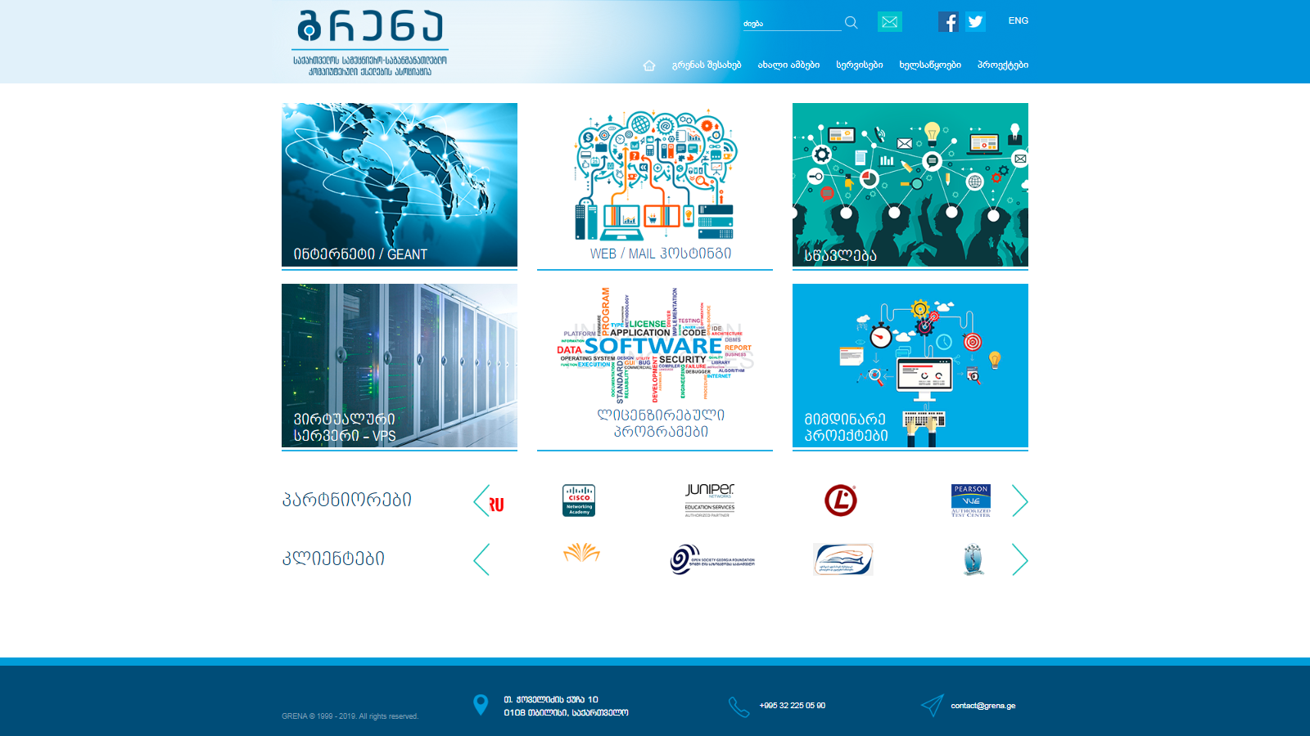
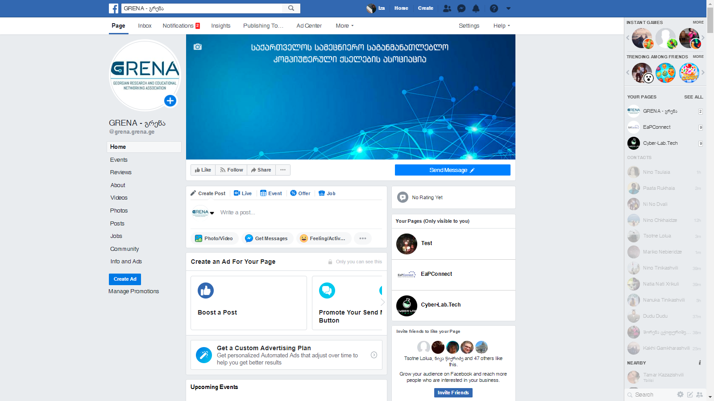
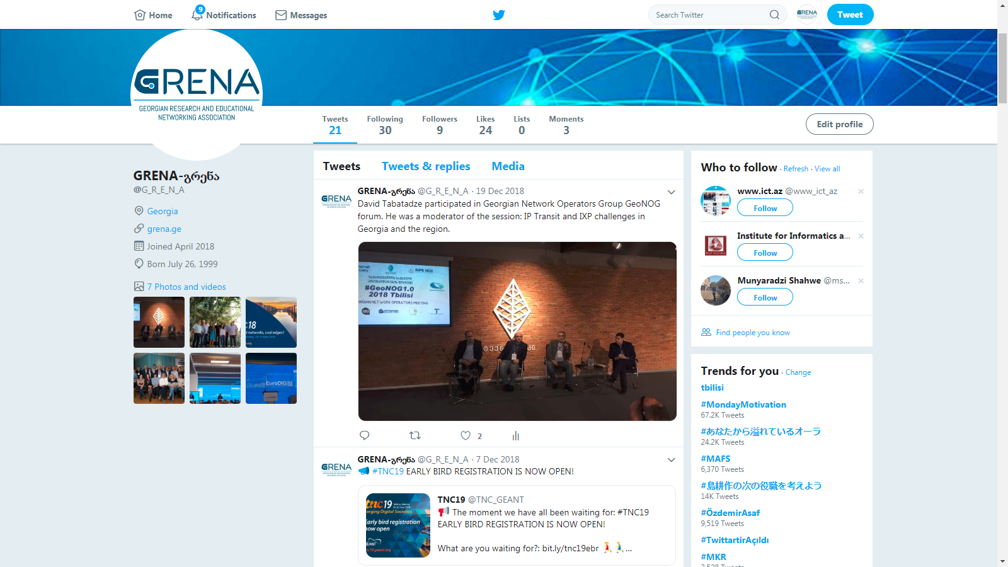
Communication Tools / Channels We Use
www.grena.ge
გრენა.გე
Facebook page: GRENA - გრენა
Twitter account
https://twitter.com/G_R_E_N_A

Slide 5
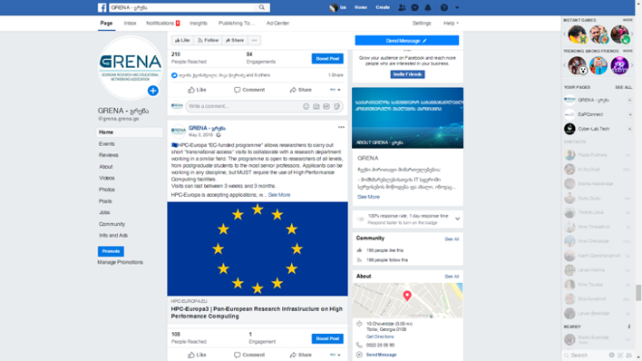
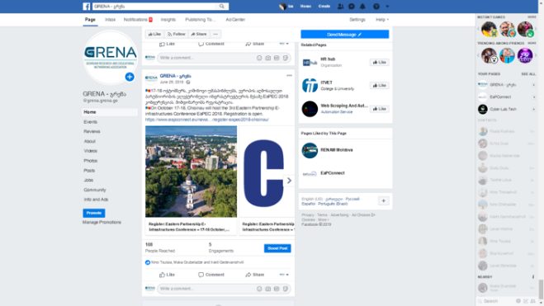
Facebook Activities/Analytics
207 likes
210 followers
More than 100 questions/answers
Posts – all news and events, happening in the field of science and IT in Georgia, promoting EaPConnect project news and events

Slide 6

Business Cards

Slide 7

Goals/Main Activities/Future Services
GRENA became accredited registrar of .GE and .გე domains
We supported The third National Cyber Olympiad "Cyber Cube 2018“/Promoting the event on several social channels.
EuroDIG 2018 – “The Pan-European dialogue on Internet governance” was held in Tbilisi.
Cyber-lab.tech portal.
In 2019 (spring) we will have a new service - Public DevOps Platform as a Service and virtual DataCenter; Our employee Nino Tsulaia is going to represent it on TNC19, in Tallinn, Estonia.

Slide 8

Cyber-lab.tech Portal
Cyber-lab.tech portal was created in cooperation with CERT.GOV.GE – with support of EaPConnect project
This portal is mainly intended for Georgian university students who are studying IT, in order for them to expand their practical skills in detecting and responding to cyber incidents
Facebook page/event and shared it on CERT.GOV.GE and GRENA facebook pages/marketing materials
Invitations were sent almost to all universities, public and private sectors (to IT and marketing departments)

Slide 9

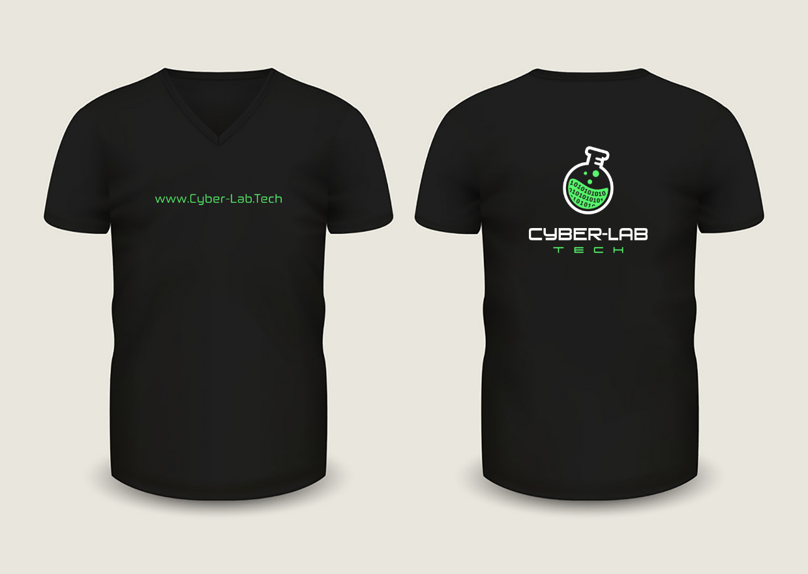

Slide 10
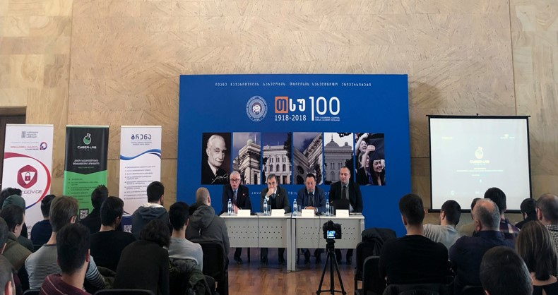
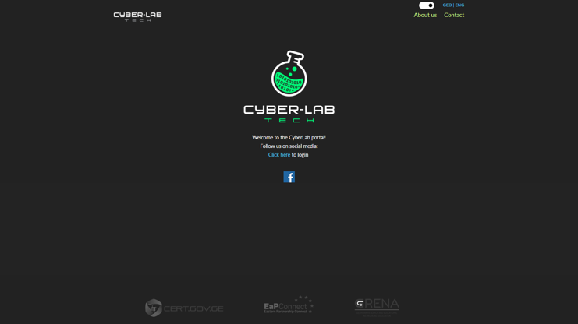
Presentation - About 90 representatives of Georgian universities as well as public and private institutions attended the event.
Articles were published on e-magazine www.cyber.kvira.ge; TSU website www.tsu.ge; EaPConnect project website.
Information about the presentation posted on Facebook pages, on twitter account and on our website.
More than 150, 2 weeks trial accounts were created.

Slide 11
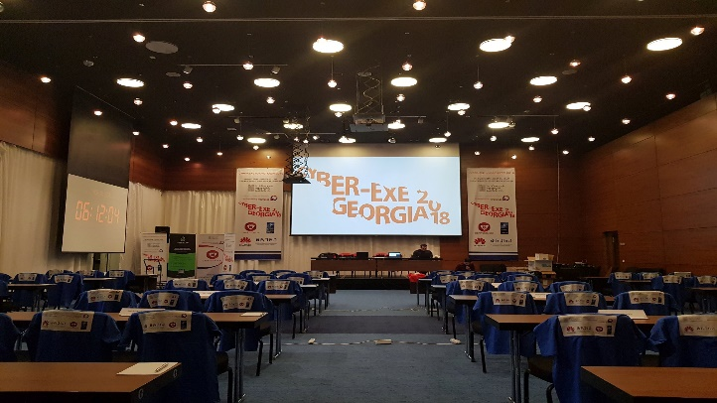
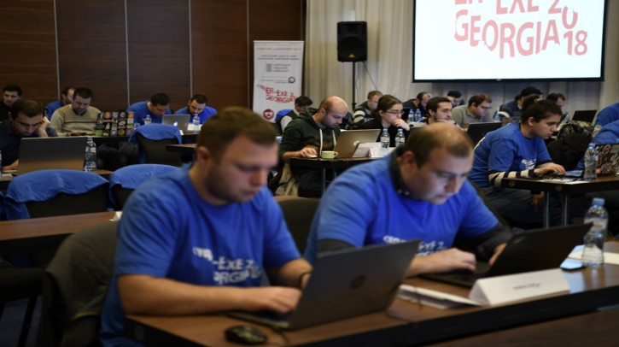
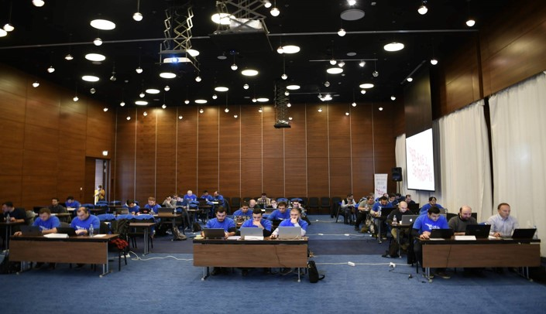
GRENA Cybersecurity team, participated in “CYBER-EXE Georgia 2018”.
“CYBER-EXE Georgia 2018” was held for the fifth time, aiming to train IT Professionals from public and private sector, for cyber attacks in crisis situations.
GRENA cybersecurity team took first place.
Articles were published on www.cyber.kvira.ge; EaPConnect project website. Posts published on facebook page and on twitter account.

Slide 12


Increase EaPConnect Project Awareness in Georgia/EYR@EaP2018/eduroam
EYR@EaP2018 - E-mails/face2face meetings/facebook post/8 proposals/1 winner from Georgia
Eduroam:
Article was published about eduroam – www.edu.aris.ge
Promotional post created on faceb`ook
E-mails were sent almost to all the universities and educational sector.
3 new universities connected to eduroam: Ivane Javakhishvili Tbilisi State University; Grigol Robakidze University; Tbilisi State Medical University. Sulkhan-Saba Orbeliani University is still in progress.
GRENA boosted eduroam visibility in Georgia at UNESCO-supported 100th anniversary of Ivane Javakhishvili Tbilisi State University (TSU) and published the article on EaPConnect/TSU websites.

Slide 13
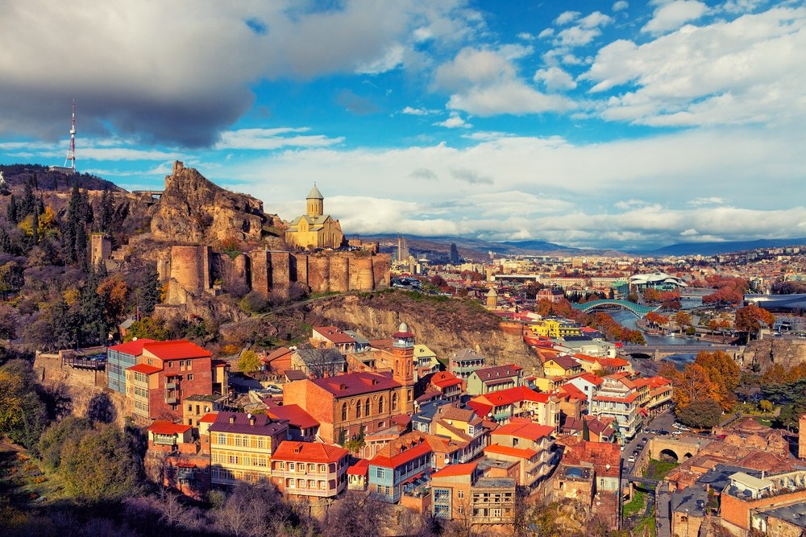

20th Anniversary
Autumn 2019 (date TBD)
Tbilisi, Georgia

Slide 14

Thank you!

