Slide 1
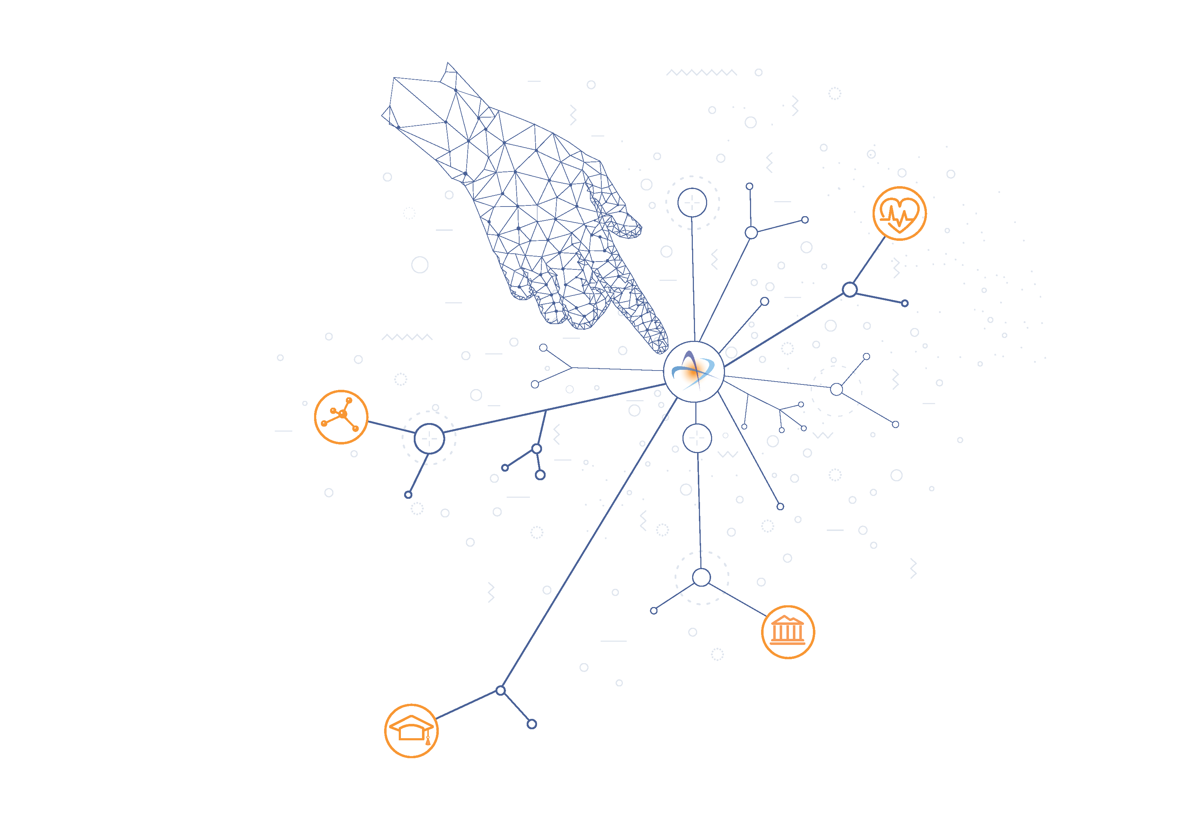
Greek Research & Technology Network
GRNET Marketing & Communications Strategy
2017-2018
Key points in creating and implementing GRNET MARCOMMs.
Lessons learned and shared, a work in progress
Artemis Psarianou
Head of Marketing and Communications Service

Slide 2








Slide 3
Agenda
Formulating MarComms Strategy
Execution Plan
Execution highlights
Learning outcomes – feeding 2019 MarComms plan

Slide 4
Formulating marcomms strategy

Slide 5
Challenge: thinking outside the ‘Strategy Box’
Non standard Marcomms Strategy formulation, due to non profit nature
Shaping: Involving key internal stakeholders
Drafting & Presenting: one-on-one, group, educating, getting feedback, revising.
Leader: marcomms professional
Strategy marcomms matrix formulation elements
  Corporate & Product (Infrastructures. Services. Projects.)
  Target audiences: Institutions & roles within
  Target markets: horizontal/vertical
  Dissemination challenges: CRM; GDPR; external influences, resources (# of specialized staff/budget)
  Devise strategy and plan: document (full & brief); ppt; excel matrix for reprioritization
Notes:
Getting to be creative, thinking outside the box, and activating marcomm strategy elements that correspond, are necessary and applicable to this NRN environment.

Slide 6
    Current situational analysis
SWOT, Trends, Best Practices, Marketing & Competition
SWOT
International/European market trends
  GÉANT new technologies, projects and trends & other national/European and International Projects, NRNEs
Marketing trends and international best practices taking into consideration the special characteristics of the Greek market, industry GRNET operates in & its public sector/non profit nature:
  Open Calls, Events, Trainings, workshops and Technology info sessions to R&E Institutions;
  Intensify the already existing online presence (SEO/website uplift/social media marketing-enhance/engage/encourage ‘conversation’ with key audiences)
  Corporate Video & Brochure, Success Stories, company news, articles, testimonials or email promotional campaigns in Greece and abroad (in the field stories, connect, https://inform.tmforum.org/)
  create educational material, common concept project /service portal characteristics for easier user experience around the different services it provides, and European /International projects that GRNET participates for the local communities it serves, by target audience, by sector, by project.
Current country economic/policy/legal status

Slide 7


Marketing Mission
Promote the GRNET brand and the key characteristics and benefits associated with the utilization of existing infrastructure and services by the Research and Education communities, Health and Culture organizations. Contributing to new Service and Infrastructure strategy formulation and promotion towards market growth.
Direct goal
Increase number of Institutions and end users from all different target audience groups and sub groups, who use existing and new services and infrastructures
Increase the number of services utilized per existing Institution/user.
Indirect goal
Strengthening of corporate GRNET’s name/brand (enhance brand identity & awareness) – direct association to services/infrastructure it provides.

Slide 8
Marketing Strategy & Execution Plan → MATRIX: Axis, Actions
MATRIX: Main Lines of Activity | Sub-lines of activities | Axis 1 ΜΑRKETING Collateral Material (Print & Electronic) | Axis 2 Advertising & Promotion (Campaigns and Actions) | Axis 3 Horizontal Support Tools and Activities
Corporate | Strategy Plan
Service/ Infrastructure/ Project | Customer service experience
 | Strategy Plan
Activities → Actions
Activities → Actions
Support Actions

Slide 9
Target Audience: market groups/sub-groups
1. Institutions/Organizations
1Α. Educational Institutions
Ministries (Education, General Secretariat of Research and Technology, Transport, Health: Hospitals, Blood donor centers, Blood Donor Registry)
2. Roles/positions within Organizations
2Γ. Other
Ministries: Minister, Dep. Minister Υφυπουργός, GSTR, other Administration, Press Secretary, Hospital staff
1Γ. Other Organizations
1Β. Research Centers
Research Centers
Board, Deans, Chancellor, Management, Administrators, Department Heads
2A.Universities
Students: Undergraduate, Post Graduate, Phd levels
IT Labs and their Teaching staff (e.g.: Networks/Telco/Programmers etc.)
Researchers all types/grades
Academics: Head of Department, Lecturers/Professors, Assistant Professors, Department, School Administration
Partners (IBM, Cisco, Juniper, Service Now, Vidyo κ.ά.)
Chamber of commerce/organizations
Conference/Cultural centers, Museums, Private Colleges
ISP/content provider companies, for : GRIX, ZΕΥΣ, HPC, DIAVLOS
For Post Grad Schools: Board, Deans, Management, Administrators, Department Heads
NOC per Institution, and NOC Manager
Researchers – categories (ABC), Management, PR/Marketing Departments, Administrators, Department Managers
Press/Media Reporters/Magazines/Newspapers
Other roles within other organizations: GM, CEOs, Account Managers, Marketing, Procurement
2B. Research Centers
Target Market
market segmentation strategy

Slide 10
Scientific Sectors and Fields
Scientific Sector | Scientific Field Category
SS 1. Natural Sciences | Field 1. SS/ Mathematics, Field 2. SS/ Computer and Information Sciences, Field 3. SS/ Physical Sciences, Field 4. SS/ Chemical Sciences, Field 5. SS/ Earth and related Environmental Sciences, Field 6. SS/ Biological Sciences, Field 7. SS/ Other Natural Sciences
SS 2. Engineering & Technology | Field 8. Ε&Τ/ Civil Engineering, Field 9. Ε&Τ/ Electrical, Electronic, Information/Computer, Engineering, Field 10. E&Τ/ Mechanical Engineering, Field 11. Ε&Τ/ Chemical Engineering, Field 12. Ε&Τ/ Materials Engineering Field 13. Ε&Τ/ Medical Engineering, Field 14. Ε&Τ/ Environmental Engineering, Field 15. Ε&Τ/ Industrial Biotechnology, Field 16. Ε&Τ/ Nano-technology, Field 17. Ε&Τ/ Other Engineering and Technologies and Architecture
SS 3. Medical & Health Sciences | Field 18. MHS/ Medicine, Field 19. MHS/ Clinical Medicine, Field 20. MHS/ Health Sciences, Field 21. MHS/ Medical biotechnology, Field 22. MHS/ Other Medical Sciences
SS 4. Agricultural Sciences | Field 23. AS/ Agriculture, Forestry, and Fisheries, Field 24. AS/ Animal and Dairy Science, Field 25. AS/ Veterinary Science, Field 26. AS/ Other Agricultural Sciences
SS 5. Social Sciences | Field 27. SS/ Psychology, Field 28. SS/ Economics and Business, Field 29. SS/ Educational Sciences, Field 30. SS/ Sociology, Field 31. SS/ Law, Field 32. SS/ Political Sciences, Field 33. SS/ Social and Economic Geography, Field 34. SS/ Media and Communications, Field 35. SS/ Other Social Sciences
SS 6. Humanities | Field 36. H/ History and Archaeology, Field 37. H/ Languages and Literature, Field 38. H/ Philosophy, Ethics and Religion, Field 39. H/ Arts, Field 40. H/ Other Humanities
market segmentation strategy
Target Market

Slide 11
Performance: KPIs
Performance
  Organic Traffic: SEO strategy
  Οn line/Social Media – traffic (Conversion Rates)
  # % measure online visitors → users – a work in progress: CRM collaboration tool / campaign management /services data
  % of overall ingress of visitors to our website which corresponds to redirection from Social Media
  Per social medium: Twitter, Facebook, LinkedIn & google analytics, YouTube work in progress
  On line campaigns- google analytics
  ‘how did you find out about GRNET’ forms
Service users numbers/statistics- piwik/google analytics/service statistics
Landing Page Conversion Rates
  Conversion of ingress traffic to ‘leads’ need CRM tool
Lead-to-Customer Ratio – account management

Slide 12
Execution Plan

Slide 13
Marketing Plan: @ a glance 2017-18
Matrix Actions 12 months
Corporate
Strategy formulation and promotional materials
Product (Infrastructure. Service. Project)
Create new logos with ‘powered by grnet’
Statistics /measurement of service usage and compare it at end of year combine with KPIs for campaigns /and organic measurements
Campaigns/online/email/cross selling to existing users: Promote the advantages of other /new services
Video/Success Stories & Testimonials/open calls/events/presentations/brochures/social media/campaign
GRNET moto, re branding service logos, create services catalogue, vertical markets (education, research, health, culture)
Target audience awareness raising : corporate branding – subliminal messaging/connecting GRNET name to services/infrastructures/projects
Events (own and participating), presentations, trainings, open calls
Landing pages, Social media strategy and content, create facebook page, cluster campaigns/synergies
Website facelift, services pages
Market research/satisfaction survey to assist design of new and /or improvement of services
SEO/Google Analytics/Key Words/activate KPIs per campaign
Website content/service portals, services catalogue and user identified matrix onto website
Video/testimonials/success stories
Pyxida, training materials for services/projects portal

Slide 14
Revised plan/Budget/Resources
Priorities selected for 12 months (2017-18) (version 2)
Resources recalculation
  Manhours: 2.47 ΜRKT FTEs marketing, 0,67 FTE from different departments: GM/SM/PMs/ΝΟC/CC
  Third party expenses: is reduced to 1/3 of initial estimate €
Highlights
Corporate
online/digital and printed brochures (website, SEO/Keyword strategy, blog, success stories, news, company profile (video, brochure) vertical sectors/ppt/service catalogue, by type of user, express interest form, service/project brochures, project/service portals, social media strategy and content, campaigns, presentations, logos-motos, Press Releases)
Technology Symposium
Product (Infrastructures/Services/Projects)
Will include the above and additional targeted actions per service/project
DIAVLOS, AAI, eduroam, e:Presence, ~okeanos, ViMa, HPC, Health sector services, GR-IX, every-where,
National, European and International projects/ infrastructures promotion and re-prioritise on demand,
Pyxida, on line training material portal, where applicable

Slide 15
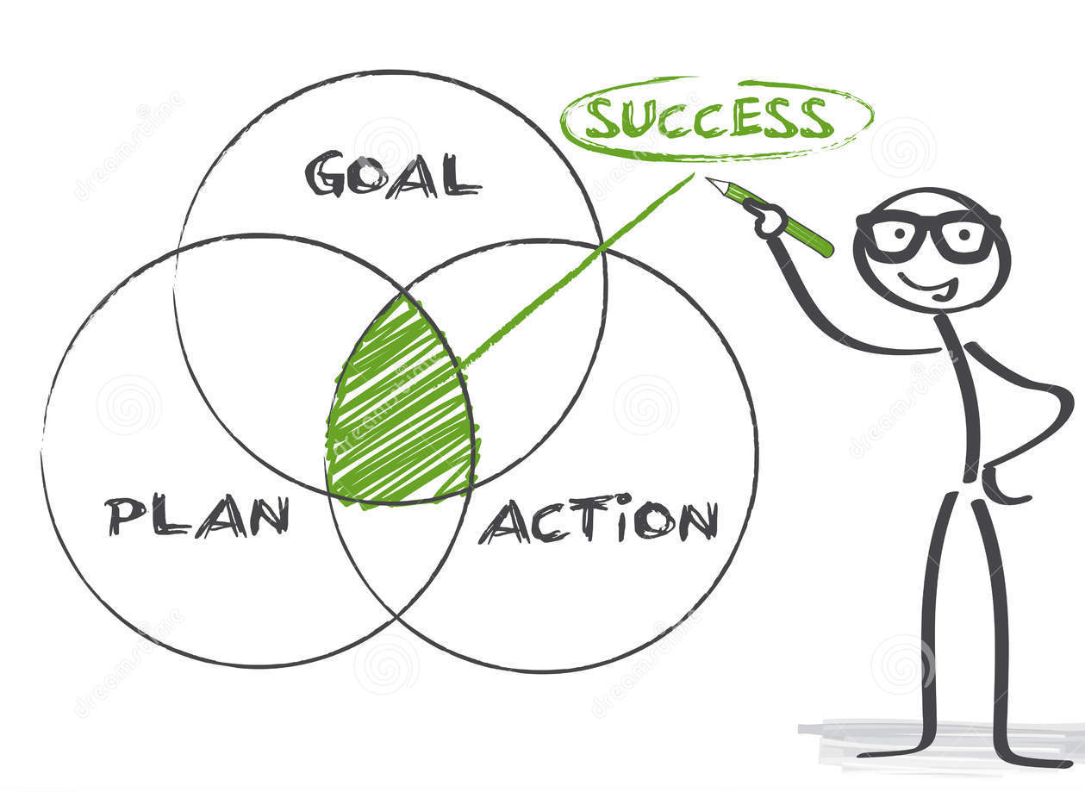
Success Factors
Coming together is a beginning;
Keeping together is progress;
Working together is success.
Henry Ford

Slide 16
Marketing Plan 2017-2018:
Important Factors for Success
Co-operation of Marketing & all Departments/Management
  Set priorities together, finalise execution plan of actions and create calendarization
  Budget allocation: Staff internal (time and money), external expenses/subcontractors
  Set KPIs, & lead generation process-account management
  Progress reporting and possible adjustment of priorities /quarter
Tools: CRM with integrated campaign management, Social Media Management & Landing Pages Tools, Photo Library, Google Analytics, Keyword/SEO, KPI, Graphic Designer/animator/Τranslator
Execution: systems, procedures, templates, calendarisation of activities, 360 communication with all departments

Slide 17
Execution Highlights

Slide 18






2017-2018 execution highlights
Corporate Video (EN & GR)
Corporate Brochure (GR & EN)
Corporate banners (GR & EN)
Success stories (4)
Logos:
  4 vertical sectors, services
  Services: powered by grnet
GRNET Technology Symposium (17k email, online campaigns, 700 registered, 380 attended, and another 1580 watched live, via livestreaming service, corporate gifts, eduroam stickers)
Website facelift/content improvement/vertical sectors
Signature branding: for staff to include social media stamps, and onto all user communications
DM Campaigns – reaching 17k key market audience at least 2 times in 12 months for different reasons (excluding user update communication)
Social Media enhanced usage
KPIs

Slide 19






Slide 20
2017-2018 execution highlights, measurements
Online
  website – increase of visitors by 64,02%:
    direct by 47,62%, organic/google by 21,21%
  Social media – point in time comparisons
  (5month current to last):
    Facebook: increase of followers 2,27 times, increase of posts 5.3 times, increase of interactions 5 times
    Twitter: increase of posts by 4 times, increase of clicks 2,31, increase of retweets, likes 1,92
    LinkedIn: increase of followers posts 1,38 times, increase of impressions 1,05 times, increase clicks on posts 3,16 times, and increase of likes/shares 5,11 times

Slide 21
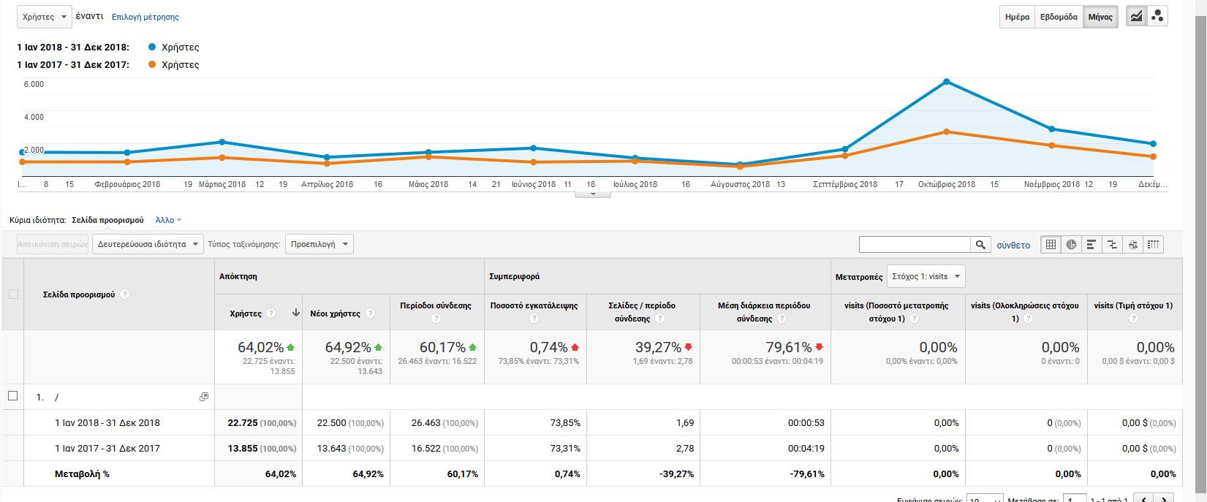
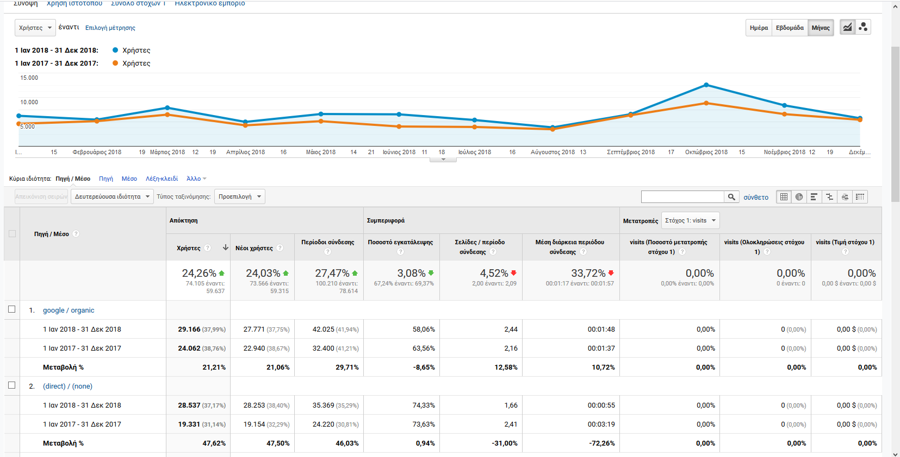
GRNET Website comparison

Slide 22
Social media: point in time comparison
Facebook | 09/2017-01/2018 | 09/2018-01/2019 | % Increase | # Increase
Followers | 300 | 680 | 126,67% | 2,27
Posts | 11 | 58 | 427,27% | 5,27
Total reach | 7528 | 28285 | 275,73% | 3,76
Clicks | 612 | 2576 | 320,92% | 4,21
Shared/Liked | 219 | 1111 | 407,31% | 5,07
Twitter | 09/2017 - 01/2018 | 09/2018 - 01/2019 | % Increase | # Increase
Followers | 1790 | 2027 | 13,24% | 1,13
Tweets | 9 | 36 | 300,00% | 4,00
Impressions | 35063 | 51842 | 47,85% | 1,48
Link Clicks | 192 | 272 | 41,67% | 1,42
Engagement -clicks | 484 | 1118 | 130,99% | 2,31
Retweets/Likes | 168 | 323 | 92,26% | 1,92
LinkedIn | 01/2018 -05/2018 | 09/2018 - 01/2019 | % Increase | # Increase
Followers | 2500 | 3447 | 37,88% | 1,38
Posts | 29 | 30 | 3,45% | 1,03
impressions | 67143 | 70227 | 4,59% | 1,05
Clicks on post | 459 | 1449 | 215,69% | 3,16
Likes/Shares | 372 | 1900 | 410,75% | 5,11

Slide 23
2017-2018 execution highlights: measurements
SEO/KPIs-google analytics for campaign monitoring vs services user behaviour
  Measuring change in user numbers per service, a direct or indirect influence by marcomms activities

Slide 24
Sample statistics for services promoted
eduroam | Ιαν-18 | Ιαν-19 | % increase | # increase
Total www.eduroam.gr visitors | 14,708 | 17,272 | 17,43% | 1,17
Total Connections on eduroam | 352,000 | 399,370 | 13,46% | 1,13
Online campaign on 20th of December each academic year: 2017-18 vs 2018-19
(email, social media)
every-where | 12/2017-01/2018 | 12/2018-01/2019 | % Increase | # Increase
Portal visits | 7,592 | 17,805 | 134,52% | 2,35
Service registrations | 1,584 | 4,280 | 170,20% | 2,70
#email campaign | 59,102 | 66,529 | 12,57% | 1,13

Slide 25
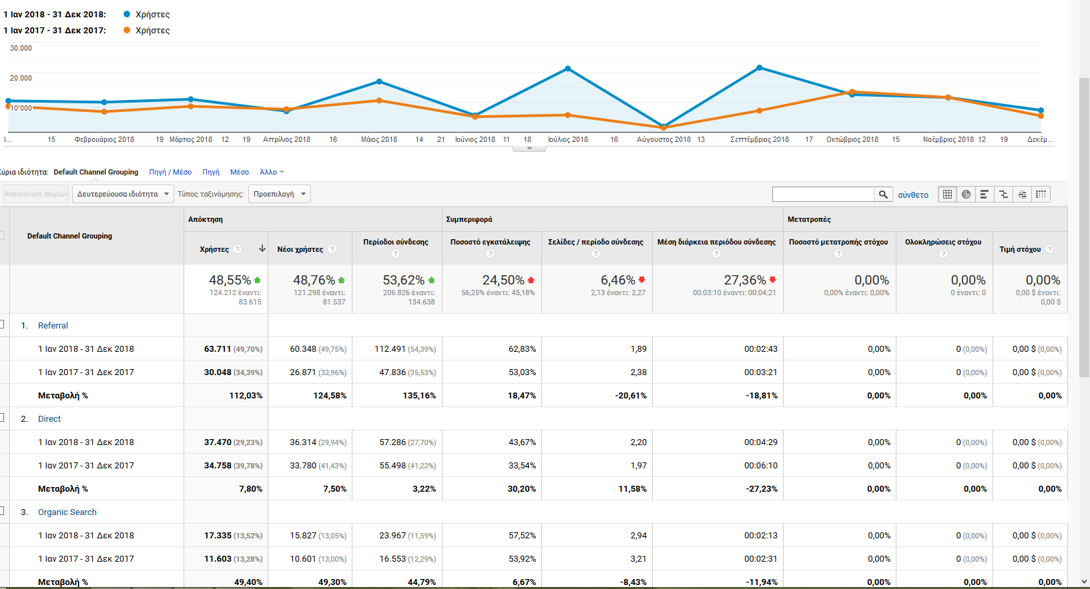
DIAVLOS: platform visitors
DIAVLOS | 2017 | 2018 | % change | # increase
#broacasts | 213 | 260 | 22,07% | 1,22
#countries | 41 | 42 | 2,44% | 1,02
Partners | 24 | 30 | 25,00% | 1,25
#VonD | 153 | 199 | 30,07% | 1,30
Views | 30,6291 | 434,560 | 41,88% | 1,42
Subscriptions GDPR compliant | 50,105 | 10,508 | -79,03% | -
Portal visit:Referral | 30,048 | 63,711 | 112,03% | 2,12
Portal visit: Direct | 34,758 | 37,470 | 7,80% | 1,08
Portal visit: Organic Search | 11,603 | 17,355 | 49,57% | 1,50

Slide 26

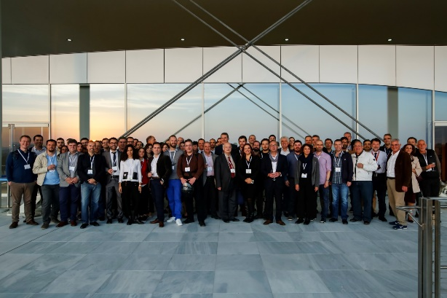
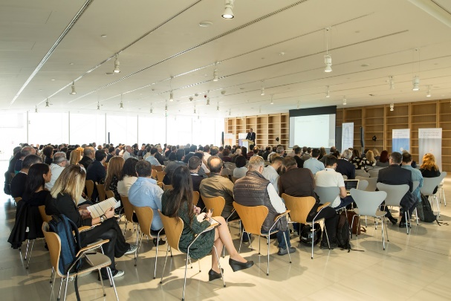
GRNET Symposium 2018
Pre event
Plan and Coordinate
Committees
Branding: “GRNET Digital Technology Symposium: Νew dimensions for Research and Education”
Timeline of marcomms actions
Campaign: online, #GRNETsymposium
  17k email, online campaigns, 700 registered, 380 attended, and another 1580 watched live, via livestreaming service, corporate gifts, eduroam stickers), live social media feed #happeningnow
Lobbying
2 days, 60 presentations, 53 presenters
Feedback forms with evaluation
Post event marketing

Slide 27
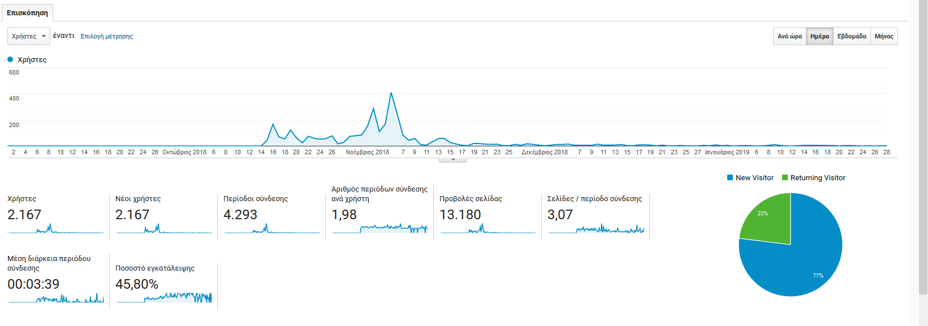
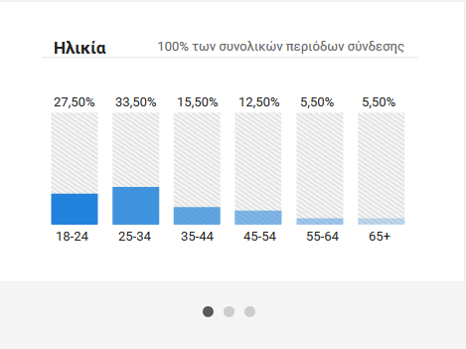
Direct email campaign: Symposium

Slide 28
GRNET 2018 Symposium Portal Stats
Medium (15/10-30/12/2018) | Visitors
(direct email) | 1342
google / organic | 276
grnetsite / email | 195
ekt.gr / referral | 116
eduguide.gr / referral | 44
events / linkedin | 39
mail.google.com / referral | 32
events / fb | 28
m.facebook.com / referral | 23
events / twitter | 17
Total | 2281

Slide 29
Learning outcomes

Slide 30
Learning outcomes: feeding 2019
Internal
  Key systems/ resources/processes need to be in place
  Monitor. Measure. Report progress. Define & Re define plan
  Stay focused on mission and key aspects of the plan to fulfill goals
    Propose ideas. Be creative. Be realistic. Lead. Keep it simple
    A master plan of specific deadlines/calendarisation for all activities, and assign task lead roles
    Proceed with online/social media content calendar plan
  Engage stakeholders (quarter/annual/daily)
    Management: Corporate, Project, Services, Infrastructure, NOC, call center/customer services reps.
    Lobbying with key Partners institutions and Board of Directors
External
  Target audience variances. GDPR compliance. Trends.
  User behavior
    Ask for their input/feedback
    Promote ‘the offering matrix”, as an important provision for them at all times

Slide 31





Thank you
Q & A
Greek Research and Technology Network
www.grnet.gr
grnet.gr
grnet_gr
GRNET SA
GRNET EDET

