Slide 1
Bringing colleagues together, wherever they are
Maddy Wall, internal communications and engagement manager, and Hannah Tennant, membership communications assistant

Slide 2
A bit of background
About Jisc
More than 660 colleagues in December 2018 – since January 2019, more than 750 and growing
Range of roles
Range of locations – all corners of the UK, and further afield
Brings some challenges!

Slide 3
Some basics
Good employee engagement
Clear, authentic leadership
Two-way
Face-to-face
Equal opportunities for everyone, wherever they are

Slide 4
Our journey with our all-hands
Trial and error….and success!
VScene
Adobe Connect
Zoom

Slide 5
Account managers- online information
Background
Approx 25 account managers
Spread throughout the UK – all home based
Communication effectively delivered through:
  Microsoft teams
  Zoom (online briefings)

Slide 6
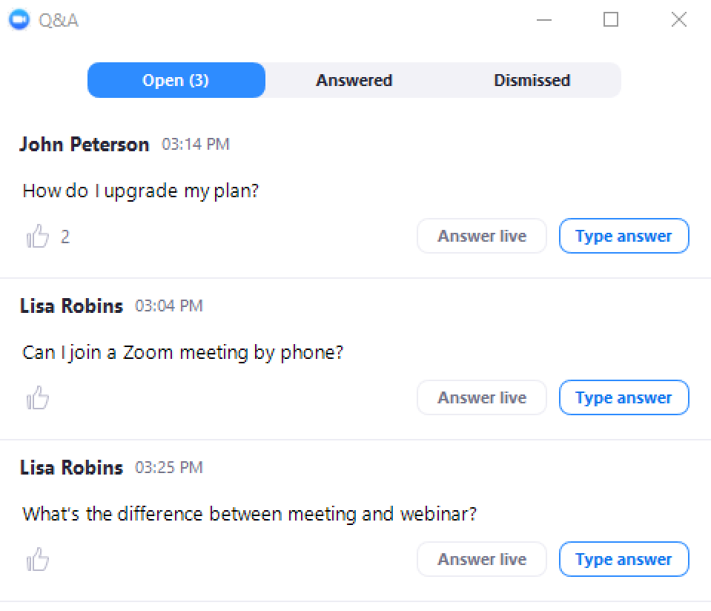
Zoom – Q&A

Slide 7
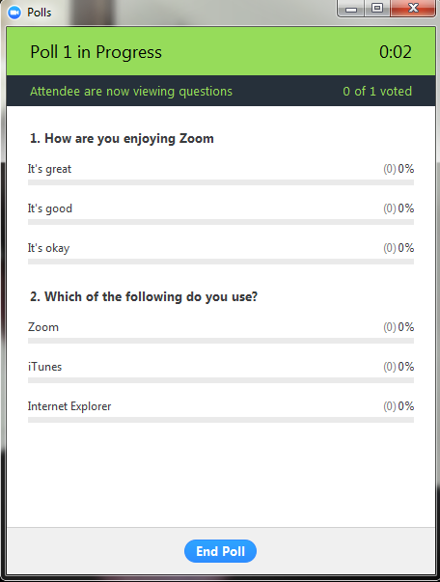
Zoom – Polls

Slide 8

Zoom – session recording

Slide 9
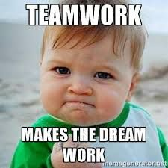
Having moments together online as one organisation

