Slide 1

Jisc Cloud Services
Jessica Wu, Cloud Services Group Manager

Slide 2
What we have done
    Made the GEANT IaaS framework available to member institutions as a referrer
    Raised awareness of cloud and identified gaps
    Developed a bespoke consultancy to help members use the cloud to achieve their strategic goals.
    Created a portfolio of cloud services
    Set up events and provided guidance
    Jisc and Eduserv merger
    Timeline of planned activities
    Challenges and lessons learnt

Slide 3
Members’ activity with GÉANT IaaS framework
Expression of Interest
40
Signed up to Jisc access agreement
21
Supplier selected and purchase made
6
A total spend of £247,871.66

Slide 4




Raising awareness and filling the gaps
Why
?
Think Cloud !
Think Jisc !
Do Jisc do Cloud . ?
Hi ! We are over here and ready to help !
Gap in awareness
………

Slide 5
Cloud Consultancy
    Help members to make cloud part of their wider digital vision
      help define cloud strategy and create roadmaps for transformation
    Solve practical, technical challenges
      Assessing readiness for cloud migration
      Designing a cloud-first architecture
      Developing roadmaps and timetables for cloud migration
      Supporting implementation and optimisation
    Make the financial case for the cloud
      financial assessment – financial-x-ray
    Develop their in-house skills
      Training and seminars, online and in person
      Skills transfer during cloud adoption and migration projects.

Slide 6
How we help
Advice and Guidance
Strategic Consultancy & Professional Services:
Solutions and Support
Solutions and Support
Frameworks
GEANT IaaS framework
Microsoft Office 365
Shared Datacentre ( North and South)
Learning Analytics (BI)
Telephony and Videoconferencing
Direct Connectivity to the Cloud (ExpressRoute)
Board and committee papers framework
Data archiving framework
G-Suite for Education (formerly Google Apps for Education)
Strategy formulation
Architecture design
Migration Plan
Security & GDPR
Procurement advice
Readiness assessment
Financial X-Ray
Janet txt framework
Shared Datacentre frameworks
Telephony Purchasing Service
Implementation
Optimisation
Managed Azure
Managed AWS
Managed O365
Managed Database

Slide 7
Events and guidance
Service documentation
Buyers guide
Product sheets
Cloud guide
Web pages
  Cloud landing page https://www.jisc.ac.uk/network/cloud
  Geant IaaS FW https://www.jisc.ac.uk/geant-iaas-framework
  Cloud consultancy https://www.jisc.ac.uk/consultancy/cloud
Events and surveys
Jisc/Microsoft joint event 6th Nov. 2017
Cloud development Webinar and survey Jan 2018
Cloud sessions at Jisc Networkshop April 2018
Jisc Architecting on AWS training session 12-14 Sept 2018
Jisc cloud enablement session with AWS Nov. 2018
Conducted a Jisc/GEANT cloud survey Nov/Dec. 2018

Slide 8

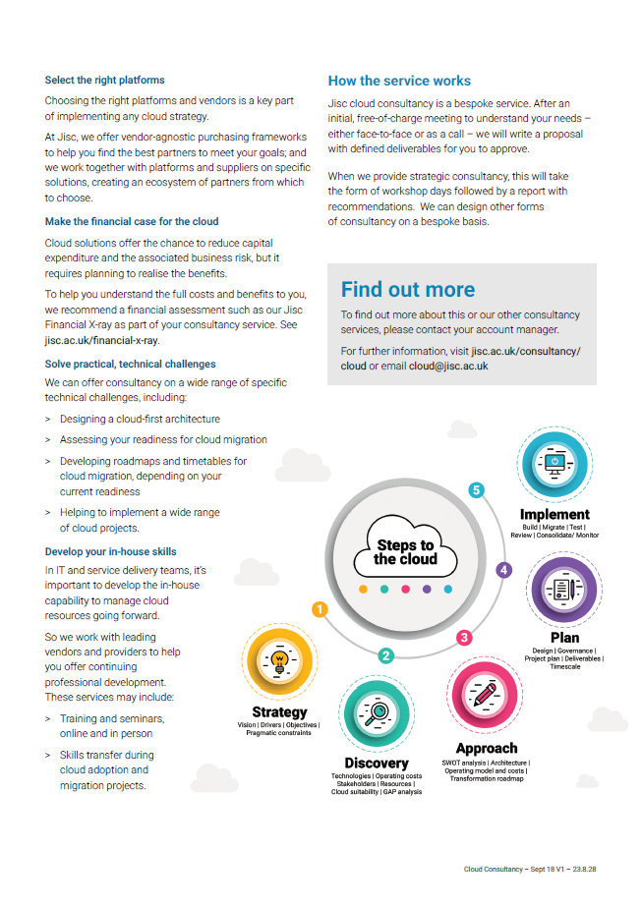
Product Sheet

Slide 9

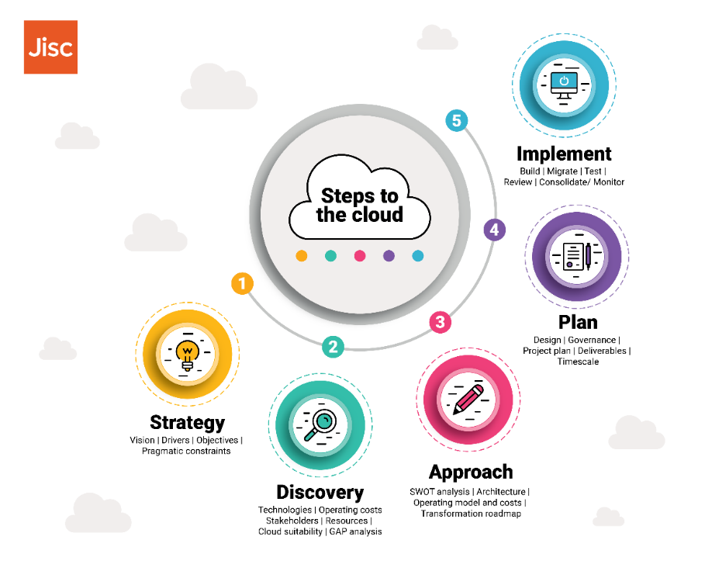
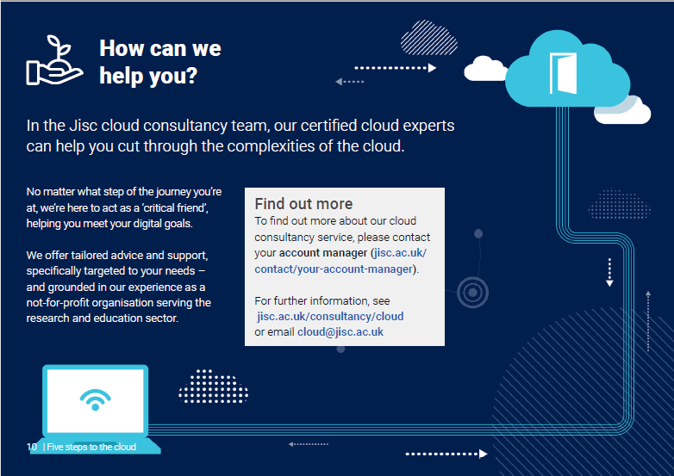
Cloud Guide

Slide 10
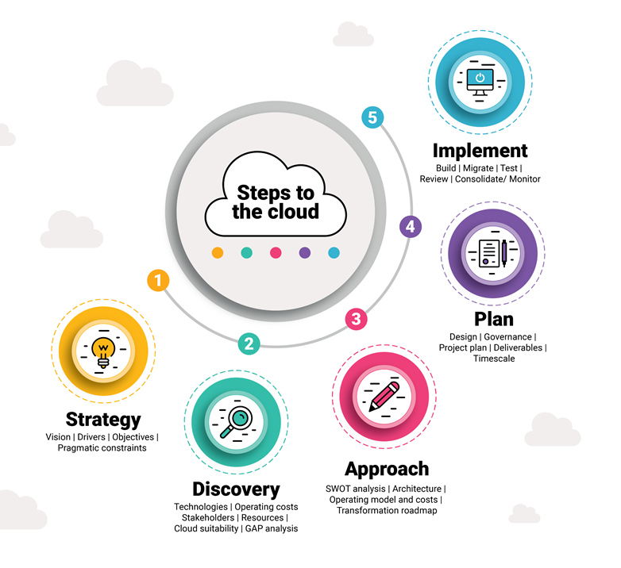
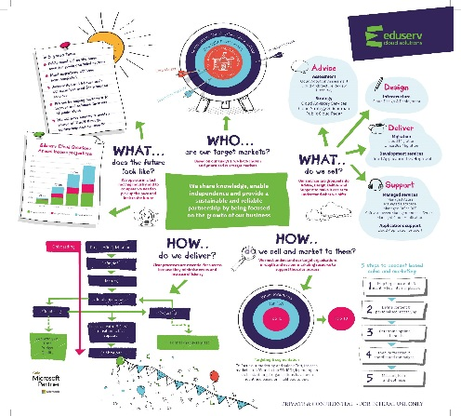
Jisc & Eduserv Merger
A team of cloud solutions consultants
Strategic consultancy
Professional services
Building an extensive partner ecosystem
Developing a managed service offering
Working with public cloud providers for the good of the membership community
Jisc Cloud Team
Jisc Cloud Team
A team of consultants, architects, engineers, project managers and Professional services
Managed services
Strong relationships with public cloud providers and a growing partnership network
Expanding the range of services, in particular around data, AI and getting ‘smart’
Helping the public and third sector do more with less through using public cloud tools
Eduserv Cloud Team
Eduserv Cloud Team

Slide 11
Time line of planned activities
Events / Report
Account Managers Marketing Campaign Briefing, 22 Mar
Cloud Strategy Workshop, Manchester, Apr/May TBC
Networkshop
9-11 April
Nottingham
Cloud Strategy Workshop, Nottingham,
9 April
Cloud Strategy Workshop, London, Apr/May TBC
UCISA Leadership Conference, 27-29 March
Edinburgh
Digital Leadership in HE Report (UCISA), mid-March

Slide 12
Challenges and lessons learnt
Challenges
  Understanding the unique selling point of each supplier and exactly what they offer
  Understanding pricing structures (necessary for fair comparison)
  Oceans of documentation can be difficult to navigate
  Raising awareness of our cloud offerings internally and externally
  Equipping account managers with relevant knowledge and increasing their confidence
  Identifying the most effective channels to communicate with a potential customer
  Lessons Learnt
  Many members are struggling to get started despite prioritising movement to cloud
  Having started their cloud journey, they need reassurance that they’re on the right track
  Adopting Cloud is not simply a purchase, first you need to resolve:
    Strategic direction
    Financial situation
    Cultural fit
    Your ‘customers’ needs and expectations (staff, researchers, students)

Slide 13
Questions ?

