Slide 1

Promotion of #love2eduroam in Slovenia
Goran Medenjak
ARNES

Slide 2

New British anthem:
The Clash - Should I Stay or Should I Go
Helge Øverås, http://www.helgeoveras.com/concertphoto.shtml [CC BY-SA 3.0
Notes:
First let me thank our hosts for a wonderful event here in the EU … and I wish you a good luck in the future folowing your dreams.

Slide 3
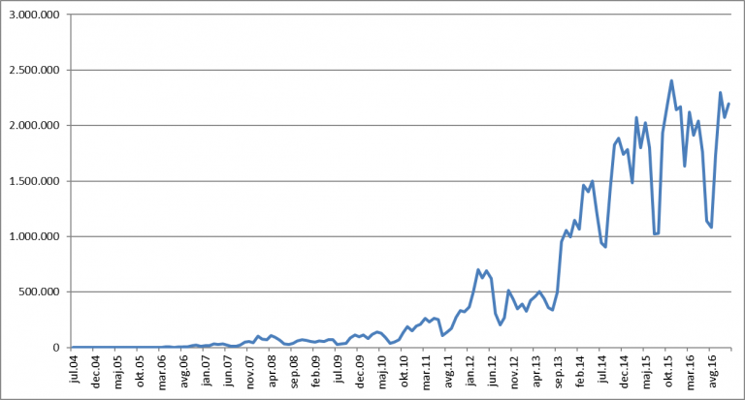
Eduroam in Slovenia
first networks in 2004
fast forward to 2017
eduroam in 199 organisations
Notes:
Anyway, Slovenia is a small country with big dreams for eduroam. First networks in Slovenia were built in 2004 and 13 years later you could find eduroam in 199 organisations across Slovenia.

Slide 4
European Regional Development Fund
ARNES
SIO-2020
From 2017 to 2020
952 institutions
3 projects
ICT equipment
ARNES procured 20.000 computers, laptops, tablets, projectors, monitors … in 2018
Development of e-content and e-services
Notes:
Now our dreams started to come true in 2017 … with the european funding. 952 institutions were included in the program SIO-2020 (slovenian educational network).

Slide 5
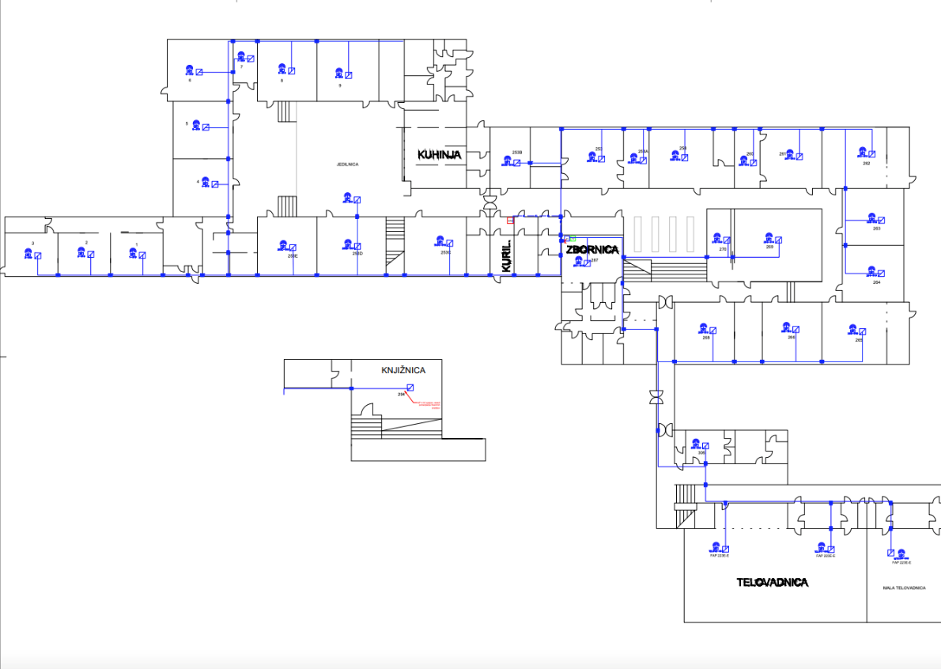
Project WLAN-2020
Building new wireless networks
With eduroam
in 2018, 2019 and 2020
Centraly managed by ARNES

Slide 6
2018 – work done
410 institutions with new eduroam networks
92 new routers
878 new switches
10.500 new AP‘s
Work in progress - 43 % done
The rest will get eduroam in 2019 and 2020

Slide 7
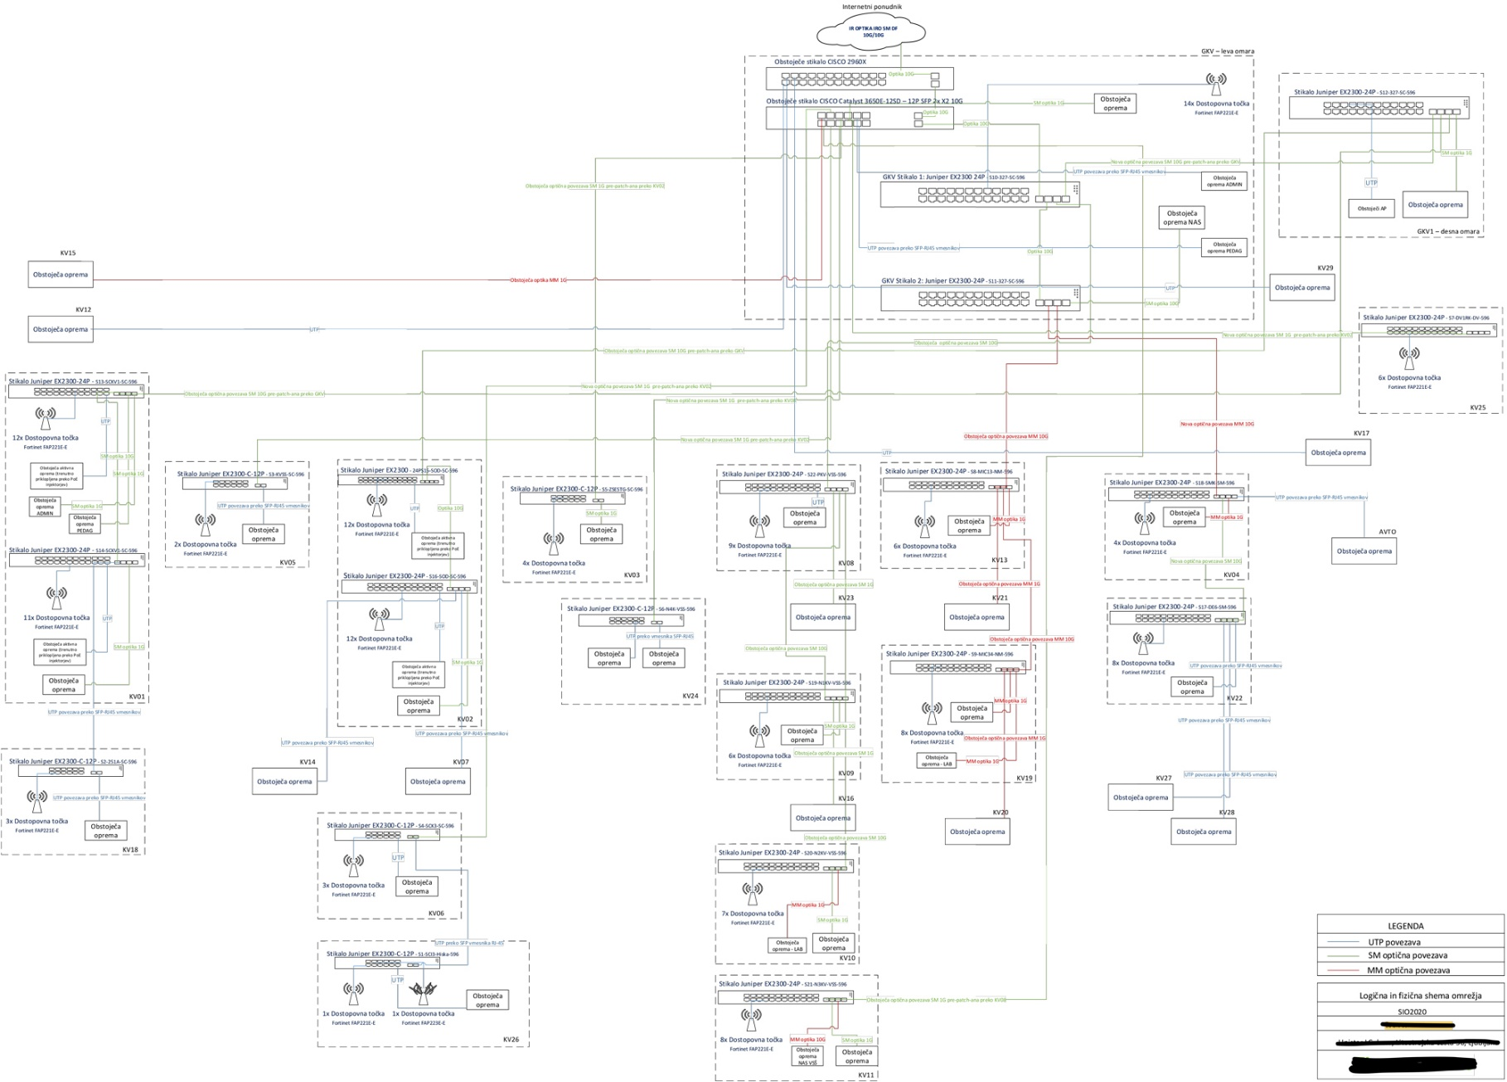
Our „Facebook“ status – it‘s complicated

Slide 8
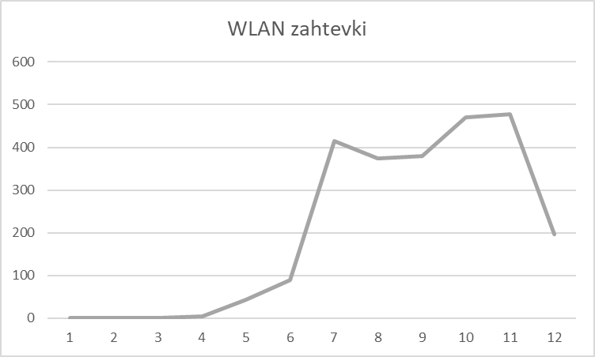
Working on new problems
New (overloaded?) system, new bugs
IPv6
Printers
Disconnections
Weak connections
Too many users
Old system worked or was „good enough“
2452 inquieries in 2018

Slide 9
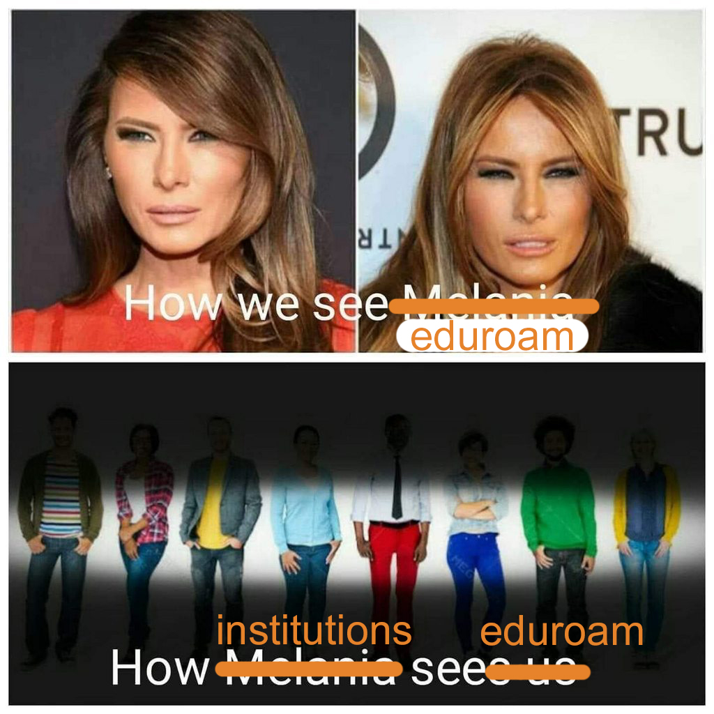
Some institutions that have the project scheduled for 2020 don‘t want a new WLAN
What can we do?

Slide 10
Promotion
Hi Karl …
Can you send me 50 please.
We’d like 30 stickers, too.
We’d like 10 stickers.
…
We are building new eduroam networks on more than 950 locations. So how many can you send?
Dear all,
We’ll be shortly receiving the #love2eduroam stickers so if you would like some
please let me and Rosanna know and we can add them to the deliveries of
CONNECT 30
We now have a quick guide to eduroam in both English and French
https://eduroam.org/quickguide
https://eduroam.org/quickguideFR
We would love to roll-out other languages so if anyone can help with translations
we would be most grateful.
Best wishes
Karl

Slide 11
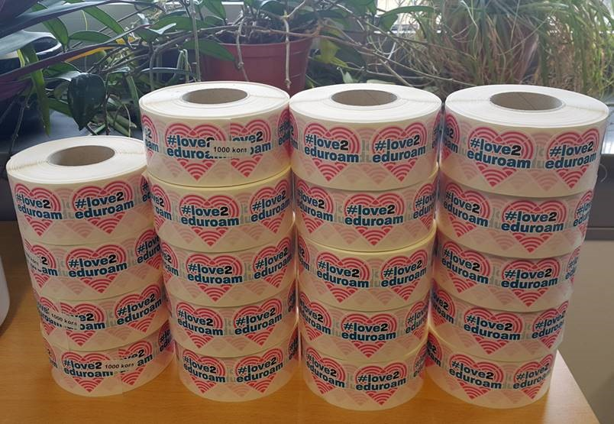
We got 50 …
Our users liked them and wanted more
20.000 stickers
For every institution in the program
For every classroom with a new eduroam network
THIS IS NOT A TOILET PAPER*

Slide 12


Promotional leaflets and 20.000 eduroam informational labels

Slide 13
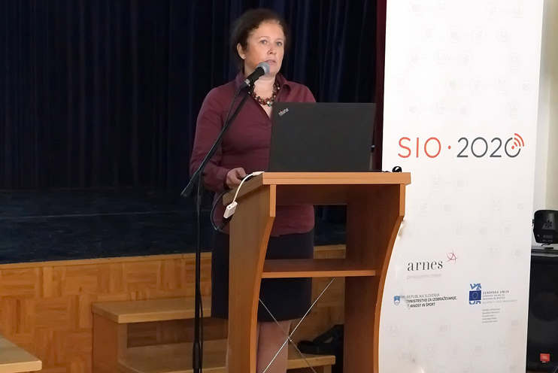
Promotional events in 2019
education is global
eduroam is safe
easy to use
modern standards
construction is co-financed
ARNES takes care of the network

Slide 14
What are your sugestions?

