Slide 1


New Services for 2019
Karl Meyer, GÉANT
January 2019

Slide 2
New Services for 2019
Primary focus for 2019 will be Trust, Identity and Security services
  Very end user focused services
eduroam Managed IdP
eduroam Visitor Access
InAcademia
eduVPN

Slide 3

eduroam Managed IdP
Designed for smaller Institutions
  <~250 students
  Without effective federated Identity service
Web-based management interface
CAT enabled for users
https://www.eduroam.org/eduroam-managed-idp/
https://www.eduroam.org/wp-content/uploads/eduroam-leaflet-IdP.pdf

Slide 4
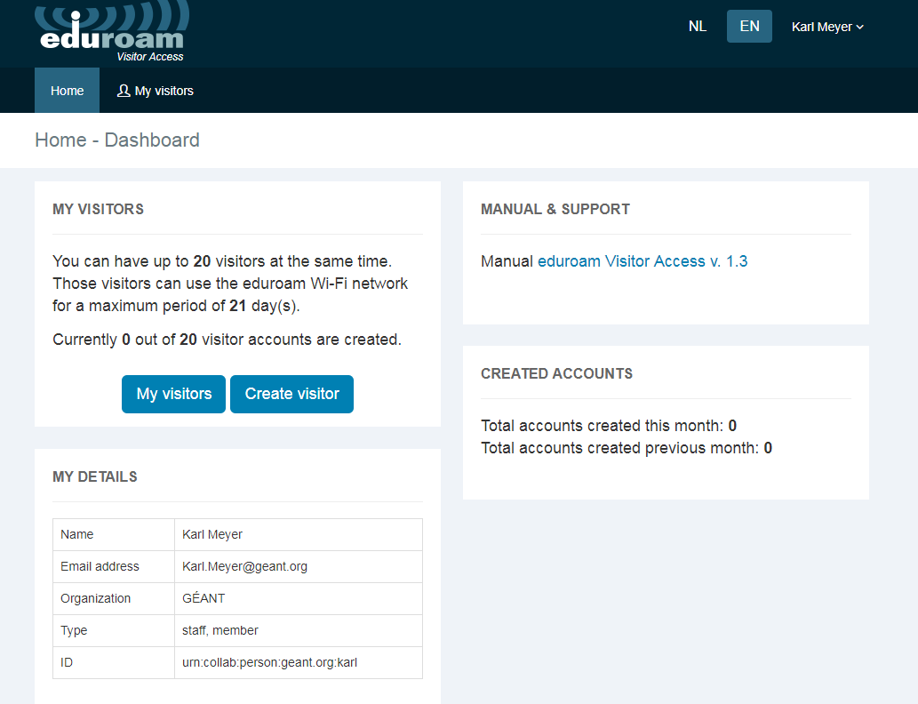
eduroam Visitor Access
Allows institutions to offer secure visitor access to eduroam.
  Avoids need to create insecure guest IDs
  Allows individual tracking (if needed)
  Can be used to promote eduroam at events
  TNC18, SC18, ICT2018
Simple web-based account creation
Operated by SURF
  https://eva.eduroam.nl/en/

Slide 5

InAcademia
Designed for commercial providers wanting to offer special deals/discounts to academic customers
Provides simple “lightweight” authorisation mechanism
  Offers a plain “Yes/No” answer and optionally “Student/Researcher/Staff” attribute
Removes the need for each service provider to register as a Service Provider with a national federation
www.inacademia.org

Slide 6
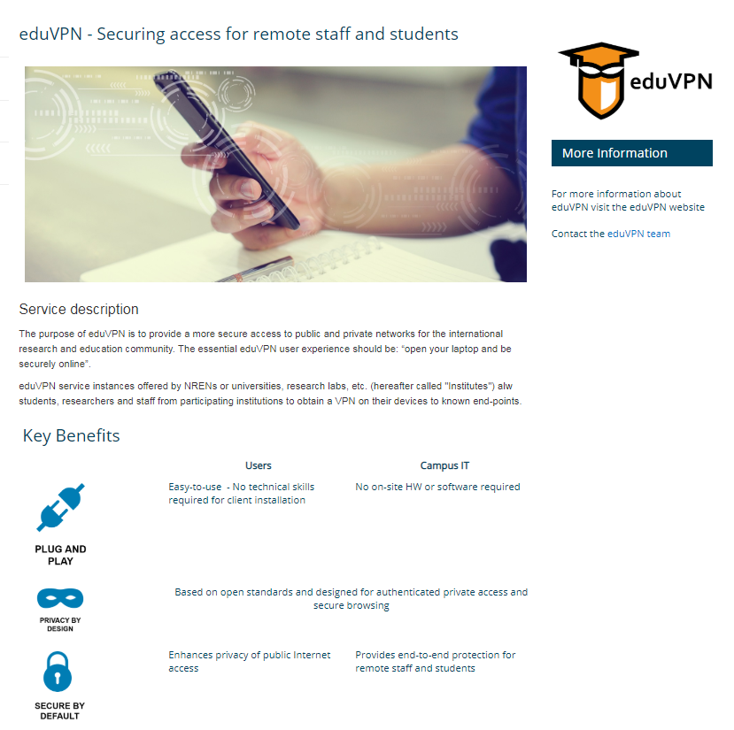
eduVPN
Point-to-point personal VPN
Secures access from public WiFi
Can bypass Firewall restrictions
  Access back to home base
Due for Launch mid-late 2019
Watch this space

Slide 7
Thank you
Any questions?

