Slide 1


GÉANT web presences
Paul Maurice, GÉANT

Slide 2
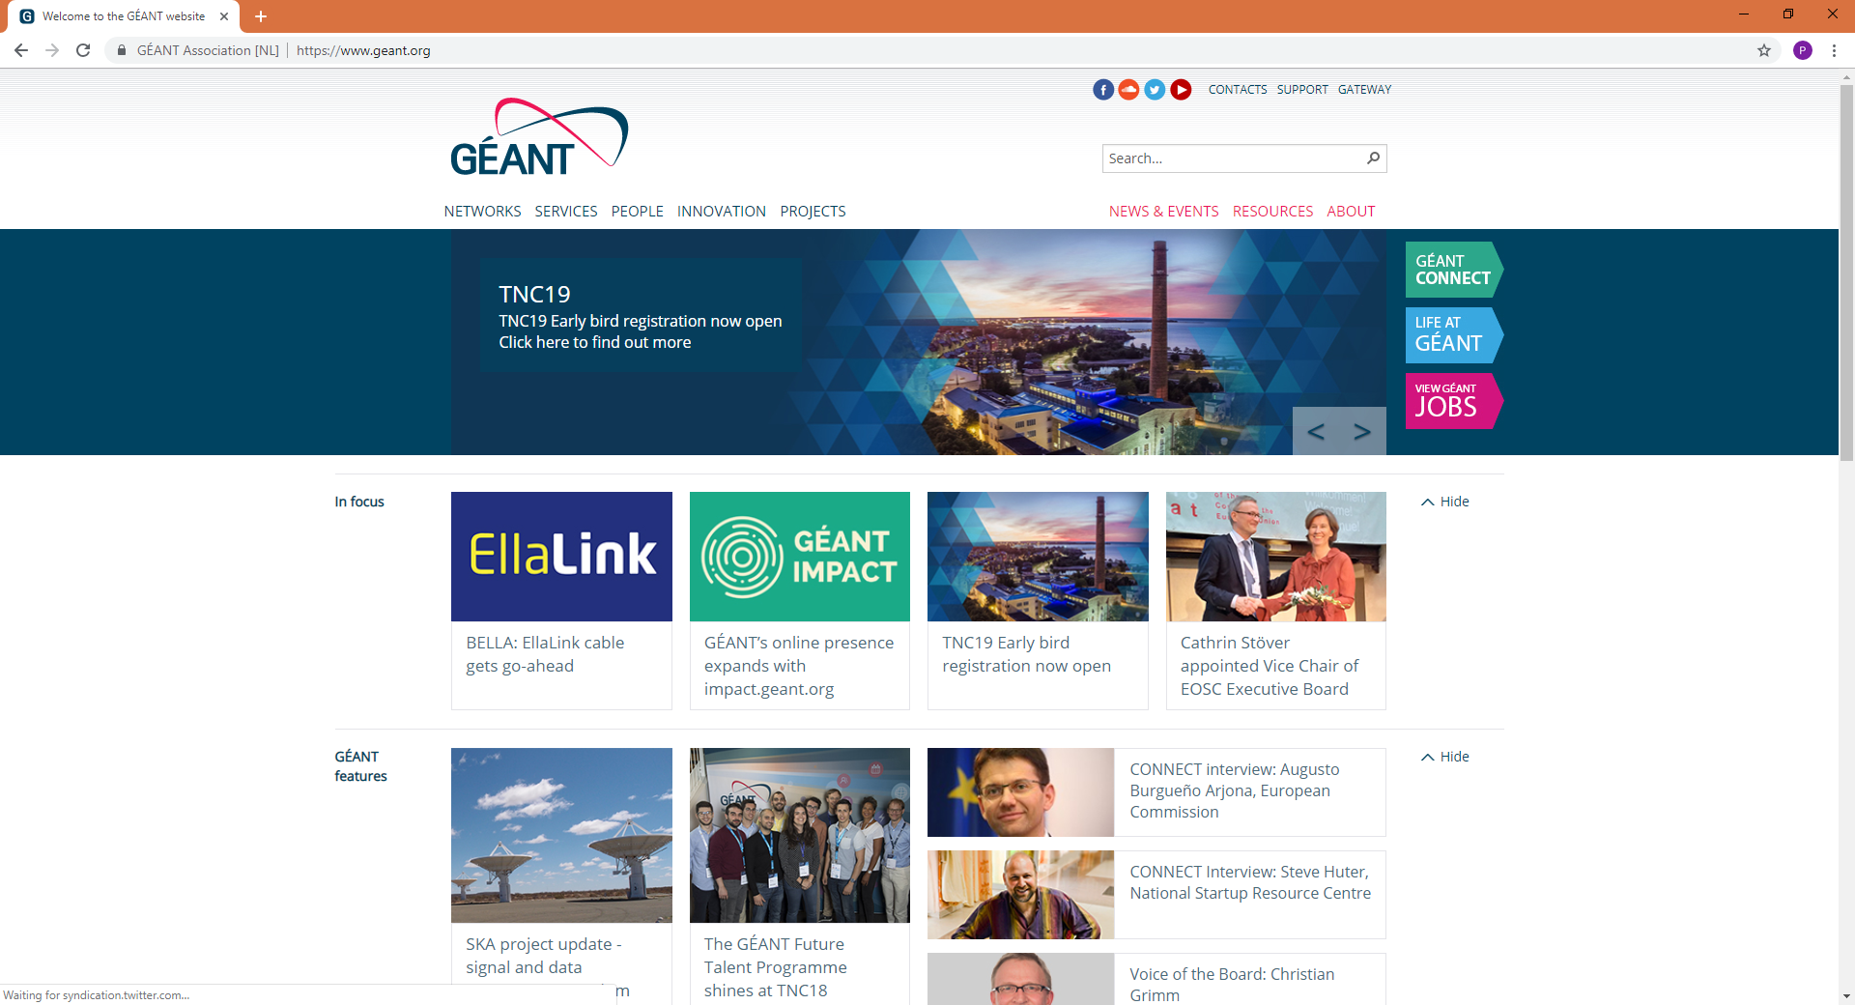
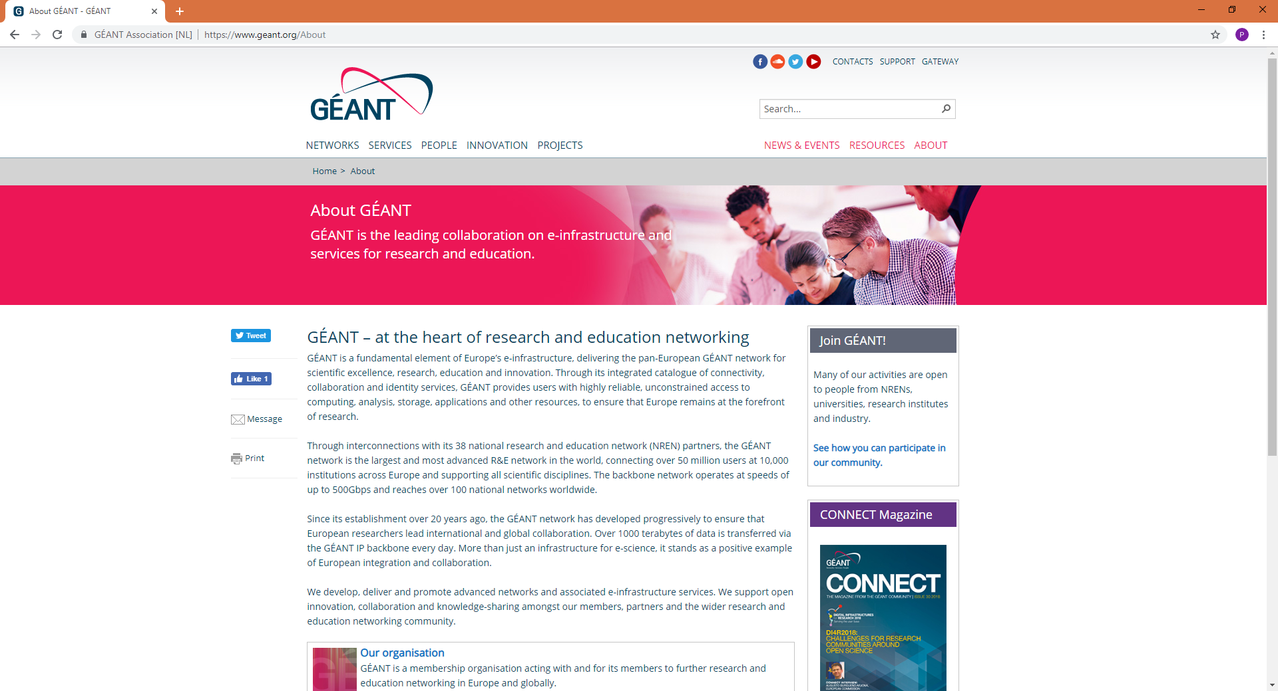
Background
We have geant.org – covering everything (too much)
Information can get lost beyond level 1 or level 2
Also, many aspects need their own web presence
  Services
  Events
  Publications
600+ pages!

Slide 3
Background
So we are ‘lightening’ geant.org to make it simpler, and easier to find key information…
… and strengthening identities of key areas by giving them their own web presence…
… and this all feeds into our digital engagement on Twitter, Facebook, Flickr, Instagram etc.

Slide 4
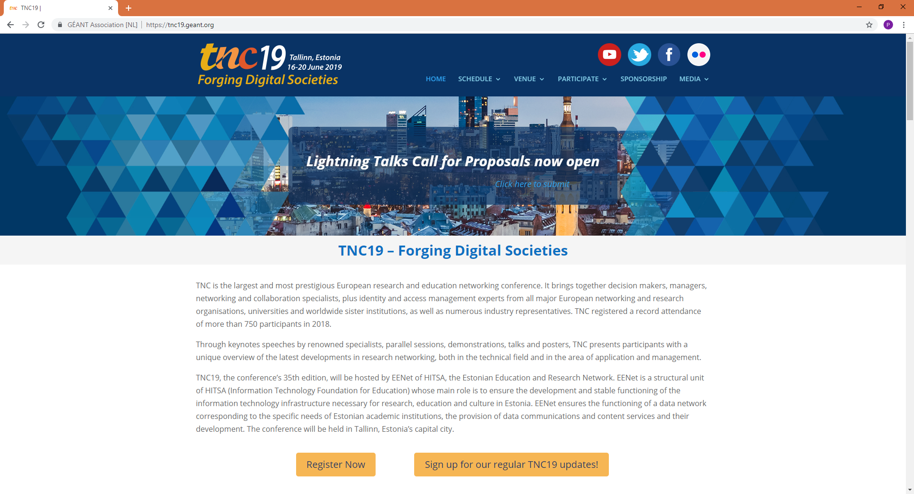
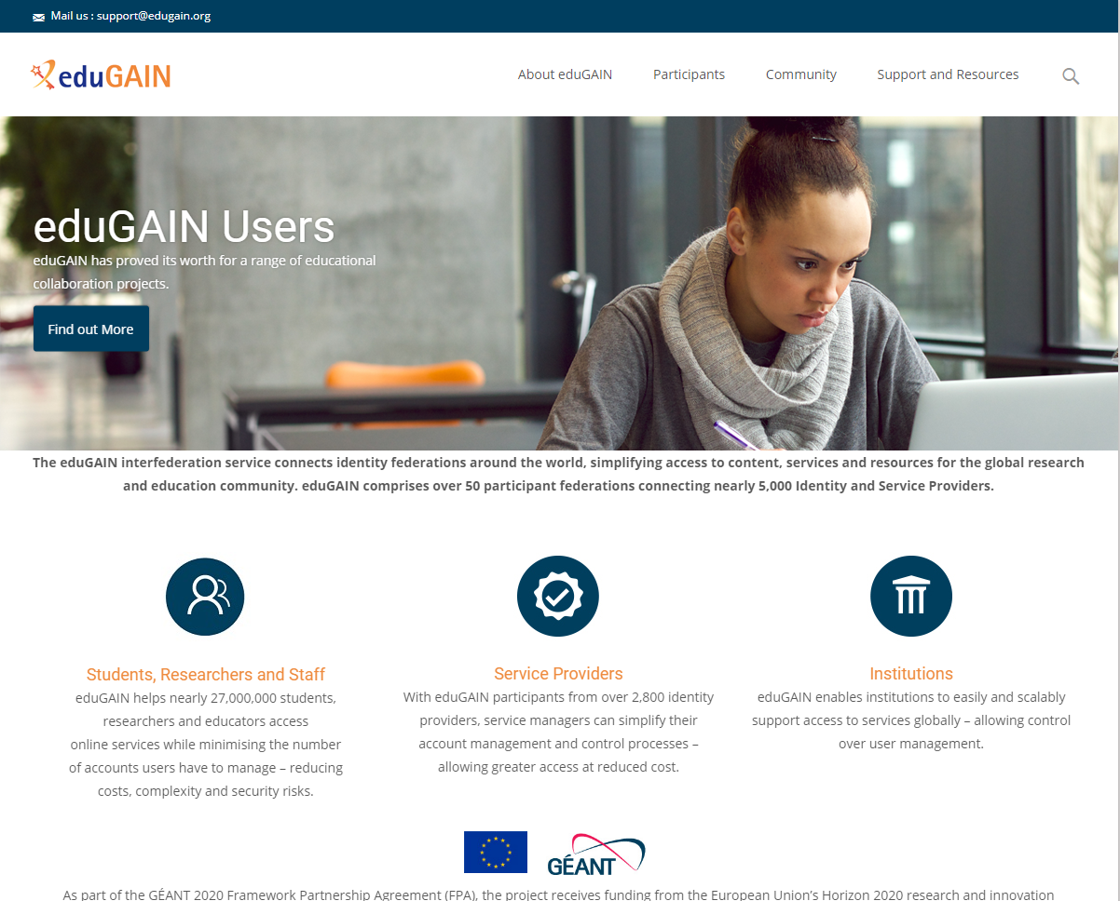
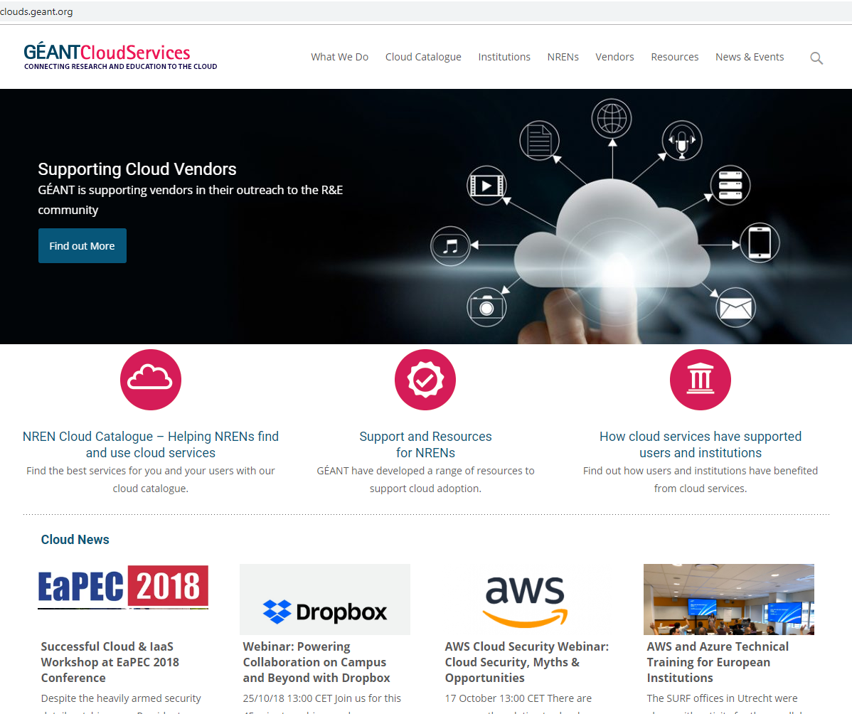
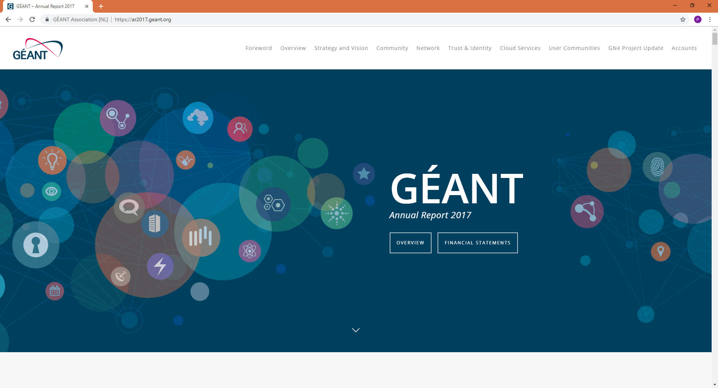
Background
So we already have a number of independent websites – e.g.
  edugain.geant.org
  clouds.geant.org
  tnc.geant.org
  ar2018.geant.org
  compendium.geant.org
  etc.

Slide 5
So what’s next?
Now we are focusing on:
  Research engagement (impact)
  Community (connect)
  Network (coming soon)

Slide 6
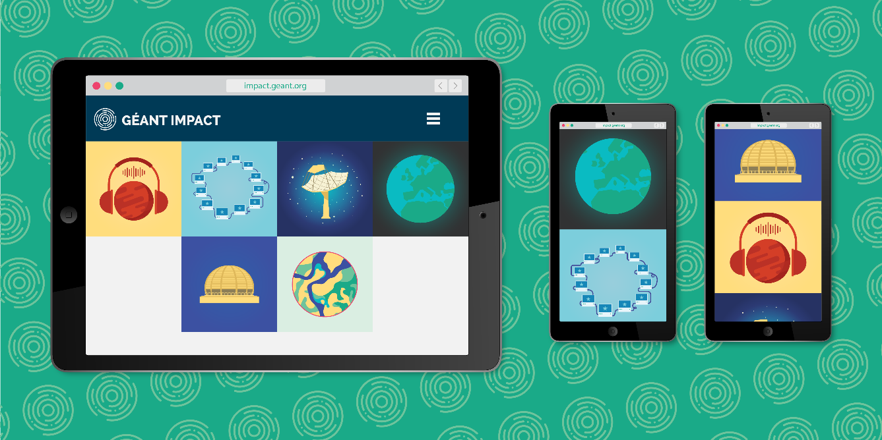
impact.geant.org
impact.geant.org launched to quickly and simply highlight some of the amazing projects supported by GÉANT and our NREN partners.
Clear GÉANT value proposition on each page
Simple, one-click access to project pages
LHC, PRACE, SKA, EUMETSAT, Copernicus so far
Used at events, and feeds digital engagement
Follows the “Why, how, impact” approach
900+ unique page views so far

Slide 7

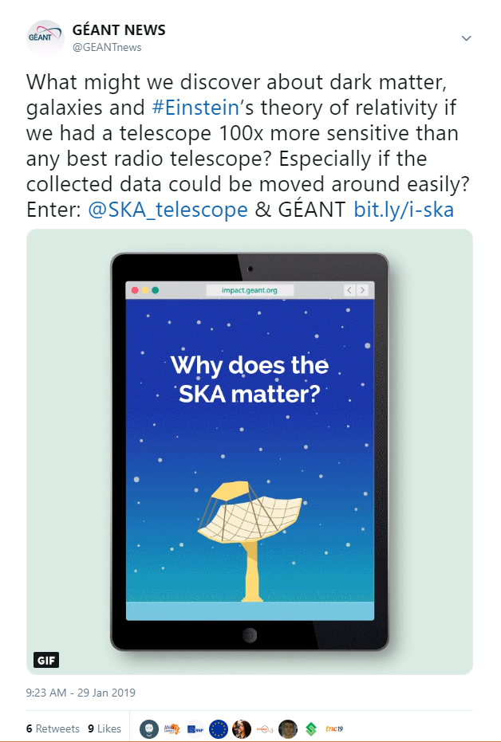
impact.geant.org
Campaign now running:
  Social media gifs
  Working with projects to expand our reach

Slide 8

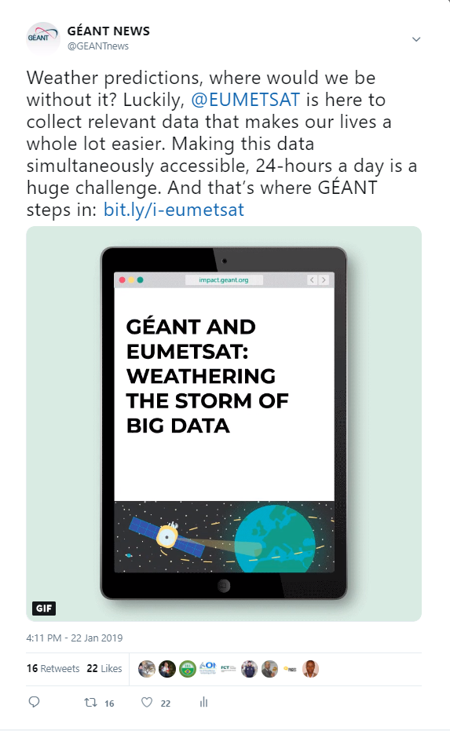
impact.geant.org
Campaign now running:
  Social media gifs
  Working with projects to expand our reach

Slide 9
impact.geant.org
Next steps
  Produce more user stories!
  4-6 more this year
  Do you want to take part?
  Which projects do you want to see?

Slide 10
So what’s next?
Now we are focusing on:
  Research engagement (impact)
  Community (connect)
  Network (coming soon)

Slide 11
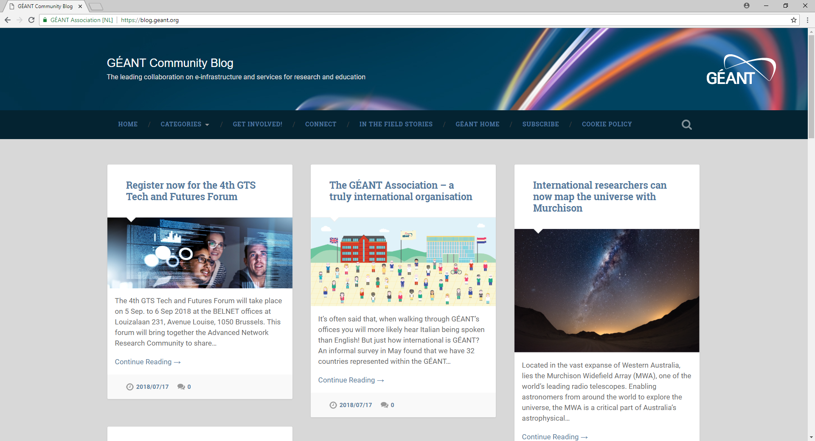
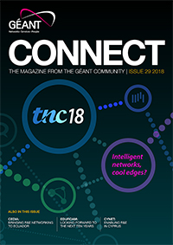
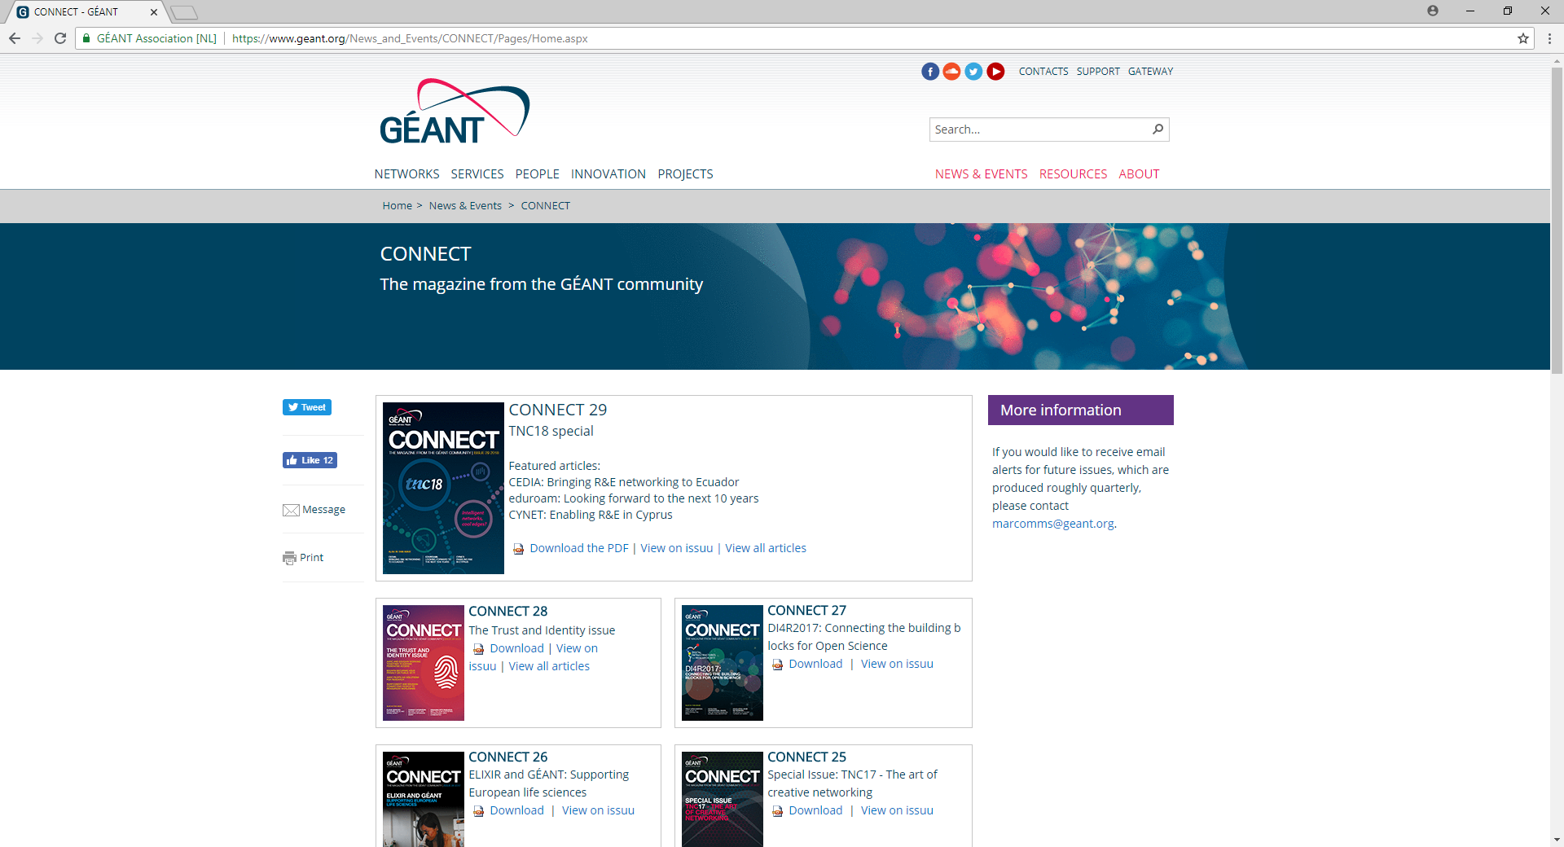
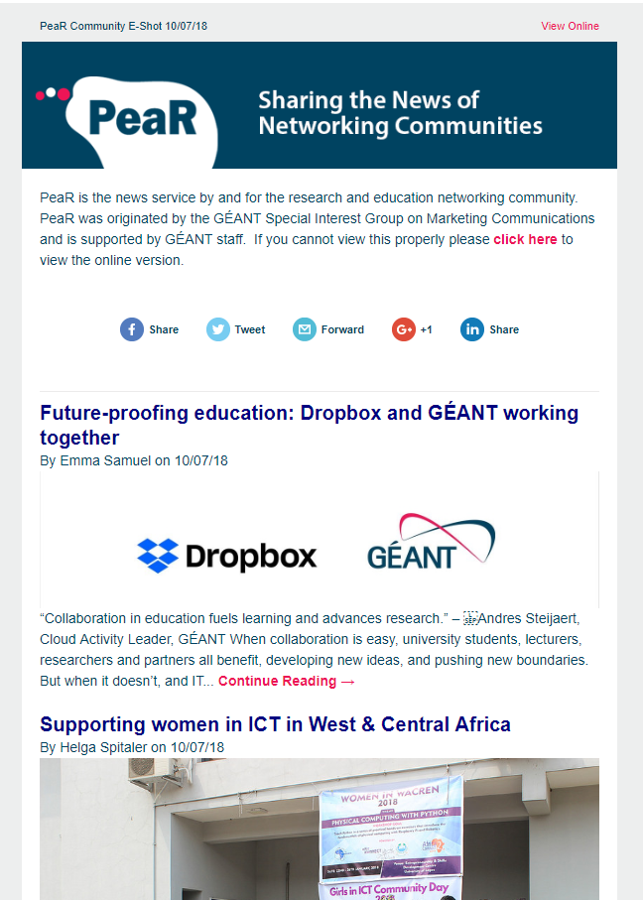
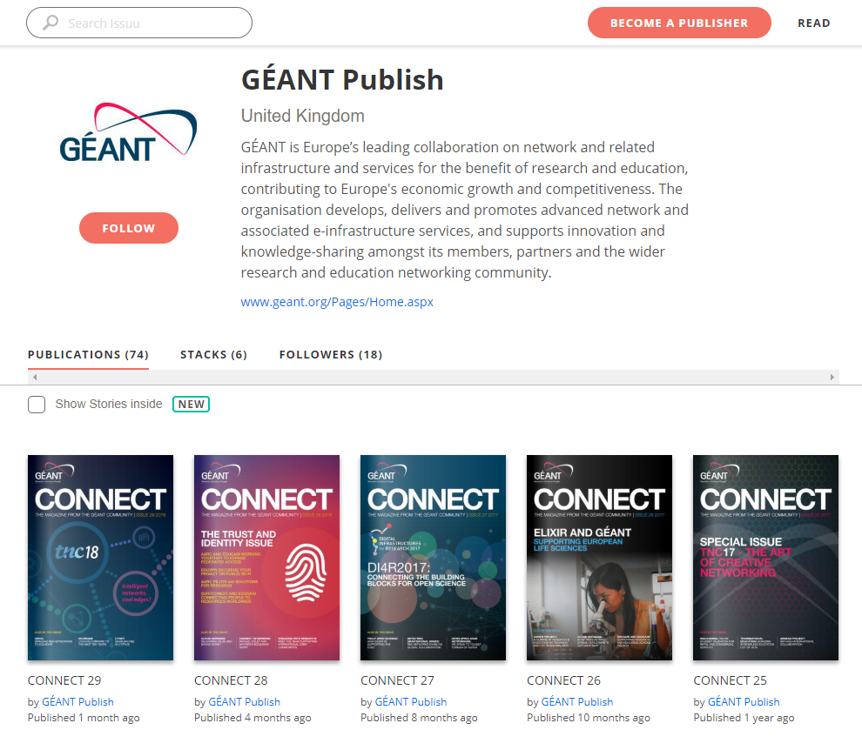
Moving from all of these:
Blog site + PeaR newsletter + CONNECT magazine + ISSUU + CONNECT section of website…

Slide 12
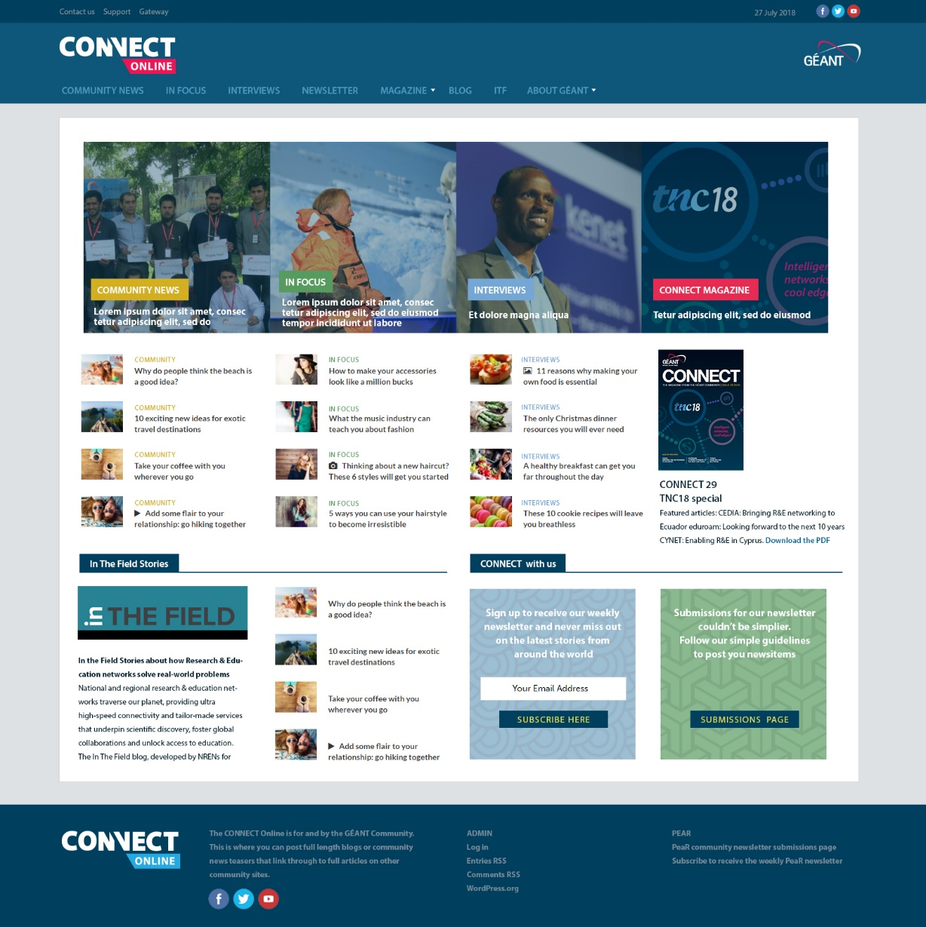
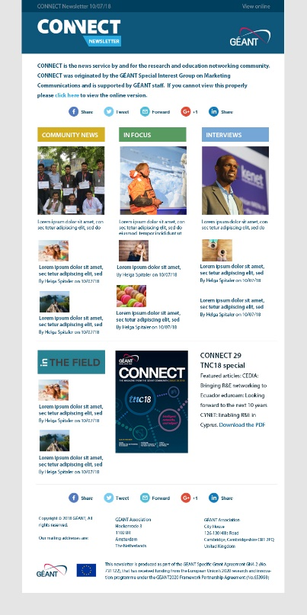
To: CONNECT family – website, newsletter, magazine
A website, newsletter and magazine.
The website will replace blog.geant.org (all existing content will be moved over, plus old CONNECT magazine articles uploaded). Sections will reflect those in the magazine. Contributors can upload news items to the Community News section, and we can add features and interviews either from the magazine, or that subsequently go into the magazine. Includes an In The Field section, plus a true ‘blogging’ area for future use.
The newsletter is effectively a rebranded and redesigned PeaR to bring consistency and to improve the reader experience – more content but less scrolling.
The magazine continues in its current format, published 3-4 times per year to coincide with events such as TNC and DI4R.
… and content feeds digital engagement on Twitter, Facebook, Flickr too!

Slide 13
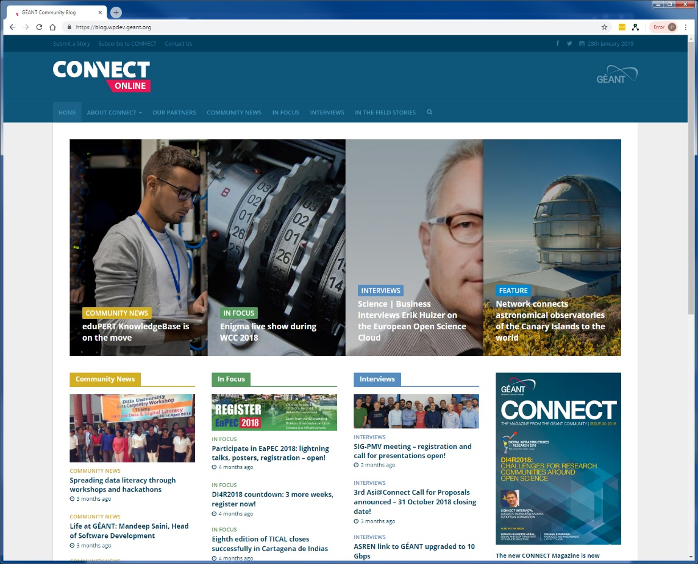
connect.geant.org – development site
Replaces blog.geant.org
All existing content will be moved over
Sections for
  Community news (news stories)
  In focus (articles)
  Interviews (including video interviews)
  Featured articles (hot topics)
- Link to ITF site
- Blogs (and Vlogs?) will come later
https://blog.wpdev.geant.org/

Slide 14
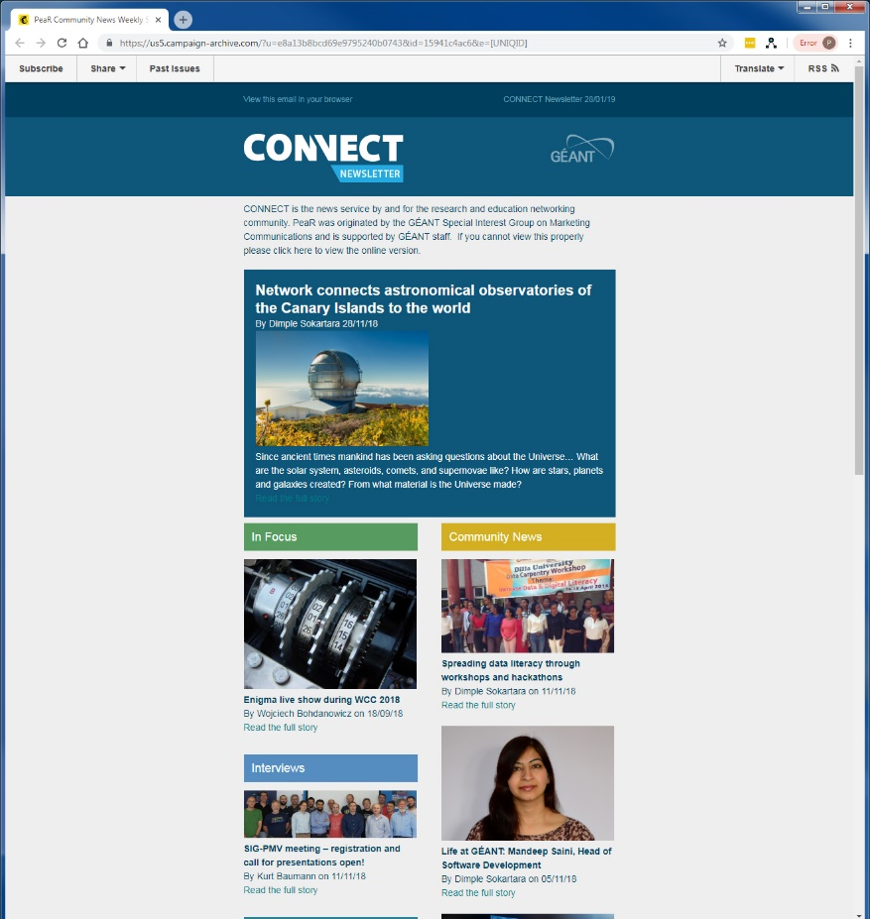
connect newsletter
Replaces PeaR newsletter
Linked to connect.geant.org, delivered via MailChimp
Same functionality for users
Each item has HEADLINE, image and URL only
Includes latest items added to:
  Community news (news stories)
  In focus (articles)
  Interviews (including video interviews)
  Featured articles (hot topics)
- Link to ITF site
Highlights social media feeds – e.g. Tweet of the week etc.
We will be in touch with more information

Slide 15
connect.geant.org and newsletter – next steps
Sign off on site design – February
Sign off on newsletter design – February
Let the community know about the changes
Produce mini-guide to show people how to use the site and newsletter
Invite beta testers – do you want to take part?
Move all old blog.geant.org content over; add all old CONNECT articles
Go live – would be nice to coincide with C31 magazine publish (March 6)…

