Slide 1


Metrics
Paul Maurice, GÉANT

Slide 2
Metrics
This is not a presentation about how to do metrics
This is just some of what we do!
You need to find what works best for you
  What are you trying to do/show?
  What are the best tools for that?
  Do they support the story you’re trying to tell?
  Do they identify areas for improvement?

Slide 3
Metrics
What do we measure?
  Website visitors, page views, device type
  Number of articles published on the blog site
  How many CONNECT magazines distributed at events?
Campaigns
  #Love2eduroam – level of engagement; website traffic etc.
  #road2TNC – level of engagement
Metrics don’t always give full picture – some things aren’t measurable with stats!

Slide 4
Websites
All GÉANT sites are set up for Google Analytics
We can see:
  How many unique visitors?
  How many unique page views?
  Which countries do our web visitors come from?
  What pages do they look at?
  Etc.

Slide 5
Channels
Weekly newsletter (sent out via MailChimp)
  How many people is it sent to?
  How many people opened it?
  How many people clicked on a story?
  How many people forwarded this to a colleague?
What can we do with these metrics?
  Do metrics show that people are interested in particular topics? If yes, we can increase amount of content about those topics

Slide 6
Channels
Twitter
  Level of activity – how many tweets are we doing per week?
  What sort of tweets brings the most engagement?
  What is our level of engagement?
  Who is re-tweeting us?
  Is our website traffic affected by this activity?

Slide 7
Setting and reporting on metrics – some examples
Objectives
  “Increase effectiveness of social media as a channel”
Plan
  How we are going to do that…
    A
    B
KPIs (Key Performance Indicators)
  At least 50% of Twitter posts to achieve at least 2% engagement rate
  At least 25% of website traffic to arrive from social media sites

Slide 8
Setting and reporting on metrics – some examples
Objectives
  “Demonstrate the impact of the marketing work for our project”
Plan
  How we are going to do that…
    A
    B
KPIs (Key Performance Indicators) – how can you measure something ‘vague’?
  Increase website visitors by 10%
  Grow social media followers by 20%
  Generate 2 case studies per research community

Slide 9
Summary
Do you need to speak to funding bodies?
It’s important to back up your story – how you choose to do this is up to you
Do you need to improve your effectiveness?
Metrics can help to identify those tools that work – and those that don’t
Do you need to justify your marketing team/budget?
Then you need stats, metrics and lots of success stories

Slide 10
What does the EC want to see?
Success stories – it helps them to justify their funding
Easy to read, easily digestible information and stats
Infographics, customer quotes, benefits – all work
Doesn’t take long – extract the positive message from your metrics and deliver it simply and in a way that’s easy to understand
BUT – you can’t pull the wool over their eyes. They know what to ask, they know what to look for – you need to be prepared to back up your story!

Slide 11
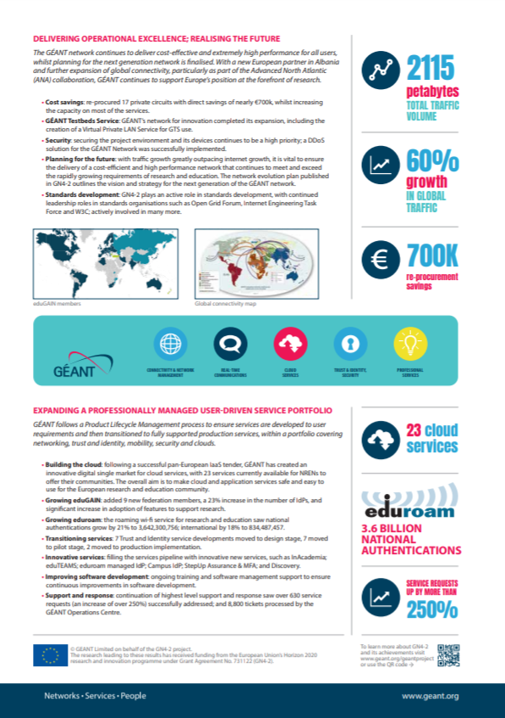
2 pager to support the EC review

