Slide 1
Jisc – what’s it all about?
Robert Haymon-Collins, Executive director, Marketing and communications

Slide 2
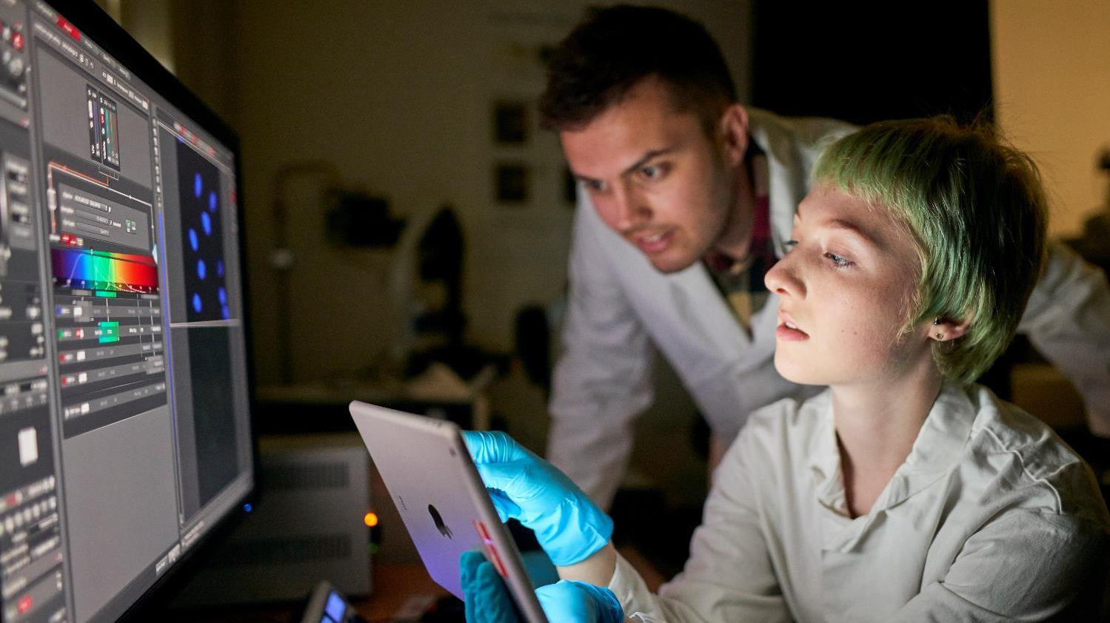
We provide digital solutions for UK education and research.
Our vision is for the UK to be the most digitally-advanced higher education, further education and research nation in the world

Slide 3



What we do…
Shared
services
Sector
deals
Advice and
assistance
Our shared digital services and infrastructure have been developed with and for UK colleges and universities
Our negotiations, procurements and frameworks give access to digital services and resources, saving time and money
We offer trusted advice and practical assistance for universities, colleges and learning providers

Slide 4
Our members and users
18 million
956
452
160
40+
Colleges
Universities
Skills providers
Research institutes etc
Users
Notes:
Jisc membership and users

Slide 5
UK core funding and HE subscriptions
HE (universities, colleges) pay an annual subscription
  A contribution to the whole
  Linked to ability to pay
FE colleges currently don’t
  But will do so from AY 19/20
  England only
15%

Slide 6





Strategic aims…
Network
Products
Valued
Sustainable
Enabled
Continue to develop Janet – the foremost national research and education network in the world
Focus our products
to make the most difference to learners, teachers and researchers
Increase our
profile with
the sectors, stakeholders, key influencers and members
Build a strong, financially sustainable position
High standards of efficiency and effectiveness, recognised as the leading sector
agency in the UK

Slide 7

Jisc in the UK
A UK-wide operation
A membership organisation, not a vendor
Five offices across the UK
  London
  Harwell
  Bristol
  Manchester
  Newcastle
725 members of staff

Slide 8








How we help our members
Cloud - frameworks and consultancy
Connectivity - connectivity services and trust and identity
Cyber security - protecting networks and organisations
Data and Analytics -addressing strategic challenges through data
Libraries and research - shared services, infrastructure and advice
Student experience - enriching learning and employability
Advice and Guidance - guides, training and consultancy
R&D - co-creating new products and services

Slide 9

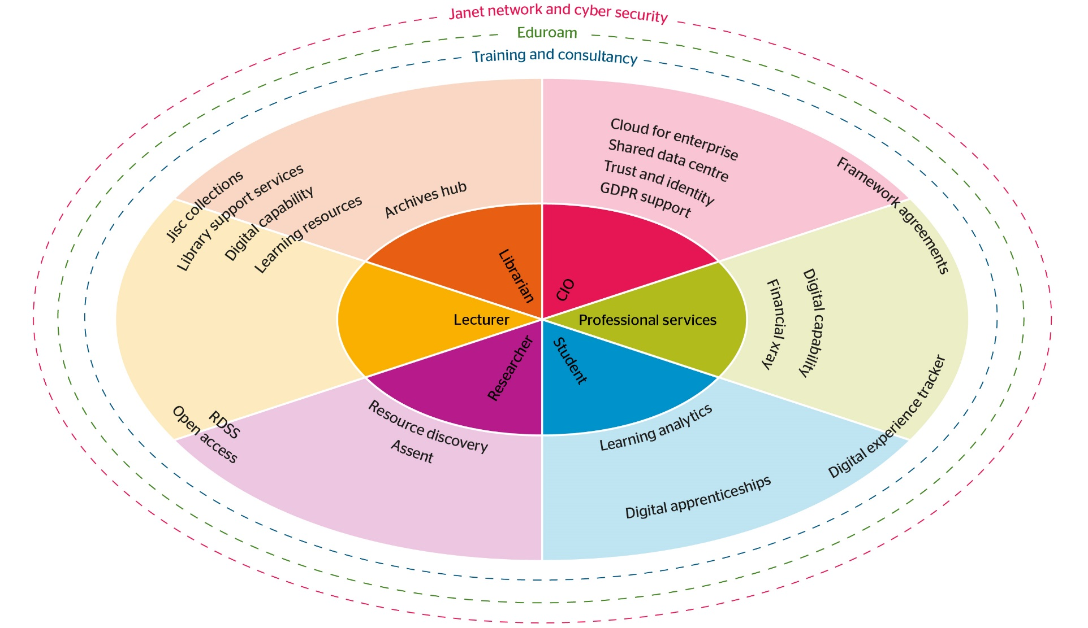

Slide 10
Marcomms in Jisc
Marketing
Product marketing planning
Product &
Portfolio
Product & lifecycle management
Insight
Market research
Comms
Internal/Corporate
Portfolio management
New ideas
Member voice
Satisfaction & loyalty
Sector intelligence
Digital platforms
Public affairs
Press & Media
Content
Multimedia
Brand
Production

Slide 11
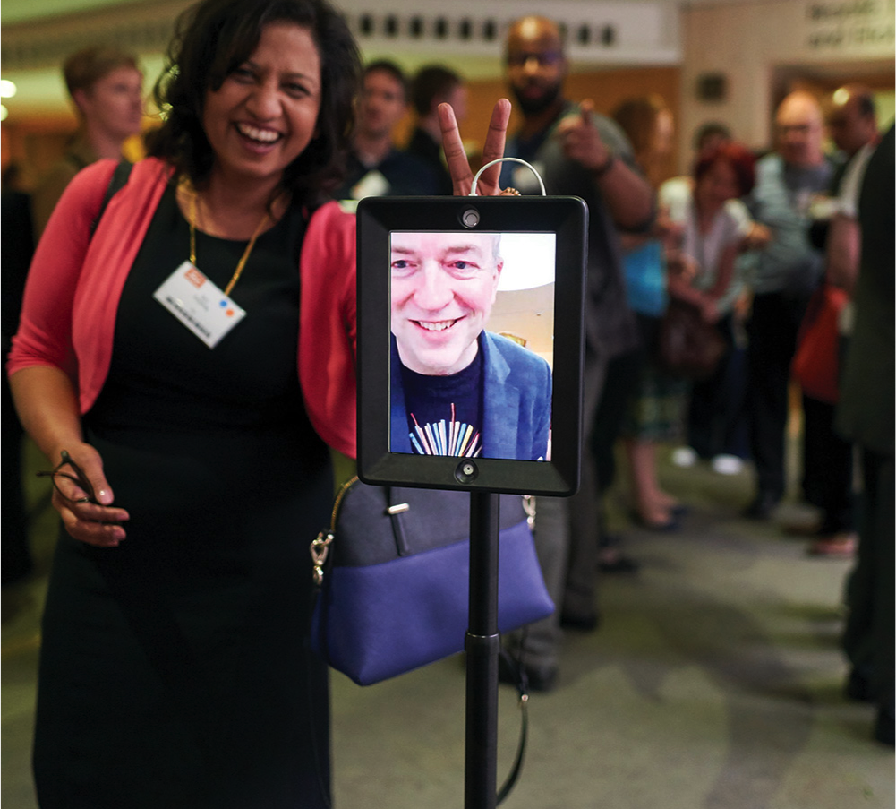
Jisc strategic direction
Being the undisputed lead digital body for UK higher and further education
Mergers for skills and technology acquisition
Drive income from non-members – public sector, government
Series of new products in cyber, learning analytics, cloud, research data, trust & identity
Thought leader in digital capabilities, Edtech and Education 4.0
A credible and trusted social enterprise deeply embedded in tertiary education and research

Slide 12
Robert Haymon-Collins
Executive director, marketing and communications
Robert.haymon-collins@jisc.ac.uk

