Slide 1
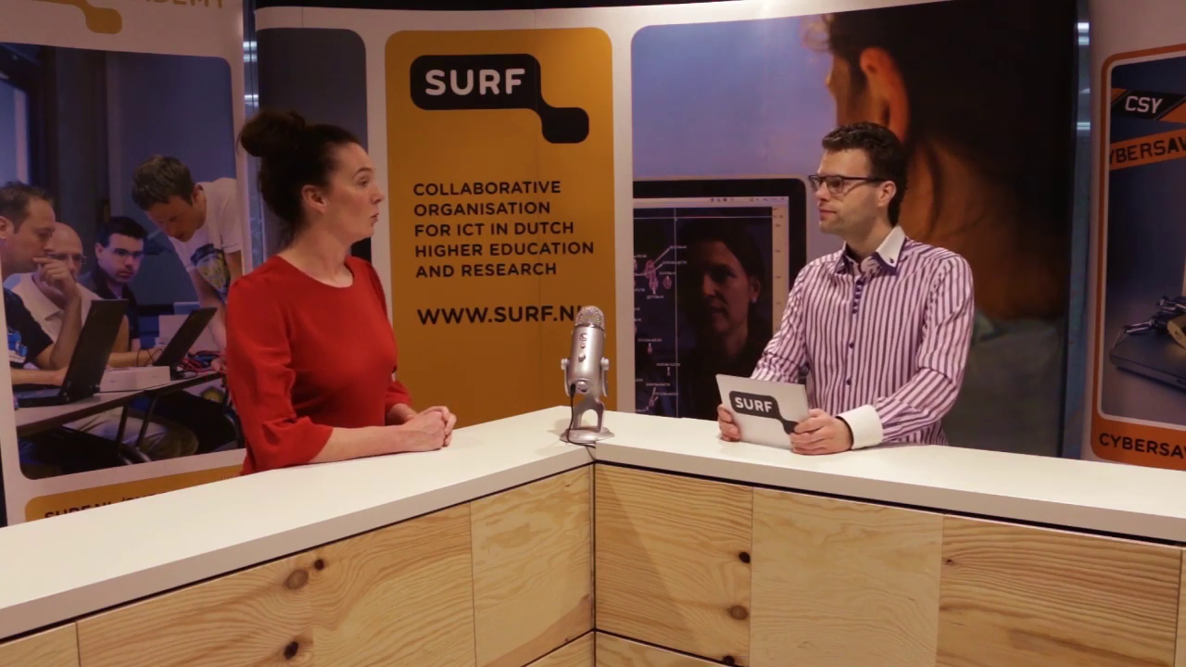
Experimenting with webinars
Lonneke Walk
SURFnet

Slide 2
Why experimenting with Webinars
Customers can choose themselves when to watch
Customers don’t have to travel for a short meeting/seminar
It’s very effective for instruction tutorials:
            You can add links, documents, images, animation or schemes
More influence on the message from communications point of view
Our institutions already do webinars, why don’t we…
It’s fun to do!

Slide 3
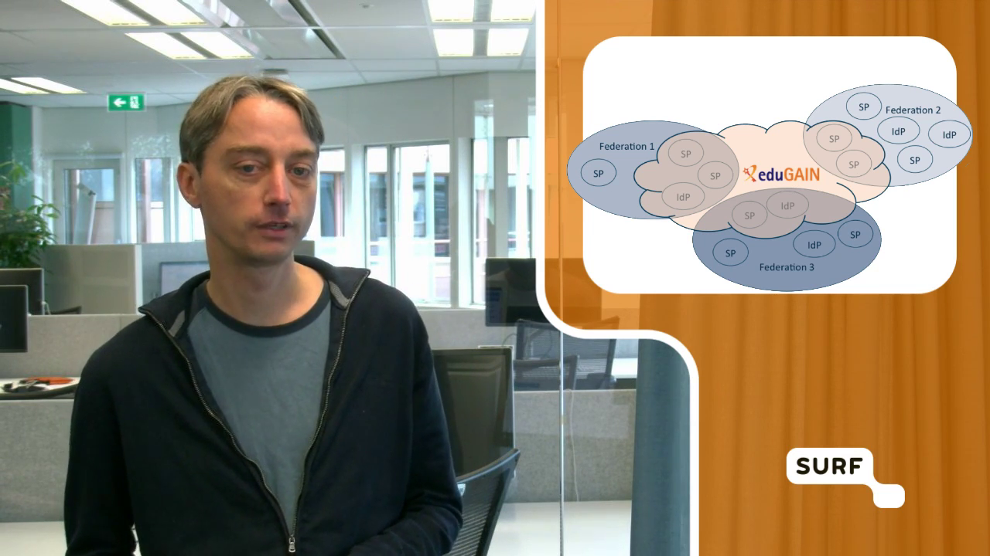
Formats we tested – presentation by one speaker

Slide 4
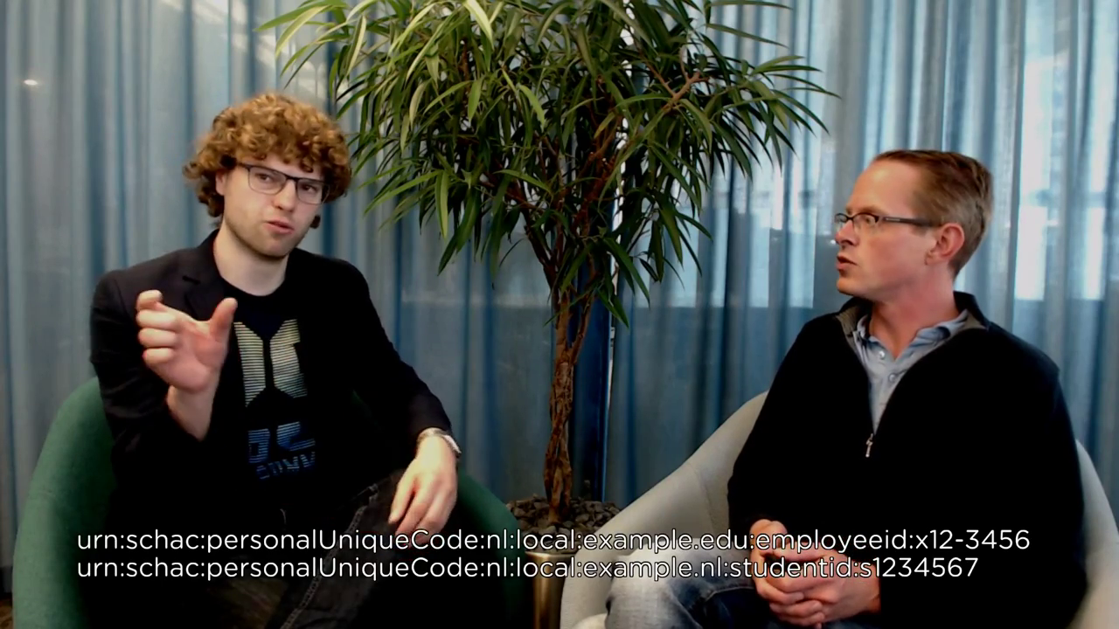
Formats we tested – 2 persons in conversation

Slide 5
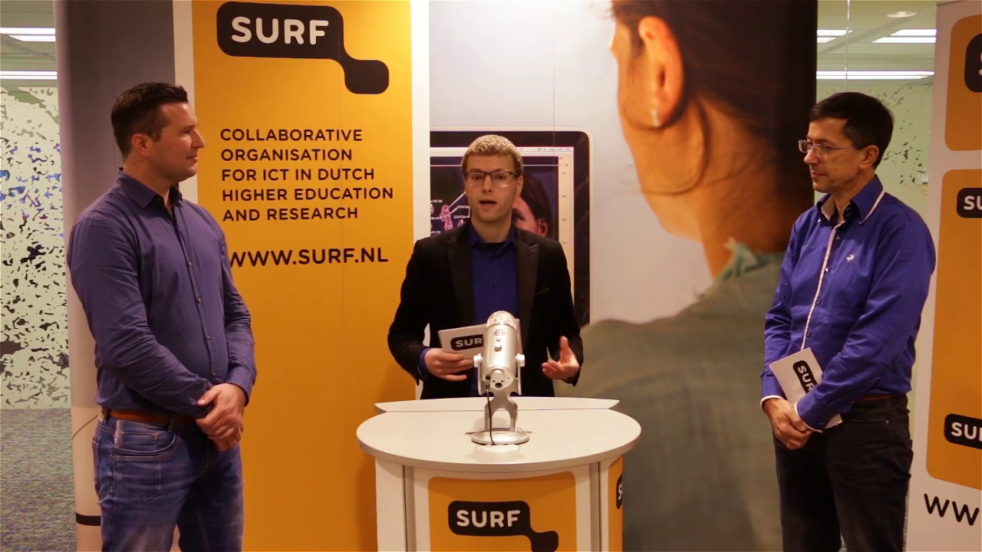
Formats we tested – Talkshow with more speakers

Slide 6
Formats we tested – Talkshow, including external reports

Slide 7
Steps
Preparation
Practice
Technical preparation
Rehearse with the technic
Broadcast
Make on-demand available

Slide 8
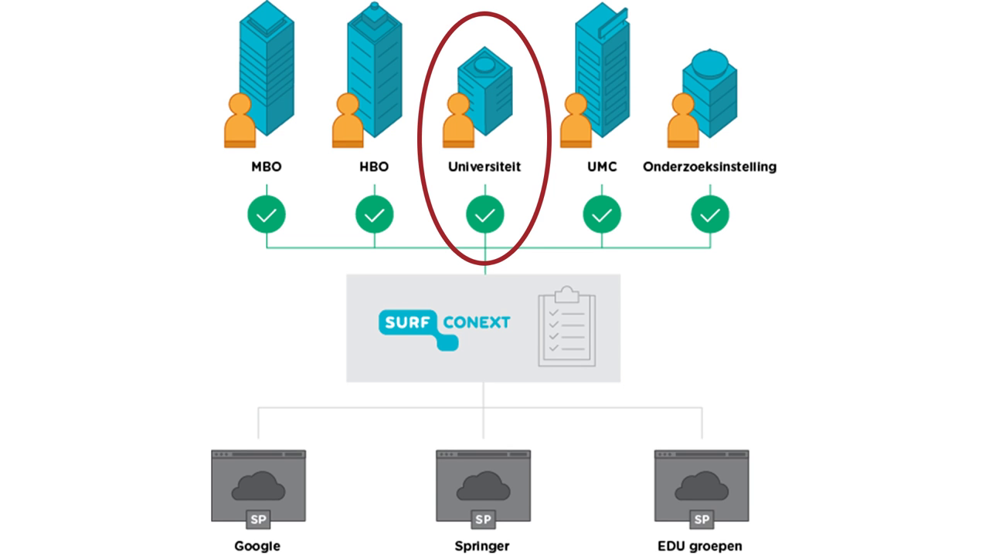
1. Preparation
SURFconext
Define your goal and message
Define your target group
Write a script!
Think about adding extra’s:
            Keywords
            Animation
            Schemes
            Screencast
Choose the best fitting format that suites your goal and message
Plan to promote your webinar

Slide 9
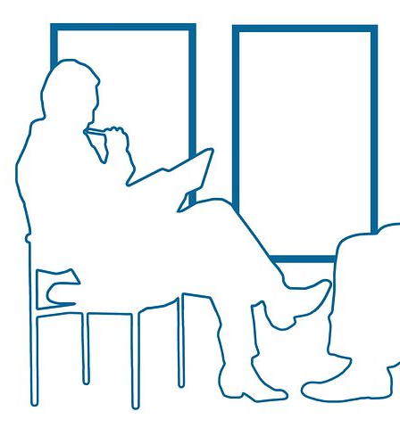
2. Practice
Practice your script without camera’s to check your storyline and timing
Know what you want to say
Know what and when you need extra features

Slide 10
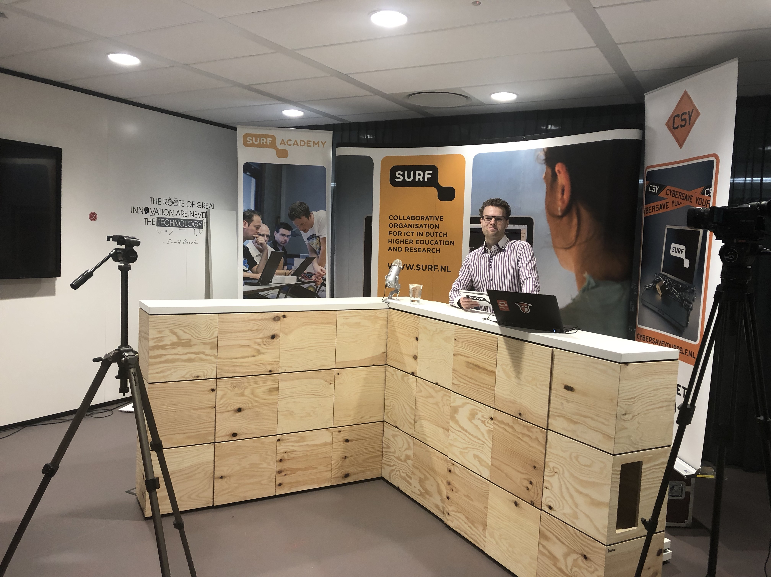
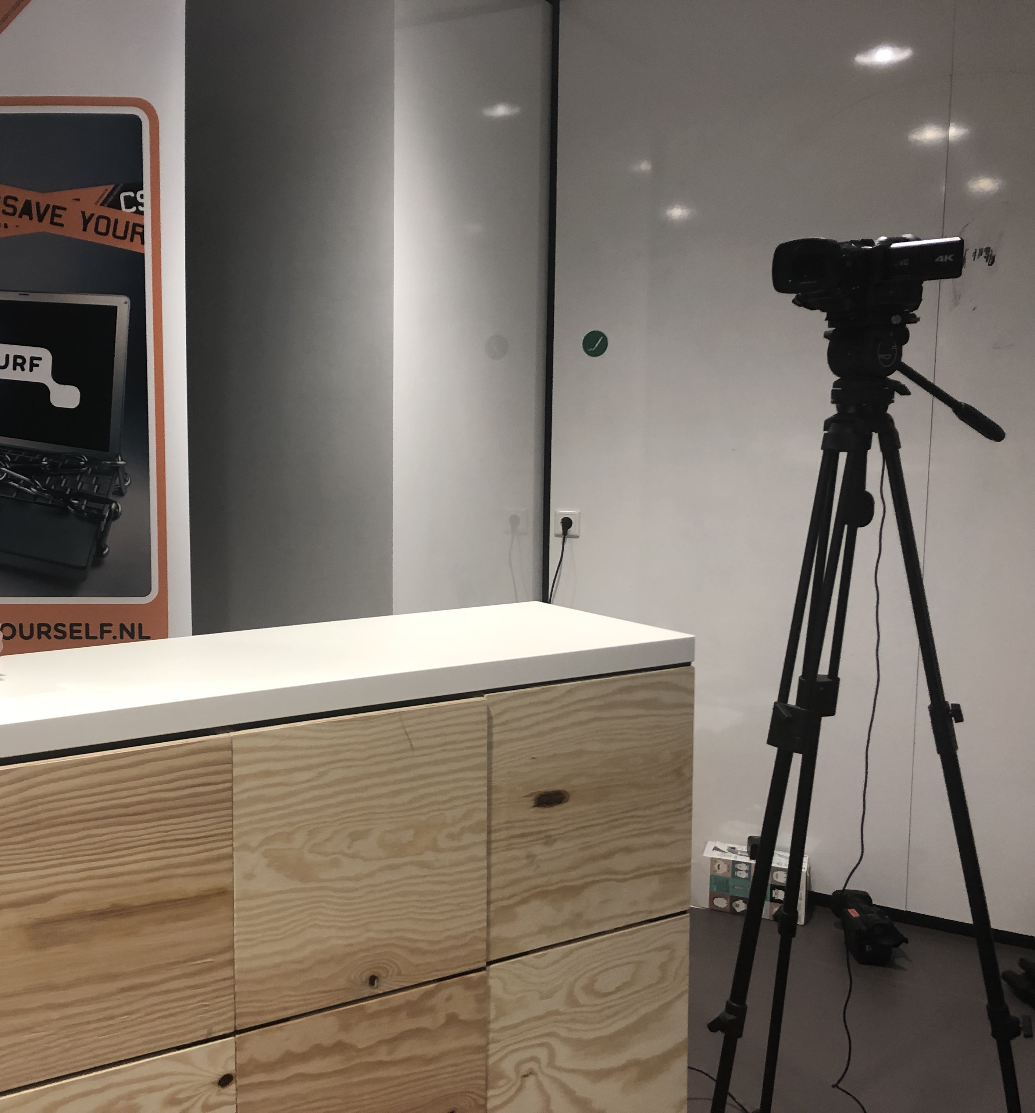
3. Technical preparation
Camera
One or more
Microphone
Better to have a separate one
Streaming software
Open Broadcasting Software and streaming service (YouTube)
Light
Environment
Desk, studio setting, your logo visible

Slide 11
4. Rehearse with technic
Know when to look at which camera
When to switch camera’s
When to transfer to a scheme, other video, animation, etc

Slide 12
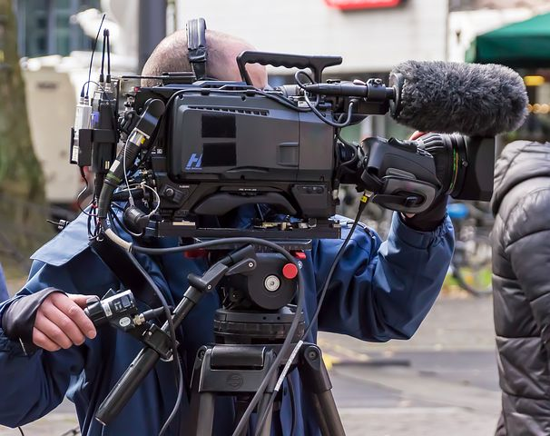
5. Broadcast
Let wathcers know how they can interact and ask questions
Host can read comments/chats on screen and takes care of answering them during broadcast

Slide 13
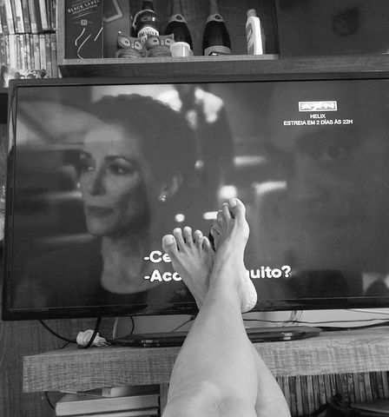
6. Make on-demand available
Communicate about the on-demand webinars
Link to more information to read or contact
Evaluate internal and external
Statistics

