Slide 1



eduroam promotion
Karl Meyer, GÉANT
January 2019

Slide 2
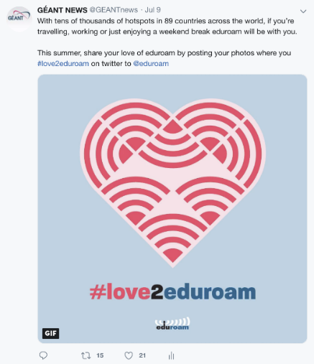

#love2eduroam
“#love2eduroam” worldwide campaign was the strongest yet
  31 NRENs across the world and many individual institutions,
  500,000 impressions
  > 20% increase in web visitors to the eduroam website

Slide 3
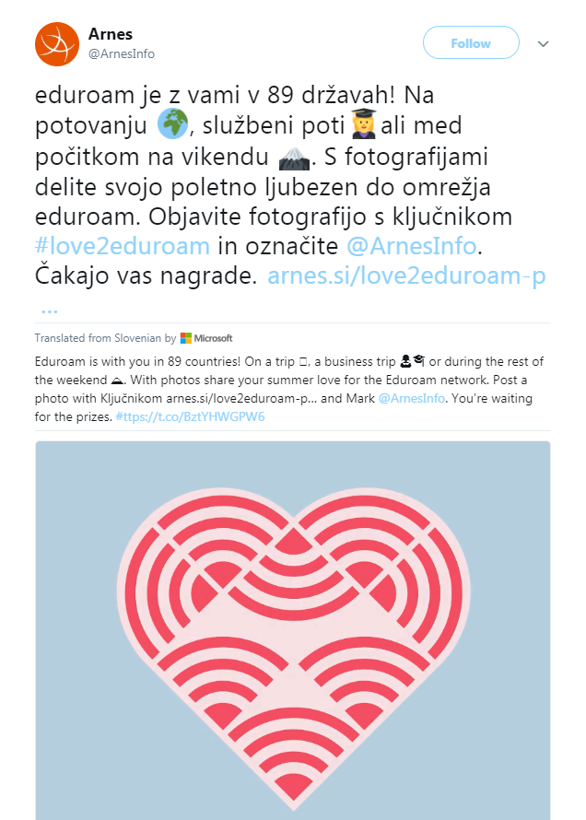
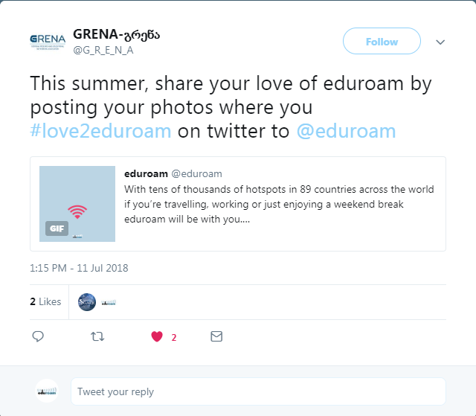
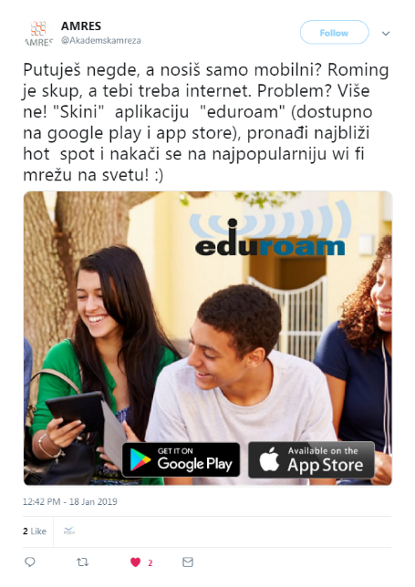
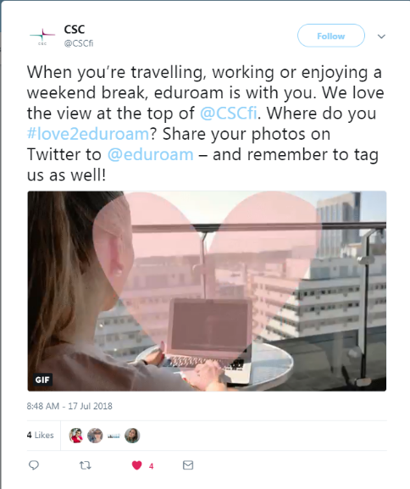
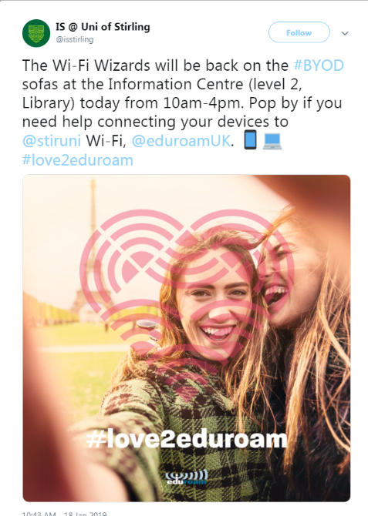
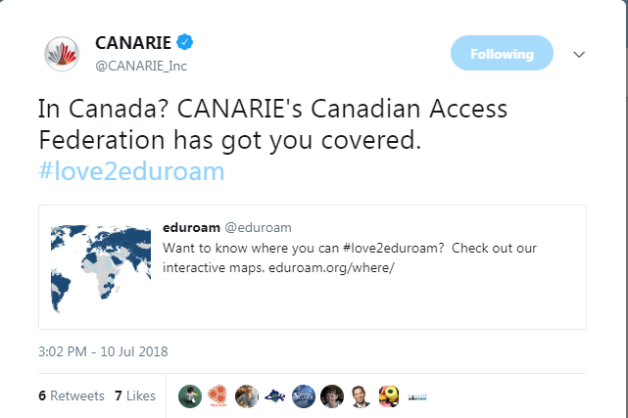
Great NREN engagement

Slide 4
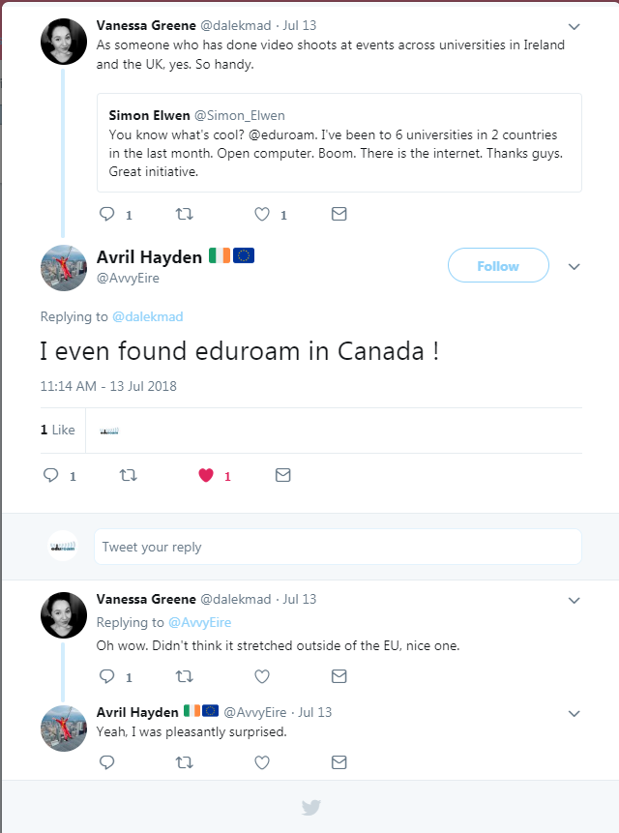
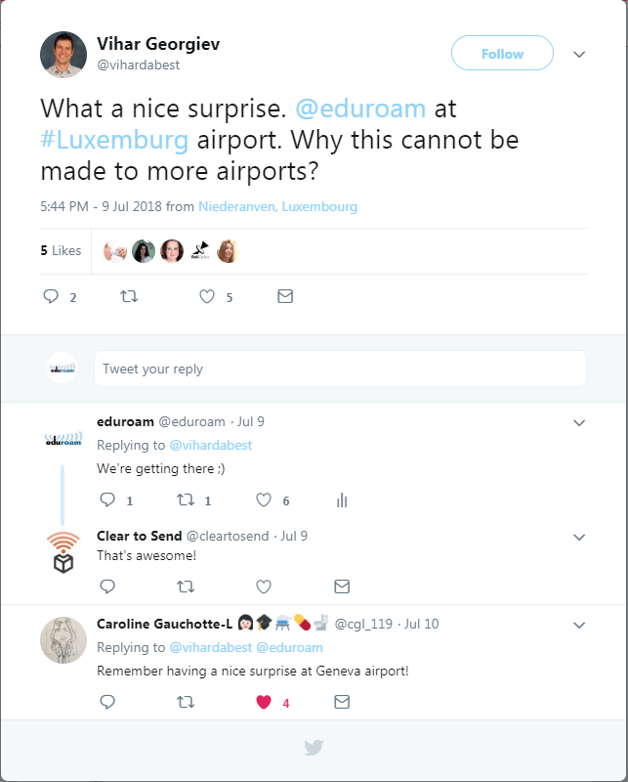
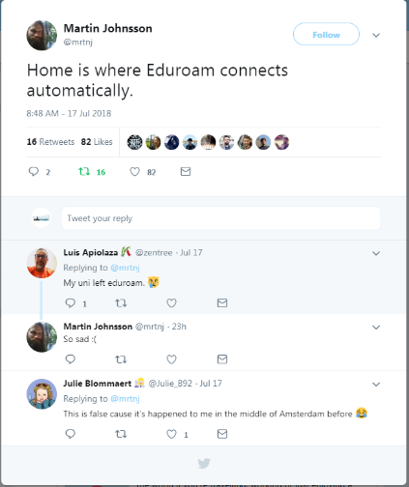
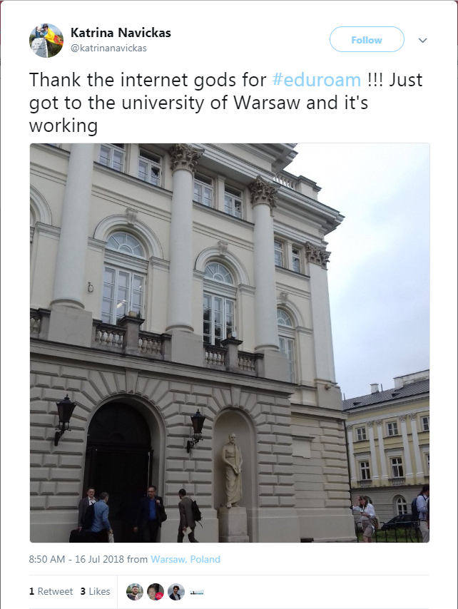
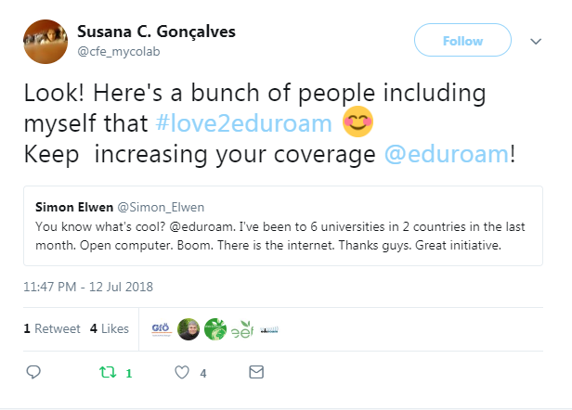
Users getting involved!

Slide 5
Where now?
Over to you!

Slide 6
Thank you
Any questions?

