Slide 1


GDPR for MarComms & Events
Best practices from GÉANT
Magdalena Rzaca
GDPR IPR Legal advisor
Dimple Sokartara
Communications Officer
GÉANT

Slide 2
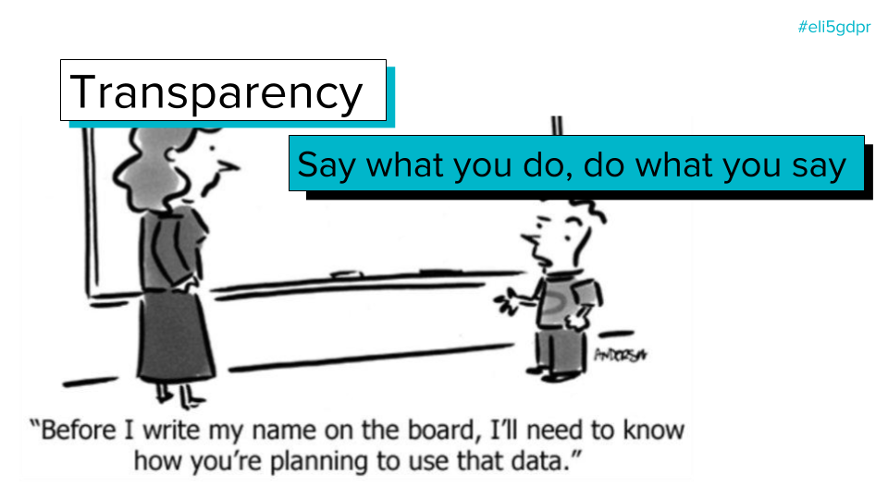
Rule of thumb
Make sure to have a clear privacy notice where everything can be referred to.
≈

Slide 3
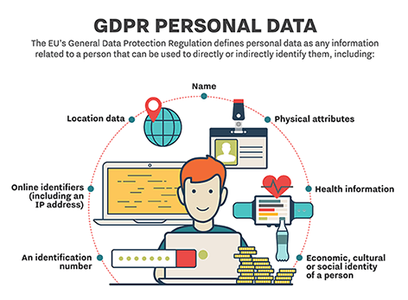
Personal data
To process personal data your MarComms and/or events team, will need to have lawful basis to do so. The possible basis are:
Consent
Contract
Legitimate interest
Additionally, any personal data must be processed for specific purposes as for example: managing registration, subscription process (e.g. for a newsletter, mailing list) or target marketing (e.g. personalized communications).
What type of personal data can be asked as a general rule?
Personal data that is necessary to make sure one of the three aforementioned objectives are met. In other words, if you are not going to use phone numbers for any purpose, do not ask for it.
What notification regarding data processing needs to be given?
In case there is no privacy notice, wherever personal data is collected – there should be clear information provided. This could be done via:
Terms and conditions document
Registration/subscription form
≈

Slide 4
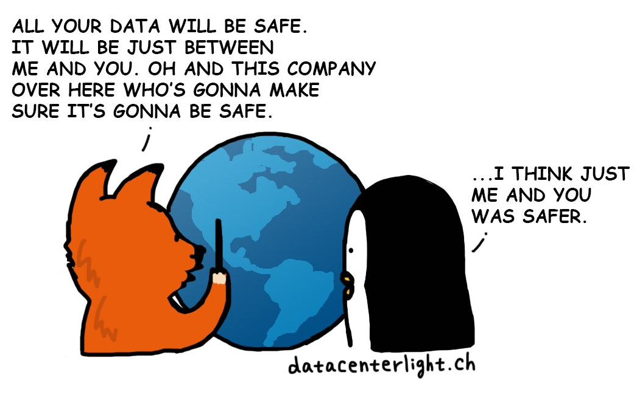
Third parties
Can third parties ask for personal data collected by your NREN/organisation?
Only if it is stated in your privacy notice, terms and conditions, or separately on a registration/subscription form.
How to deal with external photographers/videographers/editing teams creating materials during the event?
A non-disclosure agreement should be signed with such parties, where it should be clearly stated that all the materials will be handled to your organization.
Unless these parties have their own terms and conditions where they state to store the material for a definite period of time. In this case this should be communicated in your privacy notice, terms and conditions or other ways of GDPR related communication.
≈

Slide 5

Images and videos
What type of images can be uploaded without any explicit consent?
In case there is no privacy notice, group pictures during events or meetings where participants need to register for can be used online and offline. In any case it is advisable that during the registration for the event, there will be information provided on photos and videos that will be taken.
How can images/videos of individuals be used?
In case there is no privacy notice, pictures of individuals cannot be used without explicit consent or a notification that clearly states that there will be images/videos taken (e.g. communicate clearly to speakers, participants).
Can it be assumed that participants of events and meetings automatically give consent to upload images/video of them?
If it’s covered in your privacy notice and people are aware that pictures will be taken and published: yes.
≈

Slide 6

Email, website and social media
Can stored personal data be used to send e-mails about future events or to share less directly relevant content?
The retention period is explained in your privacy notice and will inform how long personal data will be stored for. In case of events, specific consent needs to be requested for the use of one’s data for other purposes.
Example, if a participant registers for this year’s edition of an event, the participant should opt-in in order to receive communications regarding next year’s edition of the same event.
Can personal data be shared on websites?
The privacy notice should clearly indicate where personal data will be stored and presented. Pictures, videos and names of speakers might be presented on certain relevant websites. This, of course, cannot be done without a clear mention or consent.
Can personal data be used for/on social media?
The same rule for websites applies to social media. When pictures are shared on an ‘official’ channel, please ensure that it is treated just as serious.
Do you have a clear privacy notice/consent to put someone’s name and image on social media?
≈

Slide 7

Thank you! Questions?
magdalena.rzaca@geant.org
dimple.sokartara@geant.org

