Slide 1


Digital engagement
Trends, recommendations, and the power of video
Dimple Sokartara
Communications Officer
GÉANT

Slide 2

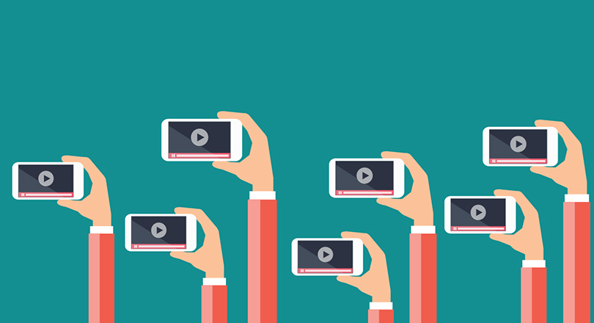
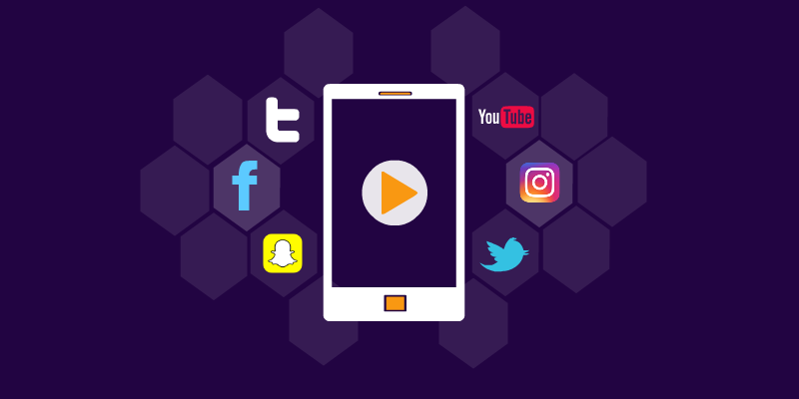
Social Media Week London 2018
Influencer marketing
Create content that focuses on value exchange, who makes a real impact in our community?
Focus on short, interesting, catchy videos
Dig deep into social data and make use of available tools
Stay true to your ‘brand’, tell your ‘brand message’
Social media live options, depending on the audience
Keep an eye on privacy and GDPR in terms of data collection
Specific strategies for each platform
Don’t ‘shove it up people’s noses’. Skepticism against social media is increasing.
≈

Slide 3
Recommendations based on analysis of GÉANT’s digital engagement 2018
Include as much pictures as possible in posts on meetings, project updates, signings etc.
Create more social media campaigns for the audience to get involved with, perhaps even highlight the most engaging post (similar to #road2tnc, #love2eduroam)
Keep tagging relevant accounts in posts
Focus on more relevant ‘celebrations’ or ‘special days’ (i.e. international women’s day, international day of science etc.)
Start ‘employee advocacy’
Create ‘personal’ stories (interviews, ‘a day in the life of..’)
Highlight the ‘themes’ we work for/with through short videos, interviews of ‘influencers’
Optimize website to make it more attractive for the audience to visit (or adjust the need to lead traffic to the website if we decide that the website will be informative rather than storytelling)
CONNECT magazine content for social media
Experiment with Instagram
≈

Slide 4
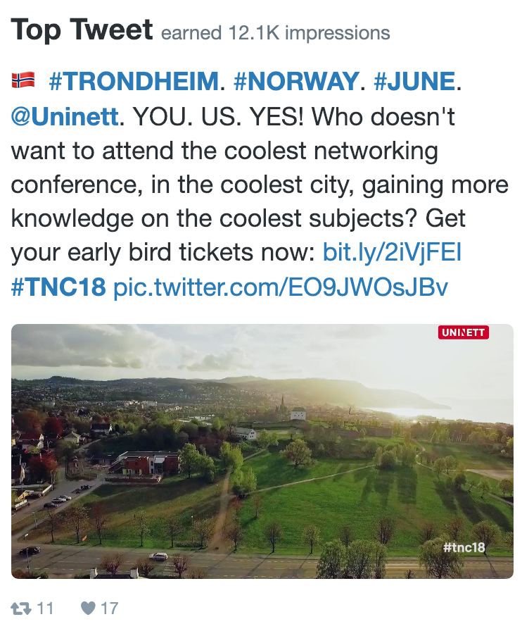
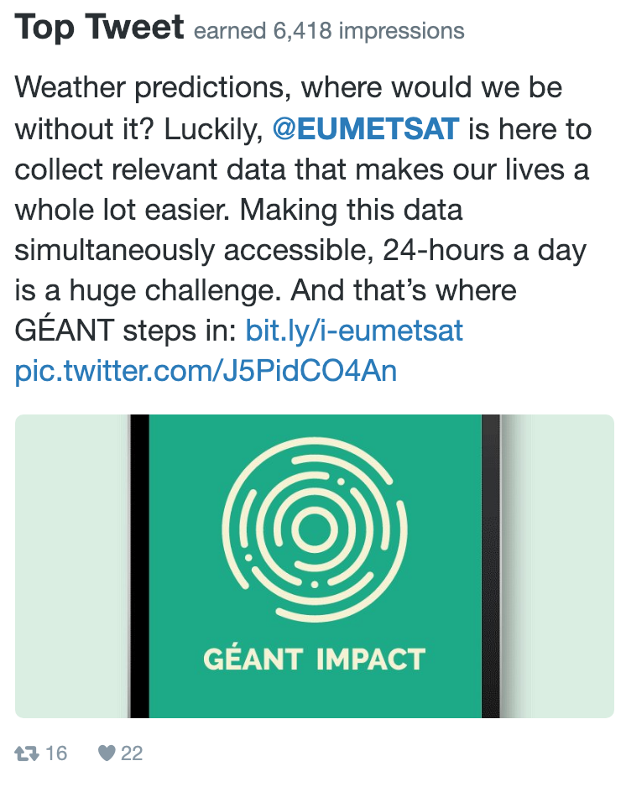
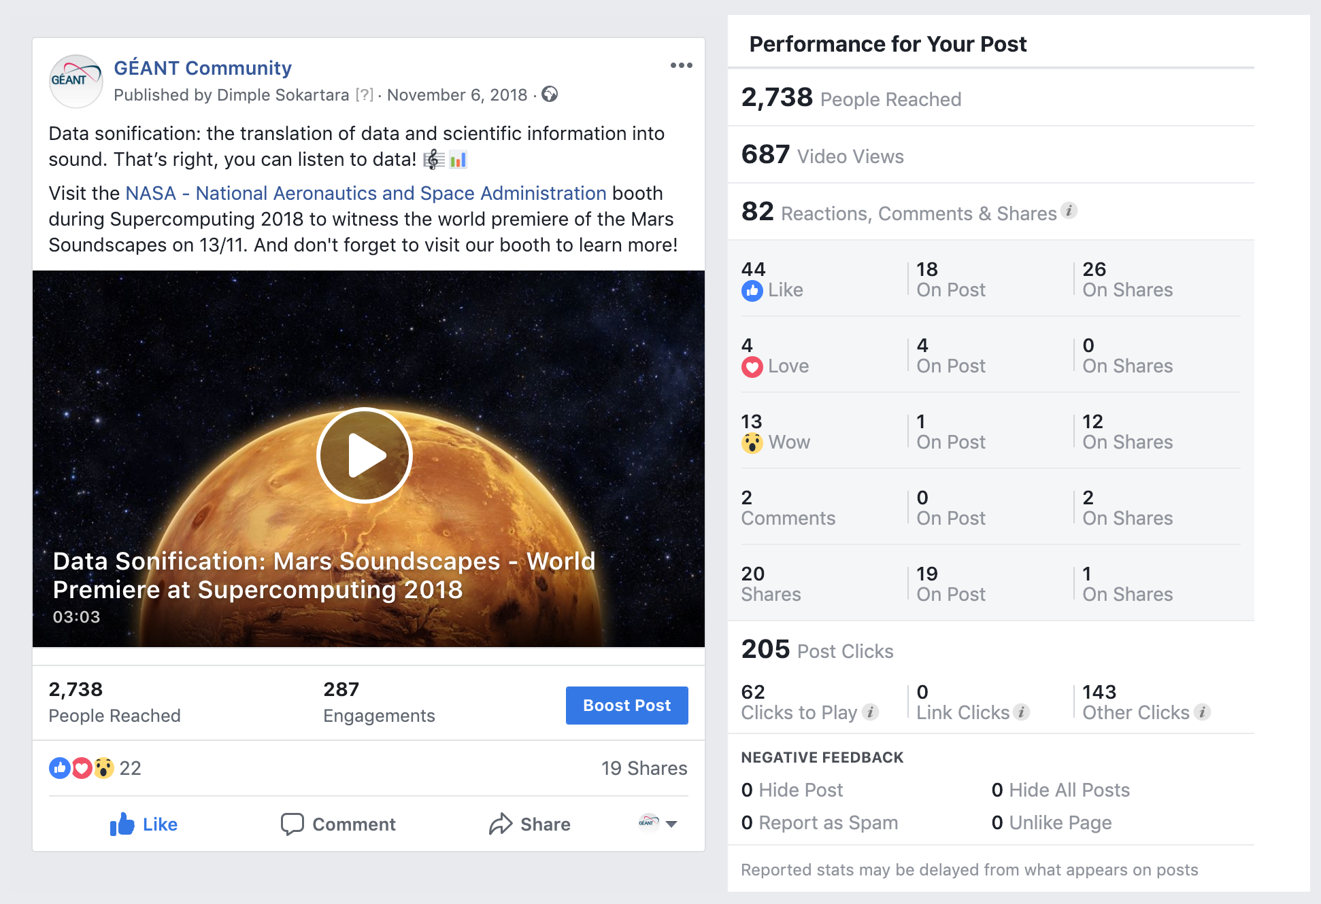
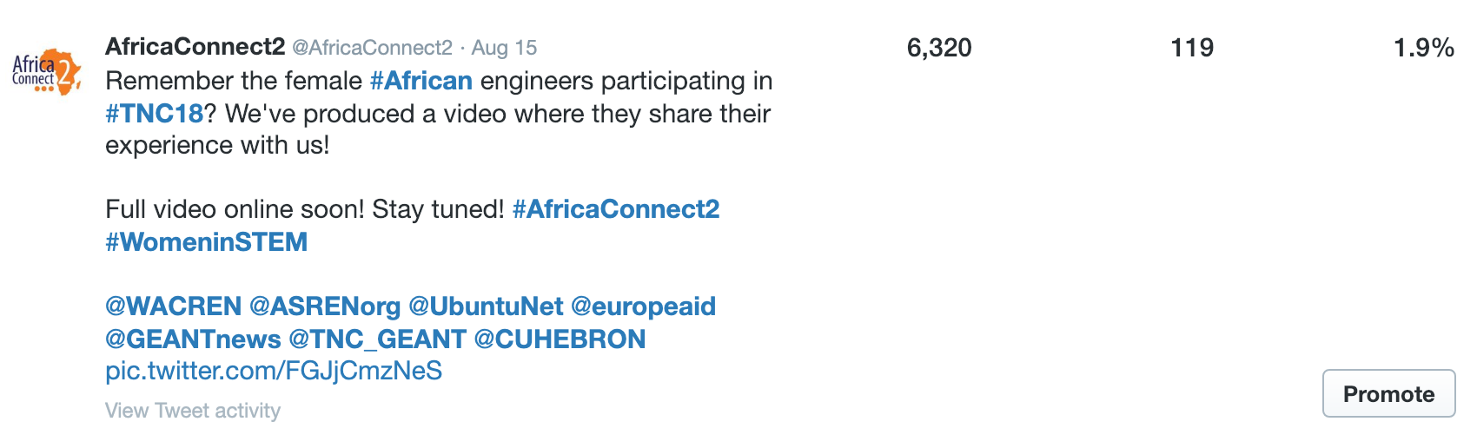
The power of video
12.1K
6.4K
2.7K
6.3K
≈

Slide 5
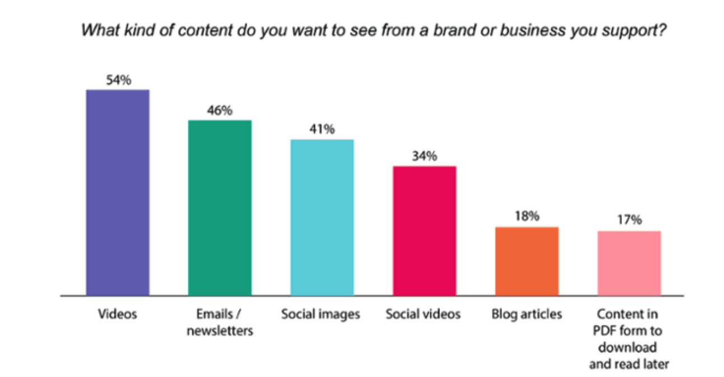
Video marketing statistics 2018 (Source: HubSpot, 2018)
90% of information transmitted to the brain is visual, and visuals are processed 60,000x faster in the brain than text
Mobile video usage has increased by nearly 10 million daily viewing minutes in the last two years
Cisco projects that global internet traffic from videos will make up 82% of all consumer internet traffic by 2021
43% of B2C marketers say pre-produced video is the most successful type of content for marketing purposes
62% of B2B marketers have rated video as an effective content marketing tactic
Globally, YouTube is consumers' leading source of video content, at 83% (Facebook is second, at 67%)
Video streaming has increased significantly in the last several years
Using the word “video” in an email subject line boosts open rates by 19% and clickthrough rates by 65%
As of 2018, 35% of marketers use live video
Live videos on Facebook have an engagement rate of 4.3% compared to 2.2% for non-live videos
90% of all video plays on Twitter take place on mobile devices
Videos 20 minutes in length or longer account for 55% of total video consumption time on smartphones
≈

Slide 6
Video content and dissemination tips
Video views are only counted if video is watched for longer that 3 seconds
Videos are more often watched with volume off
The more personal, the better
If not animated, interrupt your video with some stills
Don’t make videos too long (2 min. is the general maximum)
Social media videos are not tools to explain the full story, they should rather function as a teaser
Look at the type of social media channel to see what content and format fits best
Try going live in ‘vlog style’! During events perhaps? E.g. Facebook live, Periscope, Instagram
Use clear visuals that explain words or voice-overs
Go for gifs!
Video examples:
https://www.youtube.com/watch?v=t7dxGbd4f4M&t=1s – 724 views in 2 months
https://www.youtube.com/watch?v=rbh1MEVNejE – 587 views in 10 months
≈

Slide 7
Videos and social media channels
Users: 2.27 billion (active)
Impact: posts with videos attract 3x more engagement
Powerful content: entertainment, emotionally-charged content
Tips:
Remember to add subtitles (85% are viewed with the volume off)
Create playlists to make similar videos easy to be found
Upload directly to FB (instead of pasting a YouTube link)
Pin a video to your page
Include a CTA
Users: 326 million (active)
Impact: tweets with videos attract 10x more engagement
Powerful content: topical content, people in videos
Tips:
Have an early story arc
Feature people in the first 3 seconds (increases emotional intensity)
Remember to add subtitles
Pin a video to your page
Include a CTA
Users: 260 million (active)
Impact: not very present yet, 59% of users would prefer video over written text
Powerful content: quick tips, update from the industry, event coverage
Tips:
Make videos short and candid
Upload directly or through other channels except Facebook (shown as link)
Remember to add subtitles
Pin a video to your page
Include a CTA
Users: 1.9 billion (active)
Impact: over 1 billion hours of video are watched daily on YouTube in 88 countries in 76 languages, it is the 2nd biggest search engine after Google
Powerful content: anything interesting to your audience, videos can be long(er)
Tips:
Release news videos on a regular schedule
Create playlists
Optimise content so it ranks
Make sure links can be shared
Include a CTA
≈

Slide 8

Thank you! Questions?
dimple.sokartara@geant.org

