Slide 1
WP2 Webinar Update
Up2U Update

Slide 2
Deliverables
D2.2 Dissemination and Outreach report Y1 has been resubmitted
D2.3 Dissemination and Outreach report Y2 is due M25
  Comprehensive report on all dissemination and outreach related activities (including training) of the technical, pedagogical and business WPs in the second project year
  Time schedule:
      Due date (EC portal submission): 31.01.2018
      Submission for TA: 20.12.2018
      First draft: 08.12.2018

Slide 3
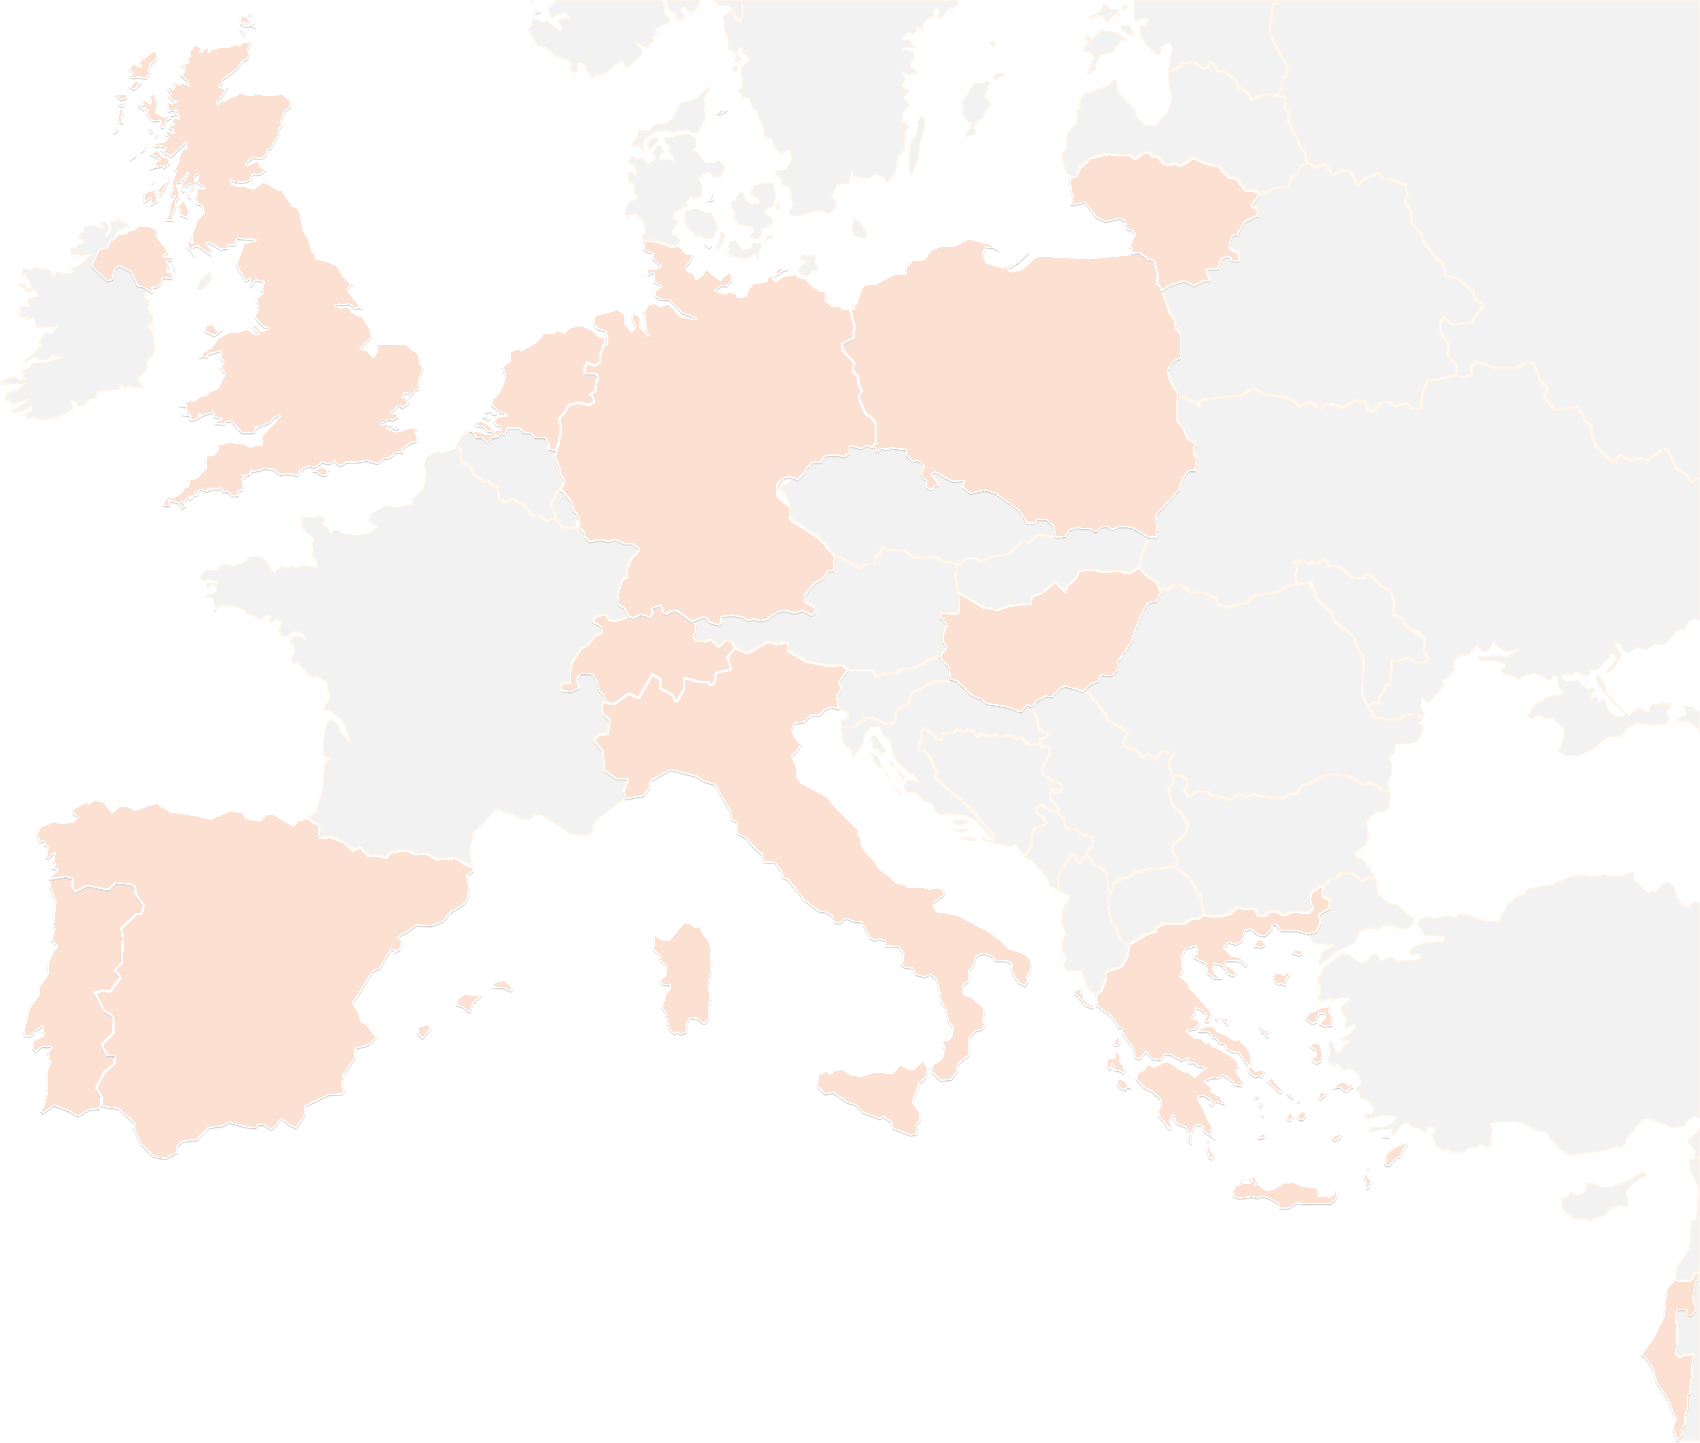
THANK YOU FOR YOUR ATTENTION!
contact@lists.up2university.eu
#up2universe

