Slide 1
UP2U WP8
Sustainability and Exploitation of Results

Slide 2
Status of Deliverables
Deliverables | Topic | Status
D8.1 | Analysis of Up2U Ecosystem and Existing Business Models | Accepted
D8.2 | Draft Plan for Sustainability and Exploitation | Accepted
D8.3 | Up2U Business Models | Sent to GEANT TA
D8.4 | Final Report on Up2U Sustainability and Exploitation | 30.06.2019 <Probably Postponed)
M2.6
M3.5

Slide 3
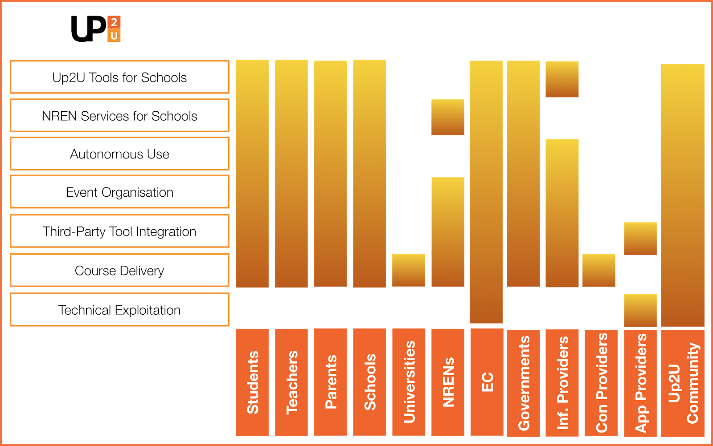
Status of D8.3

