Slide 1
WP6
_{UPDATE - February}
Gabriella Paolini
GARR

Slide 2
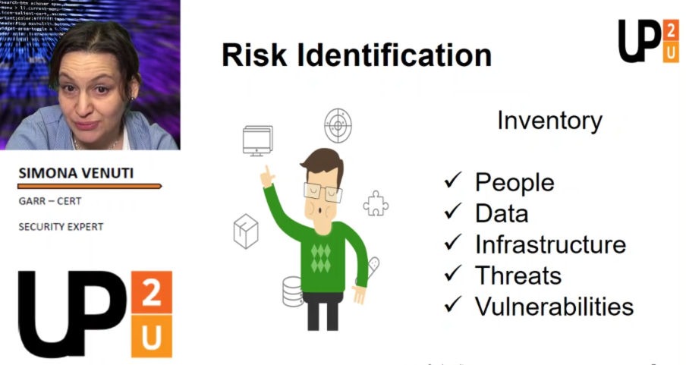
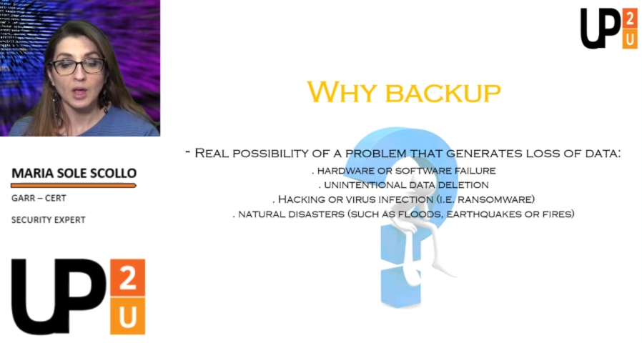
Cyber Security Video Pills (in English)

Slide 3
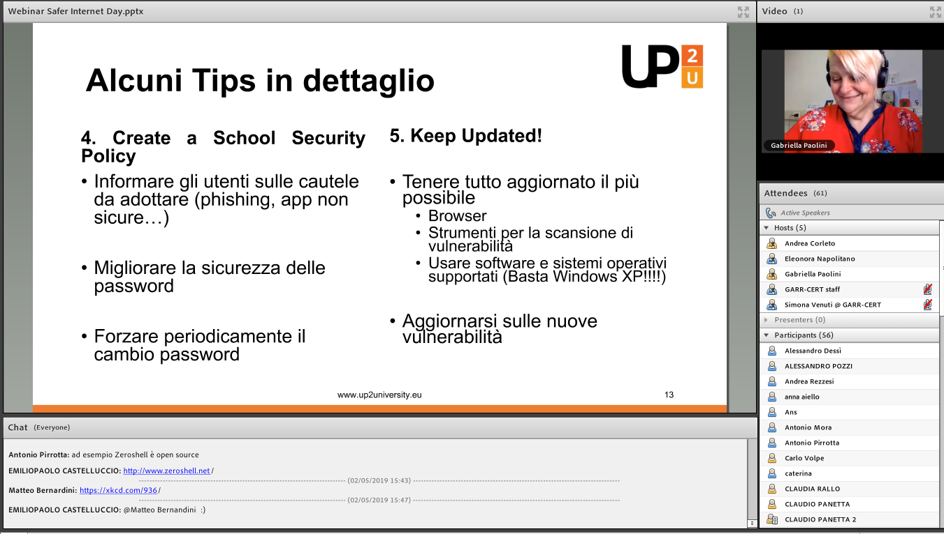
Cyber Security Webinars
Safer Internet Day (56 teachers ) - in Italian
 | https://ac.webmeetings.garr.it/pffvnuw19ijy/

Slide 4
Privacy Notice
A final version
  Ready to use
Why Do We Process Your Personal Data?
What Personal Data Do We Process?
When and How we Share Personal Data?

