Slide 1
WP1 Update
Erik Kikkenborg
Webinar #3 24/01/2019

Slide 2
Work done
EC review preparations
GDPR
TELTEK | Countersigned
KIFU / NIIF | Countersigned
GRNET | Countersigned
GWDG | Countersigned
GARR | Countersigned
PSNC | Countersigned
UVIGO | Countersigned
NTUA | Countersigned
KTU | Countersigned
FCT | Signed
ownCloud | Signed
UROMA | Pending
OU | Pending
ISEP | Pening
TAU | Pending
IUCC | Pening
CERN | Pending

Slide 3
Ongoing/Planned work
EC review preparations
Financial reporting
Monthly reporting
Board VC (24/01)

Slide 4
Up2U monthly webinar
WP2
Barbara Tóth
KIFÜ

Slide 5
Ongoing tasks
  D2.3 : sent to the Technical Writers, it is due for submission by the end of January.
    Input by partner needed regarding you’re here ASAP: https://docs.google.com/document/d/1NTRCnPN0sFa5ROglHOnJXZ20vD6KFnXwSmiYpG6nx5g/edit?usp=sharing
  Help us get feedback about the website! Usability test and bug report https://trello.com/c/iVcqKvQ8/89-up2u-website-development-usability-test-and-bug-report
Notes:
D2.3:
The document was sent to the Technical Writer last week. WP2 should get it back this week. Meanwhile, we are trying to improve the future planning part, therefore we count on the inputs from our partners regarding which activities they plan to implement locally (national level) and which project level activities they can contribute to. Deadline for this is EoB 24 January. This is very important, the reviewers want to get an idea about what we are planning.
Website improvement efforts:
In order to improve the website we introduced two tools. Please use them: bug report (for internal use) and usability test (external use). Please ask teachers, students, people who are not familiar with the project to conduct this test so we can improve the website based on their feedback.

Slide 6
Reminders, requests
  Don’t forget to share information about your local and international events:
  https://docs.google.com/spreadsheets/d/1sbdofqggjqn2uyM_1a1ZmchNXCLjW3rAq3UNK3mW0XE/edit?usp=sharing
  EDULEARN19 submission deadline: 21 March 2019
  Let us know if you have social media post or new item ideas!
  Next WP2 mtg: 25 January 2019 12:00 CET
    Zoom: https://videoconf-colibri.zoom.us/j/693659865
Notes:
Please let WP2 know if you are planning to submit a proposal to a conference/event. In the above mentioned link you can find sheets dedicated to local and to international events. Please make sure you provide input regarding your local session with teacher, as this table will be used by Michal for his WP7 reports.
We are trying to improve our social media presence by creating more content. Please provide input so we can make our feed more colourful.

Slide 7
Up2U monthly webinar
WP3
Ilias Hatzakis
GRNET

Slide 8
TASK 3.3: OER
  SAML integrated/ a login button is added below each learning object (video) to be used when a user wants to comment or rate etc.
  Following this the voluntary paradata feature (which is a specific request of the project, clearly mentioned in the DoW) is actually implemented
  Improvements on the Moodle eduOER user experience
  NEW REPOS: KHAN Academy, American Museum of Natural History, TED
  We now have 47 repositories (15 HE and 32 K12 )
  We are already regularly announcing the up boarding of new repos on social media
  Soon a new home page is being designed and will be soon available for a better user experience

Slide 9
TASK 3.2
  OCM tests between UVIGO and KIFU [OC] -> [NC] (no errors reported)
  Next tests:
    testing between PSNC and CERN [CernBox]-> [CernBox]
    testing between OC and CERN
  Discussion of next testing steps and OCM v2 at the CS3 2019 -- end of January: http://cs3.infn.it

Slide 10
WP4 Webinar Update
Up2U Update

Slide 11
Platform status
Updated production and pedagogy testing platform
  Latest version on both
  Software and pilot issues addressed
Platform email configuration
  LMS notifications, e.g., forum posts, by email to users
New tool discussion (web document editor/creator, UVigo)
  Technical prep. ahead of WP5 approval
Web analytics and platform activity reporting configured
Notes:
From Github issue tracker

Slide 12
Next steps
Review preparation
Onboarding new team members (OU)
Support WP5 in transferring demonstrator courses from pedagogy to production

Slide 13
Up2U monthly webinar 24/01/19
WP5
[final]
Stefano Lariccia
UROMA

Slide 14
MONTH 24, December 2018
[Continued from previous month] Contribution to D7.3 and D8.3
Started organizing WP5 Sub-group organization
Started organizing D5.4 under TAU monitoring
Pilots planning Preparation of Learning Units
Learning Units preparation (continues from 11/18)
  Unit 1: (to be translated and uploaded onto the Up2U learning system)
  Unit 2: (to be translated and uploaded onto the Up2U learning system)
  Unit 3: Language analysis and Critical Thinking. How to increase you ability to produce texts and video clips (in progress, will be completed by the end of the month)

Slide 15
RIGHT NOW, MONTH 25 January 2019
SMC planning for supporting Pilot activities
Supporting and counseling over Pilots from a pedagogical point of view
  Greek Pilot
  Italian Pilot
  Lithuanian Pilot
  Portuguese Pilot
  Spanish Pilot
Started writing D5.4 under TAU monitoring
Monitoring Task 5.4

Slide 16
RIGHT NOW, MONTH 25 January 2019 [2]
Monitoring Task 5.4
Providing models to collect and analyse data
  Progressing activities on evaluation models based on data collection; exploring LRS query methods and potential
  Implementing Learning Units based on Jupyter Notebooks. A Learning Path on Shakespeare is accessible now thorugh CS on Up2U; some others are in progress; a selection from Calysto is under way

Slide 17
RIGHT NOW, MONTH 25 January 2019 [3]
Further piloting activities into Up2U ecosystem
  “Light” integration of existing Jupyter notebooks based on CommonSpaces integrated for formal/informal in Up2U;
  University as a Hub is planning first “flipped” class for Italian secondary schools based on CommonSpaces. 1 Pilot will start i classroom on February
  Starting planning May Meeting in Rome at SLERD 2019
  In Italy (to be integrated into WP7): started negotiation with Heritage Ministry to co-authoring a pilot in italian secondary schools about “Emergency and seismic education and risk mitigation” and “Valorisation of Archaeological sites” ; this latter activity will converge during SLERD 2019 in a demonstration of Up2U system used in Heritage studies.

Slide 18


Subject Matter Committee
24 January, 2019
Webinar – Up2U
Mary Grammatikou
mary@netmode.ntua.gr

Slide 19
Subject Matter Committee Communications
The SMC communicates with the sub-SMCs
    Each pilot country can have underlying temporary national sub-committees
    One coordinator per sub-SMC
    The coordinators of national SMCs will participate to all next meetings of SMC
    National SMCs support both Modules II and III
      Contribute to the scenarios and methodology
      Support the teachers to the on-line learning
Notes:
How the SMC communicates with the national SMCs and support both modules 2and 3

Slide 20
SMC Meetings
Two meetings in the last period
  The first one on 22nd of November 2018
  The second one on 17th of January 2019
Notes:
Two meetings took place during the last period of the project

Slide 21
Discussions in the last SMC meetings
New members discussion
Discussion about Module 1 for the 4 countries (Lithuania, Germany, Portugal, Spain) will continue now
Discussion on a full scenario for pilots
Discussion on the Module 2 for the (Greece, Italy, Poland and CERN)
What we need to add in the methodology more or what if we need to change…
The communication with the National SMCs, we need to create communication channel with these SMCs…
Notes:
What discussed in the two last meetings

Slide 22
SMC Next Steps
SMC will:
support the online education for the learning community
support the method of learning the learners
investigate the final results of pilots regarding both students and teachers
review and approve the common scenario for module 2
review and evaluate the pilots’ feedback
Notes:
SMC plans to support the project in module 2 and evaluate the results

Slide 23
Thank you!

Slide 24
UPDATE 24/01/2019
WP6

Slide 25
WP6 inside Schools
Security, Identity, Privacy, IPR items into the national pilots
  Guides annexed to Deliverable D6.2
    Collaboration with WP2
  E-learning materials (video lessons in English – 5/10 minutes)
    GARR CERT (Security Pills)
  Italian Pilot
    3 Webinars about Security

Slide 26
D6.3
End of August to EC
  Ready at the end of June for peer review and technical authors
  How Security roadmap is received in pilot schools
    A survey to collect data at the end of each pilot
    Other tools to analyze security level changes

Slide 27
WP6 NEXT Meeting
29 January 2019 11.00 – 12.00 CET
  We need the participation of:
    All the partners involved in WP6;
    All the National pilots coordinators.

Slide 28
WP7. Pilot coordination and continuous risk assessment
Michał Zimniewicz
Poznan Supercomputing and Networking Center
Up2U Update Webinar
24th January 2019

Slide 29
D7.3:
Report on the large-scale pilot services, essential features and their improvements
Led by KTU
Submitted to EC in early January

Slide 30
Pilot Progress
Country | CPD Module 1 | Numbers of schools / teachers in CPD1 | Pilots (CPD Module 2) | Schools targeted now or soon
Germany | Q2 2019 |  | Q2 2019 | Private teachers
Greece | Mar – May 2018 | 8 / 80 | Jan – Feb 2019 | 8
Hungary | Aug – Sep 2018 | 8 / 12 | Early 2019 | 8 now, 40 soon
Italy | Apr – May 2018 | 5 / 11 | Mar – May 2019
Lithuania | Nov – Dec 2018 Feb 2019 | 10 / 15 - / 160 | Nov 2018 – ongoing | 20-80
Poland | Jun – Oct 2018 | 15 / 30 | Feb – March 2019 | 15
Portugal | Jan 2019 | 1 school+ | 2019
Spain | Nov – Dec 2018 | 7 / 7 | 2019
Notes:
CPD trainings have already started all pilot countries.
Pilots involving students are lauched in Lithuania and are about to start in most of other countries.
Concrete actions for reaching new schools are scheduled in all pilot countries.
Detailed monthly updates about pilots are submitted to EC starting from November.

Slide 31
Minimum Viable Product
Q1-Q2 2019 – The second phase for collecting MVP suggestions
  Collecting new suggestions from students in pilots, mainly via Google Form
  Some improvements to be reported at the project review in spring
  More improvements to be reported in June

Slide 32
Quality Assurance
Testing activities recently launched for:
  The upgrades of Moodle
  Poddium (PR) now available as standalone tool
  EduOER Android App

Slide 33
UP2U WP8
Sustainability and Exploitation of Results

Slide 34
Status of Deliverables
Deliverables | Topic | Status
D8.1 | Analysis of Up2U Ecosystem and Existing Business Models | Accepted
D8.2 | Draft Plan for Sustainability and Exploitation | Accepted
D8.3 | Up2U Business Models | Sent to GEANT TA
D8.4 | Final Report on Up2U Sustainability and Exploitation | 30.06.2019 <Probably Postponed)
M2.6
M3.5

Slide 35
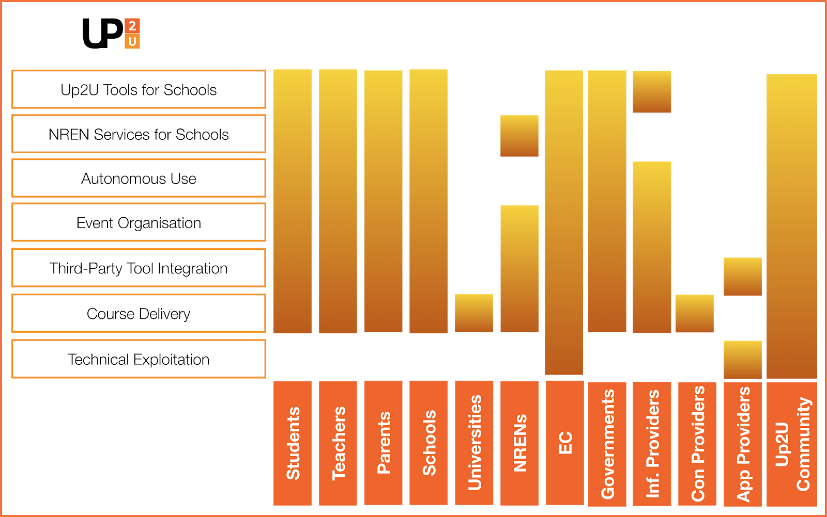
Status of D8.3

