Slide 1
Introduction & Motivation
eduPERT workshop — TNC18
Antoine Delvaux, PSNC
14-06-2018
This document is a result of work by the perfSONAR Project (http://www.perfsonar.net) and is licensed under CC BY-SA 4.0 (https://creativecommons.org/licenses/by-sa/4.0/).

Slide 2
Outline
Problem Statement on Network Connectivity
Network Performance & TCP Behaviors w/ Packet Loss
What is perfSONAR?
Installation Options
perfSONAR Community
Notes:
Make the point that the complexity of the network is too much for anyone to grasp – and with the complexity we need tools/methods to bite off smaller parts of the problem

Slide 3
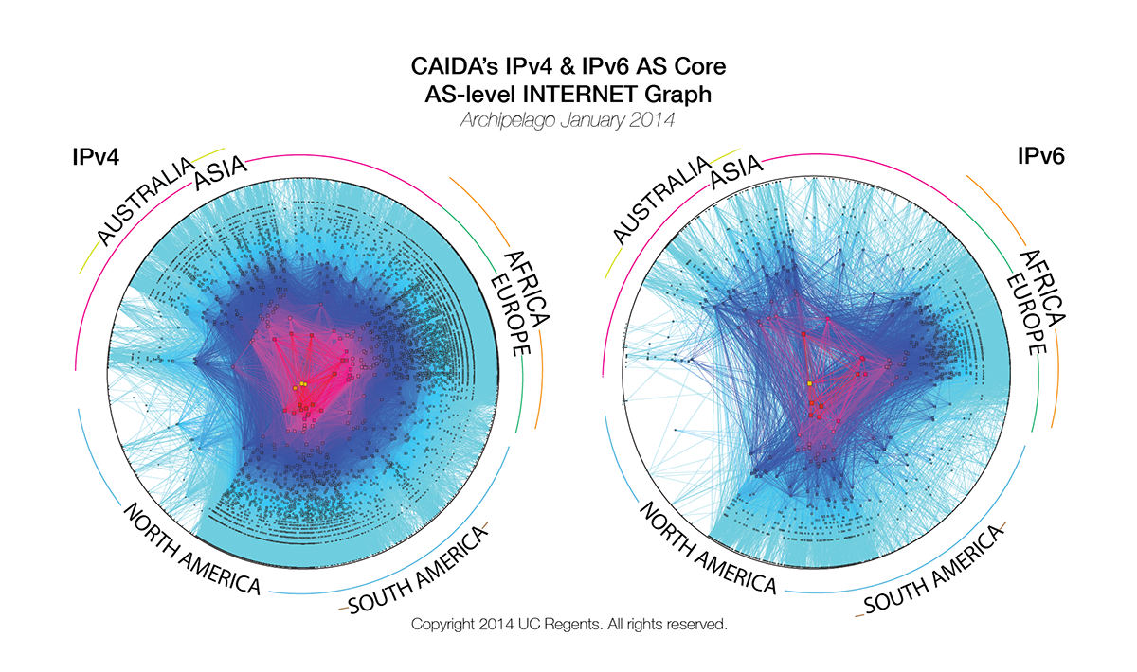
Problem Statement
The global Research & Education network ecosystem is comprised of hundreds of international, national, regional and local-scale networks.
Notes:
Make the point that the complexity of the network is too much for anyone to grasp – and with the complexity we need tools/methods to bite off smaller parts of the problem

Slide 4
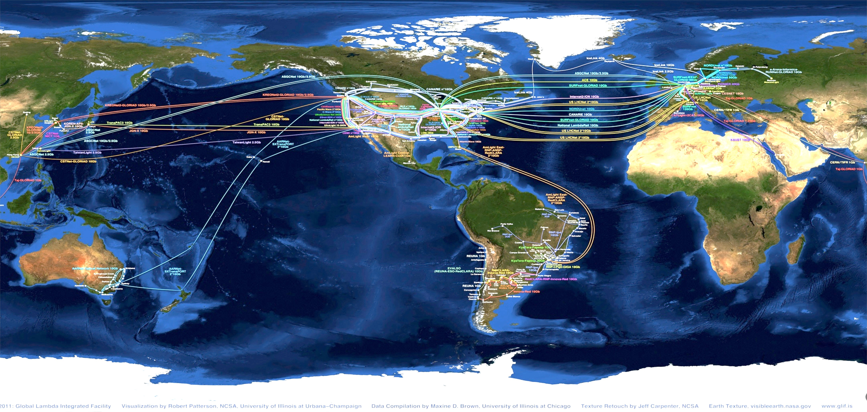
Problem Statement
While these networks all interconnect, each network is owned and operated by separate organizations (called “domains”) with different policies, customers, funding models, hardware, bandwidth and configurations.
Notes:
MAP is courtesy of the GLIF
perfSONAR is designed to be multi-domain, so drive home the fact that all transfers are multi-domain

Slide 5
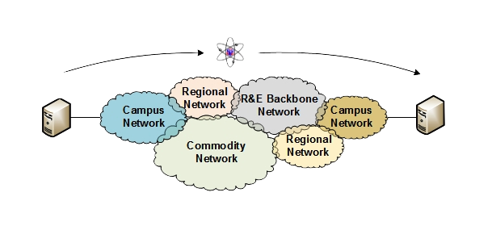
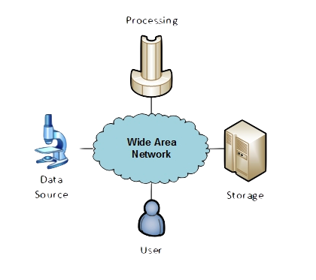
The R&E Community
The global Research & Education network ecosystem is comprised of hundreds of international, national, regional and local-scale resources – each independently owned and operated.
This complex, heterogeneous set of networks must operate seamlessly from “end to end” to support science and research collaborations that are distributed globally.
Data mobility is required; there is no liquid market for HPC resources (people use what they can get – DOE, XSEDE, NOAA, etc. etc.)
  To stay competitive, we must learn the use patterns, and support them
  This may mean making sure your network, and the networks of others, are functional
Notes:
Getting into the end to end argument – we can’t just ensure things work locally.

Slide 6
Outline
Problem Statement on Network Connectivity
Network Performance & TCP Behaviors w/ Packet Loss
What is perfSONAR?
Installation Options
perfSONAR Community
Notes:
Make the point that the complexity of the network is too much for anyone to grasp – and with the complexity we need tools/methods to bite off smaller parts of the problem

Slide 7

Lets Talk Performance …
"In any large system, there is always something broken.”
Jon Postel
Its all TCP
  Bulk data movement is a common thread (move the data from the microscope, to the storage, to the processing, to the people – and they are all sitting in different facilities)
  This fails when TCP suffers due to path problems (ANYWHERE in the path)
  It’s easier to work with TCP than to fix it (20+ years of trying…)
TCP suffers the most from unpredictability ; Packet loss/delays are the enemy
  Small buffers on the network gear and hosts
  Incorrect application choice
  Packet disruption caused by overzealous security
  Congestion from herds of mice
It all starts with knowing your users, and knowing your network
Notes:
Why is it a challenge? It’s the complexity, and it’s the tools.
We basically need to accommodate TCP to do anything useful.

Slide 8

Where Are The Problems?
Congested or faulty links between domains
Latency dependant problems inside domains with small RTT
Source
Campus
Backbone
Destination
Campus
S
D
NREN
Regional
Congested intra- campus links
Notes:
Isolating problems is challenging – consider the following sets of domains. If things are ‘slow’, it could be anything (or multiple things)
We need something that examines the entire path, and pulls out trouble

Slide 9
Local Testing Will Not Find Everything
Performance is poor when RTT exceeds ~10 ms
Performance is good when RTT is < ~10 ms
Source
Campus
R&E
Backbone
Destination
Campus
S
D
Switch with small buffers
Regional
Regional
Notes:
The magic buffer zone – if we are < 10ms, we often don’t see problems. Throughput still works well because TCP can perform well over short distances with lots of loss.
As we get further out, we notice the pain.
This leads to some false diagnostics at times – e.g. if we have a problem locally, but we only see it when we go far away, its tempting to say the problem is out there, far away. See the switch with small buffers locally as the example.

Slide 10
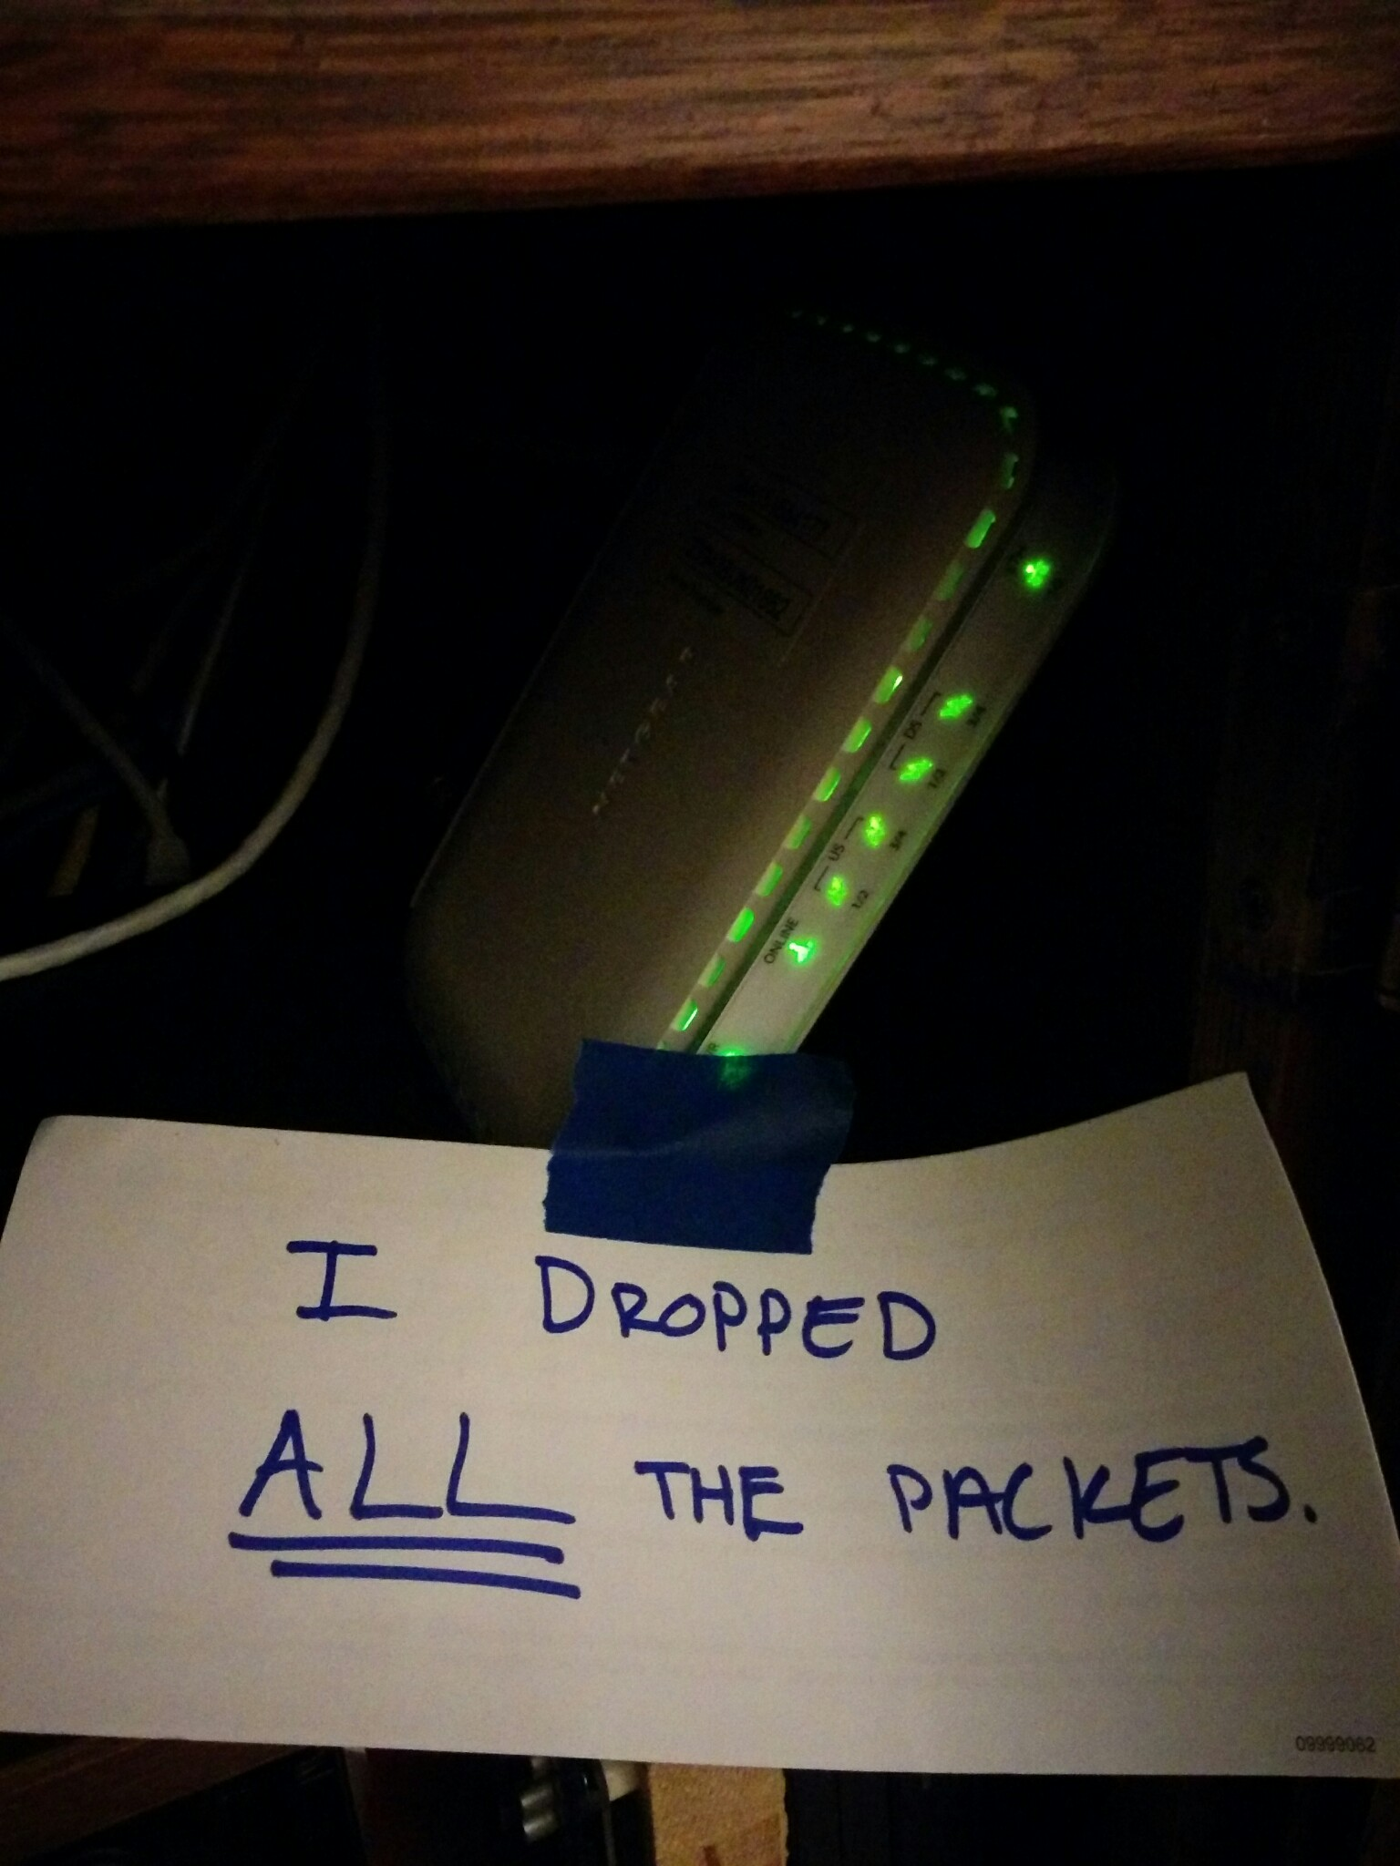
Soft Network Failures
Soft failures are where basic connectivity functions, but high performance is not possible.
TCP was intentionally designed to hide all transmission errors from the user:
  “As long as the TCPs continue to function properly and the internet system does not become completely partitioned, no transmission errors will affect the users.” (From IEN 129, RFC 716)
Some soft failures only affect high bandwidth long RTT flows.
Hard failures are easy to detect & fix
  soft failures can lie hidden for years!
One network problem can often mask others
Notes:
Introduce the soft network failure – not a loss of connectivity. This is what perfSONAR is designed to find since they are challenging to see unless you are testing end to end over a large distance.

Slide 11
Problem Statement:
Hard vs. Soft Failures
“Hard failures” are the kind of problems every organization understands
  Fiber cut
  Power failure takes down routers
  Hardware ceases to function
Classic monitoring systems are good at alerting hard failures
  i.e., NOC sees something turn red on their screen
  Engineers paged by monitoring systems
“Soft failures” are different and often go undetected
  Basic connectivity (ping, traceroute, web pages, email) works
  Performance is just poor
How much should we care about soft failures?
Notes:
Answer: we need to care *a lot* about soft failures – see next

Slide 12
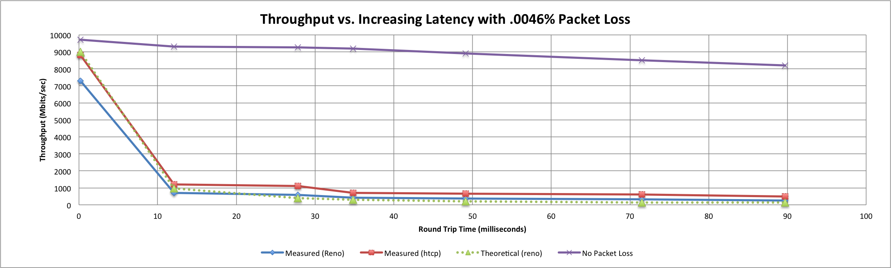
Soft Failures Cause Packet Loss and
Degraded TCP Performance
Local
(LAN)
With loss, high performance beyond metro distances is essentially impossible
International
Metro Area
Regional
Continental
Measured (TCP Reno)
Measured (HTCP)
Theoretical (TCP Reno)
Measured (no loss)
Notes:
TCP works well over short distances (e.g. 1% packet loss on the LAN will produce high throughput).
The further out you get the more pronounced the problems will be as the algorithms cope with retransmissions.

Slide 13
Causes of Packet Loss
Network Congestion
  Easy to confirm via SNMP, easy to fix with $$
  This is not a ‘soft failure’, but just a network capacity issue
  Often people assume congestion is the issue when it fact it is not.
Under-buffered switch dropping packets
  Hard to confirm
Under-powered firewall dropping packets
  Hard to confirm
Dirty fibers or connectors, failing optics/light levels
  Sometimes easy to confirm by looking at error counters in the routers
Overloaded or slow receive host dropping packets
  Easy to confirm by looking at CPU load on the host

Slide 14
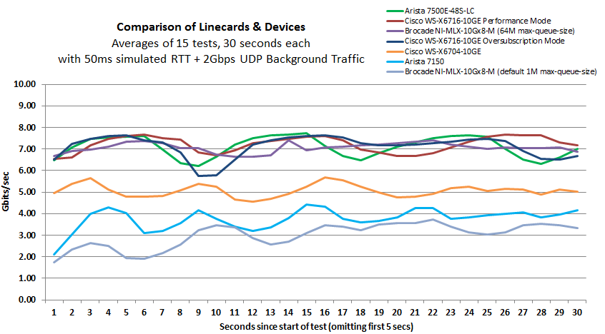
Under-buffered Switches are probably our biggest problem today
Notes:
Testing done by Michael Smitasin , LBL
1 10G TCP flow competing with 2GB background UDP

Slide 15

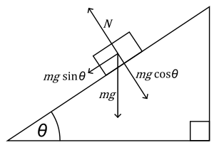
The Science DMZ in 1 Slide
Consists of four key components, all required:
“Friction free” network path
  Highly capable network devices (wire-speed, deep queues)
  Virtual circuit connectivity option
  Security policy and enforcement specific to science workflows
  Located at or near site perimeter if possible
Dedicated, high-performance Data Transfer Nodes (DTNs)
  Hardware, operating system, libraries all optimized for transfer
  Includes optimized data transfer tools such as Globus and GridFTP
Performance measurement/test node
  perfSONAR
Education & Engagement w/ End Users
  Details at http://fasterdata.es.net/science-dmz/
© 2013 Globus
© 2013 Wikipedia

Slide 16
The Abstract Science DMZ
Notes:
Simple DMZ design. Things to note:
- not ‘lack of security’, security still is *very* important. It is targeted toward a use case, not a blanket policy
- The DTN is a dedicated machine tuned for 1 job and 1 job only – moving data. Use it to handle the WAN portion of the flow. If someone needs to pull data into the enterprise, the short RTT will help the packet loss caused by the firewall. Treat the DTN as a ‘cache’
- perfSONAR on the outside. Prevents measurement traffic from perturbing things. If you have science stuff inside of the firewall, you need one there too.

Slide 17
Outline
Problem Statement on Network Connectivity
Network Performance & TCP Behaviors w/ Packet Loss
What is perfSONAR?
Installation Options
perfSONAR Community
Notes:
Make the point that the complexity of the network is too much for anyone to grasp – and with the complexity we need tools/methods to bite off smaller parts of the problem

Slide 18
But … It’s Not Just the Network
Perhaps you are saying to yourself “I have no control over parts of my campus, let alone the 5 networks that sit between me and my collaborators”
Things “you” control:
  Choice of data movement applications (say no to SCP and RSYNC)
  Configuration of local gear (hosts, network devices)
  Placement and configuration of diagnostic tools, e.g. perfSONAR
  Use of the diagnostic tools
Things that need some help:
  Configuration of remote gear
  Addressing issues when the diagnostic tools alarm
  Getting someone to “care”
Notes:
Don’t stop at network architecture, fix other stuff too

Slide 19
perfSONAR
    You can’t fix what you can’t find
    You can’t find what you can’t see
    perfSONAR lets you see
Especially important when deploying high performance services
  If there is a problem with the infrastructure, need to fix it
  If the problem is not with your stuff, need to prove it
    Many players in an end to end path
    Ability to show correct behavior aids in problem localization
Notes:
perfSONAR = visbibility

Slide 20
What is perfSONAR?
perfSONAR is a tool to:
  Set (hopefully raise) network performance expectations
  Find network problems (“soft failures”)
  Help fix these problems
All in multi-domain environments
  Over 2000 public hosts on many different networks
  http://stats.es.net/ServicesDirectory/ [note: takes a long time for data to load]
These problems are all harder when multiple networks are involved
    Focus on Research and Education (R&E) Networking, 1Gbps links or higher
perfSONAR is provides a standard way to publish active and passive monitoring data
  This data is interesting to network researchers as well as network operators
Notes:
Enables Federation
Service oriented
Designed with ‘multi-domain’ in mind
Brings together useful tools to address different needs
Several active and passive tools
Interface to configure regular testing
Diagnostic tools ready with ‘0 configuration’
Easy to install, easy to use
ISO image can be burned to CD/USB key
‘Wizard’ interface for configuration
Encouraging people to deploy ‘known good’ measurement points near domain boundaries
“known good” = hosts that are well configured, enough memory and CPU to drive the network, proper TCP tuning, clean path, etc.
Community Adoption
Over 1300 instances seen world wide
40+ countries
100s of domains

Slide 21
Simulating Performance
It’s infeasible to perform at-scale data movement all the time – as we see in other forms of science, we need to rely on simulations
Network performance comes down to a couple of key metrics:
  Throughput (e.g. “how much can I get out of the network”)
  Latency (time it takes to get to/from a destination)
  Packet loss/duplication/ordering (for some sampling of packets, do they all make it to the other side without serious abnormalities occurring?)
  Network utilization (the opposite of “throughput” for a moment in time)
We can get many of these from a selection of active and passive measurement tools – enter the perfSONAR Toolkit
Notes:
Idea – we are measuring performance by testing what is possible. If OWAMP runs stable and loss free, video will work out ok. If throughput is stable and high, bulk data movement should work on the network (does not test disk)

Slide 22
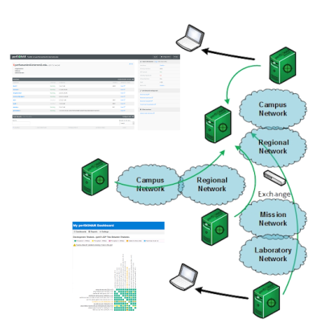
Toolkit “Beacon” Use Case
The general use case is to establish some set of tests to other locations/facilities
To answer the what/why questions:
  Regular testing with select tools helps to establish patterns – how much bandwidth we would see during the course of the day – or when packet loss appears
  We do this to ‘points of interest’ to see how well a real activity (e.g. Globus transfer) would do.
If performance is ‘bad’, don’t expect much from the data movement tool
Notes:
General use case – make the tools available and let people test against you

Slide 23
perfSONAR Toolkit
The “perfSONAR Toolkit” is an open source implementation and packaging of the perfSONAR measurement infrastructure and protocols
  http://docs.perfsonar.net/install_getting.html
All components are available as RPMs, DEBs, and bundled as CentOS 7, Debian 7,8,9 or Ubuntu 14 and 16 -based packages (as for perfSONAR v. 4.0.1)
  perfSONAR tools are much more accurate if run on a dedicated perfSONAR host
Very easy to install and configure
  Usually takes less than 30 minutes
Notes:
Install via the ISO – RPMs if you don’t want to do that

Slide 24
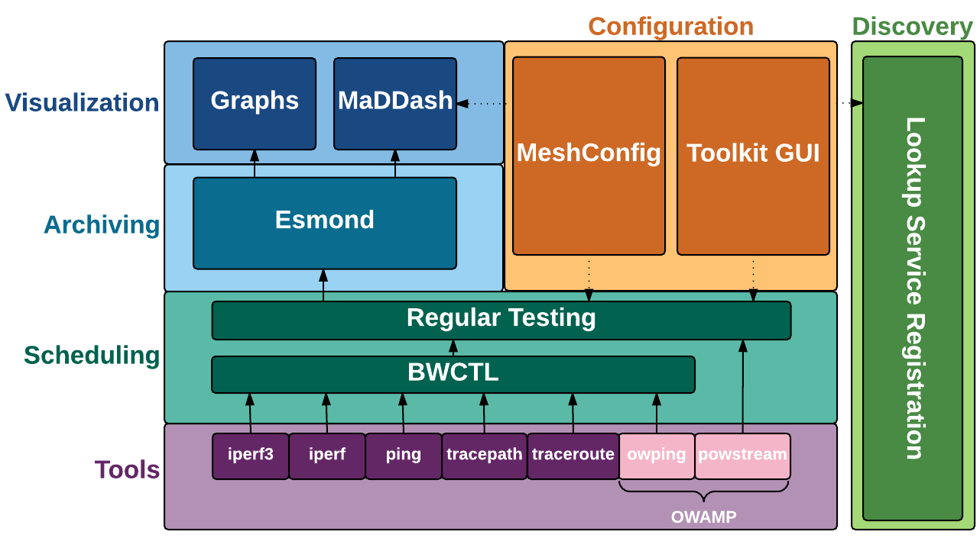
perfSONAR 3.5 Components
Notes:
Toolkit is most of these components (no maddash)
- Also have bundles that allow you to install just parts of it

Slide 25
New in perfSONAR 4.0
pScheduler
  Replaces scheduling layer with new component that adds many new features and improves on a number of old ones
New Graphs
  Cleaner display of multiple types of data
MaDDash 2.0
  Added alerting features
CentOS 7 and Debian 8 support
Notes:
Highlight NDT getting dropped. Also highlight that even in 3.5 diagram not shown because it was on an island and had 0 interaction with other pieces.

Slide 26
Removed from perfSONAR 4.0
Web100 and NDT no longer included in new perfSONAR 4.0 installs
  CentOS 7 kernel does not support web100
Upgrade does NOT remove NDT or web100 packages from existing installs
Will continue to build web100 kernels until October 17, 2017
The Measurement Lab project (https://www.measurementlab.net/) will be updating their platform, including new hardware, modern kernels and cluster management software. This includes migrating key tools (including NDT) from Web100 to TCP_INFO.
  https://www.ietf.org/proceedings/98/slides/slides-98-maprg-refreshing-mlab-matt-mathis-00.pdf
Notes:
If you want just an NDT box, perfSONAR hasn’t been the best way to do that for awhile.

Slide 27
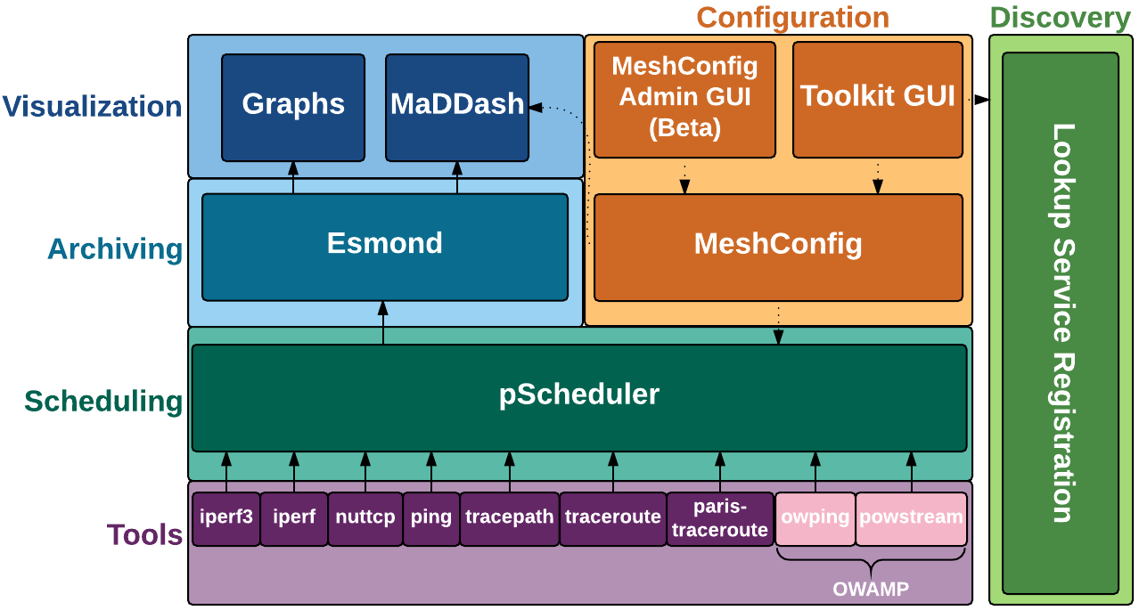
perfSONAR 4.0 Components
Notes:
- Big change is pScheduler is now the entire scheduling layer
Notice that we a) have all tools going through same component at scheduling layer and b) there are more tools supported by the ENTIRE system (before just BWCTL supported some and not regular testing and vice versa)
Also note these are just the default tools, other can write their own
Also note that there is a REST interface to pScheduler itself
Also changes in configuration layer
- Added MeshConfigGUI which is still in beta at time of release
- Funnel both GUIs through meshconfig for simplicity. Not required and is possible to access pscheduler API directly
- Imporvements at Visualization layer, though not a significant architechtural change.
- Improvementat other layers as well but largely the same

Slide 28
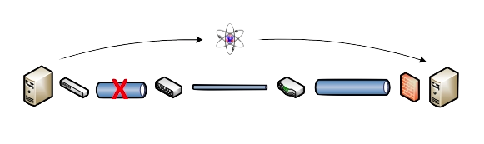
Benefits: Finding the needle in the haystack
Above all, perfSONAR allows you to maintain a healthy, high-performing network because it helps identify the “soft failures” in the network path.
  Classical monitoring systems have limitations
    Performance problems are often only visible at the ends
    Individual network components (e.g. routers) have no knowledge of end host state
  perfSONAR tests the network in ways that classical monitoring systems do not
More perfSONAR distributions equal better network visibility.
Notes:
Metcalf law argument – only useful because people are using it

Slide 29
Outline
Problem Statement on Network Connectivity
Network Performance & TCP Behaviors w/ Packet Loss
What is perfSONAR?
Installation Options
perfSONAR Community
Notes:
Make the point that the complexity of the network is too much for anyone to grasp – and with the complexity we need tools/methods to bite off smaller parts of the problem

Slide 30
HIDDEN SLIDE – Installation options
There is an entire other hardware deck – look in the rest of the materials for it.
Perhaps stick some things from that in here, if you need them.
Otherwise, summarize hardware as ‘use server hardware for best results’. If someone presses you, go into detail about virtualization and micro-machines. The best retort is ‘for real network performance, use real machines’ For fake network performance, use fake machines’.

Slide 31
Hardware Considerations
http://docs.perfsonar.net/install_hardware.html
Dedicated perfSONAR hardware is best
  Server class is a good choice
  Desktop/Laptop/Mini (Mac, Shuttle, ARM) can be problematic, but work in a diagnostic capacity
Other applications running may perturb results (and measurement could hurt essential services)
Running Latency and Throughput on the Same Server
  If you can devote 2 interfaces – version 3.4 and above of the toolkit will support this.
  If you can’t, note that Throughput tests can cause increased latency and loss (latency tests on a throughput host are still useful however)
Notes:
Remind everyone that we do update the web site regularly.
Takeaways – ‘real’ hardware (not virtual, avoid super small machines until the small node effort has data)

Slide 32
Hardware Considerations
http://docs.perfsonar.net/install_hardware.html
1Gbps vs 10Gbps testers
  There are a number of problem that only show up at speeds above 1Gbps – both are still super useful
Virtual Machines do not always work well as perfSONAR hosts (use specific)
  Clock sync issues are a bit of a factor
  throughput is reduced significantly for 10G hosts
  VM technology and motherboard technology has come a long way, YMMV
  NDT/NAGIOS/SNMP/1G BWCTL are good choices for a VM, OWAMP/10G BWCTL are not
  Docker containers being tested for performance as well; TBD
Notes:
Remind everyone that we do update the web site regularly.
Takeaways – ‘real’ hardware (not virtual, avoid super small machines until the small node effort has data)

Slide 33
Install Options: Classic or Advanced
CentOS 7 ISO image
  Full toolkit install
  Easy, all contained
Want more control? Bundle of packages
  perfsonar-tools
  perfsonar-testpoint
  perfsonar-core
  perfsonar-toolkit
  perfsonar-centralmanagement
  + optional packages
  CentOS 6 – 7, Debian 7 – 8 – 9, Ubuntu 14 – 16

Slide 34
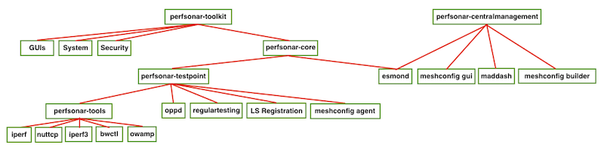
Package bundles structure

Slide 35
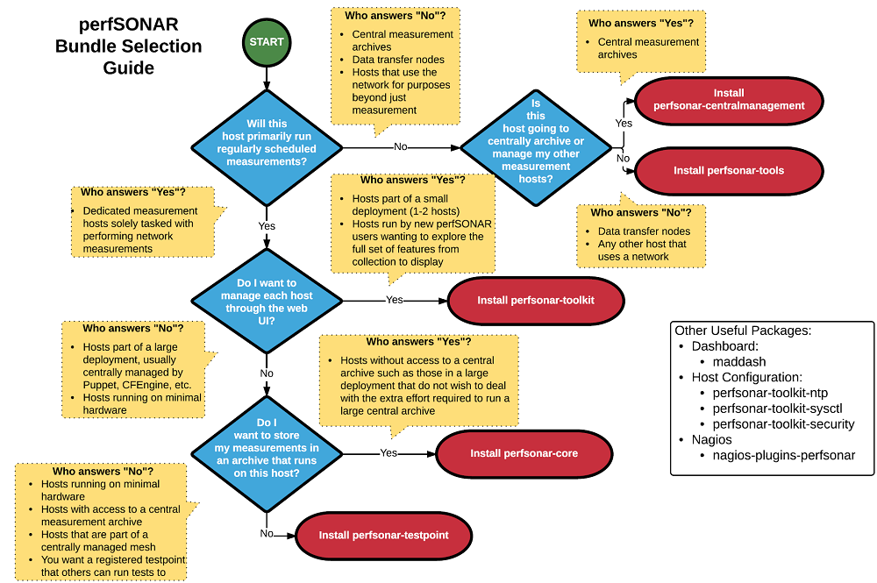

Slide 36
Outline
Problem Statement on Network Connectivity
Network Performance & TCP Behaviors w/ Packet Loss
What is perfSONAR?
Installation Options
perfSONAR Community
Notes:
Make the point that the complexity of the network is too much for anyone to grasp – and with the complexity we need tools/methods to bite off smaller parts of the problem

Slide 37

Benefit: Active and Growing Community
Active email lists and forums provide:
  Instant access to advice and expertise from the community.
  Ability to share metrics, experience and findings with others to help debug issues on a global scale.
Joining the community automatically increases the reach and power of perfSONAR
  The more endpoints means exponentially more ways to test and discover issues, compare metrics

Slide 38
perfSONAR Community
The perfSONAR collaboration is working to build a strong user community to support the use and development of the software.
perfSONAR Mailing Lists
  Announcement Lists:
    https://mail.internet2.edu/wws/subrequest/perfsonar-announce
  Users List:
    https://mail.internet2.edu/wws/subrequest/perfsonar-users

Slide 39

Resources
perfSONAR website
  http://www.perfsonar.net/
perfSONAR Documentation
  http://docs.perfsonar.net/
perfSONAR mailing lists
  http://www.perfsonar.net/about/getting-help/
perfSONAR directory
  http://stats.es.net/ServicesDirectory/
perfSONAR YouTube Channel
  https://www.youtube.com/channel/UCjK-P49pAKK9hUrrNbbe0Sg
FasterData Knowledgebase
  http://fasterdata.es.net/

Slide 40
Introduction & Motivation
Event
Presenter, Organization, Email
Date
This document is a result of work by the perfSONAR Project (http://www.perfsonar.net) and is licensed under CC BY-SA 4.0 (https://creativecommons.org/licenses/by-sa/4.0/).

