Slide 1
perfSONAR toolkit basics
eduPERT workshop — TNC18
Antoine Delvaux, PSNC
14-06-2018
This document is a result of work by the perfSONAR Project (http://www.perfsonar.net) and is licensed under CC BY-SA 4.0 (https://creativecommons.org/licenses/by-sa/4.0/).

Slide 2
Outline
Workshop lab setup
perfSONAR toolkit web interface
Running measurements/tests

Slide 3
Workshop lab setup
VM
  Don’t do that for real deployments!
SWITCHengines
  OpenStack, firewall, IPV4 NAT
10 VM x 3
  perfSONAR toolkit 4.0.2
  perfSONAR toolkit 4.1-beta (pre-beta)
  Nagios XI

Slide 4
Accessing the VM
Group in pairs
Web admin access
  Username: psadmin
  Pass: edupert
ssh access
  Username: edupert
  Pass: to be distributed during the workshop

Slide 5
Outline
Workshop lab setup
perfSONAR toolkit web interface
Running measurements/tests

Slide 6
Configuring pS toolkit
See sheets with VM details
We will go through the toolkit configuration pages
And set up some measurements
Notes:
First ask if they’re familiar with the toolkit UI
If yes, then skip
If not, then go through some examples

Slide 7
Configuration - Web
We can do most other things via the web interface once we have a user that can auth against it
  do-it-yourselfers can still hand edit config – we just won’t deal with that here
Some things we care about:
  Administrative info (See our privacy policy)
  NTP (time keeping)
  Configuring some tests (directly)

Slide 8
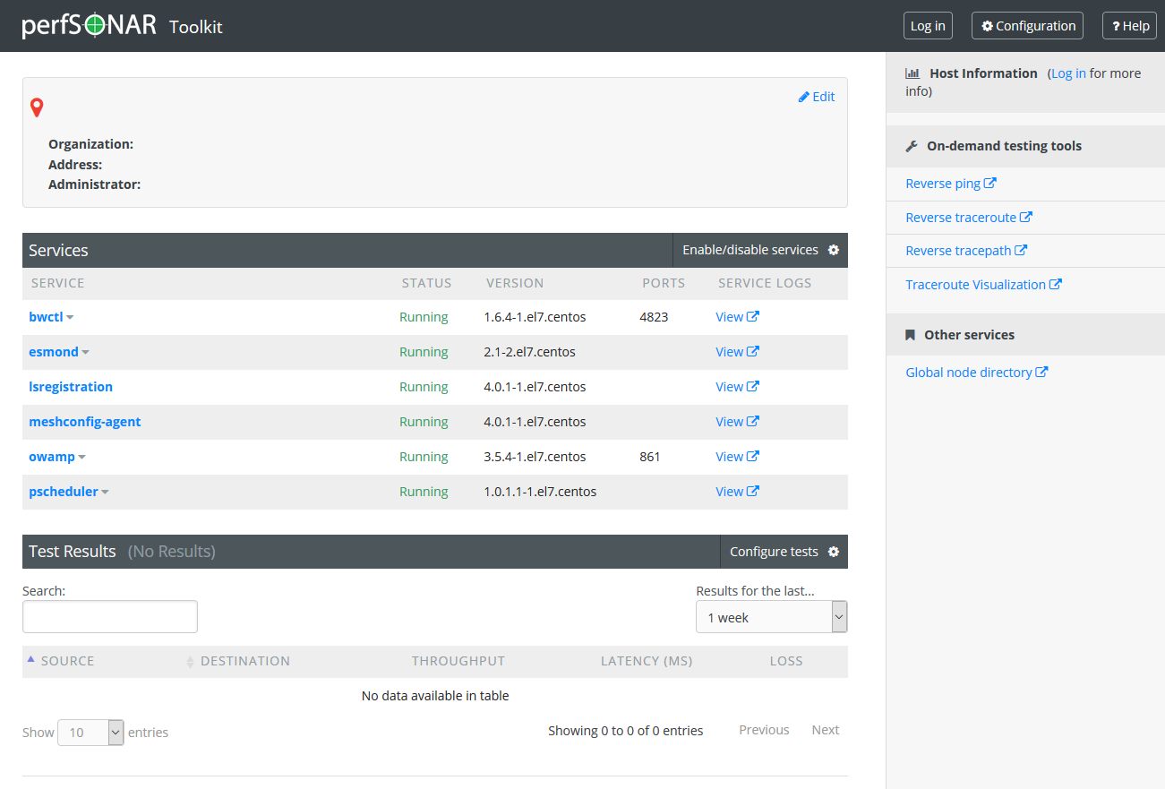
Configuration - Web

Slide 9
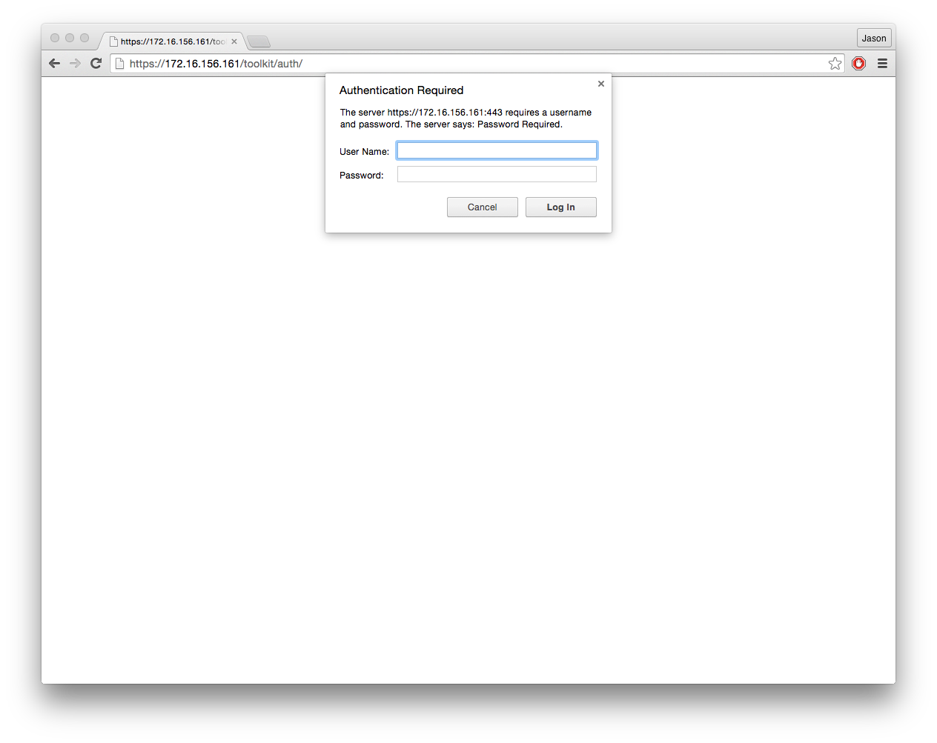
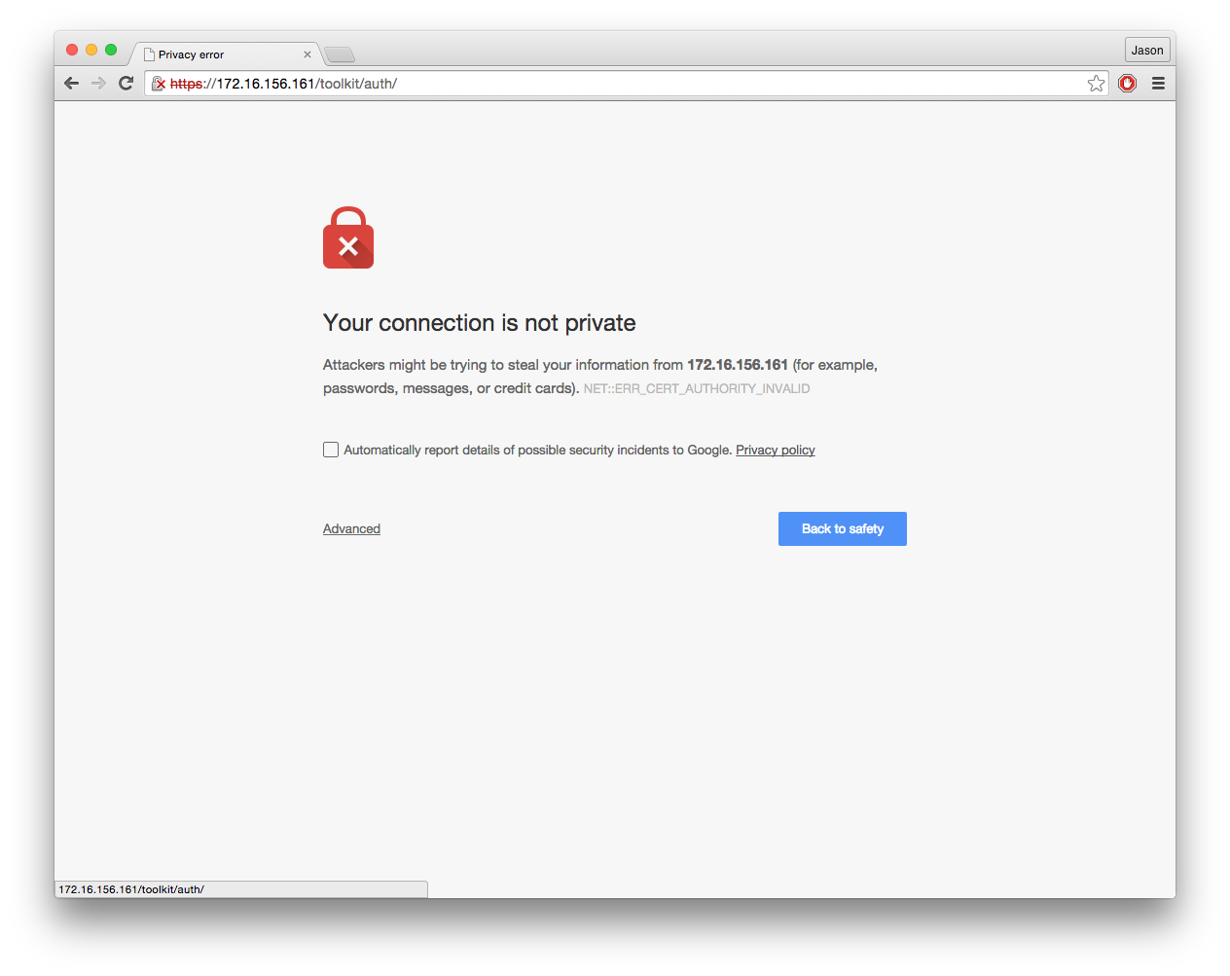
Authentication
The user you created will need to authenticate to make system level changes.
The machine has a self-signed (e.g. ‘lame’) certificate, so be aware of that:
9 – 6/12/18, © 2013 ESnet, Internet2
J. Zurawski – zurawski@es.net

Slide 10
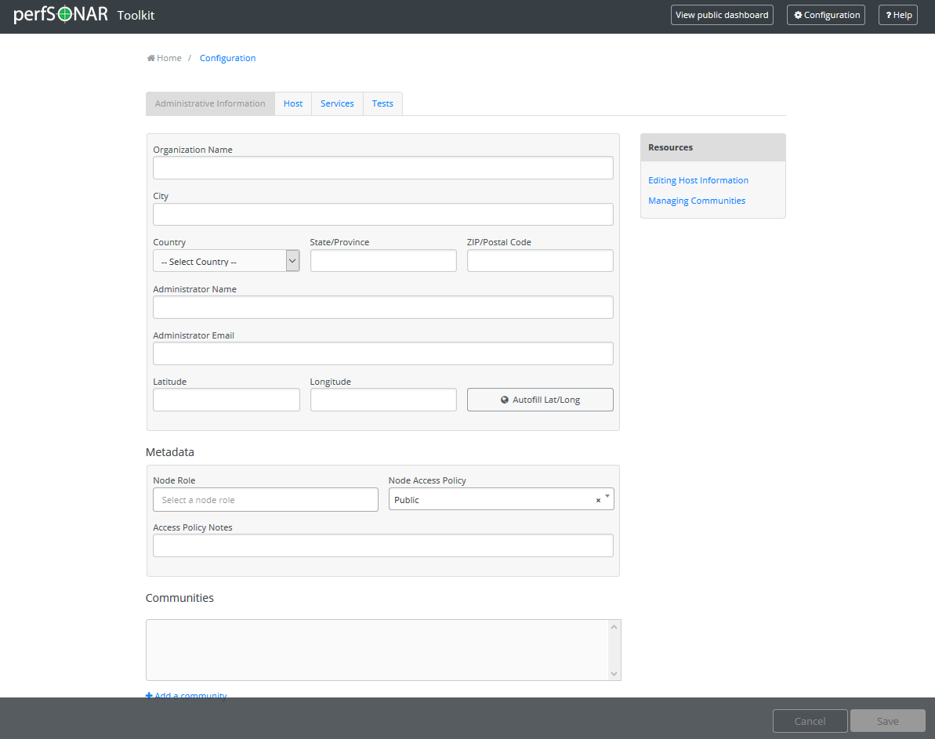
Administrative Info
For the most part this is point and click – the system needs this so that it can be located, and so that certain services will start.
Notes:
Everyone should do this, and be sure to enter lat/long info
Note that after this occurs – LS registration happens ‘automatically’ as long as the host is not in private space

Slide 11
Lookup Service Integration
Once you complete the administrative info – your host will attempt to register with the “Lookup Service”
This is a global directory that makes it easier to find perfSONAR nodes.
If your host as the admin info present, and isn’t a private IP, it will do this automatically
Notes:
Everyone should do this, and be sure to enter lat/long info
Note that after this occurs – LS registration happens ‘automatically’ as long as the host is not in private space

Slide 12
NTP
Note that it may take a day to fully stabilize the clock
Pick 4 – 5 Close servers for NTP
We have a fast way to do this, or you can manually select
Can also add your own servers if you don’t like ours
Notes:
Also a requirement. If your site is blocking NTP, use internal servers

Slide 13
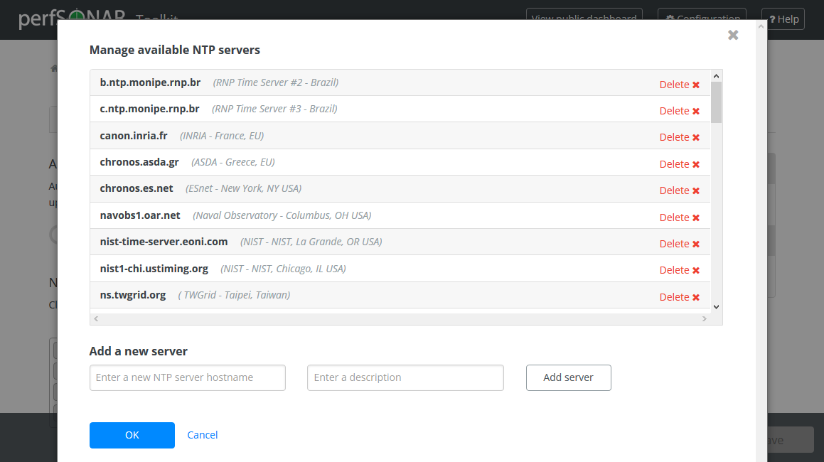
NTP
pScheduler and OWAMP require a very stable time source.
The toolkit interface allows you to configure your own host, or choose public ones we know of.

Slide 14
Add some measurements
Measurements also called tests
We will go together through some examples

Slide 15
CLI tools
Measurements tools are CLI based
  ping, traceroute, tracepath
  iperf
  owamp
Measurements scheduler (perfSONAR)
  pscheduler
Linux
  Text configuration files

Slide 16
perfSONAR toolkit basics
eduPERT workshop — TNC18
Antoine Delvaux, PSNC
14-06-2018
This document is a result of work by the perfSONAR Project (http://www.perfsonar.net) and is licensed under CC BY-SA 4.0 (https://creativecommons.org/licenses/by-sa/4.0/).

