Slide 1
pScheduler basics and bwctl replacement, command examples
TNC18 workshop
Matt Zekauskas, Ivan Ganizov FAU/DFN
June 14, 2018

Slide 2
Agenda
pScheduler introduction
pSc performance measurement tests
pSc CLI hands-on
pSc debug output

Slide 3
pScheduler introduction
Role and function
pSc communication flow
pSc coordination and negotiation process

Slide 4
pScheduler
Software for scheduling, supervising and archiving measurements.
pScheduler is designed to be standalone
Test, tool and archiver plugins are individually-installable packages
Can add plugins to systems that need them.
Removing a plugin package renders pScheduler unaware that it exists.

Slide 5
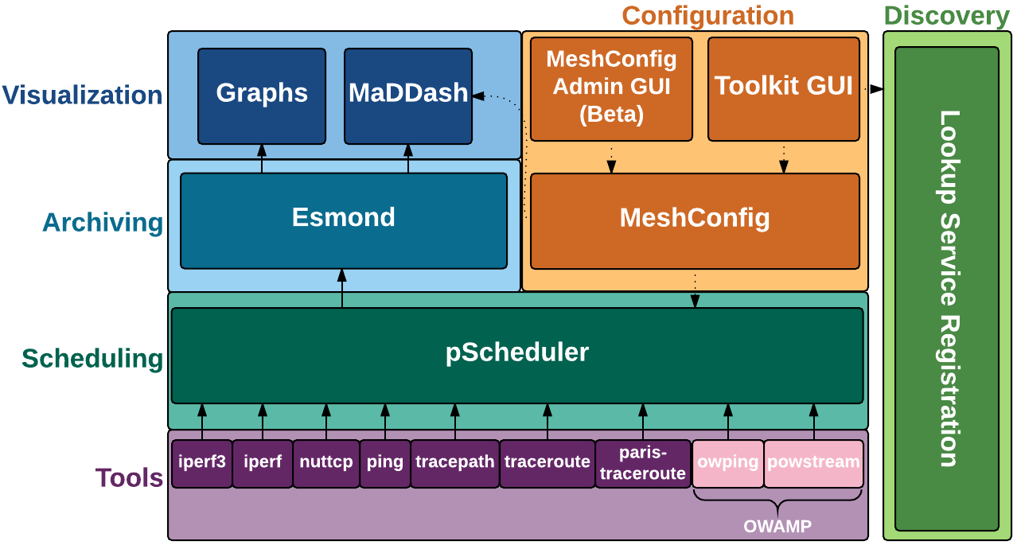
pScheduler role in perfSonar 4.x
REST
Picture from
Andy Lake

Slide 6
pScheduler Features
Visibility into prior, current and future activities
Measurement diagnostics provided with results
Full-featured, repeating testing for all measurement types baked into the core of the system
System for imposing policy-based limits on users
Reliable archiving (with multiple archivers, including Esmond, RabbitMQ and HTTP)

Slide 7
pScheduler Features
REST API
Standardized, documented data formats using JavaScript Object Notation (JSON)
Extensible via plug-in system. Integrate new…
  Tests Things to measure
  Tools Things to do the measurements
  Archivers Ways to dispose of results

Slide 8
Test Abstraction
pScheduler abstracts the tests you do from the tools that do the measurements.
  throughput not nuttcp or iperf
  latency not owamp
  rtt not ping
  trace not traceroute
There are provisions for tool-specific features and selection of specific tools.

Slide 9
Nomenclature
Test – A measurement to be conducted
Task – A job for pScheduler to do that includes a test
Run – One execution of a test
Participant – A pScheduler system involved in carrying out the test
Lead Participant – The participant where a task is submitted, that is responsible for scheduling the task and archiving results
Complete list: https://docs.perfsonar.net/pscheduler_intro.html

Slide 10
The Lifecycle
A human or system submits a task to the lead participant’s API
  The pscheduler CLI also uses the API
  Test, scheduling parameters, test-specific parameters…
pScheduler schedules and creates runs for the task
  One or more than one, depending on if the task repeats
Each run is executed
Results collected when they become available

Slide 11
Pscheduler task: schedule a new task
pscheduler task [ task-opts ] test [ test-opts ]
task-opts – Switches related to everything but the test itself
  Scheduling
  Tool Selection
  Other (archiving, output format, etc.)
test – What test the task is to perform (e.g., throughput or trace)
test-opts – Test-specific switches and parameters
  Measurement parameters

Slide 12
Simple: round-trip time
pscheduler Front-end command
task pScheduler command
rtt Test type (round-trip time)
--dest localhost Destination host
--length 512 Packet size in bytes
--timeout PT2S Round-trip timeout
Line breaks and indentation added for clarity.
Test
Options

Slide 13
PT2S?
Subset of ISO 8601 Duration:
  PT19S 19 seconds
  PT3M 3 minutes
  PT2H5M 2 hours, 5 minutes
  P1D 1 day
  P3DT2H46M 3 days, 2 hours, 46 minutes
  P2W 2 weeks
Inexact units (months, years) are not supported.

Slide 14
Test Options
These vary with the test.
  To list the installed test plugins:
  pscheduler plugins [--host host] tests
  Can do the same for tools and archivers.
To list the options for a test:
  pscheduler task [--assist host] test-name --help
  Use --assist if the plugin is installed on another host.

Slide 15
Output - I
% pscheduler task rtt --dest localhost --length 512
Submitting task...
Task URL:
https://ps.example.net/pscheduler/tasks/87e29f38-5b46…
Fetching first run...
Next run:
https://ps.example.net/pscheduler/tasks/87e29f38-5b46…
Starts 2016-12-07T07:57:30-05:00 (~7 seconds)
Ends 2016-12-07T07:57:41-05:00 (~10 seconds)
URLs you can reference

Slide 16
The URLs…
Task – Identifies the task.
  Attach and watch runs
  Cancel future runs
  https://host/pscheduler/tasks/task-id
Run – Identifies a single run of the task.
  Retrieve results after the fact
  https://host/pscheduler/tasks/task-id/runs/run-id
These are globally-unique.
Can be used remotely if network and server allow it.

Slide 17
Output II
Waiting for result...
1 127.0.0.1 520 Bytes TTL 64 RTT 0.0430 ms
2 127.0.0.1 520 Bytes TTL 64 RTT 0.0590 ms
3 127.0.0.1 520 Bytes TTL 64 RTT 0.0640 ms
4 127.0.0.1 520 Bytes TTL 64 RTT 0.0540 ms
5 127.0.0.1 520 Bytes TTL 64 RTT 0.0620 ms
0% Packet Loss RTT Min/Mean/Max/StdDev = 0.043000/0.056000/0.064000/0.010000 ms
No further runs scheduled.

Slide 18
Throughput old vs pS 4.x style
  $ bwctl -c receive_host -s send_host -t 30
  $ pscheduler task throughput
  --source send_host
  --dest receive_host
  --duration PT30S
Exclusive

Slide 19
Loss/latency RTT old vs pS 4.x style
Old
  $ bwping -s send_host -c receive_host
pS 4.x
  $ pscheduler task rtt --source send_host --dest rcv_host
Background

Slide 20
One-way Loss/latency old vs pS 4.x style
Old
  $ bwping -T owamp -s send_host -c rcv_host -N 1000 -i .01
pS 4.x
  $ pscheduler task latency
  --source send_host
  --dest receive_ host
  --packet-count 1000
  --packet-interval .01
Normal

Slide 21
Traceroute old vs pS 4.x style
  $ bwtraceroute
  -c receive_host -s send_host
  $ pscheduler task trace
  --source send_host
  --dest receive_host
Background

Slide 22
Throughput
Exclusive
  $ pscheduler task throughput
  --source send_host
  --dest receive_host
  --duration PT30S

Slide 23
Loss/latency
Background
Round-trip latency and loss
  $ pscheduler task rtt --source send_host --dest rcv_host
One-way latency and loss
  $ pscheduler task latency
  --source send_host
  --dest receive_ host
  --packet-count 1000
  --packet-interval .01
Normal

Slide 24
Traceroute
Exclusive
  $ pscheduler task trace
  --source send_host
  --dest receive_host

Slide 25
pSc debugging
pscheduler troubleshoot
pscheduler ping
pscheduler monitor
pScheduler debug output

Slide 26
Other Useful pScheduler Commands
$ pscheduler task clock --source host1 --dest host2
Measure the clock difference between two hosts
$ pscheduler task dns --query www.es.net --record a
Measure the time to do a DNS lookup

Slide 27
Notes:
Can mention on-ended versus two-ended tasks when explaining the runner

Slide 30
Questions?
Matt Zekauskas, Ivan Ganizov FAU/DFN
matt@internet2.edu, ivan.garnizov@fau.de

