Slide 1
Best practices for securing Securing the Science DMZ and maintaining performance
Nick Buraglio
ESnet Planning Team
Lawrence Berkeley National Laboratory
eduPERT
TNC18
Trondheim, Norway
06/12/2018

Slide 2
Overview
You have a need for a Science DMZ
You currently have an existing open perimeter network or DMZ
There is a need to provide confidentiality, accountability and integrity on this network while maintaining high performance
There is a need/desire for a refined security architecture specific to the Science DMZ
Performance needs to be measured and tracked
Notes:
The Science DMZ is now a widely deployed and utilized design in campuses, labs and other scientific environments. However, if managing an open perimeter network is not typical in your envionment, there may be concerns about unknowns from management, networking or security teams. The good news is that in many cases the framework for securing your environment is likely mostly there already, and the rest can be migrated to other locations within your architecture.

Slide 4








IDS, Flow,
Security data collectors
Notes:
Common campus or lab type deployent. There may already be some one-off DMZ services but majority of traffic flows through a security appliance or set of devices of some sort. This will likely remain but the addition of a Science DMZ will add a “fast path” into the network that bypasses these typical filtering mechanisms.

Slide 5

IDS, Flow,
Security data collectors
Science Image from http://www.science.fau.edu/
Notes:
Example of a basic science DMZ. A fast path out for scientific and other research traffic. However…This is how a security engineer doing his due diligence is going to see it, and that’s a good thing

Slide 6
100G
Notes:
There are different perspectives needed for securing an open perimeter network. It’s important to note, however, that it is fairly easy to create an equivalent security level on such a network, and it has been done in many high profile locations for many for many years.

Slide 7


IDS, Flow,
Security data collectors
Notes:
Practically speaking, this is a well monitored network from a 5000 foot view. Note the tap on the science DMZ link for providing visibility into the traffic on the science DMZ. This is a very important aspect of securing the science DMZ.

Slide 8
What is your existing workflow?
Evaluate existing policy
  Border security
  Perimeter access control
  Best practices for routing and device hardening
  Adjust and optimize routing according to the resource
Notes:
When building out a Science DMZ, you should evaluate how your existing security works and recycle anything that fits, there will be a pretty good amount of overlap which will ease the deployment even more. The strategy is often very similar to existing security policy with a handful of notable exceptions. The largest of which is that we want to add as much visibility as is reasonable in a given environment. I like to think about it like a doorman, we may remove the lock on the door but we scrutinize all parties going through it.
What does the current security architecture do? What does it need to do and what does it not do? Pretend firewalls don’t exist. How would you accomplish those functions without one firewall?

Slide 9
Routing: Limit exposure
Announce only what needs to access research resources
  Where reasonably possible, announce only research resources via science DMZ
Research Networks
Commodity Networks
Research traffic:
a.b.c.d/24 in
x.y.z.0/24 out
Enterprise traffic:
0.0.0.0/0 in
x.y.z.0/16 out
Notes:
Routing is your sledgehammer and you’ll need to engage your networking team to accomplish these pieces if you are not part of that group.
The basic premise is that you probably don’t need to announce the entire address space of your institution to a given resource. If possible, announce only your dedicated prefixes via the Science DMZ. For example, if out of your network only a subset of that is utilized for research, only announce that subset via your science DMZ. While this may not always be possible, it is a reallypowerful tool for limiting the amount and types of traffic that will transit your science DMZ to only what is actual science and research data. It also serves as a way to minimize the amount of data you’ll need to consume within any IDS or other security data collector. Doing this will drastically diminish the surface area of your open perimeter network.
The research and commodity networks may very well be the same network with logical partitions, OSCARS circuits, VRFs or they may be as simple as an additional specialty peering.

Slide 10

Perimeter Access Control
Best Practice ACLs
  BCP38
  Block access to control plane
  Deny inbound access to known exploitable protocols
Notes:
You’ll want to utilize best practice filtering for hardening your border hardware. Create filters on the router as you would a normal internet facing device. This generally includes blocking management protocols to the devices addresses and interfaces. You will also likely want to filter things that should never traverse that path such as probing for things that should never come from external entities. Things you generally don’t want poking at your normal network. Your network engineering team is likely already doing this kind of thing but double checking checking doesn’t hurt. Take into account any network device that may have a public address within your science DMZ as a whole. Switches, routers, IB switches, SAN devices, LOM/IPMI/DRAC address. Any address you connect to to manage a device should be filtered in this way.

Slide 11
Hosts
Patch Scheduling
Host based firewalls
Centralized host management
Host IDS
User management / Accountability
Two-Factor authentication
Notes:
It goes without saying that appropriate patch scheduling should always be in place. Keeping up to date on software patching is something you’re likely already doing, removal of your perimeter security is all the more reason to keep on top of it.
Utilize host based firewalls whenever possible If you aren’t used to your hosts being “out in the wind” you may need to spend some time tuning these options. Consider the host based firewalls a living document for a period of time, just like a normal perimeter firewall is, engage your networking and security teams for help with protocols, ports if needed. Tune your configurations to your needs and then replicate to like systems.
Any modern operating system should have some firewall function available.
Think of this as hardening your hosts to accomplish some of the tasks that a traditional enterprise firewall does and as a great way to shift that filtering as close to the resource as you can get it, which is general filtering best practice. There are projects like googles caprica that can automate some of these processes and take some of the pain out of the initial generation of the rules. Other tools can aid in the mass dissemination of the policy. This brings us to the next piece of the strategy, host management.
Central host mamagement has been utilized for years in cluster systems and is now widely available and very well documented in enterprise and campus environments. Cloud providers utilize these tools to scale to enormous sizes, they work well. Utilizing tools like PXE booting images, cfengine or puppet you can greatly simplify deployment of new software and ensure uniformity across your resources. When configured to do so it can also ensure that the versions of software that you want and expect to be running are the ones that are in fact running.
There are many options in the host IDS world now and they all have their strengths and complexity level. OS Sec is one of the more powerful offerings and is widely deployed in the R&E world. This can be a very powerful tools for any service host that exists outside of a perimeter firewall device as it can providea level of visibility and alerting from within the actual host system. This can also be one of the more time consuming pieces to construct, but it does pay off once it is in place and tuned correctly for a given environment.
I personally prefer to think about accountability as one of the more nuanced pieces of security. There are so many ways to do it and it is highly interpretable. Central user management is a big piece of this. This can be controlled and managed in a number of ways and can be tied into your central host management software as well. Jump boxes or head nodes can be used to further simplify entry points into a given compute resource and even further reduce the surface area of a Science DMZ. Teo factor authentication is also a very useful piece to aid in management of resources.
In addition to the typical accountability requirements, being able to create baselines to address anomalous behavior is *critically* important. Which brings us to...

Slide 12
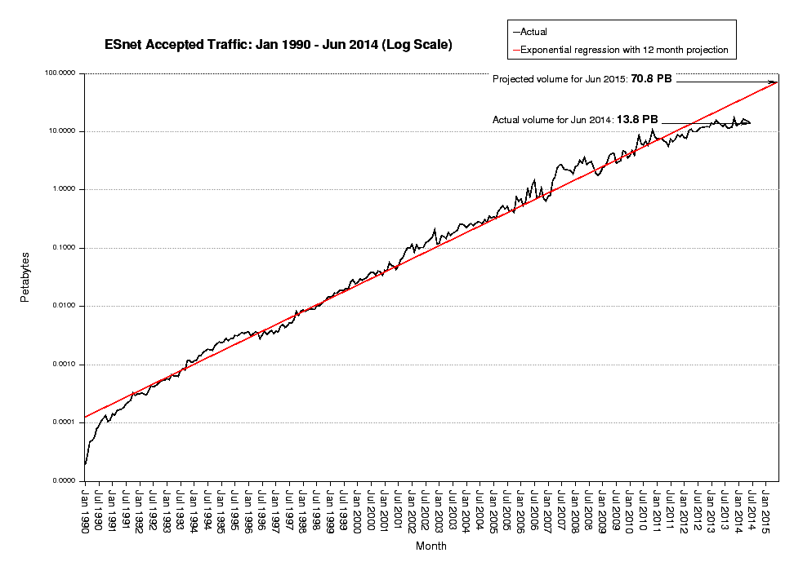
Baselines, logging and traffic analytics
Traffic graphs
Flow Data
Syslog (host and network)
Performance data (latency, RTT, etc.)
Soft failure / soft event detection
Notes:
Baselines are useful from the perspective of identifying anomalies. In addition to its other uses, what baselines will provide is a great visual cue for anomaly detection.
Again, your networking team likely already has a mechanism for recording this information, the Science DMZ just needs to be included. Some platforms even allow for alerting on deviations from baselines. Baselines can be made for any data that you collect over time, be if flow data, SNMP graphs, syslogs, whatever.
There are many commercial and opensource projects that can do log aggregation very easily and efficiently and your infrastructure and networking folks probably have something in place already. You can duplicate it for your science DMZ or utilize an existing service, the important thing is just to create useful logs that can be stored, sorted and queried. Open Source options are easily scriptable and scalable and commercial options are very feature rich.
Can’t stress enough how important logging is and how often I personally use it for so many different aspects of networking and security.

Slide 13
Confidentiality & Integrity
Use secure protocols whenever possible
  Globus turns on end to end checksum by default
  Globus can be configured to encrypt traffic in transit
HPN-SSH patches in a pinch
Notes:
Providing data integrity is important not only for control of the software and systems, but also to verify the data that is sent and received over the network. Using secure protocols such as ssh and ssl to communicate with the compute resources is just as important as the data itself because it helps guarantee the control channel is not being tampered with. It’s important to remember that things like encryption add overhead and may impact transfer speeds, so using scp to move data around may not be the best option for huge datasets, which is why it’s useful to verify the data transfers utilizing mechanisms like checksums before and after data is transmitted. Not only can this help ensure the data is accurate it also can shield against any other anomalies while the data is in flight.
Not many tools do end to end checksums by default, globus does. Aspera verifies integrity to the receiving process, but not to the file system.

Slide 14
Visibility, filtering & event based actions
Intrusion detection system(s)
Dynamic black hole routing
  Community BGP feeds (Bogons, etc.)
Notes:
The real work of securing a science DMZ is handled by an intrusion detection system. The deep packet inspection is how the system will understand the traffic passing through the science DMZ. Regardless of what it ends up being, it will need to be tuned and adjusted to reflect the needs of your science dmz, just as a firewall and IPS needs to be adjusted and tuned in an enterprise network. Bro-IDS is commonly deployed in research and education networks due to its ability to very flexibly support policy, protocol and large amounts of data. Bro also has a mechanism for signaling events that is very powerful and the platform as a whole has been actively developed and proven in real world science networks for quite some time.
It scales very well to fit expanding or shifting needs. Other IDS systems are available, just make sure to do a needs assessment before choosing one.
So you have all of this stuff in place and you have a science DMZ in production. What everyone really wants to know is “how do I block bad actors?”
The tried and true way to block is to employ a well documented mechanism called BGP black hole routing. The possibilities with this are very flexible and if a software router is used it can be deployed as a virtual machine and heavily automated. On modern routing platforms the action generated by the black hole router will be performed in hardware using traditional layer3 routing.
Some environments have a desire or requirement for human intervention for any action taken on an active network path, meaning, your network team may want to check and verify, or manually perform any filtering that may be necessary based on logs, alerts or other policy. In some environments, it is more desirable to automatically perform these actions, and in others it may be a mix, it is wholly up to the site. My personal opinion is that I want to automate the things that constitute the noise, filtering hosts, incoming scans, etc. and leave the large prefix filtering to a manual process to ensure human eyes see anything with a large scope, like an entire institution.

Slide 15
IDS, Flow,
Security data collectors
X
Black Hole Router
Notes:
The mechanics of this are that your black hole router will push out an update to your border routing devices and they will operate as fast as the network hardware can insert and withdraw routes.
At a basic level, the remote triggered black hole router functions like this: Nefarious traffic appears, anomaly detected by IDS system. It signals the black hole router which sends a BGP update to the science DMZ router that then blocks the traffic using the policy configured for that peering. It’s fast, reliable and low overhead.

Slide 16
Additional considerations
External Scanning Services
Don’t forget IPv6
BGP FlowSpec (RFC 5575)
  Dissemination of rules via BGP NLRI
SDN
Cross group collaboration
Notes:
Consider making use of an external scanning service to regularly scan your science DMZ for known vulnerabilities. Many services both commercial and open source are available and their regular use will provide
You’re all using IPv6, right? If you aren’t, the science DMZ is a decent place to test that out if you’re not utilizing it within your network. However, it’s important to remember that IPv6 is a completely parallel protocol so if you’re deploying it you need to ensure that all of the steps you are taking to secure the science DMZ are also taking IPv6 into account. Even if you aren’t actively deploying IPv6 you should be aware of it because some platforms will tunnel IPv6 automatically if they don’t have a native v6 address.
An emerging option called BGP Flowspec is a relatively new protocol extension that defines a mechanism used to distribute more complex rules. What this means is that a network can selectively drop traffic flows based information more like a traditional packet filtering firewall. There are some serious caveats with this, it’s a powerful tool but it requires a significant amount of care in deployment because it can consume a great deal of resources on your networking hardware. It should be used sparingly, not as a primary blocking mechanism. Hardware support is still growing, and as time goes on some of the resource limitations may relax. As of today of the major routing vendors support it on their higher end hardware and there is an `opensource implementation that supports it as well that can be utilized as a virtual blackhole route source.
SDN is has some interesting implications networking world, but it also lends itself really well to the security realm. Depending on the scope of your science DMZ your institutional knowledge of SDN, you can potentially take advantage of lower cost hardware utilizing OpenFlow and a centralized controller to block, allow tor otherwise maneuver traffic based on your sites policy. This is a subject that is very large in and of itself, feel free to contact me offline if you’d like to talk more about it.
With everything discussed here you’re probably thinking “how do we get this in place?” How do we build this out top to bottom? How do we add the pieces that make sense to add that aren’t already there? There is a trick, and I can tell you from experience that this trick does work!
Cross group communication will also provide a significant in-road into deployment of the phases of the science DMZ.

Slide 17
Functional considerations
Access to resources
  From inside
  From outside
Use the DTN

Slide 18
Useful tools and Links
engage@es.net
http://fasterdata.es.net/science-dmz/science-dmz-security/
Notes:
A very short list of things to help you get started with in securing your science DMZ or open perimeter network.

Slide 19

Questions?
Nick Buraglio
Esnet Planning Team
buraglio@es.net

