Slide 1
From mesh-config to pSConfig
eduPERT workshop — TNC18
Antoine Delvaux, PSNC
14-06-2018
This document is a result of work by the perfSONAR Project (http://www.perfsonar.net) and is licensed under CC BY-SA 4.0 (https://creativecommons.org/licenses/by-sa/4.0/).

Slide 2
Outline
Deployment models
  Beacon, Island and Mesh
  Sample site deployment
Regular testing
  Develop a test plan
pSConfig
  From mesh-config…
  …to pSConfig
Hands-on
Notes:
Make the point that the complexity of the network is too much for anyone to grasp – and with the complexity we need tools/methods to bite off smaller parts of the problem

Slide 3
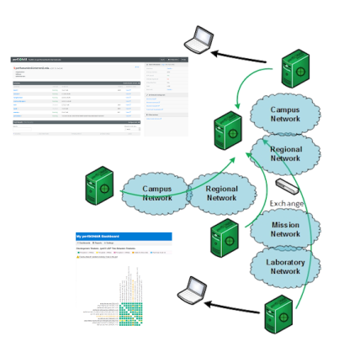
Regular Testing - Beacon
The beacon setup is typically employed by a network provider (regional, backbone, exchange point)
  A service to the users (allows people to test into the network)
  Can be configured with Layer 2 connectivity if needed
  If no regular tests are scheduled, minimum requirements for local storage.
  Makes the most sense to enable all services (bandwidth and latency)

Slide 4
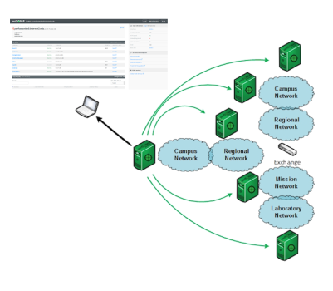
Regular Testing - Island
The island setup allows a site to test against any number of the 1200+ perfSONAR nodes around the world, and store the data locally.
  No coordination required with other sites
  Allows a view of near horizon testing (e.g. short latency – campus, regional) and far horizon (backbone network, remote collaborators).
  OWAMP is particularly useful for determining packet loss in the previous cases.
  Throughput will not be as valuable when the latency is small

Slide 5
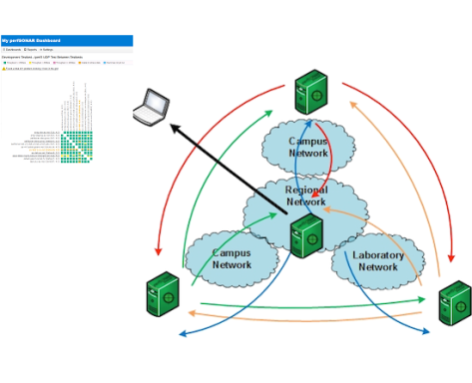
Regular Testing - Mesh
A full mesh requires more coordination:
  A full mesh means all hosts involved are running the same test configuration
  A partial mesh could mean only a small number of related hosts are running a testing configuration
In either case – bandwidth and latency will be valuable test cases

Slide 6
perfSONAR Deployment Locations
Critical to deploy near key resources such as DTNs
More perfSONAR hosts allow segments of the path to be tested separately
  Reduced visibility for devices between perfSONAR hosts
  Must rely on counters or other means where perfSONAR can’t go
Effective test methodology derived from protocol behavior
  TCP suffers much more from packet loss as latency increases
  TCP is more likely to cause loss as latency increases
  Testing should leverage this in two ways
    Design tests so that they are likely to fail if there is a problem
    Mimic the behavior of production traffic as much as possible
  Note: don’t design your tests to succeed
    The point is not to “be green” even if there are problems
    The point is to find problems when they come up so that the problems are fixed quickly
Notes:
A lot of people want to prove that they are not the problem, and design their tests to succeed. This is not helpful.

Slide 7
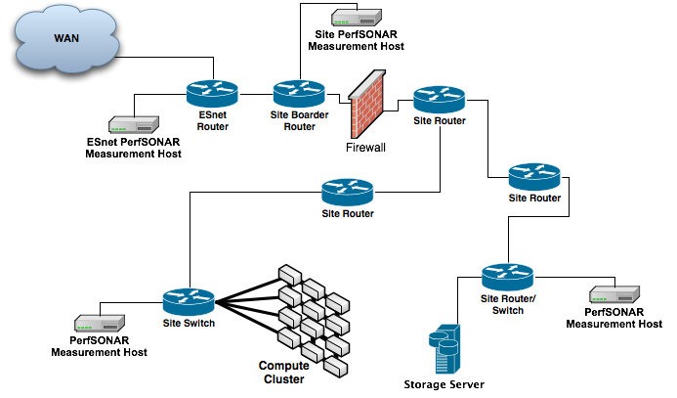
Sample Site Deployment
Notes:
Place nodes where the people are located

Slide 8
Outline
Deployment models
  Beacon, Island and Mesh
  Sample site deployment
Regular testing
  Develop a test plan
pSConfig
  From mesh-config … to pSConfig
Hands-on
Notes:
Make the point that the complexity of the network is too much for anyone to grasp – and with the complexity we need tools/methods to bite off smaller parts of the problem

Slide 9
Importance of Regular Testing
We can’t wait for users to report problems and then fix them (soft failures can go unreported for years!)
Things just break sometimes
  Failing optics
  Somebody messed around in a patch panel and kinked a fiber
  Hardware goes bad
Problems that get fixed have a way of coming back
  System defaults come back after hardware/software upgrades
  New employees may not know why the previous employee set things up a certain way and back out fixes
Important to continually collect, archive, and alert on active throughput test results
Notes:
Soft failures are everywhere – and they may hide other soft failures

Slide 10
Regular perfSONAR Tests
We run regular tests to check for three things
  TCP throughput
  One way packet loss and delay
  traceroute
perfSONAR has mechanisms for managing regular testing between perfSONAR hosts
  Statistics collection and archiving
  Graphs
  MaDDash display
  Integration with NAGIOS
This infrastructure is deployed now – perfSONAR hosts at facilities can take advantage of it
At-a-glance health check for data infrastructure
Notes:
Purpose of testing should be to find problems. Design tests to find things, not always succeed.

Slide 11
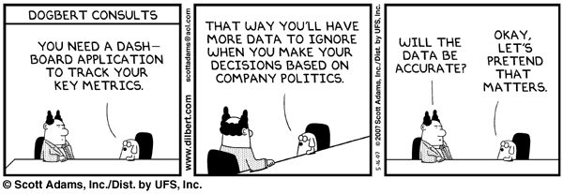
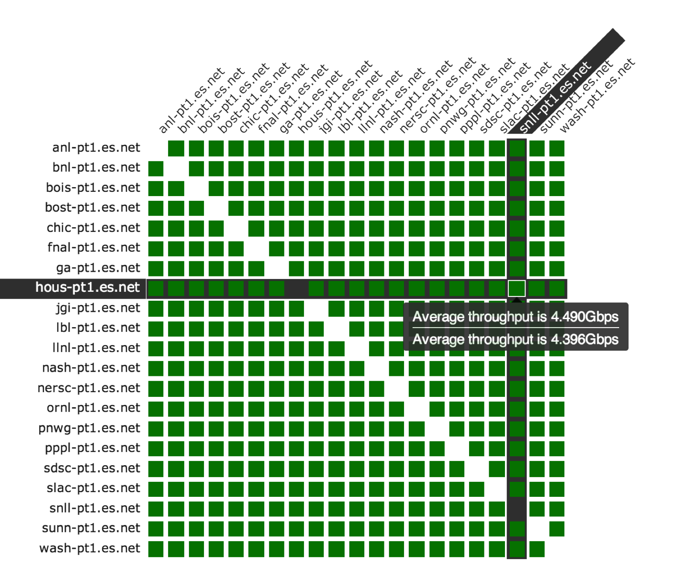
MaDDash: http://ps-dashboard.es.net
Notes:
This is a clean dashboard image – note to people that the dashboard they look at ‘live’ may not be clean. This is ok – dashboards are meant to find problems, not be green all the time.

Slide 12
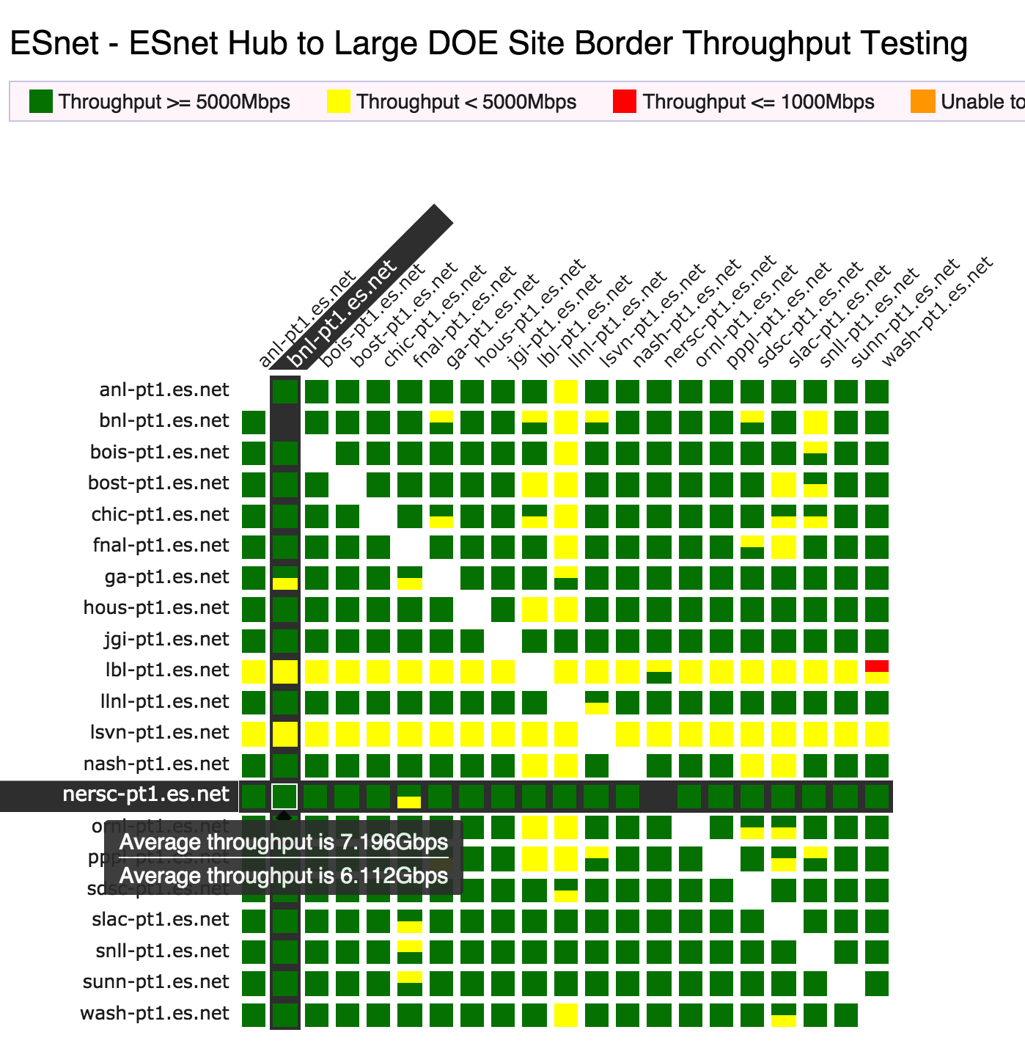
perfSONAR Dashboard: Raising Expectations and improving network visibility
Status at-a-glance
Packet loss
Throughput
Correctness
Some live instances at
http://perfsonar-smallnodes.geant.org/ http://pas.net.internet2.edu/
http://ps-dashboard.es.net/
Drill-down capabilities:
Test history between hosts
Ability to correlate with other events
Very valuable for fault localization and isolation
Notes:
Dashboards – requires coordination of testing

Slide 13
Develop a Test Plan
What are you going to measure?
  Achievable bandwidth
    2-3 regional destinations
    4-8 important collaborators
    4-8 times per day to each destination
    20 second tests within a region, longer across oceans and continents
  Loss/Availability/Latency
    OWAMP: ~10-20 collaborators over diverse paths
  Interface Utilization & Errors (via SNMP)
What are you going to do with the results?
  NAGIOS Alerts
  Reports to user community
  MaDDash
Notes:
On bandwidth – make note that localized (e.g. in the LAN or metro) bandwidth tests don’t give you much and may case loss themselves. Test bandwidth to things further out to get the most out of the measurement.
Packet loss should be done everywhere (especially LAN/MAN distances)

Slide 14
Outline
Deployment models
  Beacon, Island and Mesh
  Sample site deployment
Regular testing
  Develop a test plan
pSConfig
  From mesh-config…
  …to pSConfig
Hands-on
Notes:
Make the point that the complexity of the network is too much for anyone to grasp – and with the complexity we need tools/methods to bite off smaller parts of the problem

Slide 15
pSConfig: Re-imagining MeshConfig
Major feature for perfSONAR 4.1 will be refactoring of MeshConfig into pSConfig
The introduction of MeshConfig helped shape a lot of today’s deployments
perfSONAR has changed a lot the past few years and MeshConfig hasn’t kept up in every area.
Just as pScheduler was transformative at the test scheduling layer in 4.0, we hope pSConfig will be equally as transformative for the test configuration layer in 4.1

Slide 16
How people use meshconfig today
MeshConfig generally used for:
  Medium to large internal deployments (e.g. ESnet)
  Medium to large collaborations (e.g. WLCG)
Made it easier to deploy tests on lots of hosts and visualize it…which has been good but interesting side-effects
  Over-testing not uncommon making it hard to see patterns
Test design is hard and probably impossible to completely solve but can hopefully help
  Clearer syntax so take advantage of things like “disjoint” topologies and auto-discovery features.
  Easier to write tools to auto-generate tests based on topological knowledge, etc

Slide 17
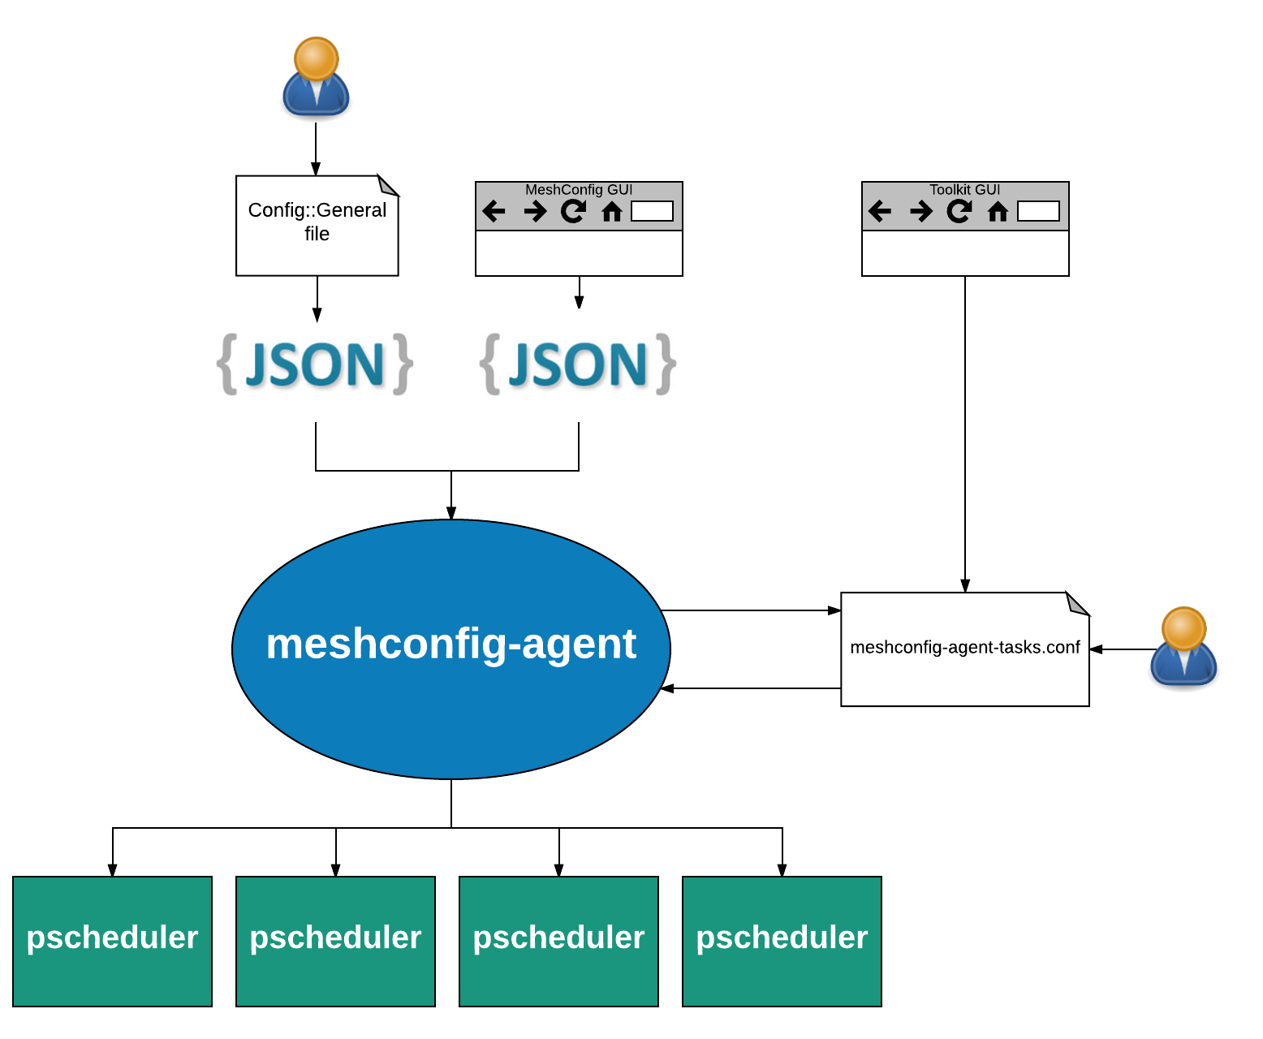
Current MeshConfig Agent

Slide 18
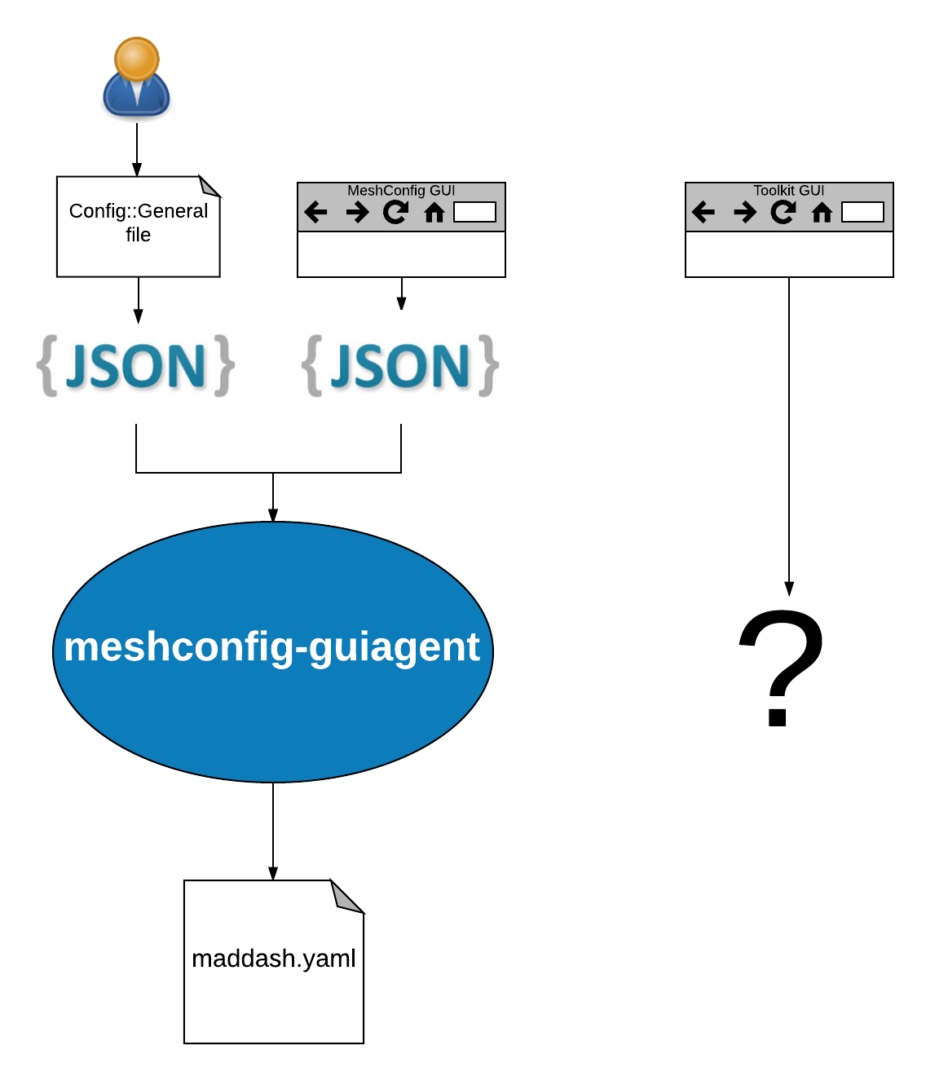
Current MeshConfig GUIAgent

Slide 19
Extensibility (or lack thereof)
MeshConfig uses perl classes with fixed set of properties and methods to define tests
There is one set of classes for the ConfigGeneral format and another for meshconfig-agent-tasks.conf format
  Every time we add a new test option, we have to update both sets of classes.
  If we add a new archiver or test type we have to create and test brand new classes in each
JSON generally just works if you change the other two…except when it doesn’t
For gui-agent, if we add a new test type we need to write code in the MaDDash.pm generator

Slide 20
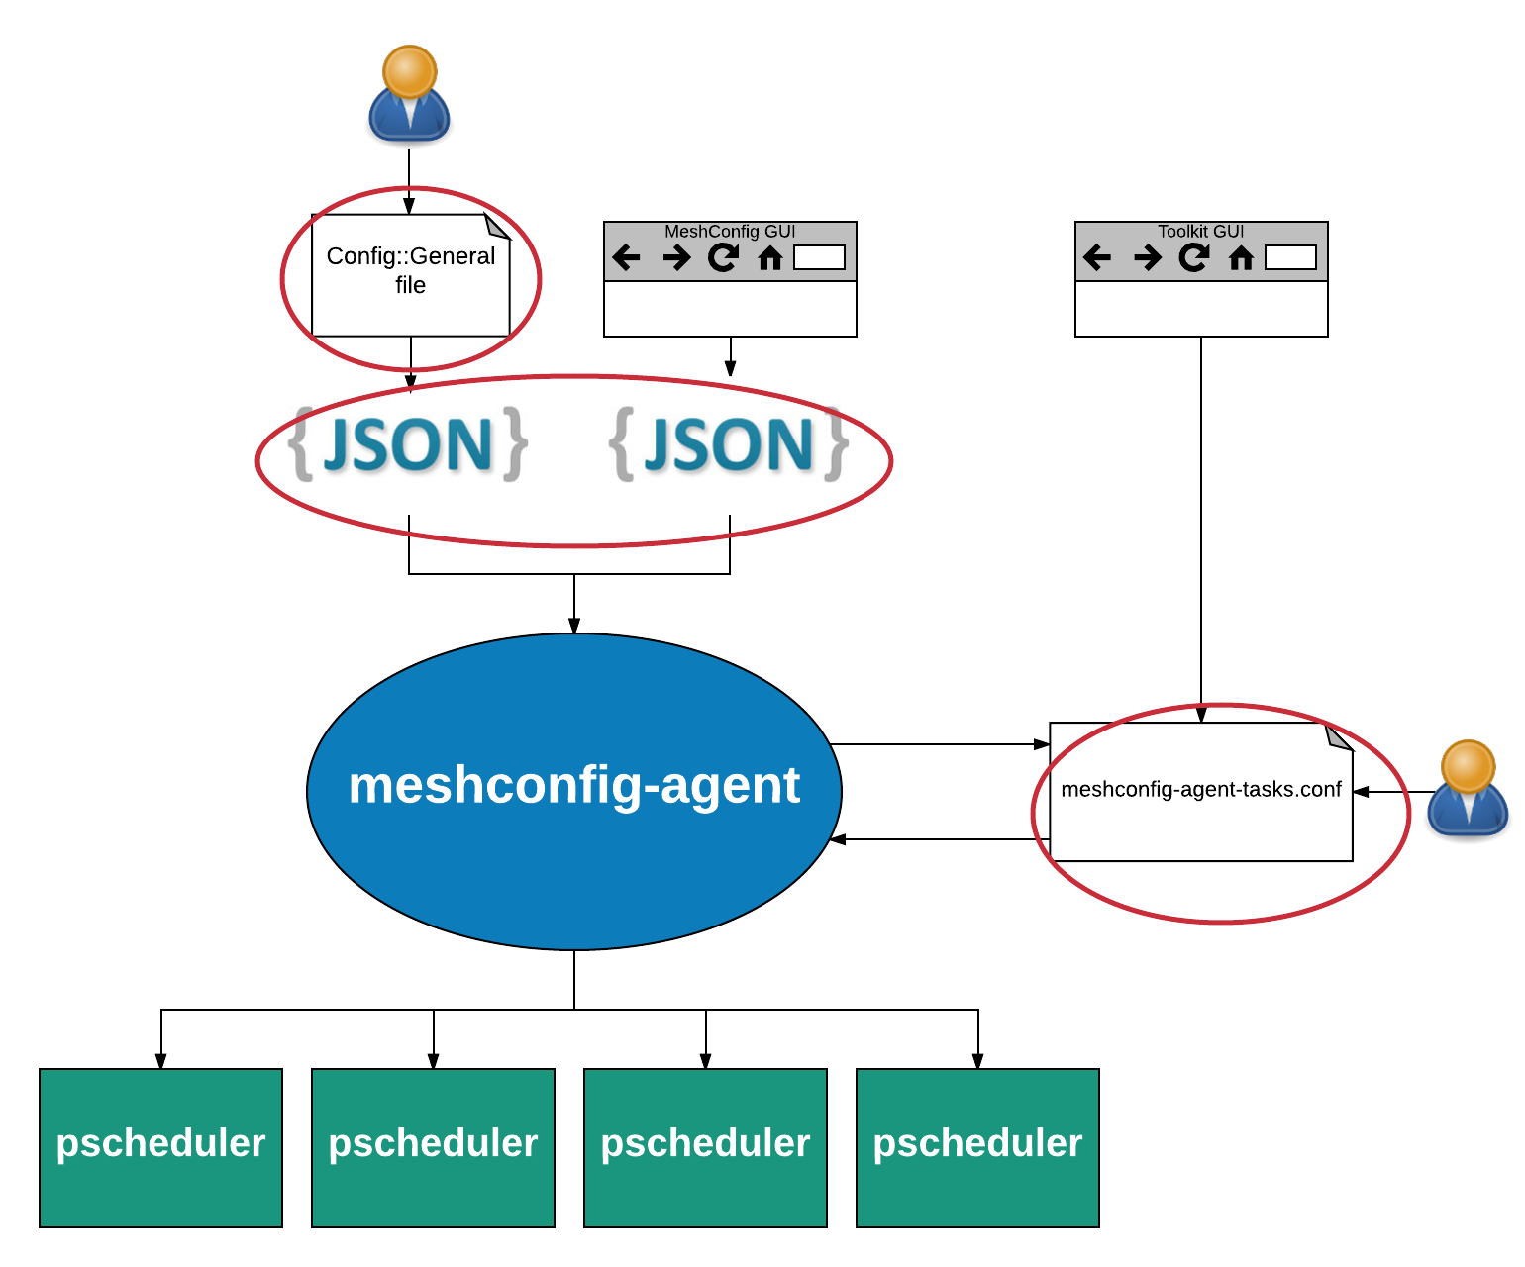
Changes when we add plugin or new options

Slide 21
MeshConfig– The Good
The JSON file pull model seems to be a good way to pass around tests for our users
Support for some advanced features like host classes and address maps that distinguish us from the pack
Its useful to be able to add in local options to tests from remote files (e.g. refine test ports or api-keys to a local archive)
Having a local list of what should be running is useful for debugging
We have a lot of code in place for maintaining a batch of pscheduler tasks that seems to work reasonably well

Slide 22
MeshConfig– The Bad
The process is still confusing, partially due to the various formats.
As we add new plug-ins to pscheduler, meshconfig will inevitably lag behind
ConfigGeneral format is still error prone despite intentions

Slide 23
MeshConfig– The Ugly
The test spec and archive configuration syntax has almost nothing to do with the current set of perfSONAR components and its confusing

Slide 24
pSConfig
MeshConfig renamed to pSConfig
Single JSON configuration format
No need to change any code when adding new test or archiver, will validate against pscheduler or maddash check profiles
Terminology such as task, test and archiver to be made consistent with how pscheduler uses them
CLI for building meshes to avoid syntax errors and provide real-time guidance on options.
Three packages:
  psconfig-publisher – Tools to help edit and publish task JSON files
  psconfig-pscheduler – Daemon to create pscheduler tasks from JSON files
  psconfig-maddash – Daemon to configure maddash based on JSON files

Slide 25
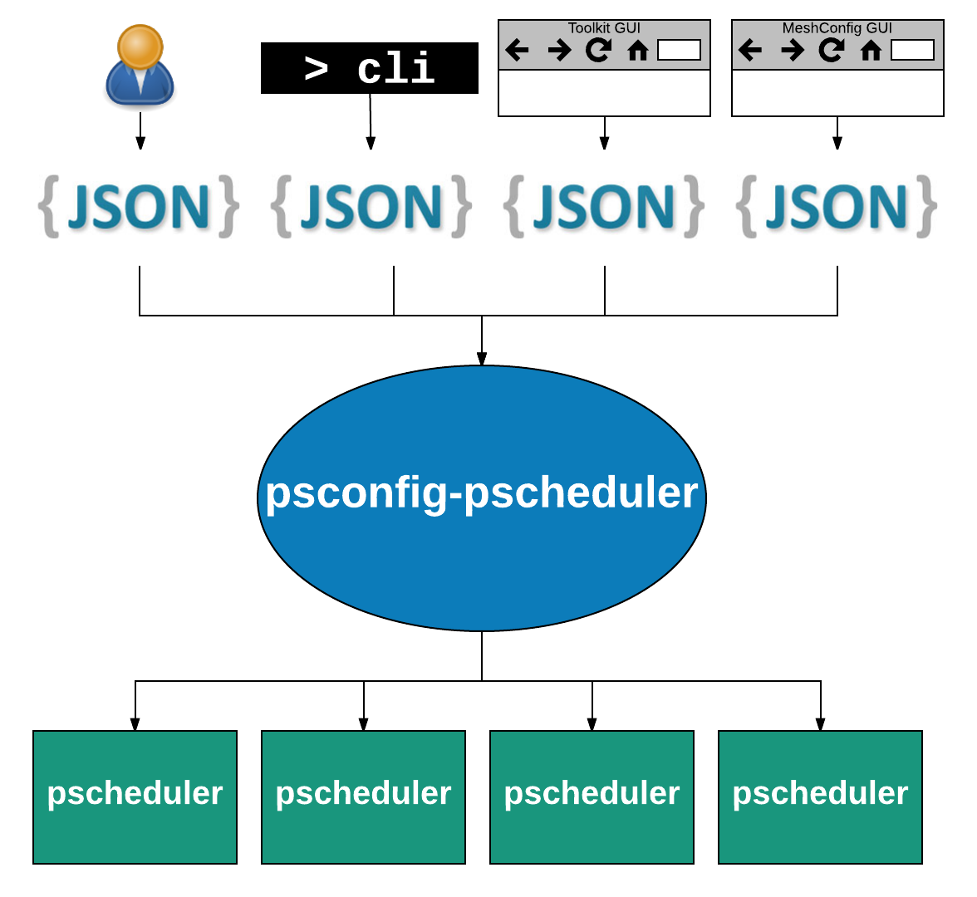

Slide 26
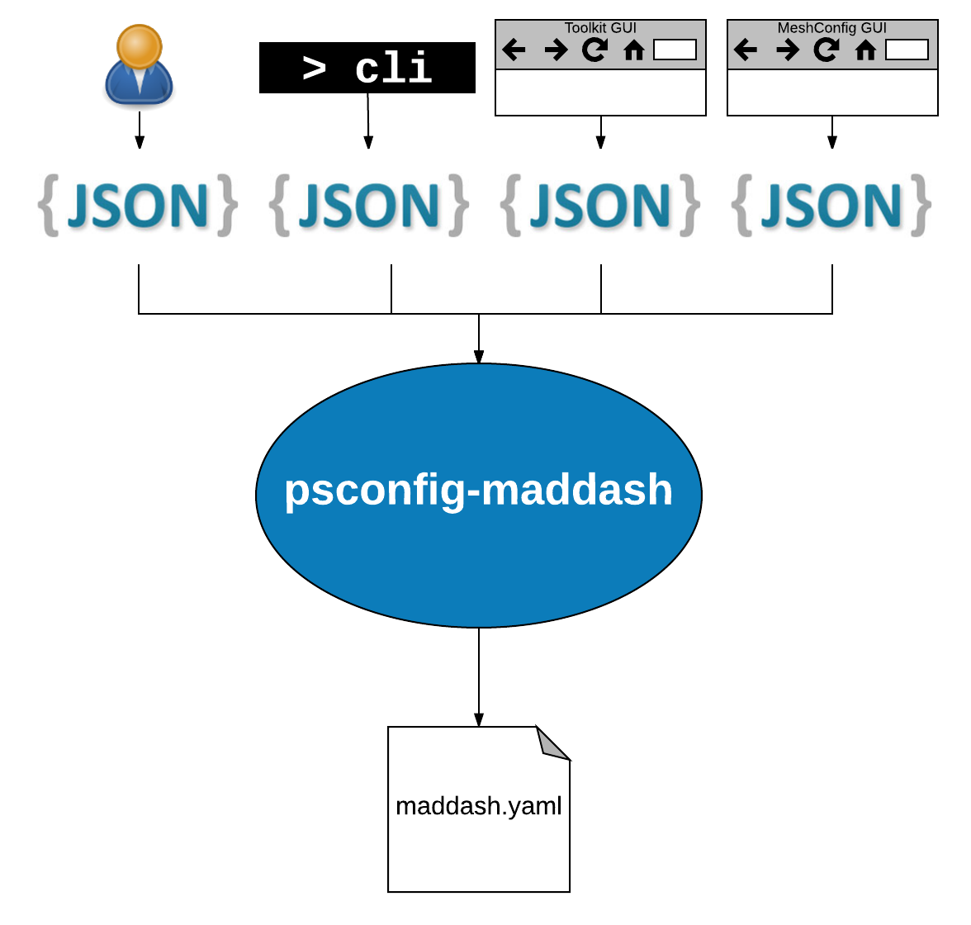

Slide 27
Example - Archivers
OLD FORMAT
NEW FORMAT
<measurement_archive>
type traceroute
read_url https://…
write_url https://…
</measurement_archive>
<measurement_archive>
type perfsonarbuoy/bwctl
read_url https://…
write_url https://…
</measurement_archive>
<measurement_archive>
type perfsonarbuoy/owamp
read_url https://…
write_url https://…
</measurement_archive>
<measurement_archive>
type perfsonarbuoy/pinger
read_url https://…
write_url https://… </measurement_archive>
</measurement_archive>
"archives": {
"example-archive-central": {
"archiver": "esmond",
"data": {
"url": "https://…”
}
}
},

Slide 28
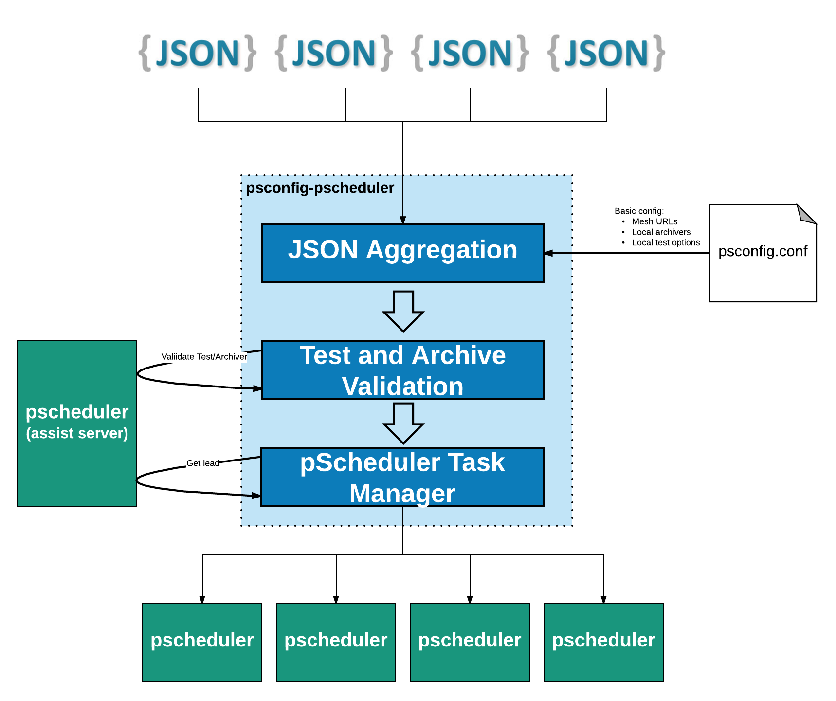

Slide 29
Backward Compatibility
psconfig packages will convert any config files to new format
If running old meshconfig agent…
  psconfig-publisher package will be able to generate old json
  Can use rewrite rules and user-agent header to serve-up old version
If running new psconfig agent…
  Option 1: Understand just the new (could ditch a lot of old code sooner)
  Option 2: Detect format and parse each
MeshConfig GUI
  Generate both and serve-up correct based on user-agent header

Slide 30
Outline
Deployment models
  Beacon, Island and Mesh
  Sample site deployment
Regular testing
  Develop a test plan
pSConfig
  From mesh-config…
  …to pSConfig
Hands-on
Notes:
Make the point that the complexity of the network is too much for anyone to grasp – and with the complexity we need tools/methods to bite off smaller parts of the problem

Slide 31
Hands-on
Participating in a mesh
  psconfig remote
Checking mesh measurements are running
  pscheduler
Translating your mesh configuration to psconfig format

Slide 32
psconfig remote
psconfig remote list
psconfig remote add http://mp10/workshop/edupert.json
psconfig remote list
tail /var/log/perfsonar/psconfig-pscheduler-agent.log
psconfig pscheduler-stats
psconfig remote delete

Slide 33
Running pScheduler Commands
$ pscheduler monitor
$ pscheduler schedule --filter-test=throughput
Show the upcoming throughput tests
$ pscheduler schedule --filter-test=throughput
-PT1H --host somehost
Show the throughput tests run in the past hour on somehost
$ pscheduler plot-schedule PT3H > /var/www/perfsonar/workshop/schedule.png
Plot a graph of the current scheduler for the next 3 hours

Slide 34
Scheduled run states
Pending: run will execute in the future
On-deck: run scheduled to execute, will begin soon
Running: run is executing
Cleanup: run finished, final operations underway
Finished: executed and finished successfully
Overdue: run did not execute when scheduled, but still in window and could
Missed: run did not execute when scheduled
Failed: run did not complete
Non-Starter: run could not be scheduled, no timeslots avail.
Canceled: task canceled before run executed

Slide 35
psconfig translate
psconfig translate http://mp10/workshop/edupert.json

Slide 36
From mesh-config to pSConfig
eduPERT workshop — TNC18
Antoine Delvaux, PSNC
14-06-2018
This document is a result of work by the perfSONAR Project (http://www.perfsonar.net) and is licensed under CC BY-SA 4.0 (https://creativecommons.org/licenses/by-sa/4.0/).

