Slide 1


perfSONAR introduction
GEANT Ops training
Ivan Ganizov FAU/DFN
GEANT pS automation and deployments
June 21, 2018

Slide 2
Agenda
perfSONAR grand scheme
perfSONAR services and interoperation
pS GEANT Ops deployment

Slide 3
perfSONAR grand scheme
Philosophy behind pS
  What is being measured: network, routers, servers?
  Suite of services
  How to find servers?
  Where to find help?

Slide 4
pS services & interoperation
pS Toolkit, Testpoint
pS Archive = “Esmond”
pS Lookup Service
  pS Service Directory
pS Dashboard

Slide 5
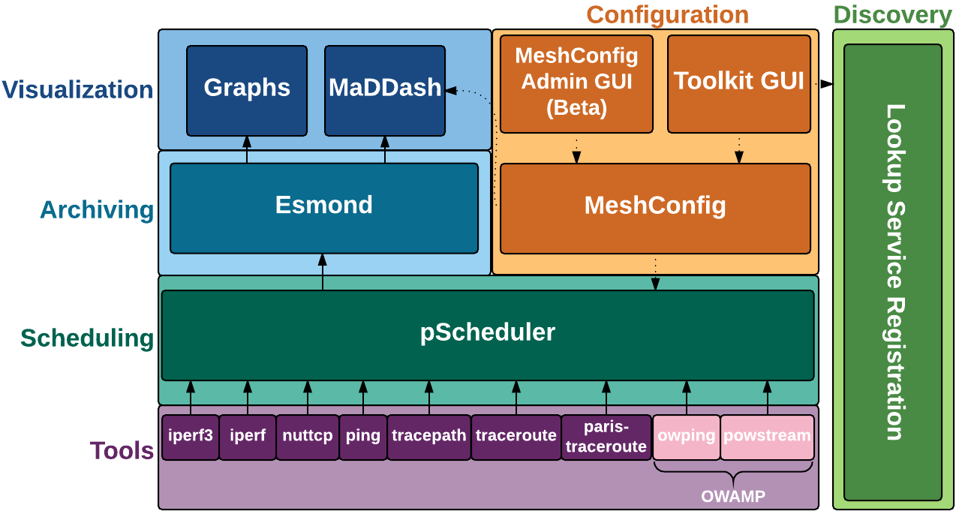
Scheme of perfSonar 4.x framework
pSconfig
REST
Picture from
Andy Lake & Matt Zekauskas

Slide 6
pS services & interoperation
pS Central coordination
  pSConfig
  Meschconfig GUI

Slide 7
GEANT Ops pS deployment
pS Test servers
  Types of deployment
  Puppet management
  Services
  Stats

Slide 8
GEANT Ops pS deployment
pS Archive
  services
  cassandra, postgresql-9.5, httpd, httpd24-httpd
  logs

Slide 9
GEANT Ops pS deployment
pS MaDDash
  services
  perfsonar-meshconfig-guiagent, httpd, httpd24-httpd, maddash-server, memcached
  logs

Slide 10
pS MaDDash links
  GEANT: https://prod-psmdsh-gn.geant.net/maddash-webui/
  ANA100G: http://maddashdev0.internet2.edu/maddash-webui/index.cgi?dashboard=ANA%20Mesh
  GNA mesh: http://maddashdev0.internet2.edu/maddash-webui/index.cgi?dashboard=GNA%20Mesh
  Esnet: http://ps-dashboard.es.net/index.cgi?dashboard=5%3A%20ESnet%20to%20Europe

