Slide 1
6th SIG-NOC Meeting
Welcome!
November 27, 2017

Slide 2
Agenda Today
Time | Session
12.00 - 13.00 | Arrival - Sandwiches
13.00 - 13.15 | Welcome by SURFnet and Steering Committee
13.15 - 14.00 | RIPE NCC Operations and Analysis Tools - Emile Aben, RIPE NCC
14.00 - 15.00 | GDPR and NOC Processes - Nicole Harris, GEANT
15.00 - 15.30 | Coffee
15.30 - 16.15 | Splunk Data Analysis for NOC Operations - Graham Parsons, IT operations specialist, SPLUNK
16.15 - 17.15 | CLAW Crisis Management Event Report - Charlie van Genuchten, SURFnet/GEANT
17.15 - 17.30 | Closing
19.00 | Dinner - Restaurant: LUC, Voor Clarenburg 8 (http://lucutrecht.nl/)

Slide 3
CLAW
Keep Calm and survive the Crisis
Charlie van Genuchten
SIG-NOC Meeting
November 27

Slide 4
Input SIG-NOC session
Essence | Input
How to make a crisis management team | How to divide and delegate tasks and roles in a large scale event How many people and what would be their profiles to choose a crisis management team?
How to make a crisis management plan | Help towards building process and plans How to develop an effective crisis management plan and how to test it The order in which we should do things Crisis management template
How to communicate during a crisis | Good/right communication How to notify management Communication, how? What to do with media Elements of media training How to manage comm's and not 'add' to the reputation damage The best way to communicate (politeness) and also email social media phone single source multiple sources What to say to our own team
Specific (technical) skills | Forensic Analysis Securing Linux servers DDoS attack mitigation
Best practices | What are others doing What worked well/ not well Learn each others views on crisis management

Slide 5
Goals of CLAW
Ensuring awareness of crisis management as a priority throughout the community;
Ensuring all NRENs have the tools and guidelines to form or enhance their crisis management plans and procedures;
Creating a common understanding and terminology to deal with crises on a European (long term: global) scale;
Kickstart an overarching Crisis Management community to share best practices.
Everyone goes away with at least one point of action on crisis management

Slide 6
Deliverables
Lightweight template for crisis management plans on an NREN level;
Rudimentary European crisis management procedure;
Agreed upon language to describe incidents/ shared terminology;
Key contact lists for major incidents;
Inventory: who is working on what.

Slide 7
How to obtain those goals and deliverables
Crisis simulation exercise
  Create a common experience
  Find common problems that occur during crises
Lightning talks
  Share best practices and horror stories
Training stress management during crisis situations
  Learn how to pre-empt emotional fall-out during crises
Explorers and Basecampers exercise
  In teams, create the first steps toward a basic template for NREN Crisis Management Plans, a European crisis management procedure and a shared terminology.
  Make an inventorisation of what different NRENs are working on.

Slide 8
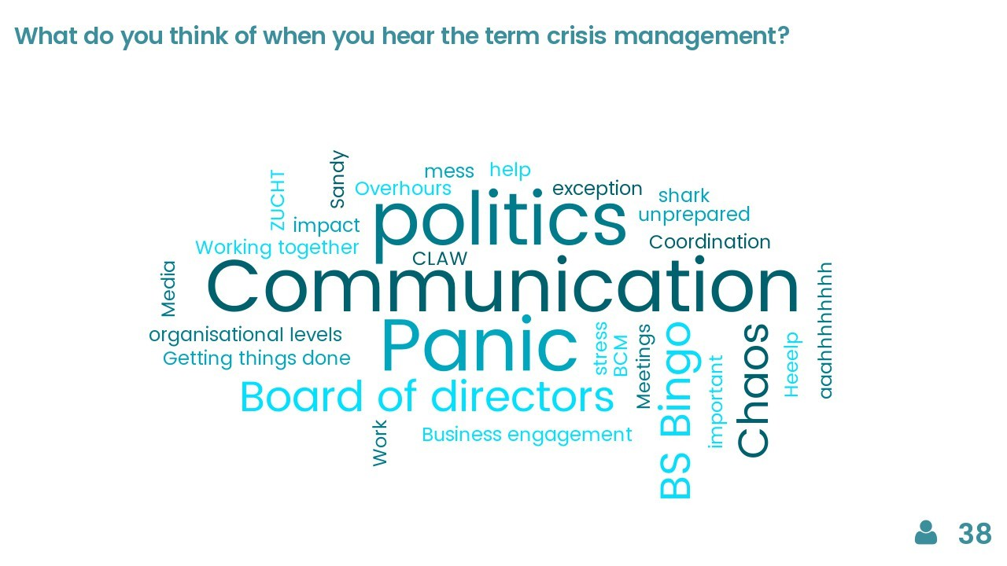
Crisis simulation exercise

Slide 9
Input SIG-NOC session
Meteorites crashing fibers and leaving huge holes in the ground
Earthquake with central European epicentre
Zero Day (with exploit) affecting all major routing vendor code
Widespread ransomware attack
Both datacenters on fire
Loss of access to all Microsoft cloud services
Loss of access to all Amazon cloud services
All the marks of the universities have been changed thanks to a back door in the NREN network analysis tool
Total blackout
Data theft
Lunatic employee tries to do as much damage as possible (with login credentials from the inside)
Major power blackout in city where head office and datacenter are located
Cyber war
Full router config deletion + backups, or changes it maliciously, or bricks the routers
Cosmic rays have damaged all the core equipment (all from one specific vendor). All the RMA are also damaged

Slide 10
Scenario
What was going on?
Crises during the week: Ariane Rocket does not launch because of a zero day bug and Guilder’s border is altered in the (supposedly immutable) European Open Science Cloud.
What was happening:
A hacker group from Florin wants to get access to land sensing data from ESA to alter the map from neighboring Guilder, with which their country has had a border dispute for decennia. This group unintentionally triggers a multicast bug on Monday, when they are hiding their tracks. This first takes Florin off the network and could compromise an Ariane rocket launch on Wednesday if a software update with a bug fix is not installed in time.
Even if the Ariane rocket gets launched on the Wednesday, the hackers still are able to compromise a highly privileged admin account of the EOSC, with which they are able to alter the Guilder map on the EOSC on Thursday. To make matters worse, the newly appointed European Commissioner for the Digital Agenda is from Guilder, and when he receives a tweet congratulating him with a link to the altered map of Guilder, he is not amused in the slightest. The Florin hacker group claims victory for their alteration on Friday, which leads to a huge amount of traffic to the EOSC, as everyone wants to see what the fuss is about.

Slide 11
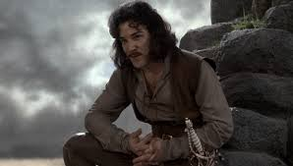
Welcome to CLAW: the organisation you all work for!
During this exercise, you are the NOC, CSIRT, ISM and Communication team of the organisation CLAW.
You will be responsible for the image, network stability and security of the whole NREN community.
You don’t have a crisis management plan, and you don’t have a crisis management team.
Your CEO is Inigo Montoya, he will be out of the country for the duration of the week.

Slide 12
Process
Each team will go to a separate room, where they will receive instructions and information from their exercise leader.
This exercise is a simulation of one week of events: when we start the exercise it will be Monday and when we end it will be Friday.
Each day will take approximately 20 minutes.
At the beginning of each day, you will get a new sheet with information.
This is a distributed tabletop exercise: almost all of it will be done analogue.
Every team can use two laptops and one telephone during the exercise. All other telephones and laptops should be placed out of sight.

Slide 13
Master event list
Audience | Information/Action | Intended Outcome
MarComms | (Tweets) Various Tweets + Email’s should be generated about eduroam’s fast connectivity, poor quality of service, a reference to someone doing something dodgy on eduroam. (Blog) Upcoming launch of an NASA/ESA rocket. (Blog) EAPconnect completes multicast trials with RouterOS hardware. | Automated response and triage of what is important and what should be followed up on.
NOC | (Webpage/Screen) Traffic information and some variation in usage graphs showing a host consuming traffic. (Email w/Attachment) Something about a city wifi service that offers eduroam having high traffic volume (also a “red herring”). (Trouble Ticket) NOC get change request for turning on multicast for EAPconnect countries (maybe a graphic that includes ESA). | ditto - launch investigation into cause of traffic?
ISM | (Email) Various CVE numbers and vendor notifications about software/hardware components. (Email) Something about WIFI hardware in here as a “red herring”. (Email) Buried in this is a RouterOS notification of a minor version upgrade. Multicast bug. (Email) Via their NREN CEO the EC has request info on security of WIFI4EU rollout. | ditto - RouterOS upgrade to be scheduled?

Slide 14
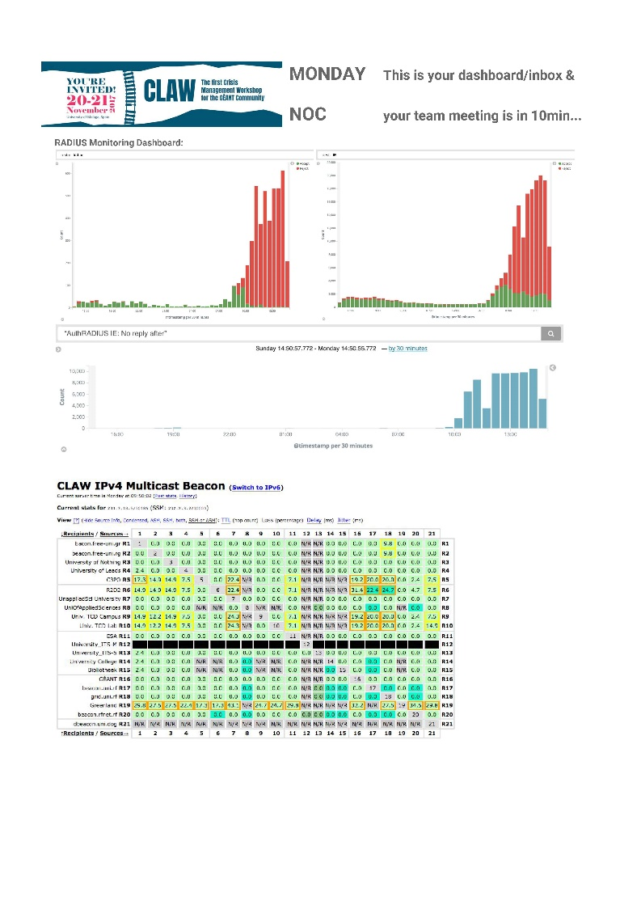
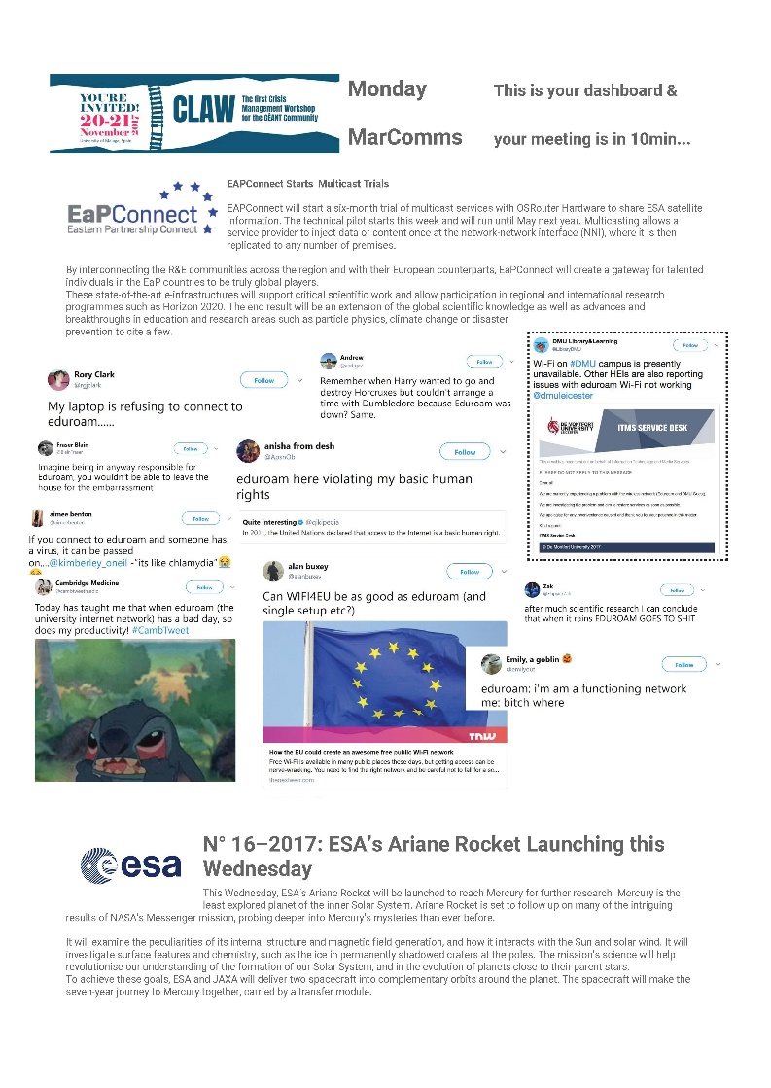
Information sheets

Slide 15
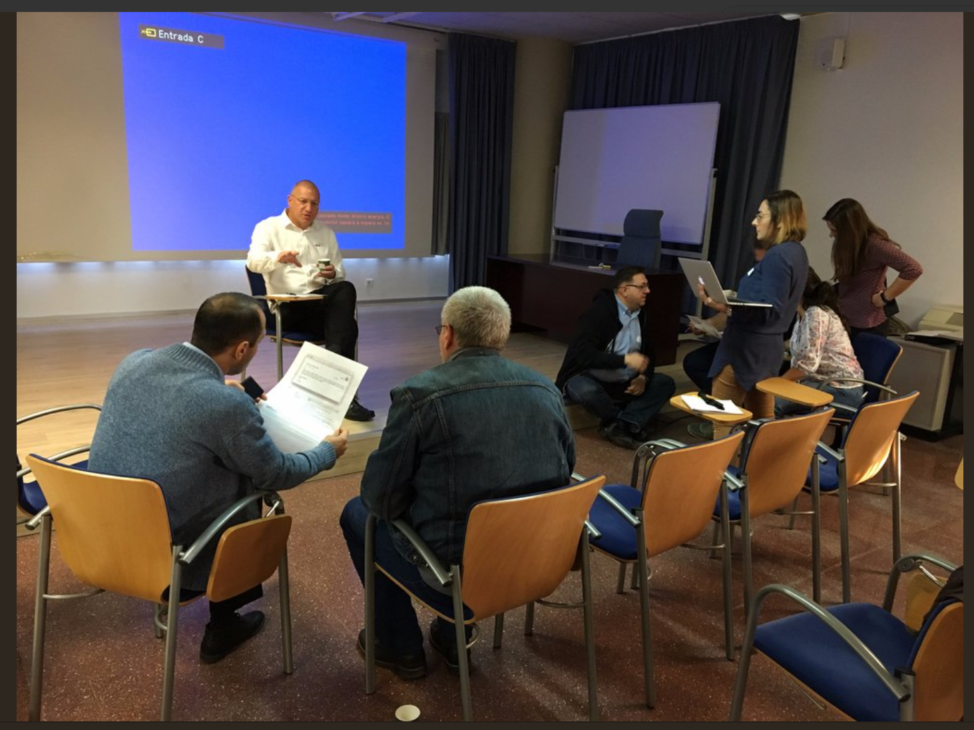
Our NOC team in action

Slide 16
What started happening
Quite quickly: some emails between teams (which didn’t arrive…)
It took a few ‘days’ before someone picked up a phone
Teams created a very fixed idea of what was going on and didn’t verify this whith each other (tunnel vision)
Outside sources (simulated) were not consulted a lot
A lack of process and mandate created a lot of confusion and friction
Emotions got heated
But also: a sort of crisis management team was created during the ‘Wednesday’
Journalists were being deferred to Marcomms
It could have been much worse: communication between CSIRT, ISM and NOC worked enough to prevent problems with the rocket launch

Slide 17

Explorers and Basecampers exercise

Slide 18
Process
Every room has two people responsible for delivering a concrete deliverable at the end of the session. They are the base-campers: they stay put for the entire exercise.
The rest of the participants are divided into 4 groups and they are assigned a route to follow: they are the explorers.
Armageddon: Crisis Management Template NREN Level
  Starting team: Avengers
Jaws: European Crisis Management Procedure
  Starting team: Guardians
Godzilla: Shared Terminology
  Starting team: Defenders
King Kong: Key Contact List for Crises & Inventory: Who is working on What
  Starting team: Justice League

Slide 19
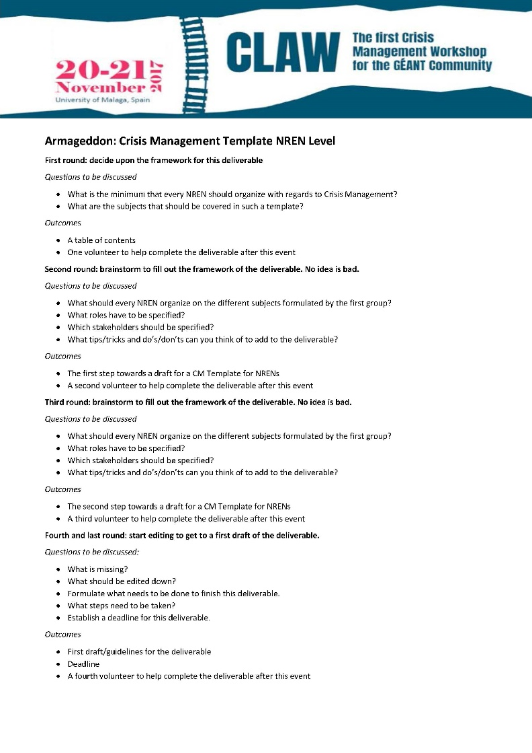
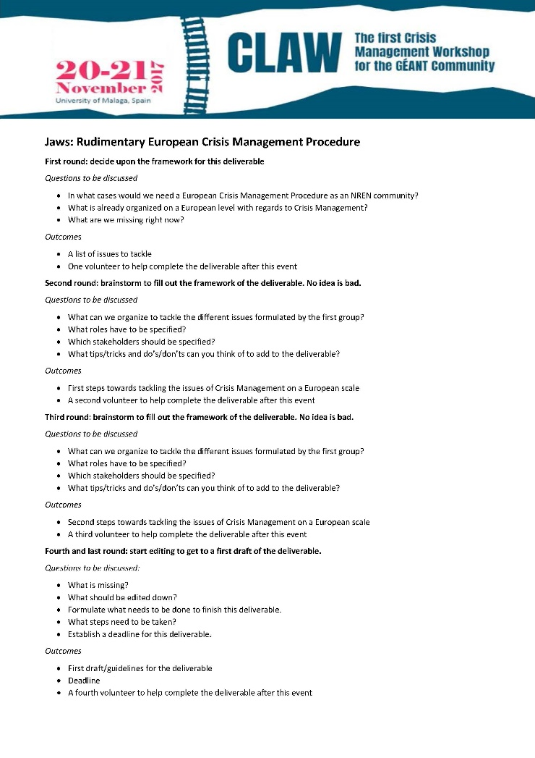
Getting there

Slide 20
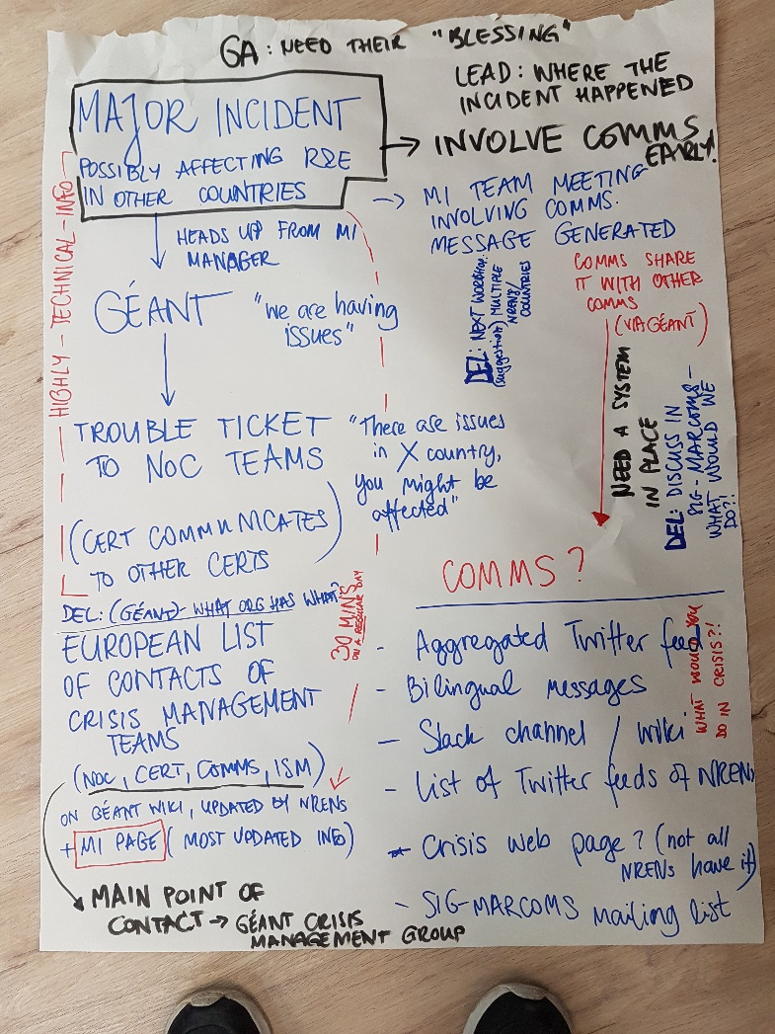
Outcomes
Template crisis management NREN level
  Deadline end of January
  A lot of input, just needs a lot of editing
European crisis management procedure
  Deadline next SIG-Marcomms meeting for the next step
  Already a lot in place for NOC and CSIRT, needs to be a discussion on the comms level first
Shared terminology
  Deadline next SIG-Marcomms meeting for the next step
  Two sprints before that, working with already existing terminology from ITIL, TRANSITS etc.
Inventory who is working on what?
  Map of all NRENs to be put up on the wiki

Slide 21
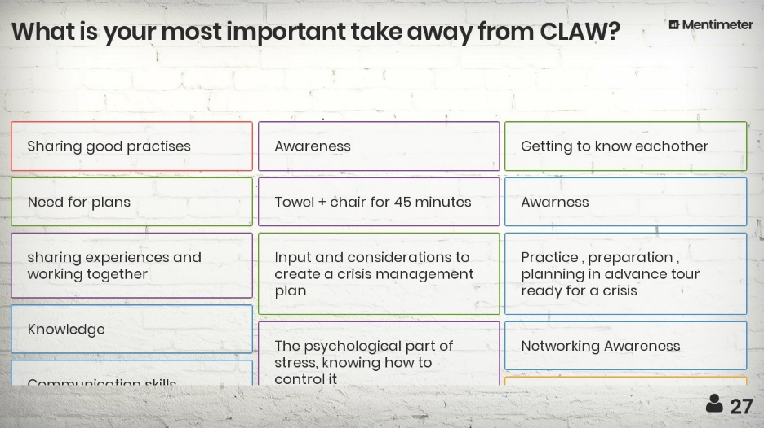
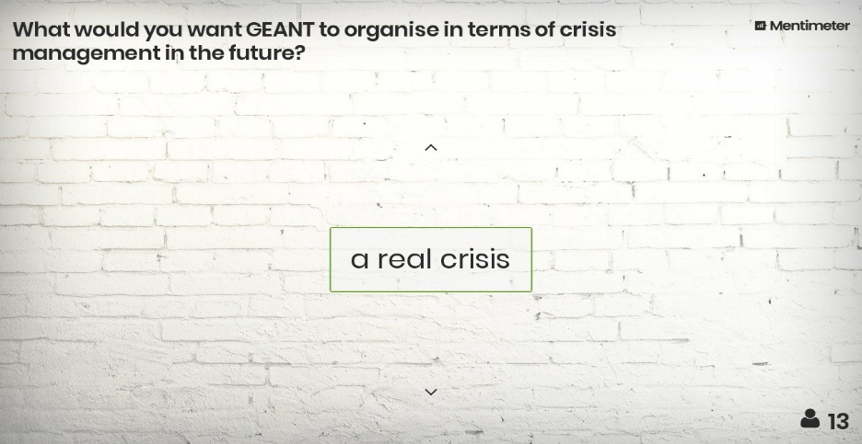
Next steps
All materials to be shared with participants this (or next week)
Deliverables to be finished by next Marcomms meeting (February)
Looking into an annual exercise
Looking into creating awareness on a strategic level

Slide 22
Questions
From me: what does SIG-NOC want to do with this subject?
From you: let me know if you have any ☺

Slide 23
Dinner!
19.00 at Restaurant: LUC, Voor Clarenburg 8
In Utrecht city centre (walking distance from here and most hotels)
Kindly provided by SURFnet

