Slide 1
General Data Protection Regulation at DeiC

Slide 2
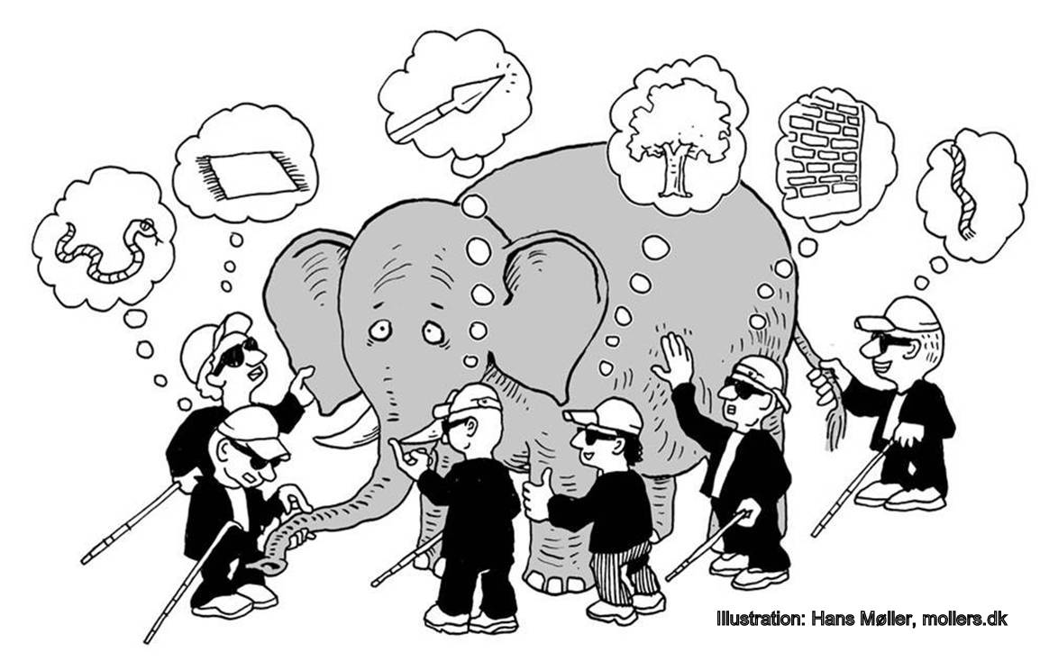
The GDPR
Is an elephant…
But how big is it?
And how do you eat it?

Slide 3
The what
What data do we have?
It is nessecary to identify what personal data we have in each service
And we need to do it with all our services
The why
Why do we have the data?
We need to know why we have the data that we have
Apparently it is not always clear why we have the data
Except that it’s nice to have…..

Slide 4
Minimization
Data shall be limited to what is necessary in relation to the purposes for which they are processed
So we are not allowed to collect or process more data than we absolutely have to in order to provide the service
§

Slide 5
What
What are we doing with the data?
We need to have a legitimate purpose to process the data
Are we only processing the data for the specified purpose
How
How can we support the rights of the data subjects?
Are our systems designed in a way where they can support the rights of the data subjects
Can we support the GDPR’s right of access, right to rectification and the right to be forgotten

Slide 6
Compliance/Accountability
The GDPR has a very big focus on compliance and accountability
If you can not document something, then you can not prove compliance
We need documented processes and we need written agreements between controllers and processors
§

Slide 7
Where
Where are we keeping the data?
We need to know all the locations, physical and virtual, where data is stored
We need to know if, how and where the data is being backed up
How
How are we keeping data safe?
The GDPR wants the security measures to be based on a risk assesment
How safe the data needs to be depends on the risks and possible consequences of a data breach

Slide 8
Security measures
What are the adequate technical and organisational security measures?
It depends on the data process
We look mostly at pseudonymisation and encryption
§

Slide 9
The Data Protection Officer
Ambassador for the data subjects
Ombudsmand for the data subjects
Operations
Legal
IT

