Slide 1
4th SIG ISM Workshop
Dublin, february 2017

Slide 2
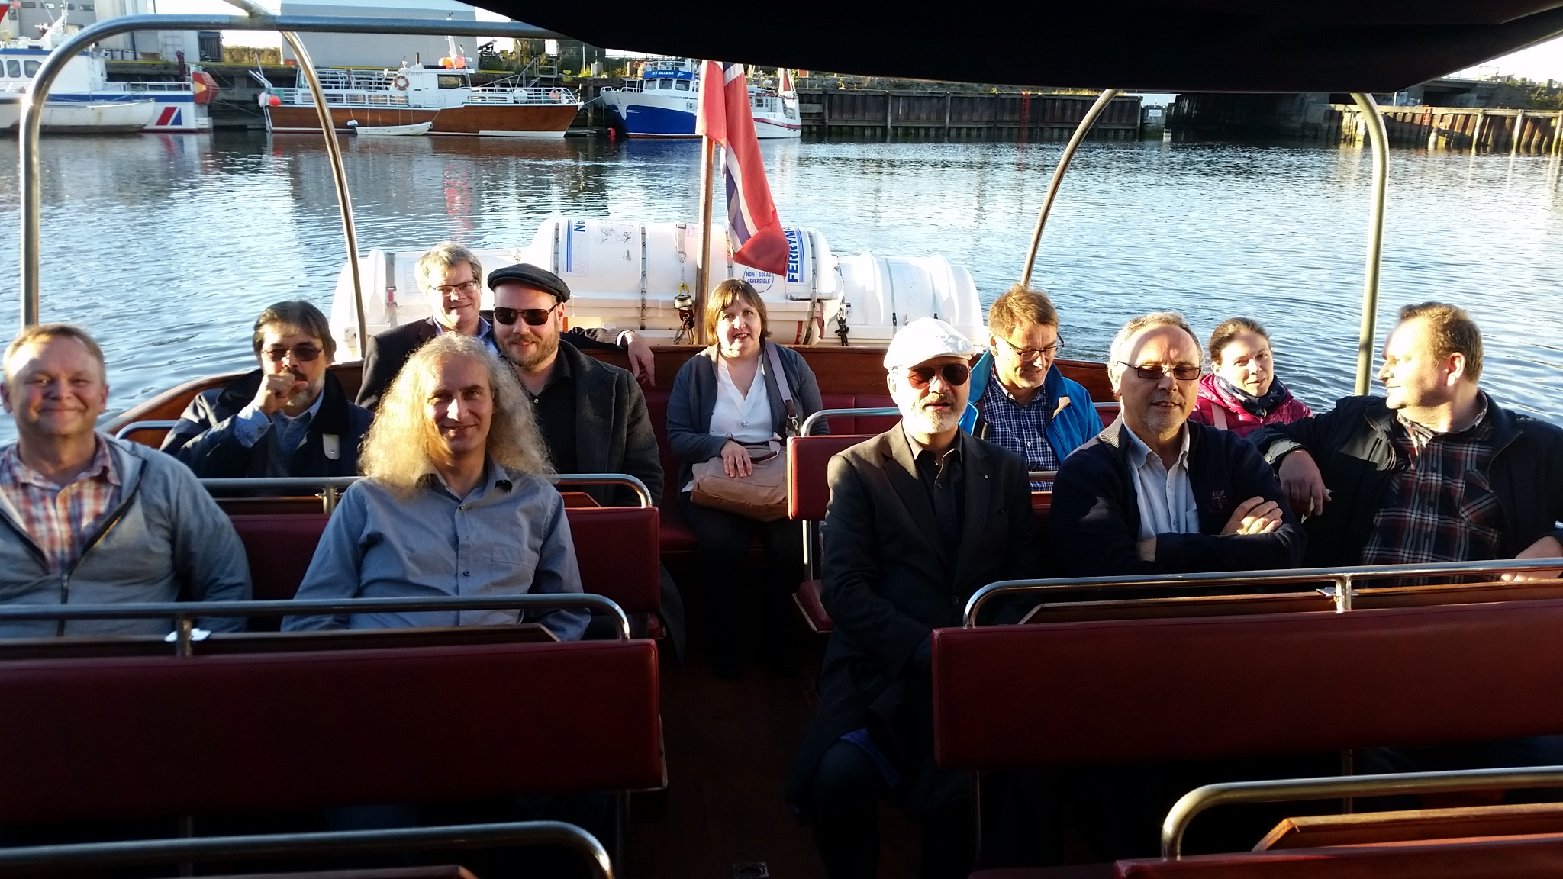
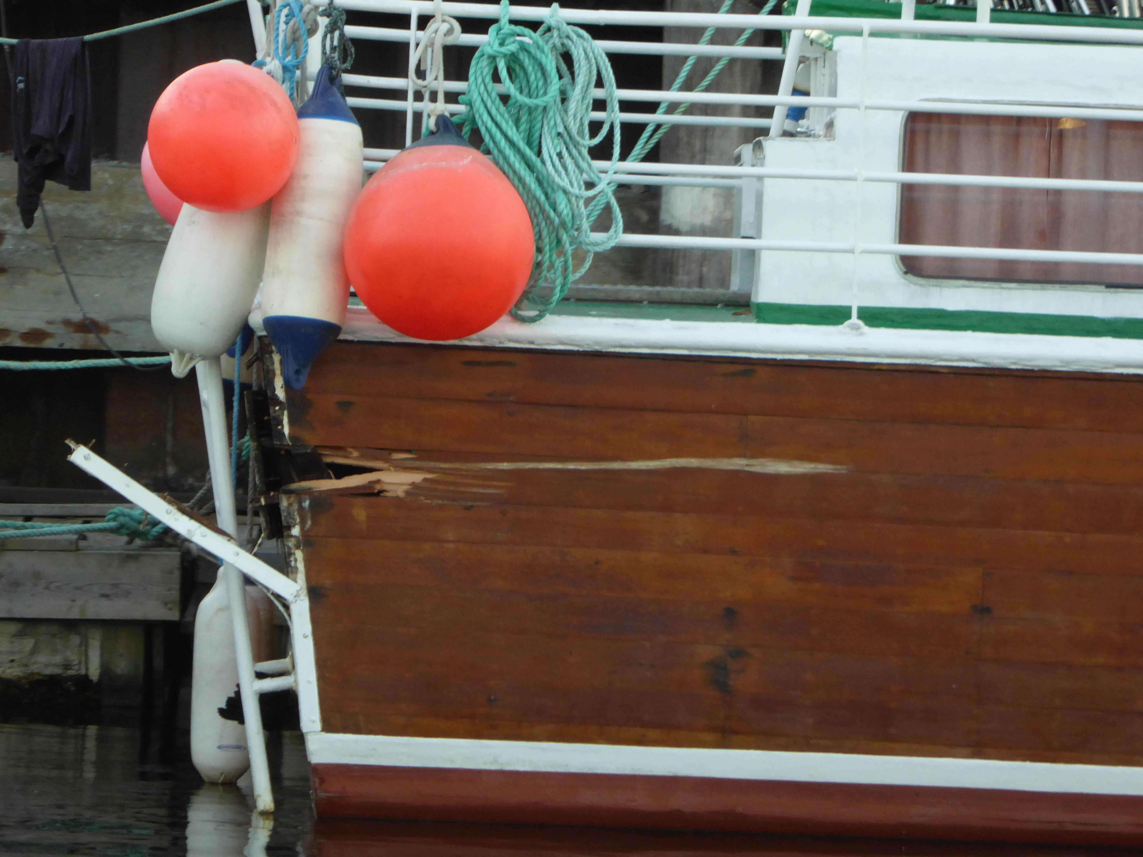

Slide 3
Agenda 22nd February (Wednesday)
13:00-13:30 | Welcome and round of Introduction (Alf Moens – SURF) Update on WISE and Global CEO Forum Security working group Regional collaboration
13:30-14:00 | Update of SIG=ISM charter (Sigita Jurkynaite, Geant) Finalising the SIG-ISM mission statement (Urpo Kaila, CSC)
14:00-14:30 | H2020 project PROTECTIVE (Brian Lee/Maciej Miłostan) H2020 project PROTECTIVE - Proactive Risk Management through Improved Situational Awareness. This project aims to develop an information sharing framework and advanced analytics to improve risk monitoring and information sharing for NREN and other CSIRTS.
14:30-15:00 | Coffee break
, 15:00-15:30 | OZON Cyber security Exercise (Sandy Janssen, SURFnet)
15:30-16:00 | National cyber exercise (Per Arne Enstad, Uninett)
16:00-17:00 | Joint cyber exercises (Charlie van Genuchten - Geant)
17.00-17.15 | Preparation for thursday, closing remarks (Alf Moens)
19:00 | Dinner at Ryan’s of Parkgate Street Victorian Pub kindly hosted by HEANet

Slide 4
Agenda 23nd February (Thursday)
9.15 – 9.30 | Arrival and Coffee
9.30 - 10.00 | Developments in the treath landscape (Bart Bosma)
10.00-11:00 | Working groups
11:00-11:30 | Coffee break
11:30 - 12:30 | Working groups continued
12:30 - 13:00 | Wrap-up from the working groups Regional collaboration: Which regions want to start? Next steps
13:00 - 14:00 | Lunch

Slide 5
SCI framework
  Signing ceremony at TNC2017
  Session at TNC2017
Participants: PRACE, EUDAT, EGI, Geant, LIGO, CTSC
WISE workshop Amsterdam 27 – 29 March (Nikhef)
Security Awareness and Training
Risk Assessment
Security in Big and Open data

Slide 6
Global CEO Forum – Security group
CEO forum? NREN CEO Forum!
Meet-up at TNC2017
  BoF and side meeting session
Participants: AARNET, SANREN, Géant, Nordunet Dfnet Janet, SURFnet, Internet2, Canary

Slide 7
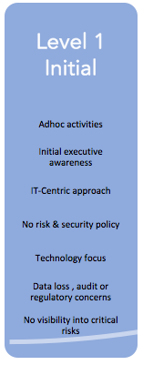
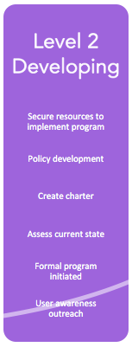
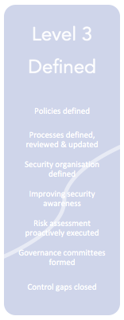
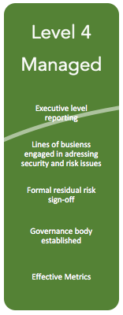
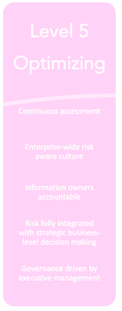
CURRENT SECURITY POSITION
(participants CEO Forum)

Slide 8
NREN CEO FOrum: LIST OF INITIATIVES
  Development of security awareness training programme
  Development of relevant induction programmes
  Develop Global Best practice in security policy
  Greater understanding of CIO security needs
  Development of advanced tools for Filtering and DDOS scrubbing
  Establishing a security baseline for NREN’s
  Work to develop an automated threat information system
  Establish a network of Security champions
  Integrate with the work of other NREN groups e.g. ISM SIG/WISE Group
  Develop and rehearse global cyber crisis exercises
  Establishing relevant certifications where applicable

Slide 9
NREN CEO Forum
PRIORITIES TOP 4 - SPONSORS
Establishing a security baseline for NREN’s
Angelica Harris - CANARIE
Development of advanced tools for Filtering and DDOS scrubbing
Ralf Groeper - DFN
Work to develop an automated threat information system
Steve Kennett - JISC
Develop and rehearse global cyber crisis exercises [IRP]
Paul Howell – Internet2 Alf Moens – SURFnet

Slide 10
Regional Collaboration
Small group, focus on actual and current subjects
Build a regional network with close contacts
Agree upon nondisclosure (sample NDA available)
Have a closer look inside the organisations
Choose your subjects
Not aimed at ‘making something’, aimed at learning and improving

Slide 11
Agenda 22nd February (Wednesday)
13:00-13:30 | Welcome and round of Introduction (Alf Moens – SURF) Update on WISE and Global CEO Forum Security working group Regional collaboration
13:30-14:00 | Update of SIG=ISM charter (Sigita Jurkynaite, GeantJurkynaite) Finalising the SIG-ISM mission statement (Urpo Kaila, CSC)
14:00-14:30 | H2020 project PROTECTIVE (Brian Lee/Maciej Miłostan) H2020 project PROTECTIVE - Proactive Risk Management through Improved Situational Awareness. This project aims to develop an information sharing framework and advanced analytics to improve risk monitoring and information sharing for NREN and other CSIRTS.
14:30-15:00 | Coffee break
, 15:00-15:30 | OZON Cyber security Exercise (Sandy Janssen, SURFnet)
15:30-16:00 | DDOS exercise (Rolf Sture Normann, Uninett)
16:00-17:00 | Joint cyber exercises (Charlie van Genuchten - Geant)
17.00-17.15 | Preparation for thursday, closing remarks (Alf Moens)
19:00 | Dinner at Ryan’s of Parkgate Street Victorian Pub kindly hosted by HEANet

