Slide 1
IKT16
Norwegian National, Intersectoral Exercise
Per Arne Enstad, UNINETT CERT
CISA, CISM, CRISC

Slide 2
The Charter

Slide 3
Project ”IKT16” was launched by the Ministry of Justice and Public Security late 2015
The Norwegian Directorate for Civil Protection (DSB) was assigned the task of planning, executing and evaluating the exercise
In close cooperation with:
  The Norwegian National Security Authority (NSM)
  The Norwegian Police Security Service (PST)
  Armed Forces
  Agency for Public Management and eGovernment (Difi)

Slide 4
Purpose
The main goal was to improve handling of a large scale information security attack, targeted at multiple sectors, including critical infrastructure
Emphasis was put on testing the effectiveness of alerting, communication, reporting and cooperation across different sectors and layers in the society
The scenario was based on public threat- and risk assessments issued by The Norwegian National Security Authority (NSM), The Norwegian Police Security Service (PST) and The Norwegian Intelligence Service (E-tjenesten)

Slide 5
Participation
More than 50 public and private enterprises and response environments took part in the exercise
Critical Infrastructure including:
  Healthcare
  Bank and Finance
  Energy and Power Grid
  Meteorology
  Telecom (TELIA)
Plus many more, not defined as Critical Infrastructure but still important for a smooth running society

Slide 6
Participants from the academic sector
Ministry of Education and Research (KD)
UNINETT CERT
UiO CERT – University of Oslo
Norwegian Meteorological Institute (MET)

Slide 7
The Main Scenario
The Agressor was a fictitious nation named DRP (”The Democratic Republic of People”)
  Population: 325 million
  Form of government: Communism, one-party state
  President: Ling Ling
A journalist from DRP, considered to be a dissident and currently in domestic house arrest, was awarded the ”Fritt Ord” (speak freely) price from ”Askepotts Journalistpris”
When this came to President Lings attention he obviously got very upset and threatened to retaliate …

Slide 8
DRP
Norway
DRP
Ailuropoda

Slide 9
The Planning phase

Slide 10
Timeline
17-18 feb 2016: Kickoff
20-22 apr 2016: Main planning conference
9-10 jun 2016: Scripting workshop
13. sep 2016: Scripting workshop – wrap-up
11-13 oct 2016: Final planning conference
11. nov 2016: Dress rehearsal
29-30 nov 2016: IKT 16 Exercise
1. dec 2016: ”Hot Wash-up” evaluation
21. dec 2016: Final evaluation report due for participants

Slide 11
Early planning steps
Establish framework
  Make consensus upon purpose, exercise goals and rules
  Split participants into workgroups
Every participating enterprise was asked to:
  Develop a scenario proposal
  Develop a map of peers and other communication partners (“Communications Map”)
  Develop a directory containing (as a minimum) “Function, Phone # and E-mail address” for all contact points and players

Slide 12
Communications map
UNINETT centric

Slide 13
Scenario selection
All scenarios was formed as a verbal storytelling – a description of events and their consequences
5 sub scenarios was finally selected at the main planning conference in april:
  Bank and Finance – targeted attack against payment systems
  Education sector – sabotage against weather forecasting and forecasting distribution
  The Government – attack against DSS infrastructure
  Askepotts Journalistpris – system compromise and digital espionage
  Various enterprises in different sectors – DDoS and Phishing campaigns
All participants was assigned to one of the sub scenarios above

Slide 14
From scenario to exercise input
The trick is to transform a verbal story into a playable item/event

Slide 15
Finalizing the planning phase
IKT16 planning ended up with a grand total of > 500 inputs
All these inputs had to be checked for (inter)dependencies before they could finally be placed on the script timeline
  Huge job!
Method: Gantt diagram, slightly modified to fit our purpose
Some suggested inputs had to be adjusted or re-written to fit in time and action with respect to other participants

Slide 16
How the Exercise was organized
Table-top
  No actual computers or networks were offended during the exercise
Central Exercise Staff (@DSB – The Directorate for Civil Protection)
  Role: Keep the big picture
  Send inputs to the participants in a timely manner, according to the script
Local Exercise Staff (@each participating organisation)
  Role: Supervise the local part of the exercise
  Make sure the play is running, give hints or initiate “players action” if something goes to halt
Local Evaluator (@each participating organisation)
  Role: Check how the players responds to inputs – according to the framework and local procedures

Slide 17
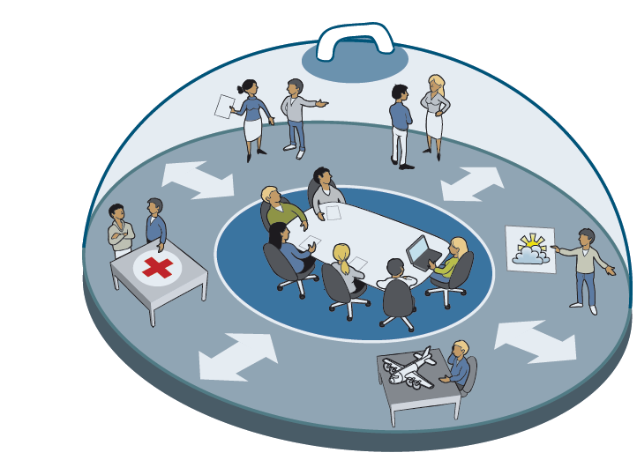
“The Cheese Bell”
Notes:
Forklar at det meste forgår innenfor klokka. Kun e-postadresser og telefonnummer er reelle, alle meldinger og opplysninger hører hjemme I øvelsen og skal ikke forveksles med IRL.
Vi hadde til og med flere mediakanaler; en øvelsesvariant av NRK Radio (general broadcaster), og to av norges største aviser. En jevn nyhetsstrøm ble formidlet her, både før og under øvelsen

Slide 18
Execution Phase viewed from UNINETT CERT

Slide 19
UNINETT CERT in a nutshell
Etablished in 1995
Team size: 6 persons forms the core + “accessories as needed”
  Virtual team
TI Accredited team since 2001
TI Certified team since 2013
De facto sector CERT for the norwegian education sector

Slide 20
Scenario for the Education Sector
The larger part of the exercise is about Meteorologiske Institutt (MET) having a unreliable access to computing resources and alerting facilities
MET is classified as critital infrasctructure
  Connected to Internet via UNINETT – The Norwegian NREN
MET’s computation of weather forecasts is primarily performed on the supercomputer facilities in Trondheim (”Vilje”)
  Jönköping (Sweden) and Reading (UK) are hot stand-by sites
A number of services is critically dependent on timely and correct information from MET:
  Civil/military aviation
  The Norwegian Coastal Administration
  + Many more

Slide 21
Status at the beginning of the exercise
Tide water is unusually high in northern Norway
Wind pressure has been high during the past few days, and there are indications that a polar low pressure is ramping up
  Early indications suggests a hurricane hitting northern Norway during next 24-36 hours
Icelandic MET reports that the vulcano ”Katla” may erupt shortly
  Calculations from VAAC (Volcanic Ash Advisory Centre) in London based on best guess indicates that high concentrations of ashes could be directed to southern Norway
Connection from MET to the supercomputer facilities has been unstable the past couple of days
  Switchover to Jönköping and/or Reading has not been successful so far

Slide 22
What happens if MET fail to produce updated weather forcasts?
Stakeholders uses other sources, obviously
  The problem is lack of accuracy due to a too coarse grid
Issue forecasts based on available information
MET considers issuing an OBS-warning based on the current weather situation in northern Norway
  Will affect all marine activity along the coast
Lack of TAFs (forecasts to airports)
  Will affect civil/military aviation, including rescue services, airborne ambulance and transportation to oil installations @ the continental shelf

Slide 23
What happened during the exercise?
MET was more or less continuously under attack
It all started off by a massive malware attack internally @MET
  Zombie computers attacked network resources and key workstations internally
  Purpose: to practise troubleshooting with several parties involved
It continued by a massive DDoS attack (> 90 Gbit/sec) towards the supercomputer in Trondheim. When attempting failover the alternative sites were swamped, too
  Purpose: to practise communication with domestic and foreign parties that could assist in mitigating the problem, for example NSPs (NORDunet) and other IRTs having responsibilities for address spaces where traffic seems to originate
One domestic university college was used as a major beachhead, and was incommunicado
  Purpose: to practise use of escalation procedures

Slide 24
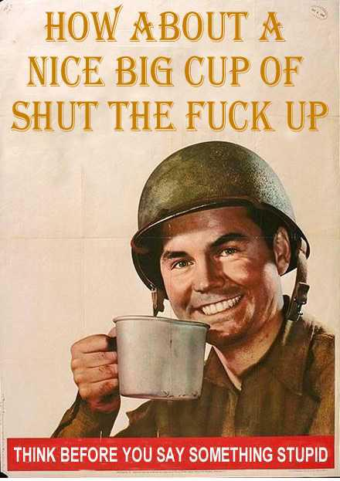
Inquiries from the press and possibly agents from the aggressor trying to impersonating the press
  Purpose: to test the IRT media policy during a high stress period
  BTW: UNINETT CERT policy is to refer to the communications department (or the president in serious matters)

Slide 25
All is well that ends well…
Control was regained early afternoon @ day 2
The polar low pressure did not become as deep as expected and it picked a northern trajectory and vanished into the arctic ocean without making any harm to installations or vessels
Katla did not erupt
MET was able to compute and distribute forecasts again

Slide 26
Evaluation Phase

Slide 27
What was the upside?
The inputs was designed to have enough information to players to make a (correct) decision
  In some cases the players had to “invent their own facts” to keep the play going
  This worked very well!
Communication with other parties is time consuming but still critically necessary to achive our common goal
  The UNINETT CERT team is doing this on a daily basis and handled their challenges very well
We had a number of inquiries from the media and a couple of “unknown” parties
  All these were handled correct and according to our media policy

Slide 28
… and the downside?
Although all problems apparently were handled correctly, there was no technical investigations or mitigation steps involved
The limited size of our team would most certainly NOT be able to handle a real situation of this magnitude if we had to actually dig into systems/logs in search of clues and to do actual mitigation steps on real systems
This is probably our most important learning point from the exercise!
  Improvement already in progress

Slide 29

Questions?

Slide 30

Thanks for your attention!

