Slide 1
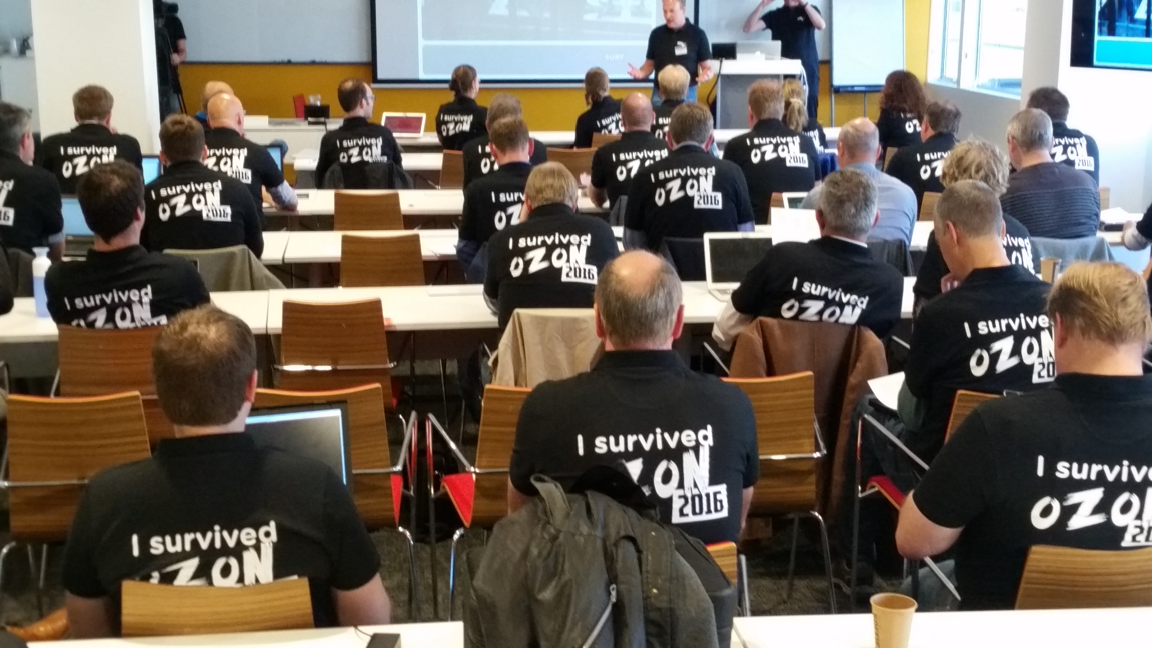
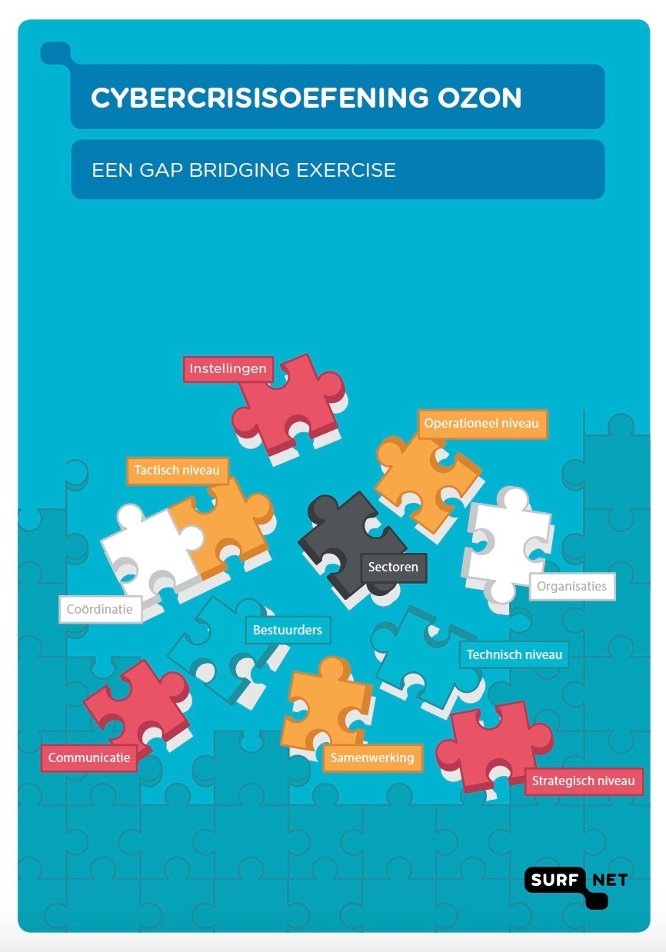
Cybercrisisexercise OZON 2016
FROM IT to BOARDROOM –
A gap bridging exercise
Sandy Janssen (SURFnet - Netherlands)

Slide 2
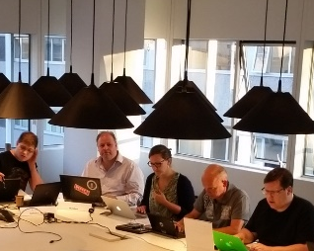

Let’s introduce myself
Sandy Janssen
Graduated Master of Law at the University of Groningen
(RUG) on the safety regulations for High Voltage Power Lines.
worked at the Centre of Information Technology of
the University of Groningen.
Since may 2016 part of Young Talent
program of SURFnet and
Involved in setting up cyber crisisexercise OZON
Helped designing the institution’s scenario’s
Wrote whitepaper
Wrote script for cyber crisisexercises

Slide 3
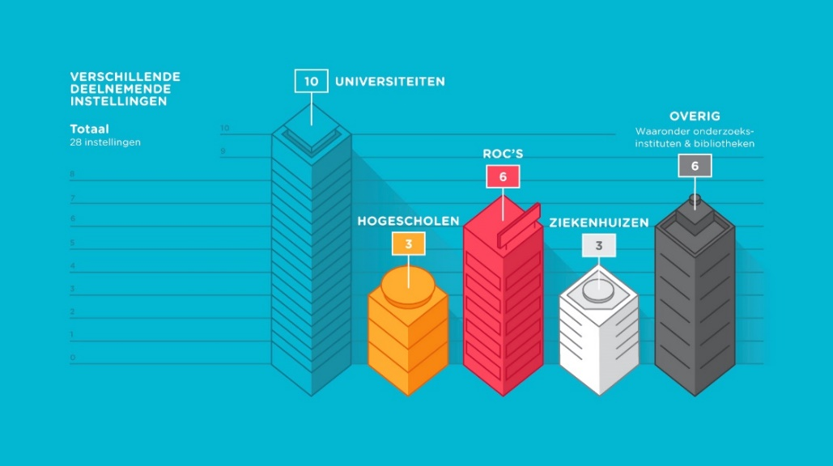
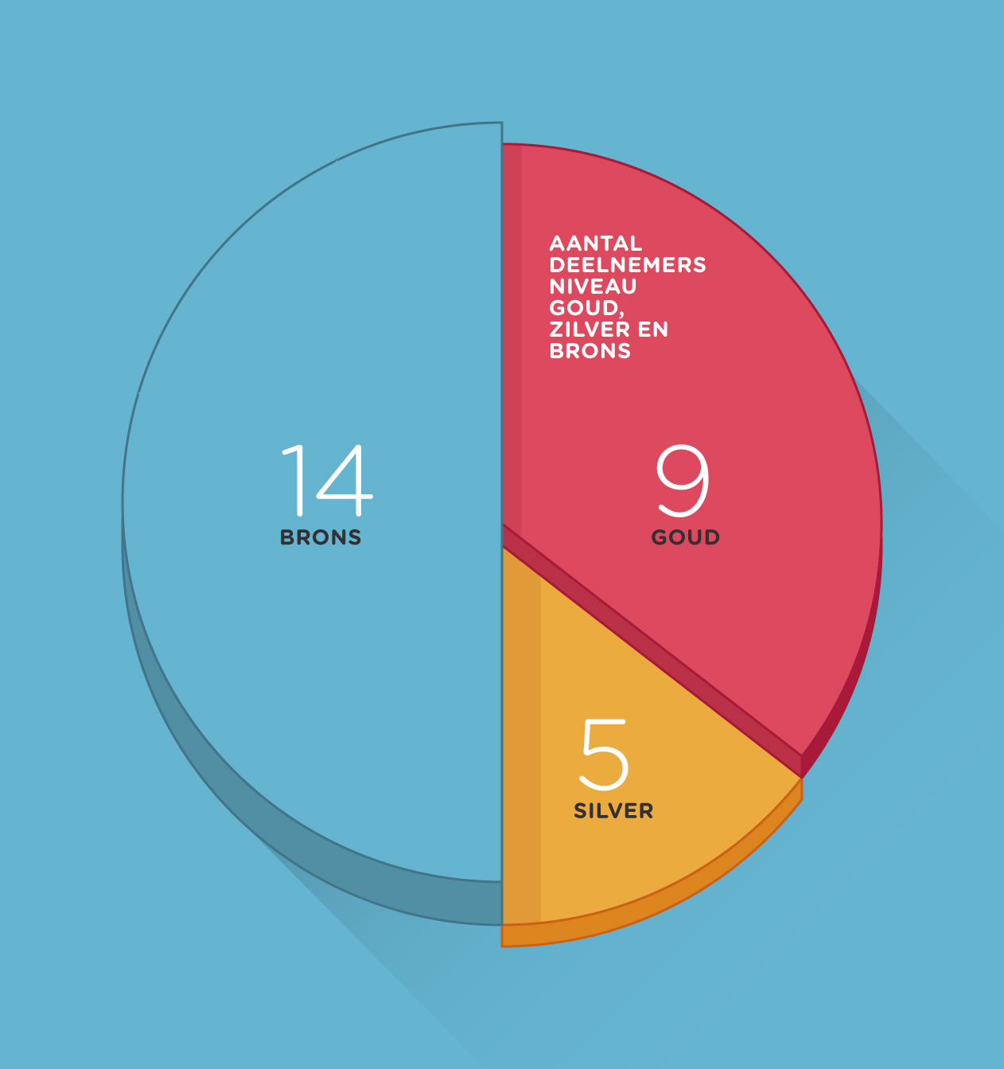
Participants
Participating institutions
Other:
Including research institutions and libraries
Universities
Regional Teaching Centres
Total: 28 institutions
Number of participants Gold, Silver and Bronze
Tertiary Education
Institutions
Hospitals
Bronze
Gold
Silver
Notes:
28 participating institutions ; 10 Universities, 3 Tertiary Education Institutions, 6 Regional Teaching Centres, 3 Academic Hospitals, 2 Libraries and 2 research institutions
And SURFnet
3 levels of participation;
Gold (they played a complete simulation with their own institution scenario on strategic, tactic and operational level),
Silver (they played at tactic and operational level, the strategic level was simulated)
Bronze (observing role and a small game element, capture the flag exercise whereby an infiltrant was at the institution
with a laptop with installed software
Which should be found by the IT department)
9 institutions played at Gold level
5 at Silver and
14 at Bronze
At first when we started we thought that we would play with about 5 to 10 institutions, but the enthousiasm was massive, so we had to close the registration
Earlier than expected and we played with far more participants than expected.

Slide 4
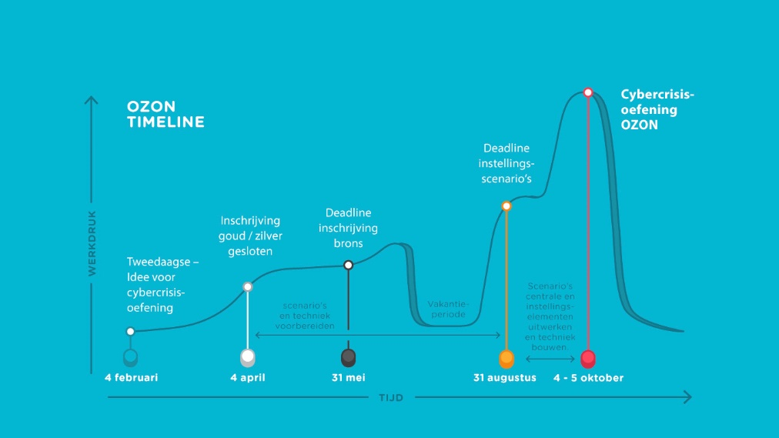
Preparation
Cybercrisis
exercise
Deadline institution scenarios
Gold/Silver registration closed
Bronze
Registration closed
Workload
Idea for
2 day cybercrisis-exercise was born
Central scenario and Institution
scenario development event and technical construction
Scenario and technical preparation
Holiday
Period
4 February
4 April 31 May
31 August – 4/5 October
Time
Notes:
Preparation Time
The complete preparation time took about 8 months, and cost a lot of effort and time. This was necessary for engage the institions, to prepare the central
And the institution’s scenario’s. It was an invest well worth it, because the exercise was very well executed.
Exercise
We played to days; the forth and fifth of octobre last year.
The heart of the organisation was at SURFNet. We were there with 21 people who prepared and executed the exercise.
The players played their own role in their own organisation. (about 200)

Slide 5
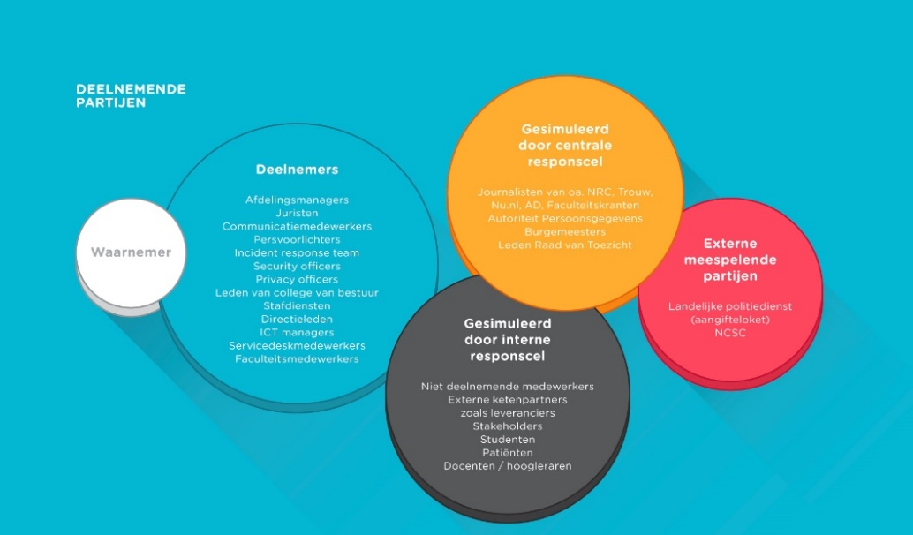
Participating roles
Participating roles
Simulated by
Responscel
Journalists, including NRC, Trouw, Nu.nl, AD, (national (online) newspapers)
Dutch Data protection Authority
Mayors
Members of the Supervisory Board
Participants
Department managers
Lawyers
Communication
Press Officers
Security Officers
Privacy Officers
Members of the Executive Board
Staff services
Board Members
ICT managers
Service employees
Faculty Staff
Observers
Contributing
External Partners
National Police,
(digital declaration
counter)
NCSC
Simulated by
internal responscel
Non-participating employees
External supply chain partners such as suppliers
Stakeholders
Students
Patients
Teachers
Professors
Notes:
For the exercise we developed a realistic scenario involving a hackergroup that had both sympathetic ideals and a criminal purpose. To make the
exercise scenario realistic for participating organisations they had to develop their own “implementation” of the scenario, tuned to their own, specific
exercise goals and tuned to their own situation.
Participants will be drawn into the crisis more quickly and will therefore react to the crisis realistically.
As the exercise was targeted at both technical levels and board levels we had to prepare plausible
Evidence of hacked systems and leaked information. This is where the customisation of the exercise
scenario came in play.
Scenario: centraal scenario en daarop gebaseerd eigen instellingsscenario met eigen specifieke instellingselementen.
(Een hackerscollectief vindt dat teveel informatie om economische redenen niet openbaar gemaakt wordt. Per instelling is bepaald welke informatie relevant is om zo het scenario instellingsspecifiek te maken. Ook werd gaandeweg een crimineel component zoals cijfermanipulatie geïntroduceerd.)
Door zowel techniek als ethiek in te zetten zijn we erin geslaagd om samenwerking tussen de verschillende lagen op gang te brengen en niet een probleem met een simpele doorverwijzing af te doen. Er was overleg en afstemming voor nodig.

Slide 6


Events
Media and communication
Unknown number of communication via Skype, Phone, Jabber, etc.
Notes:
Prepared and messages sent during the exercise 530 tweets, and sent a total of 650,
and together with the team we prepared 11 news articles.
During the exercises they sent 40 facebook messages
1600 emails (monitored)
Interventions from simulated journalists of NRC, trouw, Nu.nl, and other external parties as we saw. Like mayors etc.
I

Slide 7

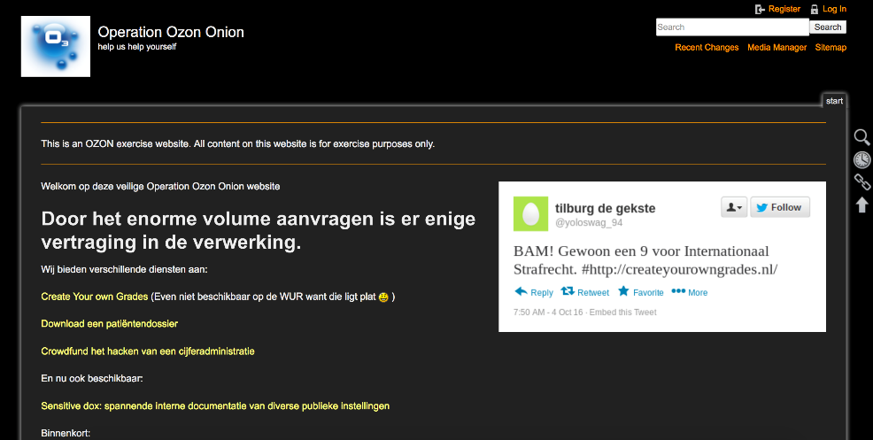
Technical elements
Disclosing critical research and business information on a prepared website
Offering ”create your own grades” through websites

Slide 8
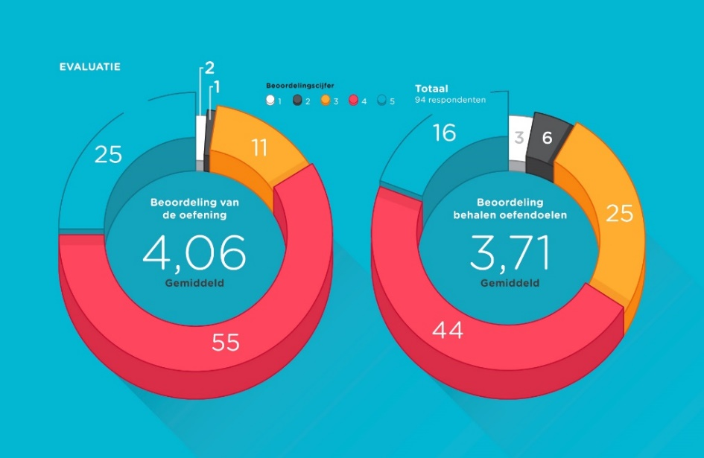
Ratings
Evaluation
Ratings
94
respondents
Evaluation of the Exercise
Evaluation of achieving Exercise Goals
Average
Average
Notes:
Evaluation
The evaluation was well rated, from all the 94 respondents the exercise was rated with a 4,06 (on the scale from 1 to 5)
En 3,71 avarage on achieving exercise goals
The scenario contained sufficient strategic and technical challenges, and the level of the scenario reflected the exercise goals
. De enkele lage scores die vielen zijn vooral gebaseerd op de hoge werkdruk en de vooraf gemanagede verwachtingen.

Slide 9
Cybercrisisexercise OZON
Background and purpose
Crisis exercises within institutions are mostly fysically oriented (i,e, fire, evacuation, drills)
The need to practice with cyber crisis / IT security
Inspiration by participating in other big cyber exercise
Purpose;
Increase awareness and resilience
To test the internal and external information chain
To test internal communication, processes, and testing protocols
To increase knowledge and understanding of the development a cyber crisis
Scenario and exercise
Multilayer attack, with ethical and criminal component;
Strategic and technical dilemmas to encourage cooperation between strategic, operational and tactical levels
Both technical and strategic challenges; leakage of researchdocuments, business data, manipulating data, mirror sites, simulation of productionenvironments
Big challenge to find compelling case for bridging the gaps between technical and strategic level
Conduct and performance
The content was prepared by OZON team and the institutions, for completeness and robustness we had assistance of external agency.
Two days of exercise directed from the central location at SURFnet, the players practiced on location and in their own role.
Outcomes
Experienced as succesful, informative and highly realistic
Voluntary participation and practiced with great enthousiasm
The involved where very positive and the atmosphere was good.
Gaps where bridged between operational/tactical and strategic level
Gaps where bridged between different disciplines like communication and technique
Cooperation between institions strenghthened
Results, recommendations and what’s next
Make cybersecurity integral part of crisis management
Sharing information earlier in crisisprocess between organisations
Research into form of national coordination in a sector-wide cyber threat. To define autonomy and mandate of the institutions
To practice more large- and small exercises, sectoral- and/or topic specific. Preparation and execution of exercise together to achieve economies of scale
To share the outcomes, conclusions and recommendations of exercises to create more awareness and to create support of cyber threats and exercises.
Outcomes, lessons learned and recommendations stipulated in whitepaper, script for cybercrises exercise and video impression
Notes:
Scenario: centraal scenario en daarop gebaseerd eigen instellingsscenario met eigen specifieke instellingselementen.
(Een hackerscollectief vindt dat teveel informatie om economische redenen niet openbaar gemaakt wordt. Per instelling is bepaald welke informatie relevant is om zo het scenario instellingsspecifiek te maken. Ook werd gaandeweg een crimineel component zoals cijfermanipulatie geïntroduceerd.)
Door zowel techniek als ethiek in te zetten zijn we erin geslaagd om samenwerking tussen de verschillende lagen op gang te brengen en niet een probleem met een simpele doorverwijzing af te doen. Er was overleg en afstemming voor nodig.
Vervolg:
Er wordt onderzoek gedaan naar een vervolg van het doen van oefeningen zowel op grote schaal (OZON 2018) als op kleine schaal met deeloefeningen op strategisch en operationeel niveau.
Inzet personen en kosten
Aan de oefenvoorbereiding van OZON hebben circa 30 personen meegewerkt, 10 voor de algemene opzet, het centrale scenario en de techniek, 20 als oefenvoorbereider en scenarioschrijver voor de deelnemende instellingen. Aan de oefening namen in totaal circa 200 personen deel, inclusief alle spelers.
Bestede dagen: Voorbereiding
Organisatie en advies:50 dagen
Begeleiding instellingen:40 dagen
Projectleider:16 dagen
Techniek:24 dagen
Projectsecretaris:20 dagen
Oefenvoorbereiders van de instellingen
80 dagen (20 maal 4 dagen)
Totaal voorbereiding: 230 dagen
Bestede dagen uitvoering
Uitvoering van de oefening (28 instellingen)
400 dagen (200deelnemers maal 2dagen)
Totaal uitvoering: 400 dagen
Naast tijdsbesteding waren er ook out-of-pocket kosten voor onder meer externe projectbegeleiding, techniek, bedankjes en goodies en reis- en verblijfskosten voor ongeveer 40.000 euro. OZON is gefinancierd uit het SURF Innovatie Programma Betrouwbare en Veilige Omgeving, de deelnemende instellingen hebben de inzet van hun eigen medewerkers voor hun rekening genomen.

Slide 10
To know more? / Questions?
White paper and script of OZON
https://www.surf.nl/kennisbank/2016/
whitepaper-cybercrisisoefening-ozon.html /
soon in English available
Article in Informatiebeveiliging Magazine
Moens, A, Janssen, S.B “Ozon: Bruggen bouwen;
een cybercrisisoefening” PvIB 01-2017, p. 10-15
Presentation at Cyber Security Congres (Nov 2016)
Presenations at national platforms such as saMBO
and ZORG-ISAC, Security Tweedaagse (feb 2017)
Presentation Geant SIG-ISM Dublin (feb 2017)
Presentation One Conference (proposed mei 2017)
Presentation TNC 2017 Linz Oostenrijk (mei 2017)
Presentation First Conference Puerto Rico (juni 2017)
English version coming soon
Notes:
Whitepaper:
Gaat in op achtergrond van crisisbeheersing (h2), oefenvormen voor specifieke doelen en oefeningen (h3), werkwijze en methoden voor het opzetten van een simulatieoefening zoals OZON (h4), de opzet en uitkomsten van cybercrisisoefening OZON (h5), en de aanbevelingen (h6). De whitepaper is bedoeld voor ICT beleidsmakers en beveiligingsspecialisten en kan gebruikt worden als handreiking voor het creëren van draagvlak voor het doen van cybercrisisoefeningen en het opzetten van cybercrisisoefeningen.

