Slide 1
PROTECTIVE Overview
Proactive Risk Management through Improved Situational Awareness

Slide 2
Key Facts
H2020 Proposal submitted under DS-04-2015 “Information Driven Cyber Security”
36 month duration
10 partners
  3 academic partners
  4 SME partners
  3 Network partners
8 countries
  Ireland, UK, Poland, Austria, Germany, Spain, Czech Republic, Romania

Slide 3
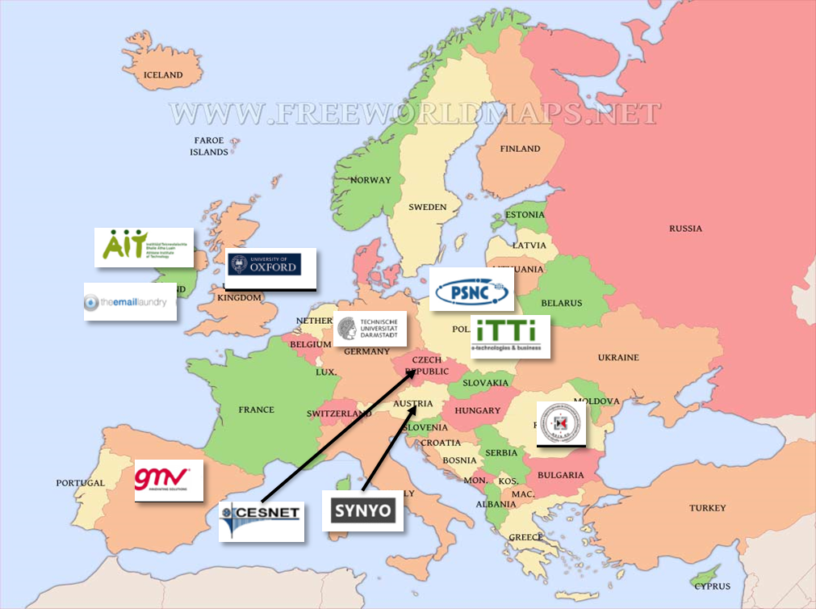
Consortium
Partners

Slide 4
PROTECTIVE – Why ?
Cybercrime hurts ! – costs over $400 billion annually
Escalation has created a daunting technology arms race
Computer Security Incidence Response Team (CSIRTs) struggle to keep up :-
  Too much information
  Lack of manpower

Slide 5
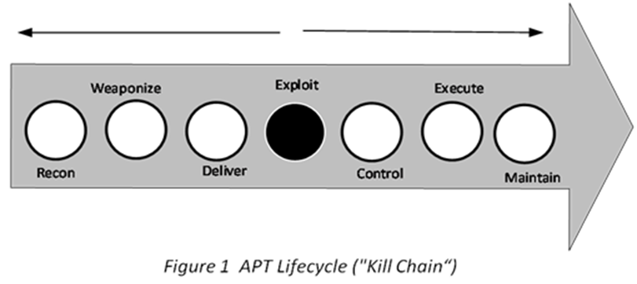
PROTECTIVE – Why ?
CSIRTS need to develop a better awareness of their adversary’s behaviour, capability, and intent
to move from reactive to a proactive security posture
Advanced Persistent Threat Lifecycle

Slide 6
PROTECTIVE – Approach
Making existing tools interoperable and promoting the use of standards for data exchange
Enhancing the functionality of existing tools as regards:
  Interoperability
  Correlation engines for incident analysis
  Improved threat intelligence
  Advanced analytics and visualisation for massive numbers of incidents
  Automatic prioritisation
ENISA (Detect, Share Protect)

Slide 7
PROTECTIVE – Approach
Improve proactive response through better
  Cyber Situational Awareness (CSA)
  “Within a volume of time and space, the perception of an enterprise’s security posture and its threat environment; the comprehension/meaning of both taken together (risk) and the projection of their status into the near future”
  (US Committee on National Security Systems )

Slide 8
PROTECTIVE – Approach
Improve CSA perception and comprehension through better
  Threat Awareness
  what are the external and internal threats ?
  Mission Awareness
  the importance (criticality) of the organisations assets to the functioning of the business
  Constituency Awareness
  inventory of the configuration and operational status of assets /info of member organisations
  Context Awareness
  threat status information must be correlated to the context of the business. (=> Mission Awareness X Constituency Awareness)

Slide 9
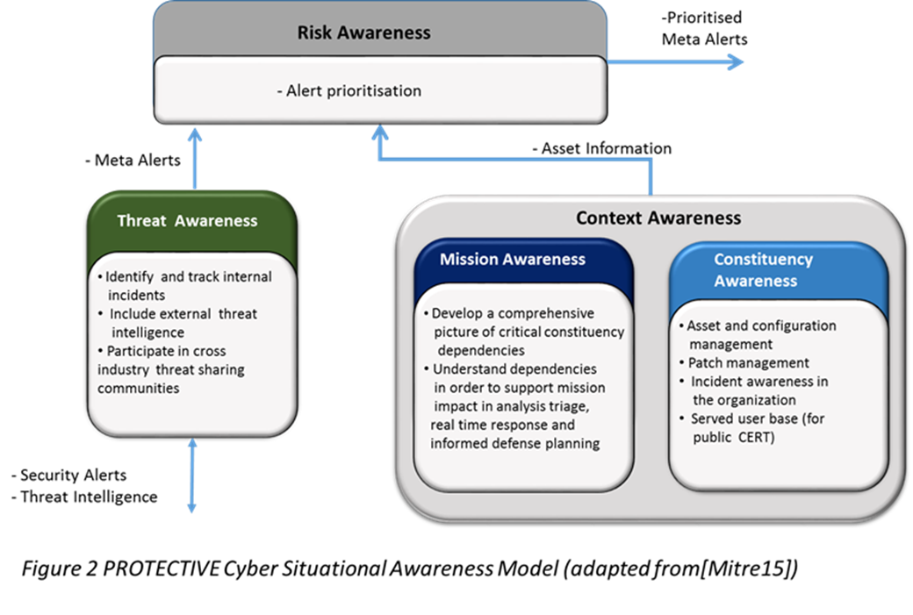
PROTECTIVE – Approach

Slide 10
PROTECTIVE - System
PROTECTIVE is composed of two functional subsystems
Risk Monitoring
  realisation of risk awareness and context awareness concepts as well as elements of the threat awareness concept
Threat Intelligence Sharing
  realisation of elements of threat awareness through information sharing

Slide 11
Risk Monitoring – stages
Collection is where security alerts are acquired, normalised and stored
Correlation is the process whereby similar alerts are grouped to form a higher level ‘meta alert’
Context awareness – this stage consolidates asset inventory information
Prioritisation - meta alerts are annotated with information about the organisation and prioritized
Decision making –analyst decides on how to handle the prioritised alerts.

Slide 12
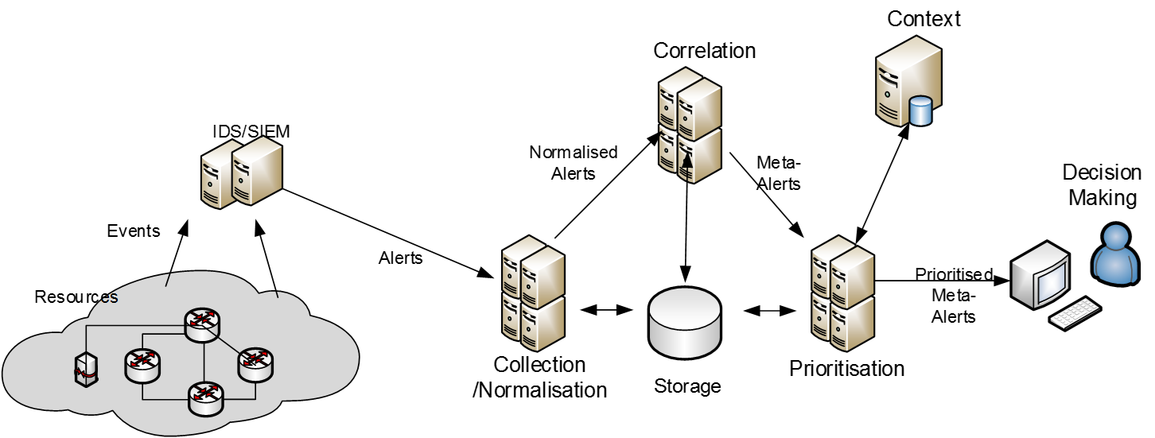
Risk Monitoring – stages
Context
Correlation
IDS/SIEM etc
Decision
Making
Security
Alerts
Security
Meta-alerts
Normalisation
Prioritisation

Slide 13
Threat Intelligence (TI) -Taxonomy
Some content here
More coLow-level information – information from monitoring systems within an organisation e.g. network traffic etc. In most cases such data is not useful without additional context.
Detection Indicators – is a pattern that can be matched against low-level data to distinguish threats. These include e.g. IP addresses, URL’s, MD5 hashes etc.
Advisories – includes several types of information that cannot be directly (i.e. automatically) translated into a process for preventing threats but still provides information that can be used by analysts to trigger defensive actions.
Strategic – highly summarised report that aim to provide an overview of particular situations
  ntent

Slide 14
TI Sharing - Mechanism
Knowledge Exchange
  a service containing a list of data publishing organisations and their associated data or service offerings
  The KE may process incoming data to perform quality assurance, data enrichment etc. Organisations can visit a KE and subscribe to data by contacting the publishing organisation directly.
  KE approach leads to a decentralised organic ecosystem of data and service offerings

Slide 15
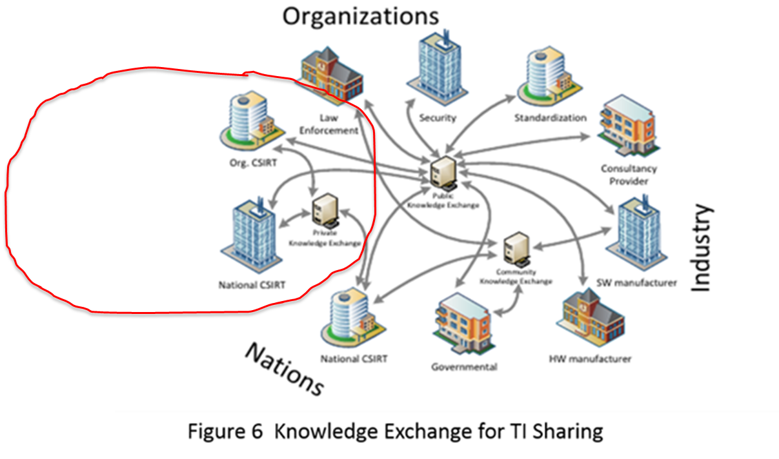
Big Picture
Protective
Communityy

Slide 17
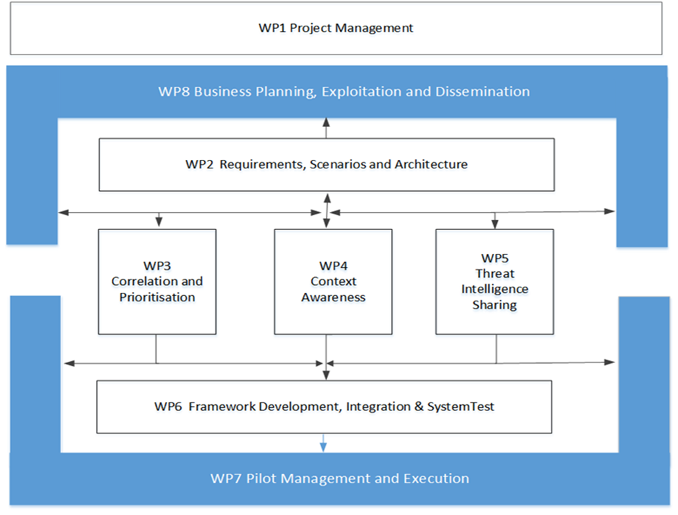
Work Plan

Slide 18
PROTECTIVE - Pilots
The PROTECTIVE system is designed to provide solutions for public domain CSIRTs and SME’s who both have needs outside the mainstream of cyber security solution provision.
Public CSIRTs needs arise in part because commercial tools do not address their unique requirements. This has created a shortfall, clearly articulated by ENISA, of tools with the required analytical and visualisation capabilities to enable public CSIRTs provide optimised services to their constituency.
SME’s also are vulnerable to cybercrime as they have limited resources to protect themselves and often a limited understanding of what needs to be done

Slide 19
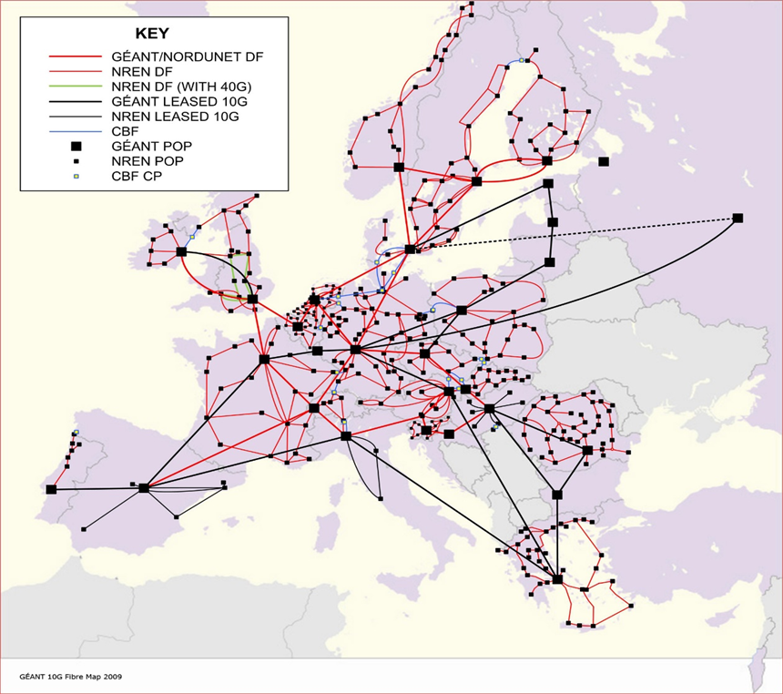



GEANT NREN Backbone
RoEduNet - Romania
PSNC- Poland
Cesnet - Czech

Slide 20
PROTECTIVE Pilots – SME’s
The pilot will be conducted in conjunction with theEmailLaundry
EML provides security services both directly to SME’s and to other managed security service providers (MSSP).
The pilot will focus on the application of PROTECTIVE to EML’s MSSP customers.
The reasons for this include
  i) our belief that MSSPs are particularly well positioned to provide cyber security solutions to SME and
  ii) we can reach more SMEs in this way and
  iii) it will be more efficient to evaluate the pilot

Slide 21

Questions ?

