Slide 1
Joint cyber exercises
Charlie van Genuchten
SIG-ISM meeting, Dublin
February 22nd, 2017

Slide 2
Overview
Introduction
Crises: what are we talking about?
Needs and objectives
Different kinds of exercises

Slide 3
Definition of cyber crisis
A cyber incident is an IT incident that disrupts the expected availability of services and/or provokes the unauthorised disclosure, acquisition and/or modification of information.
A cyber crisis is "an abnormal and unstable situation in which strategic goals, reputation and reliability are threatened by a disturbance, intentional or unintentional, at the core of the targeted organisation."
Notes:
Let’s take a step back and first find out what we are talking about.
Please raise your hand if you have experienced an incident with your NREN. Een paar eruit halen om meer te vertellen over hun incidenten.
Who would say they have experienced a crisis? Een paar eruit halen om meer te vertellen over hun crises.

Slide 4
Dealing with crises
Crisis team?
Crisis management plan?
Crisis communication?
Unknown?

Slide 5
Exercises can be used to
Validating policies, plans, procedures, training, equipment and/or inter-organizational agreements
Testing ICT disaster recovery systems
Clarifying and training personnel in roles and responsibilities
Improving inter-organizational coordination and communications
Identifying gaps in resources
Improving individual preformance
Identifying opportunities for improvement
Providing a controlled opportunity to practice improvisation

Slide 6
Performance objectives can be
orientation/demonstration: simulating experience of an expected situation to increase awareness of vulnerabilities and the importance of effective action in response to the simulated conditions;
learning: enhancing knowledge, skills, or abilities by individuals or groups with the goal of mastering specific competencies;
cooperation: providing an opportunity for people to work together to achieve a common end result;
experimenting: trying new methods and/or procedures with the intent of refinement; and,
testing: evaluating a method and/or procedure to assess which components are sufficiently developed.

Slide 7
What are your needs and objectives regarding crisis management?
Notes:
In groepjes van 3 of 4 uiteen om hierover te discussiëren. Na 10 minuten terugkoppelingen met needs and objectives

Slide 8
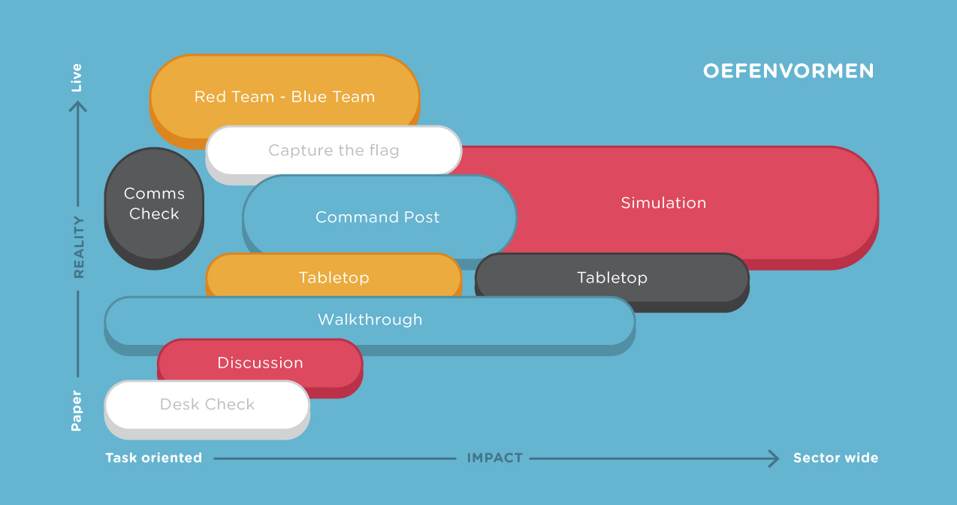
Exercise types
Notes:
Desk Check – A desk check is a method used to validate plans and procedures and any changes to them. This is usually conducted in conversation with the author of the plans and procedures.
Tabletop exercise – a tabletop exercise covers all aspects of crisis management. All participants receive the same information in advance about the simulated crisis situation and their role.
Distributed tabletop exercise – A distributed tabletop is a role-play exercise where participants play their usual role in the plans and procedures of a scenario. This exercise is similar in structure to a tabletop exercise, but there is no possibility for discussion.
Command Post Exercise (CPX) 100 – In a CPX (sandbox exercise), a crisis is simulated without the use of emergency services, external environmental factors or players. The crisis teams deal with questions and orders in a realistic and evolving scenario.
Red Team/Blue Team - In a Red Team/Blue Team exercise, the red team attacks the network or another important business service and the blue team tries to foil the attempt.

Slide 9
Exercise types
Desk Check – A desk check is a method used to validate plans and procedures and any changes to them. This is usually conducted in conversation with the author of the plans and procedures.
Tabletop exercise – a tabletop exercise covers all aspects of crisis management. All participants receive the same information in advance about the simulated crisis situation and their role.
Distributed tabletop exercise – A distributed tabletop is a role-play exercise where participants play their usual role in the plans and procedures of a scenario. This exercise is similar in structure to a tabletop exercise, but there is no possibility for discussion.
Command Post Exercise (CPX) 100 – In a CPX (sandbox exercise), a crisis is simulated without the use of emergency services, external environmental factors or players. The crisis teams deal with questions and orders in a realistic and evolving scenario.
Red Team/Blue Team - In a Red Team/Blue Team exercise, the red team attacks the network or another important business service and the blue team tries to foil the attempt.

