Slide 1
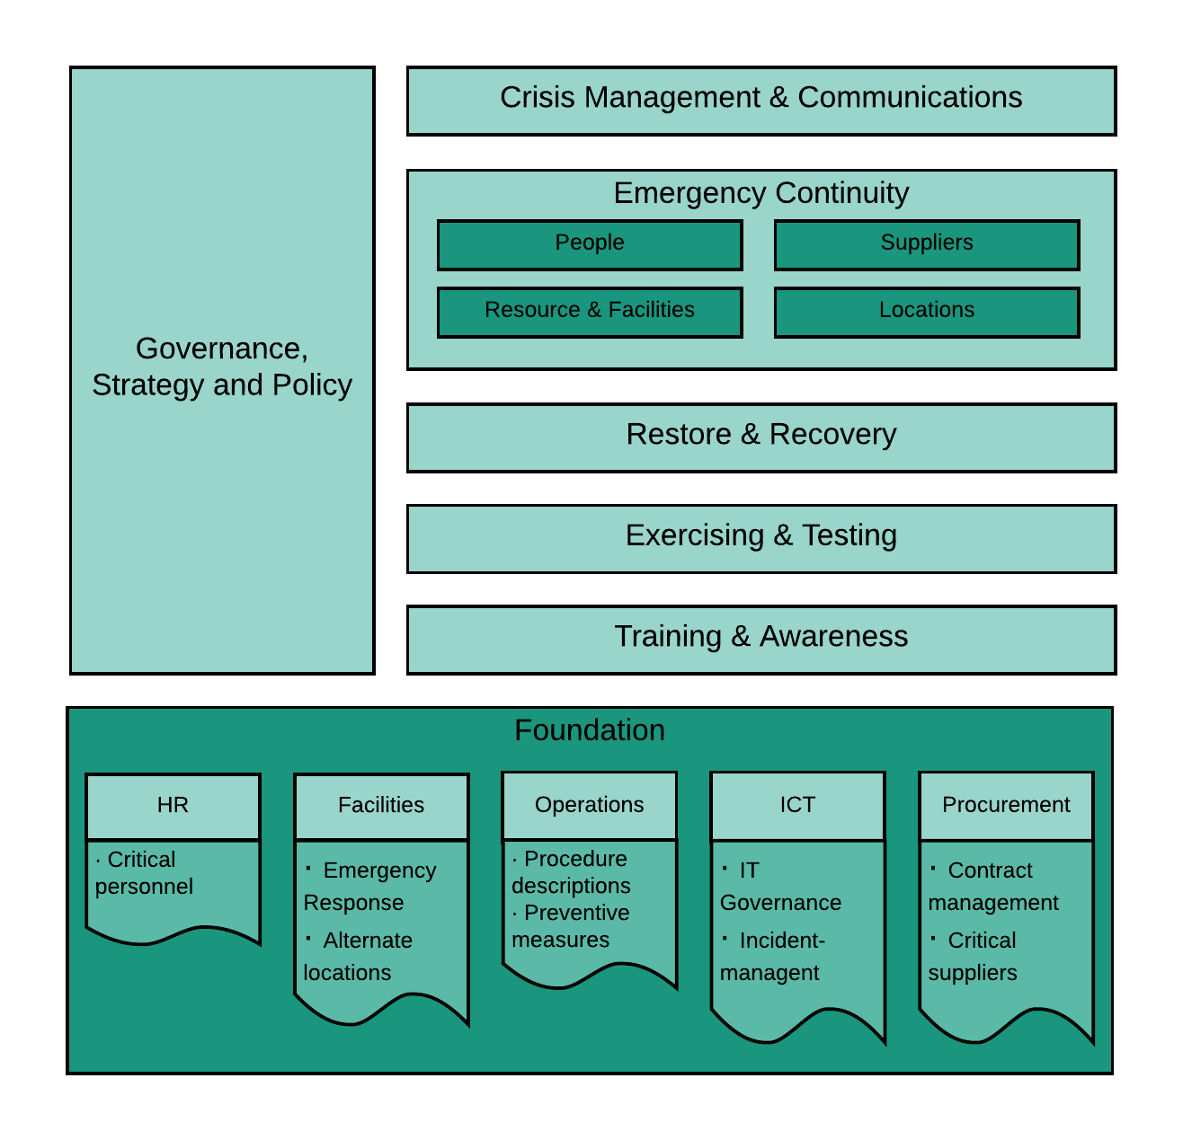
Business Cointinmuit Framework
Framework and implementation guidelines
Covers Business Continuity, Disaster Recovery and Crisis Management
Based in international standards, not 1 standard is covering everything
54 control statements in 7 chapters
Some overlapping controls (identified) with security frameworks and with privacy frameworks
Available under CC-4.0-BY license

Slide 2
ISMS – Information Security Management System
Information security policy
RISK ANALYSIS
CONTROLS
PLAN
OPERATE
EVALUATE
PERFORMANCE
Organization- wide controls
Organization wide risk analysis
Annual Planning organization
Implement genericcontrols
Organization-wide audit and benchmark
Baseline
Planning
Service
Implement specific controls
Service audit
Service risk analysis
Service specific controls
Explain deviations to baseline (comply or explain)

Slide 3
ISMS mapping ISO 27001
5. Leadership
Information security policy
10. Improvement
4. Context of the organisation
RISK ANALYSIS
CONTROLS
PLAN
OPERATE
EVALUATE
PERFORMANCE
generic controls
7. Support
Organization wide risk analysis
Annual planning organization
Implement generic controls
organization-wide audit and benchmark
Baseline
8. Operation
9. Performance evaluation
5. Leadership
Planning
Service
Implement specific controls
Service audit
6. Planning
Service risk analysis
Service specific controls
10. Improvement
Explain deviations to baseline to security officer (comply or explain)
10. Improvement

Slide 4
ISMS Products
information security policy
Governance SURFnet
RISK ANALYSIS
CONTROLS
PLAN
OPERATE
EVALUATE
PERFORMANCE
Risk analysis security officer and management team
Awareness, logserver, etc
(Annual) planning SURFnet
generic controls
Controls strategic level
Coable, benchmark, internal review, etc.
Organization wide risk analysis
Planning SURFnet
Implement generic controls
Organization wide audit and benchmark
Wiki baseline
Baseline
Controls tactical level
Risk analysis Service
Planning Service
Implement specific controls
Service audit
Service risk analysis
Service specific controls
(Annual) planning Service
Controls operational level
Pentest, audit, etc.
Controls selected by Service
Explain deviations to baseline to security officer (comply or explain)
Risk logbook, comply or explain
Governance Service

Slide 5
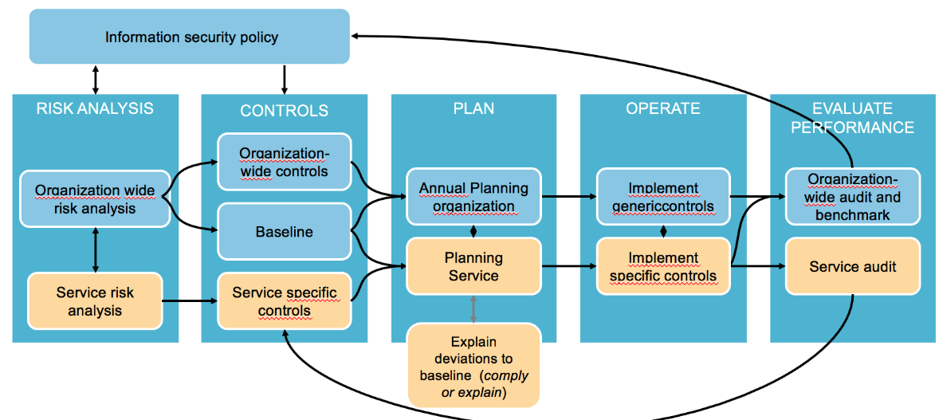
Baseline - ISO 27002 based: generic and specific
Integration in management and development processes
risk management & security manageemnt
General, policies
Systems management and operations
Assets
Employees
Employment
The ISMS model is supported by a baseline with a grouping of relevant ISO 27002 controls in 12 theme’s. For each theme you can describe what (strategic) choices you have made, what is generic and what is service or department specific. The 12 theme’s are designed to be close to the daily working processes. Because the baseline is ISO 27000 based, as well as the management processes, the organization will be well prepared for a future certification process.
Cryptography
Suppliers
Security incidents
Systems and software development
Continuity
Access Management

