Slide 1

Presentation of sikresiden.no
- On the safe side
Géant SIG-ISM
05.10.2017
Øivind Høiem, UNINETT
Notes:
Ledet sikresiden-prosjektet i 2017, forberedt det høsten 2016

Slide 2

sikresiden.no is a mobile-adapted website
provides user-friendly training and help on what to do
for students and employees
in Norwegian and English
free for state-owned universities and university colleges

Slide 3
















320.000 students and employes

Slide 4
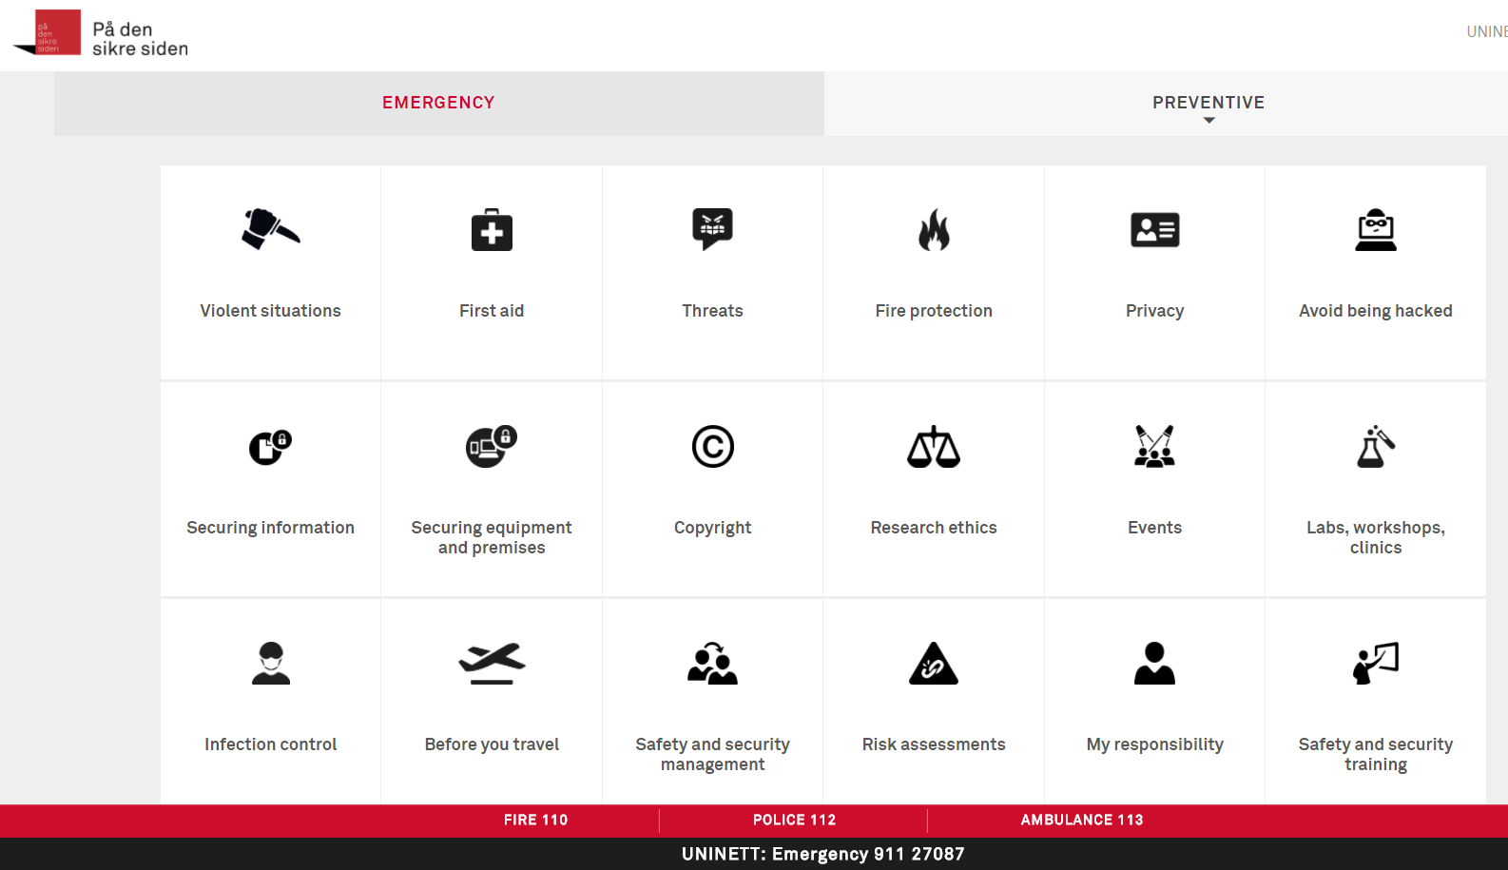
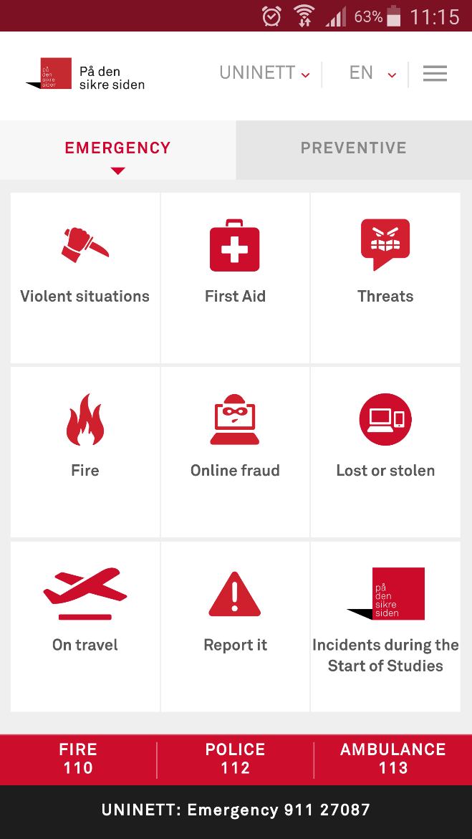
What you can find on sikresiden.no
One input to information and e-learning
What you can do preventive (Black Icons)
What to do when something happens (red icons)
Adapted to mobile, desktop and tablet
Common information
Local information

Slide 5
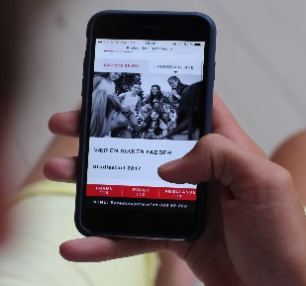
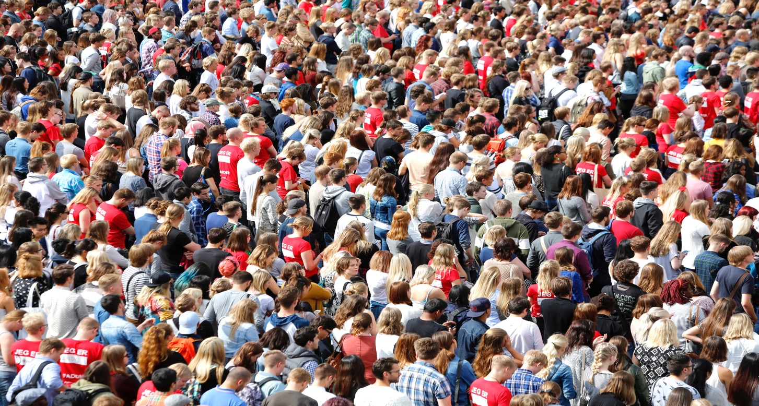
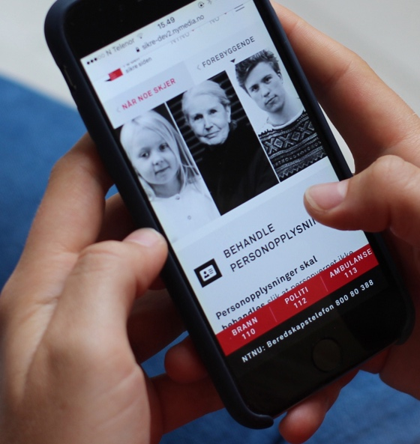

Background - We have the same challenges,
therefore, we share and collaborate
The design concept are developed by HiOA 2014-2016
Shared with the higher educational sector on sikresiden.no
from 2017
Initiators:

Slide 6

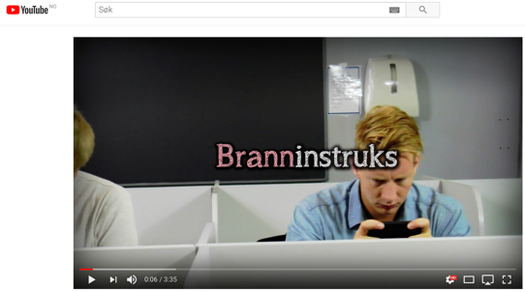

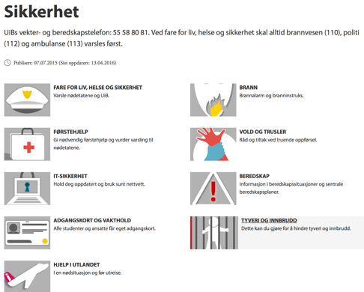

Gather, distill and further develop good content

Slide 7


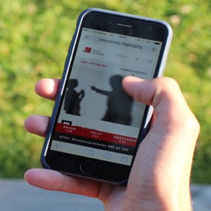

sikresiden.no
– når du skal sikre personopplysninger
Universiteter
og høgskoler
sikresiden.no
– personal action competence
– common security culture
Notes:
Margedsføre den for Målgruppa – lett å finne det jeg selv kan gjøre for å være
90% studenter
Nå dem – brukerne hva de skal gjøre i situasjoner, når og hvordan bruke den
Nå ut!

Slide 8

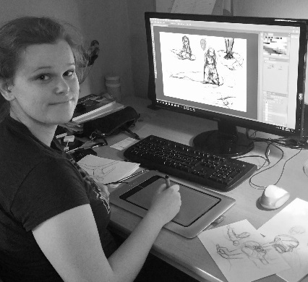
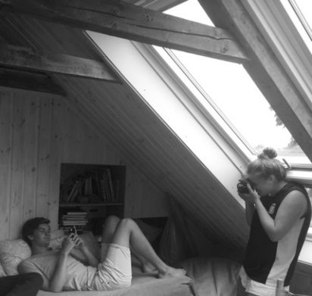
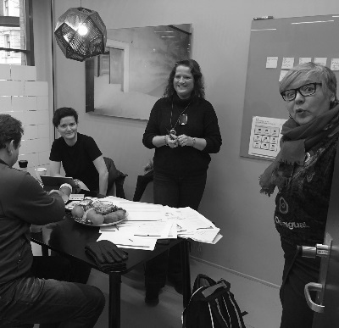
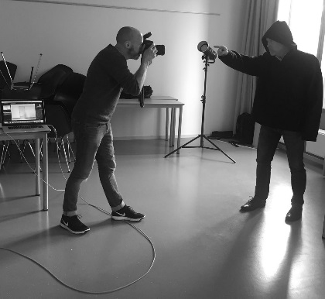
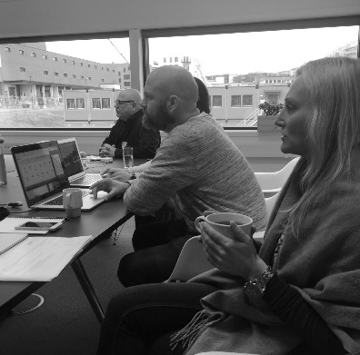
The sikresiden.no-project
Contributions in workgroups to create content
Project leader: Jorid Bodin (HiOA)
Managers of Workgroups:
Øivind Høiem (UNINETT), Olaug Eiksund (UIB)
Ingrid Jacobsen (HiOA), Kenneth Nielsen (UiO)
Funding: Information Security Secretariat at UNINETT
Web development: Nymedia Technical solution and visualization
Graphic Design: Redink
Interaction Design: USIT (UiO)
Icons: Stafan Ellmer
Photo: Skjalg Bohmer Vold, Thomas Ekström picture archives UiO and UiB
Violance video, animations, first aid illustrations: Rebekka Sefland
Promo Videos / Photo: Nora Bodin
E-learning violent situations: Siv Dokmo (Junglemap)
Input/contribution in quality assurance
The Norwegian Police
Directorate of health
Norwegian Competence Service for trauma
The National Research Ethics Committees
National Security Authority
The Abuse Reception, Oslo Municipality
Happy drinking

Slide 9
The development process
Graphical design
Web development
Content production
Interaction
testing

Slide 10
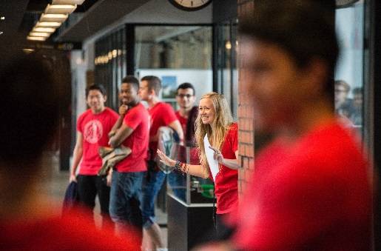
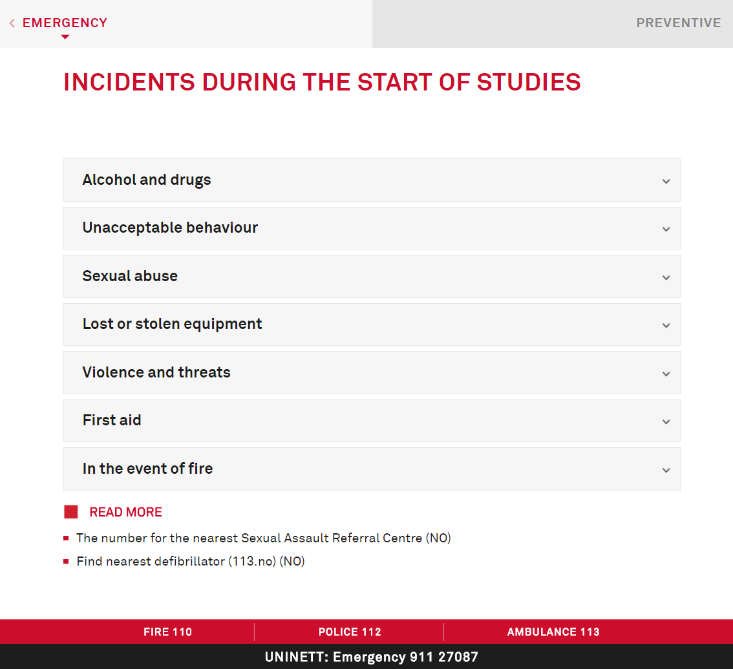
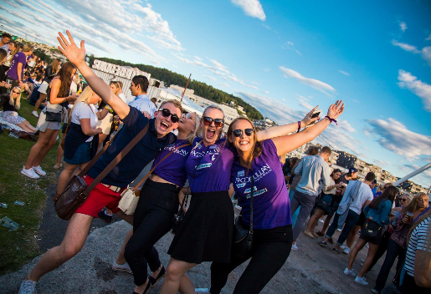
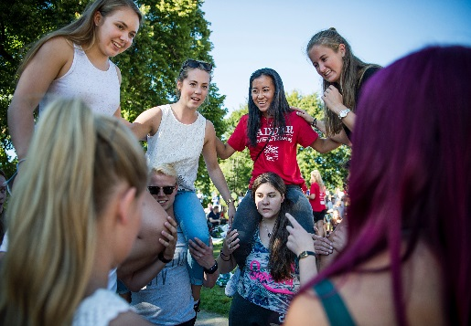
Pilot test: Buddy – ” We can use this if something happens at a party too!”
1400 buddies downloaded
Notes:
laget av studentene selv i samarbeid med fagmyndigheter innen rus og helse

Slide 11
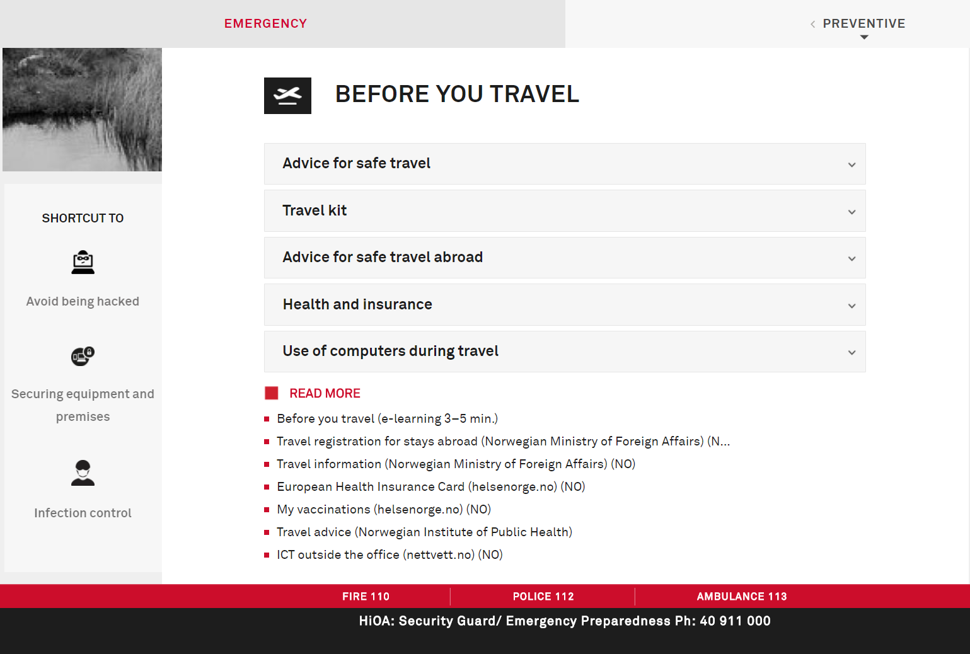
Før du reiser
Interaksjonsdesign
Brukertesting
Visuelt design
Webutvikling
E-læring
Illustrasjoner
Animasjoner
Ikoner
Foto
Video

Slide 12
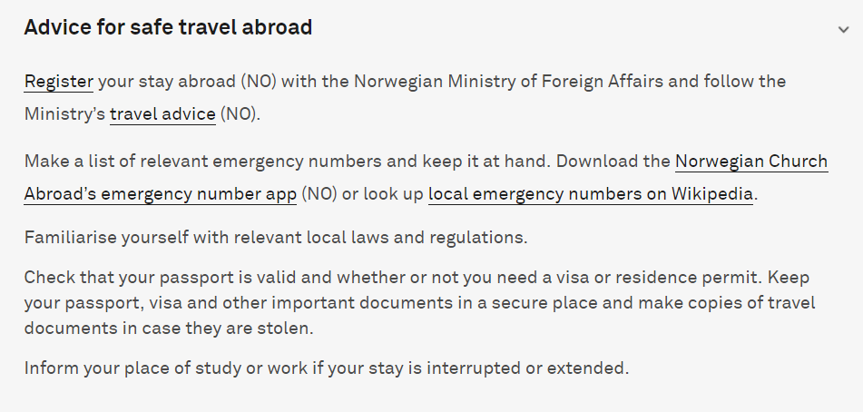
Before you travel
Interaksjonsdesign
Brukertesting
Visuelt design
Webutvikling
E-læring
Illustrasjoner
Animasjoner
Ikoner
Foto
Video

Slide 13
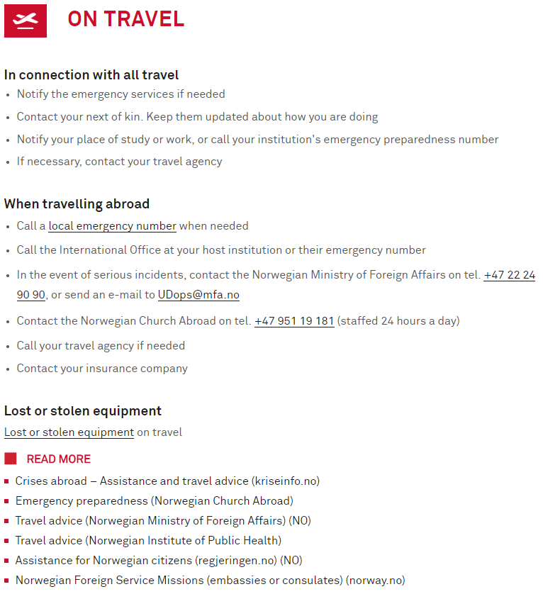
Emergency

Slide 14
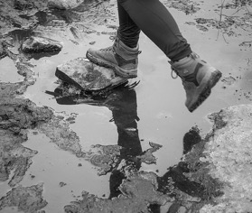

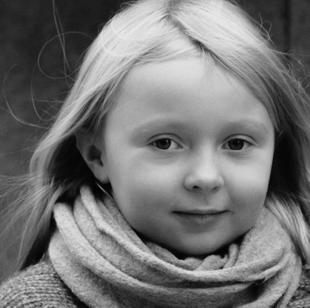
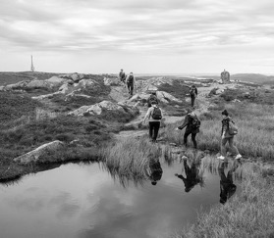
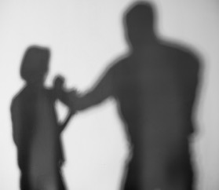
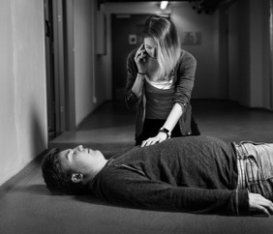
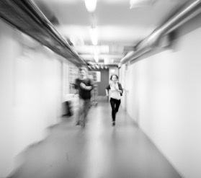
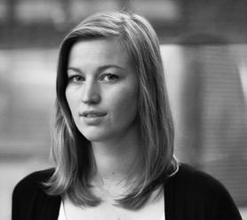

Basic training in safety, e-learning
secure
fire
risk
information
threats
privacy
travel
online fraud
Nano learing 3-7 min
my
responsibility
life threatening
violence
first aid

Slide 15


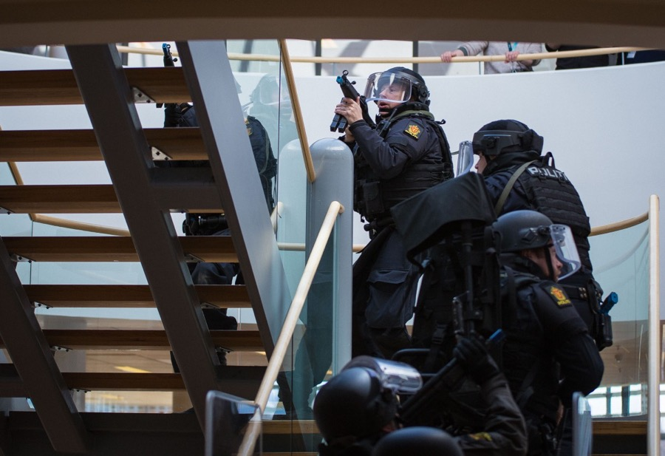
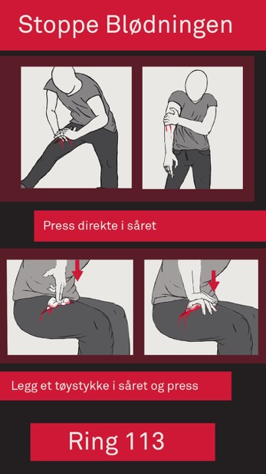
Life threatening violence, first aid and threats
NKT Traume
Link to movie
Notes:
Thor Langli, Erik Hestvik

Slide 16
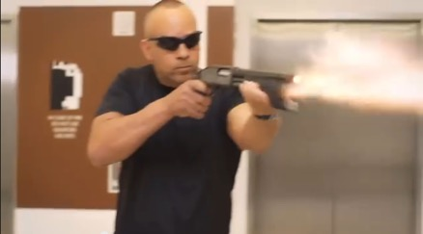
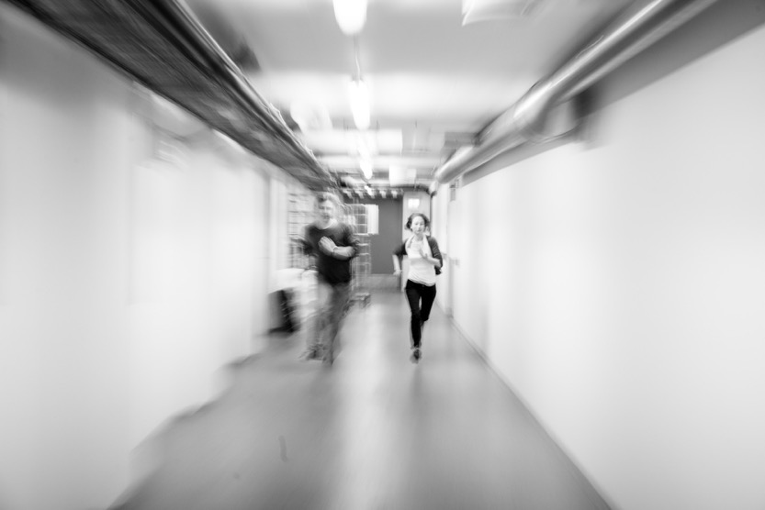
What you can do in the face of life-threatening violence
Inform without scaring
13.09.2017
Film (6 min)
6 e-learning lessons:
Ongoing life-threatening violence
Run, hide, fight
Know the premises
Holding a management position
First aid
When the police arrive
foto
illustrations
animations

Slide 17
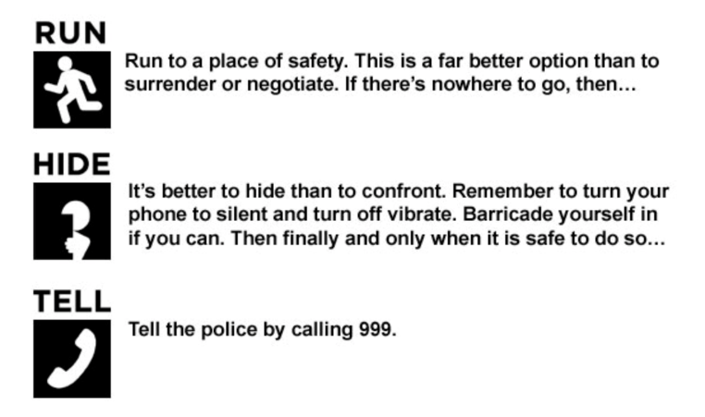


13.09.2017

Slide 18
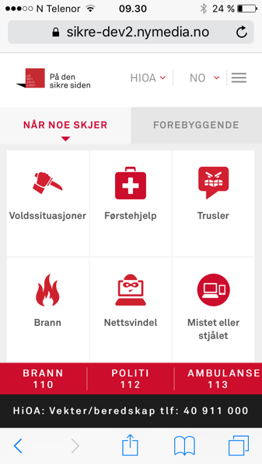
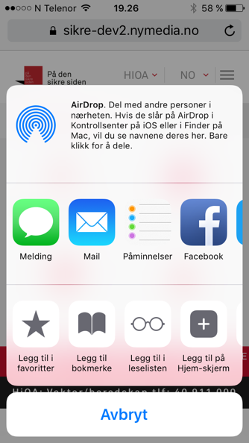
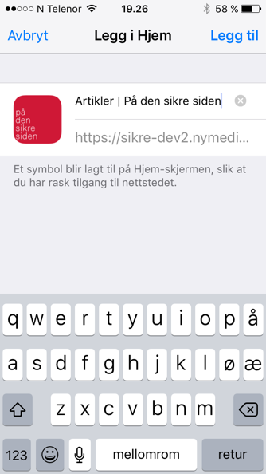
https://sikresiden.no
Get sikresiden.no on your mobile
iPhone
Android
Notes:
Løsningen er spesielt tilpasset universiteter og høgskoler, blant annet ved at lokalt nødnummer ved egen institusjon er lett tilgjengelig.
Sikresiden.no gir en felles inngang til ulike typer sikkerhetsinformasjon
Informasjonen er på norsk og engelsk.

