Slide 1
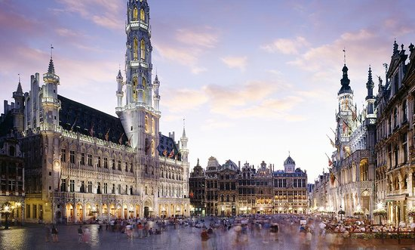
SIG-ISM – Oktober 2017 – Belnet - Bruxelles
Agenda October 5 (Thursday)
12:30 – 13:30 – Light lunch upon arrival
13:30 - 14:00 - Welcome, introductions, update on other related activities (WISE, Global CEO Forum Security group, FIRST Academic SIG, CLAW exercise)
14:00 - 14:30 - "On the safe side" - information on safety and security for the Norwegian higher education sector - Øivind Høiem, UNINETT AS
14:30 - 15:00 - Updates on regional collaborations
15:00 – 15:30 – Coffee break
15:30 - 16:15 - GDPR discussion with introductions by Alf Moens (SURFnet), Rolf Normann (UNINETT) and Urpo Kaila (CSC)
16:15 - 17:00 - GN4-3 Security white paper discussion with introduction by Alf Moens (SURFnet)
17:00 - 17:15 - Closing remarks
Evening – Dinner

Slide 2
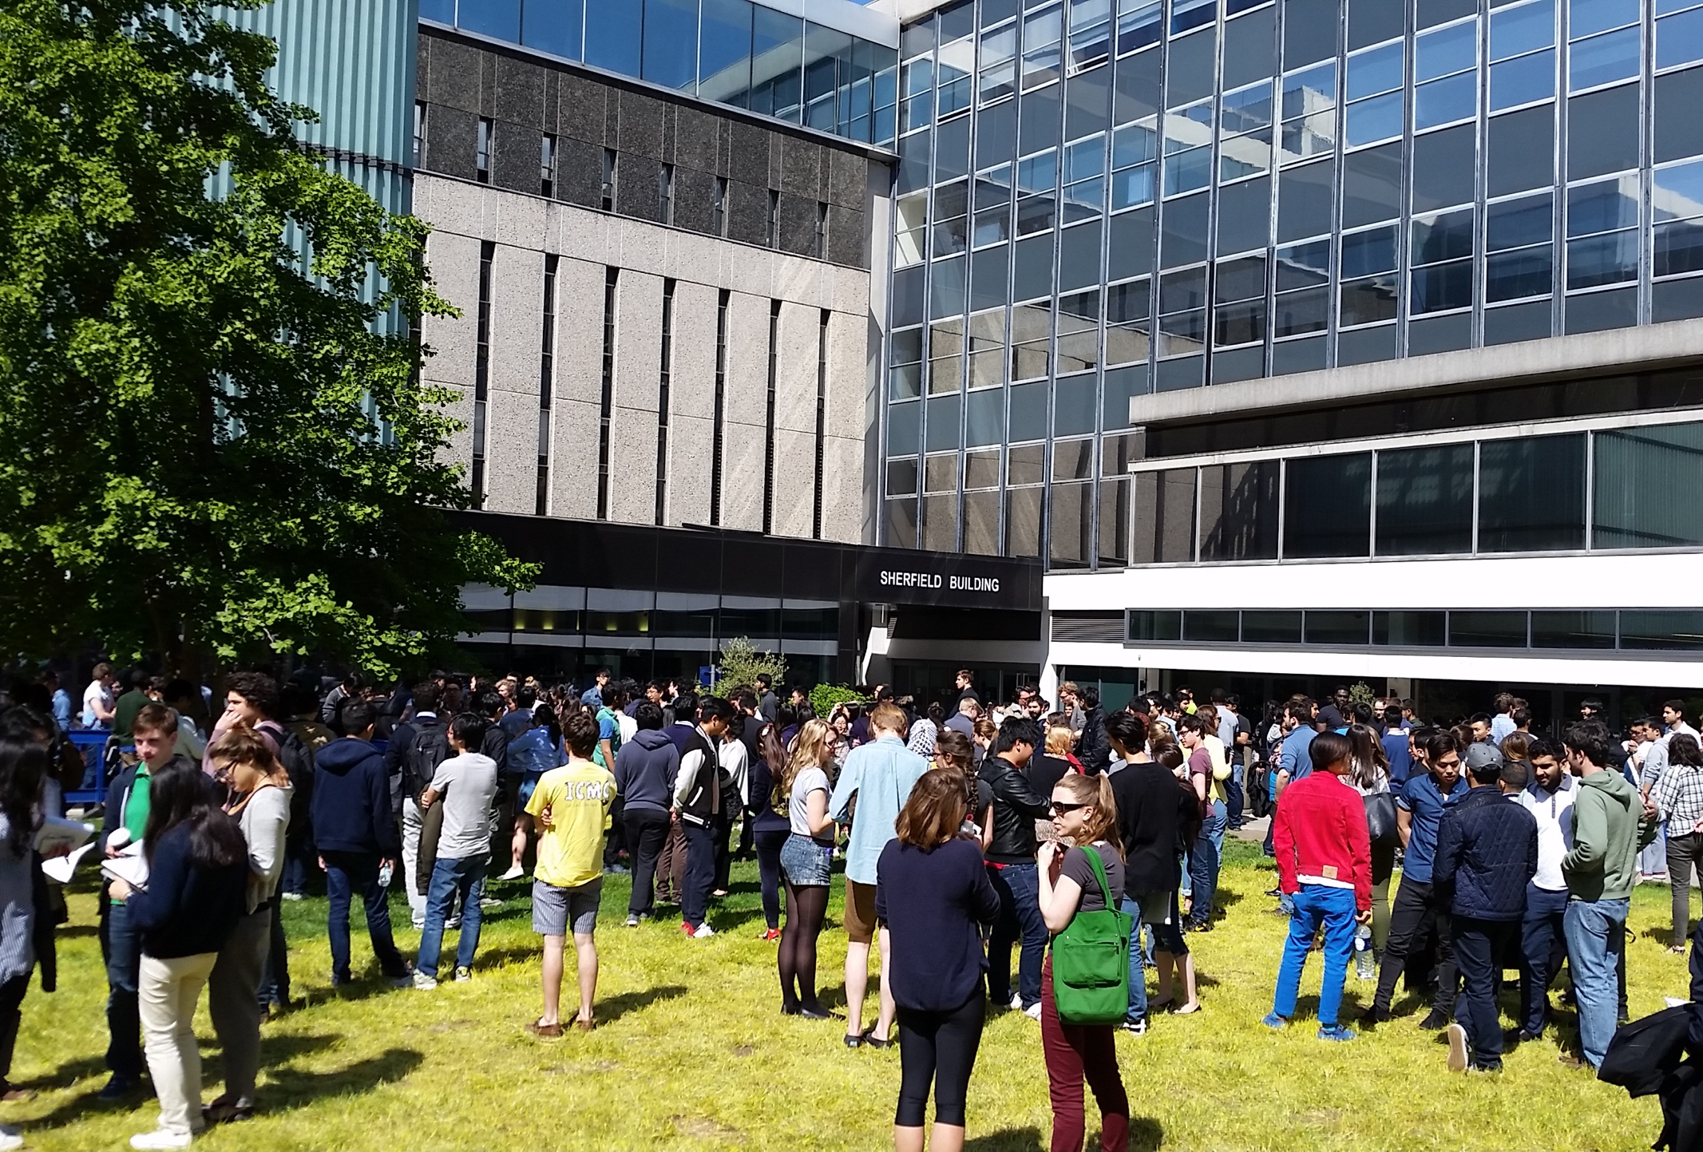

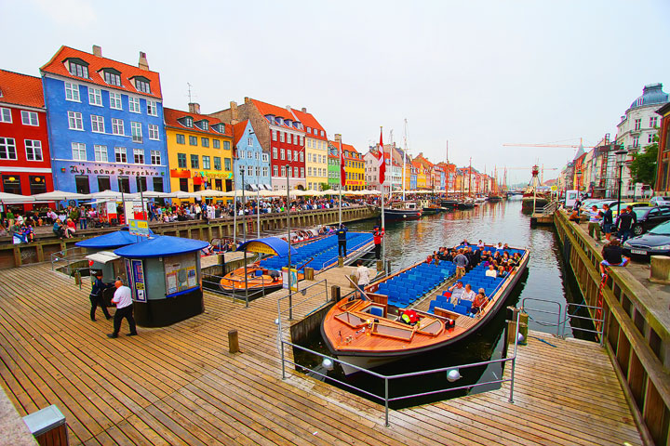

SIG-ISM: Never a Dull moment

Slide 3
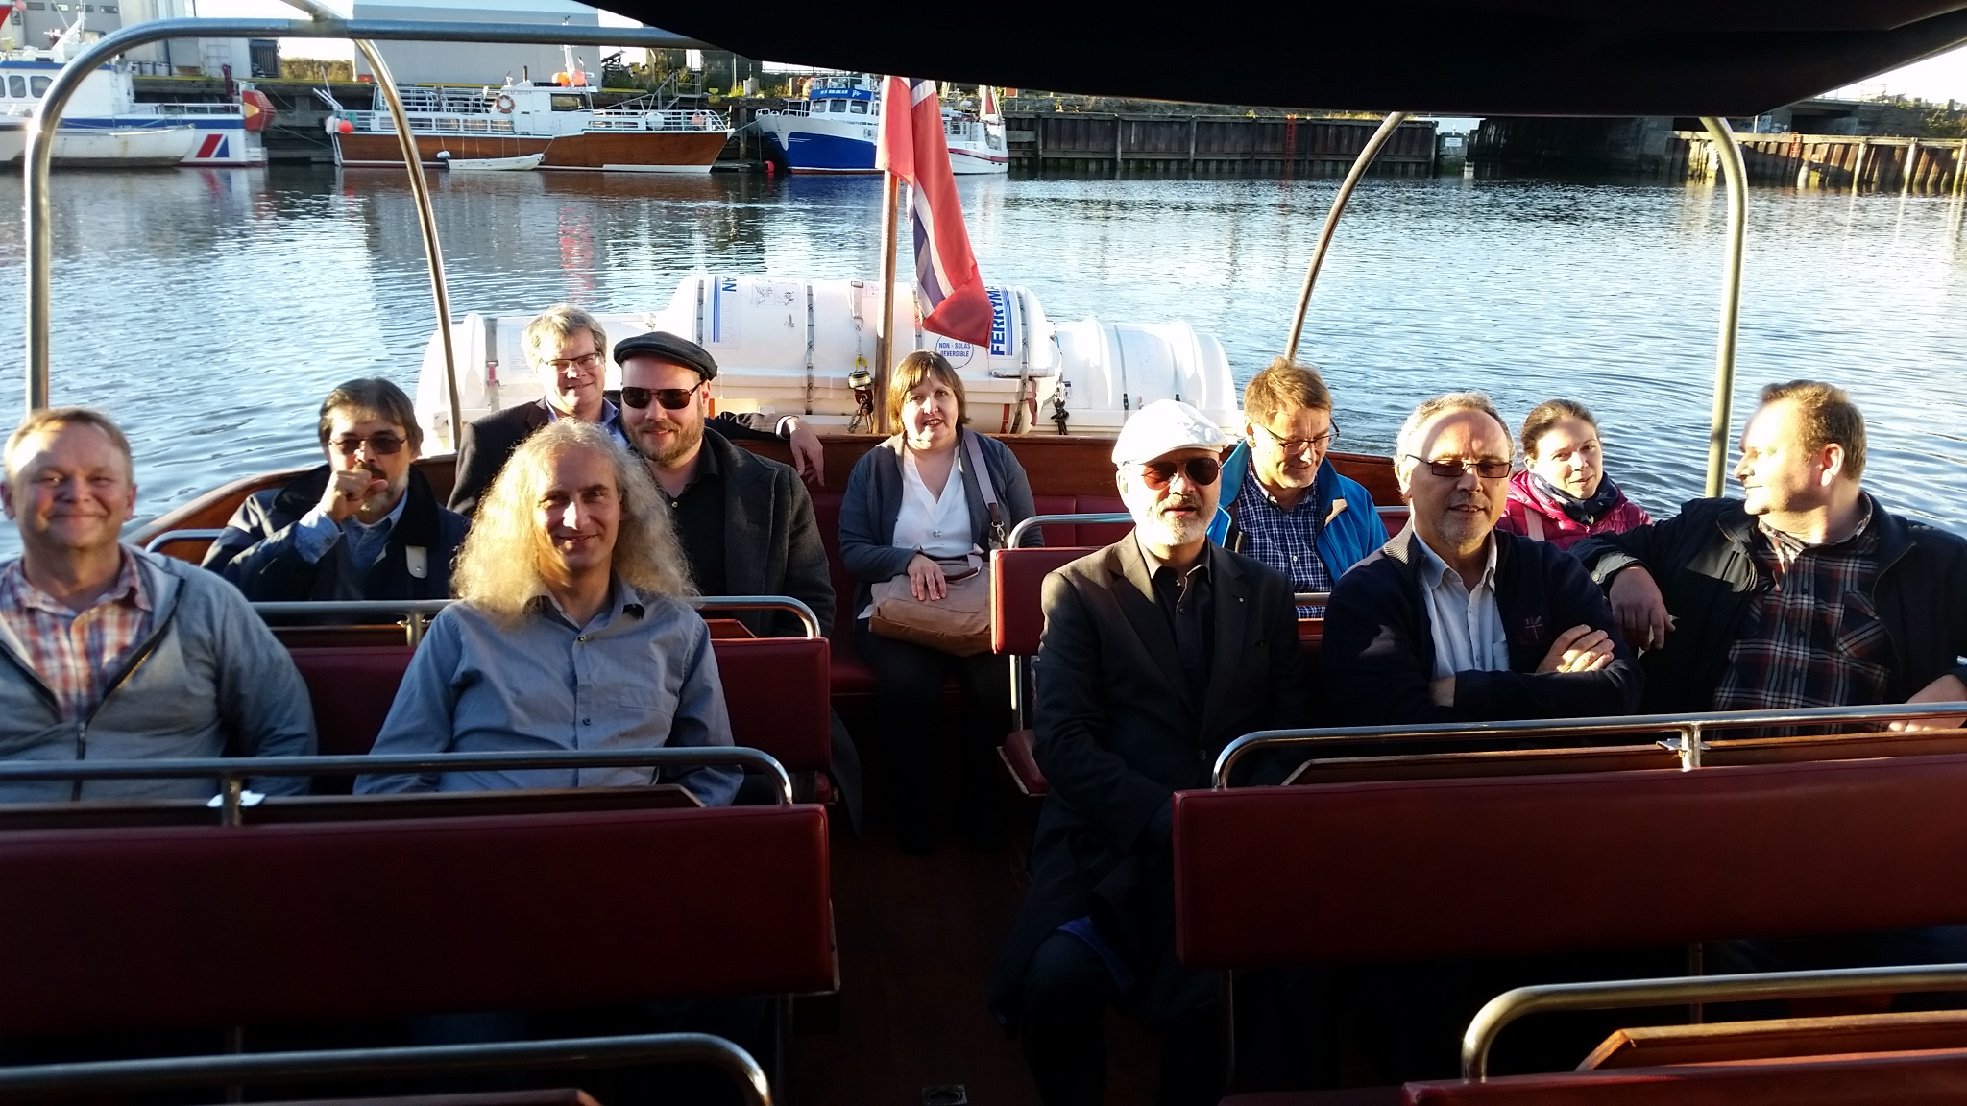


Slide 4
SIG-ISM: Never a Dull moment

Slide 5
SIG-ISM – Oktober 2017 – Belnet - Bruxelles
Agenda October 5 (Thursday)
12:30 – 13:30 – Light lunch upon arrival
13:30 - 14:00 - Welcome, introductions, update on other related activities (WISE, Global CEO Forum Security group, FIRST Academic SIG, CLAW exercise)
14:00 - 14:30 - "On the safe side" - information on safety and security for the Norwegian higher education sector - Øivind Høiem, UNINETT AS
14:30 - 15:00 - Updates on regional collaborations
15:00 – 15:30 – Coffee break
15:30 - 16:15 - GDPR discussion with introductions by Alf Moens (SURFnet), Rolf Normann (UNINETT) and Urpo Kaila (CSC)
16:15 - 17:00 - GN4-3 Security white paper discussion with introduction by Alf Moens (SURFnet)
17:00 - 17:15 - Closing remarks
Evening – Dinner
Friday morning: working group work sessions

Slide 6
International collaboration
TF-CSIRT
SIG-ISM
WISE
Global NREN
FIRST academic
TF-DPR
Incident respons teams
NREN
security officers
E-infrastructure security officers
NREN
security officers
NREN and academic security officers
NREN privacy and legal officers
Trusted Introducer
Conferences
Transit trainings
Inventory
Security management
Risk register
SCI framework
Awareness and training
Risk assesments
Security in bog and open data
Security baseline
DDOS filtering
Crisis exercises
Automated threat information
TBD, aimed at cooperation with and between academies
2018: prepare for GDPR
CLAW crisis management workshop
https://wise-community.org/2017/07/31/security-is-the-new-black-of-the-re-community/

Slide 7
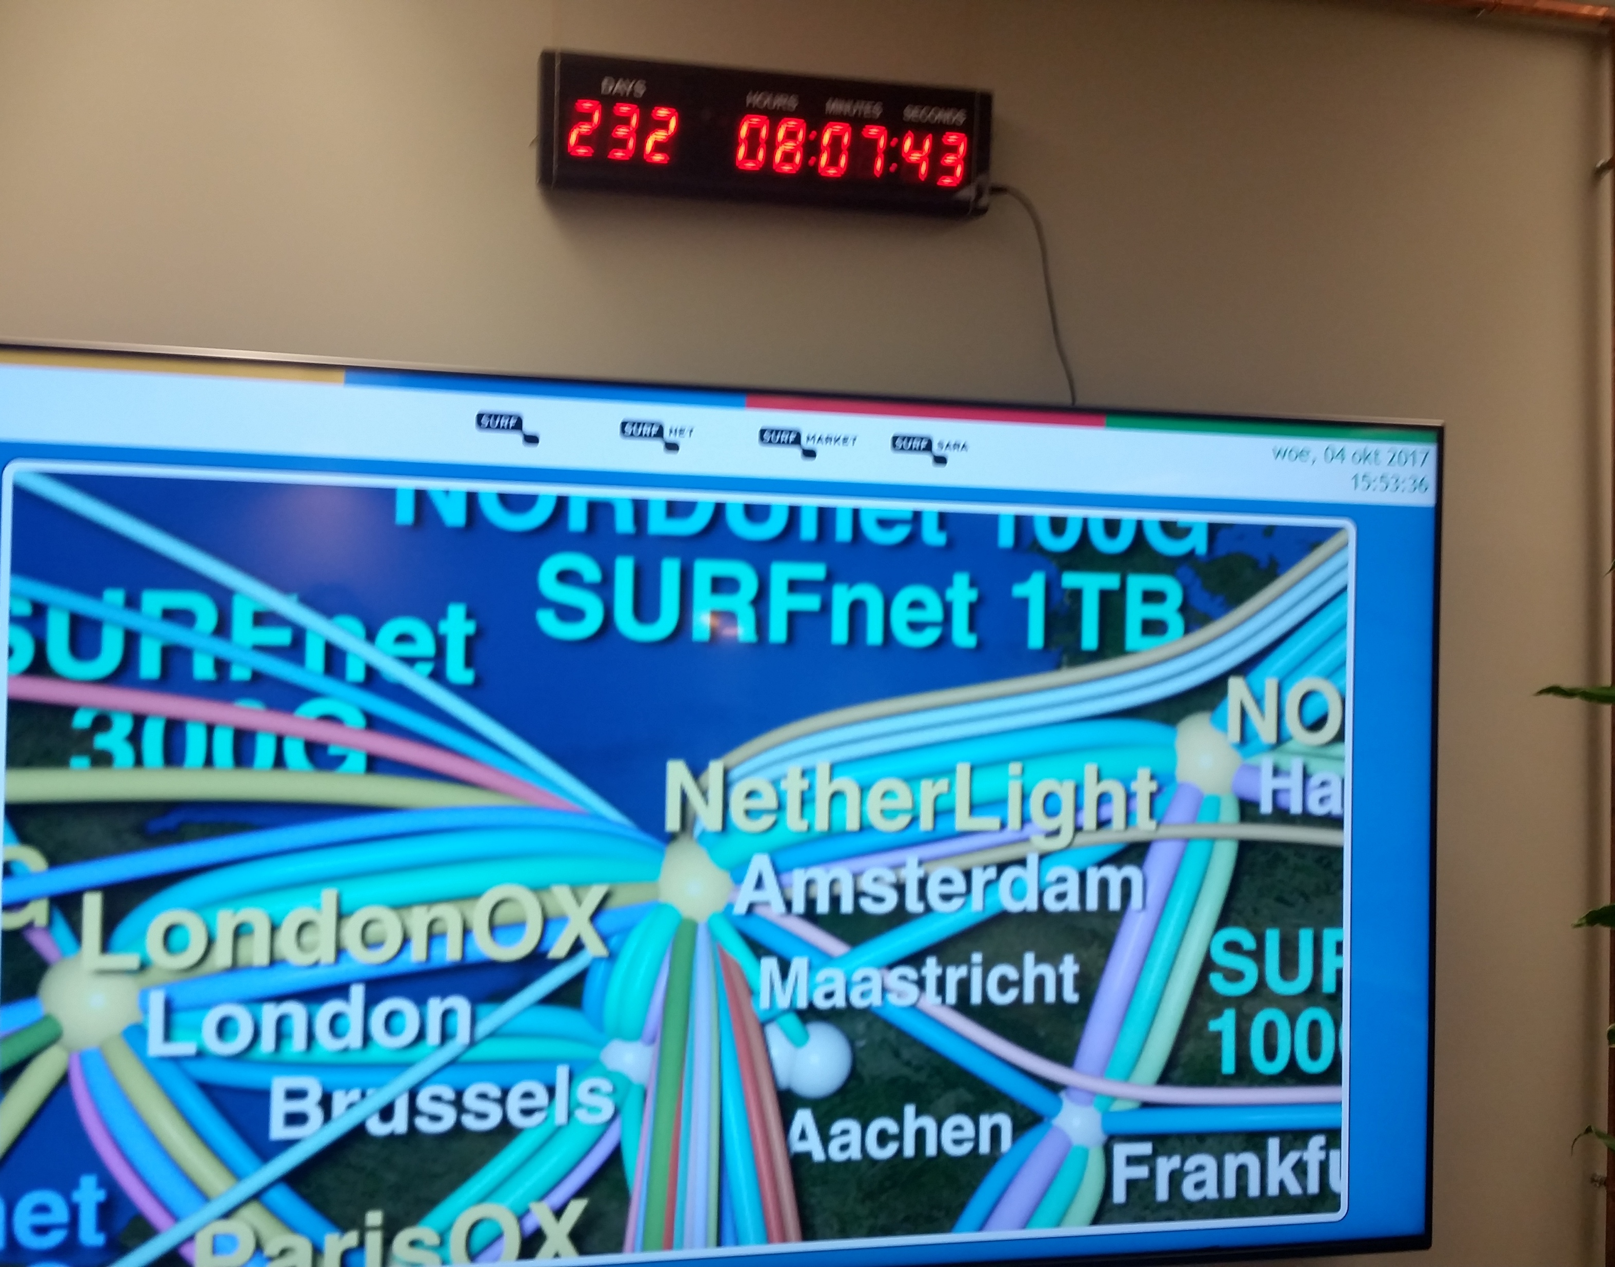
General Data Protection Regulation
Countdown to May 25, 2018
Shortlist:
  Inventory of what (PII) data you are processing
  Privacy Imopact Assessments
  Agreements with suppliers
  Adequate security measures
  Data breaches: detection and notification
  Privacy by default
  Privacy by design: Data minimalisation
  Right to be forgotten
Foto on 20171004_155336

Slide 8
GÉANT Security Whitepaper 2018 - 2022
Security Baselining
Standards, Frameworks, best practices, benchmarking
(Managed) Security Products & Services
DDOS mitigation, certificate services, crypto technologies
Legal Compliance
GDPR, NIS guideline, eIDAS, best practices
Management of Risk
Risk analysis, threat assessments, threat intelligence sharing
Training and Awareness
Develop new trainingmaterials, share best practices
Incident respons, Business continuity and crisis management

Slide 9
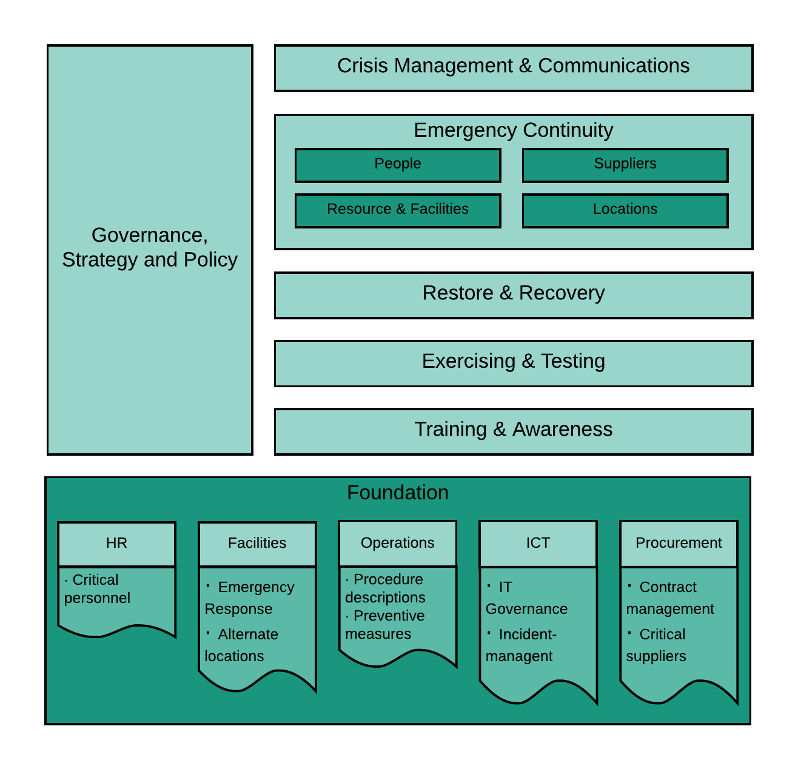
Business Cointinmuit Framework
Framework and implementation guidelines
Covers Business Continuity, Disaster Recovery and Crisis Management
Based in international standards, not 1 standard is covering everything
54 control statements in 7 chapters
Some overlapping controls (identified) with security frameworks and with privacy frameworks
Available under CC-4.0-BY license

Slide 10
SIG-ISM – Oktober 2017 – Belnet - Bruxelles
Agenda October 6 (Friday)
09:00 - Arrivals and coffee
09:05 - 10:30 - Working in groups
10:30 – 11:00 – Coffee break
11:00 – 12:30 - Working in groups
12:30 – 13:30 – Wrap up- Light lunch and departures

Slide 11
ISMS – Information Security Management System
Information security policy
RISK ANALYSIS
CONTROLS
PLAN
OPERATE
EVALUATE
PERFORMANCE
Organization- wide controls
Organization wide risk analysis
Annual Planning organization
Implement genericcontrols
Organization-wide audit and benchmark
Baseline
Planning
Service
Implement specific controls
Service audit
Service risk analysis
Service specific controls
Explain deviations to baseline (comply or explain)

Slide 12
ISMS mapping ISO 27001
5. Leadership
Information security policy
10. Improvement
4. Context of the organisation
RISK ANALYSIS
CONTROLS
PLAN
OPERATE
EVALUATE
PERFORMANCE
generic controls
7. Support
Organization wide risk analysis
Annual planning organization
Implement generic controls
organization-wide audit and benchmark
Baseline
8. Operation
9. Performance evaluation
5. Leadership
Planning
Service
Implement specific controls
Service audit
6. Planning
Service risk analysis
Service specific controls
10. Improvement
Explain deviations to baseline to security officer (comply or explain)
10. Improvement

Slide 13
ISMS Products
information security policy
Governance SURFnet
RISK ANALYSIS
CONTROLS
PLAN
OPERATE
EVALUATE
PERFORMANCE
Risk analysis security officer and management team
Awareness, logserver, etc
(Annual) planning SURFnet
generic controls
Controls strategic level
Coable, benchmark, internal review, etc.
Organization wide risk analysis
Planning SURFnet
Implement generic controls
Organization wide audit and benchmark
Wiki baseline
Baseline
Controls tactical level
Risk analysis Service
Planning Service
Implement specific controls
Service audit
Service risk analysis
Service specific controls
(Annual) planning Service
Controls operational level
Pentest, audit, etc.
Controls selected by Service
Explain deviations to baseline to security officer (comply or explain)
Risk logbook, comply or explain
Governance Service

Slide 14
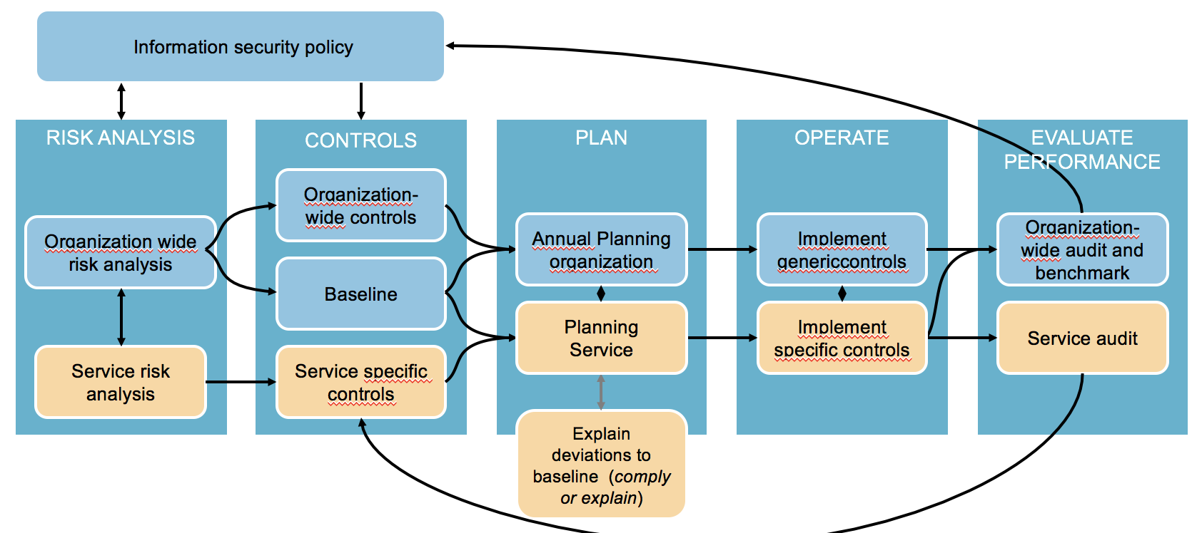
Baseline - ISO 27002 based: generic and specific
Integration in management and development processes
risk management & security manageemnt
General, policies
Systems management and operations
Assets
Employees
Employment
The ISMS model is supported by a baseline with a grouping of relevant ISO 27002 controls in 12 theme’s. For each theme you can describe what (strategic) choices you have made, what is generic and what is service or department specific. The 12 theme’s are designed to be close to the daily working processes. Because the baseline is ISO 27000 based, as well as the management processes, the organization will be well prepared for a future certification process.
Cryptography
Suppliers
Security incidents
Systems and software development
Continuity
Access Management

Slide 15

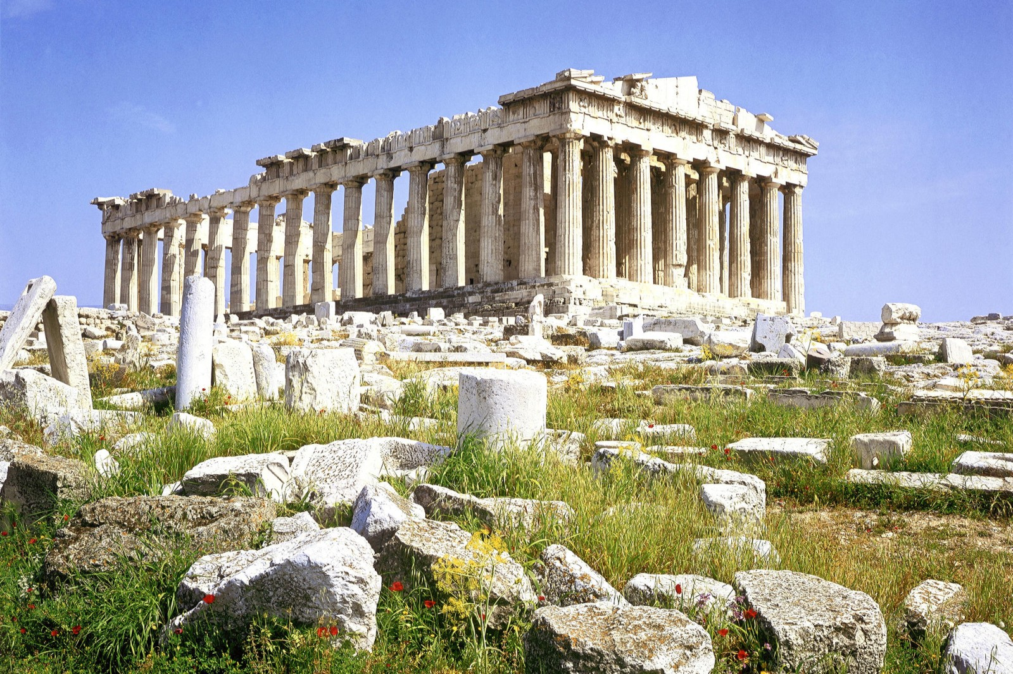
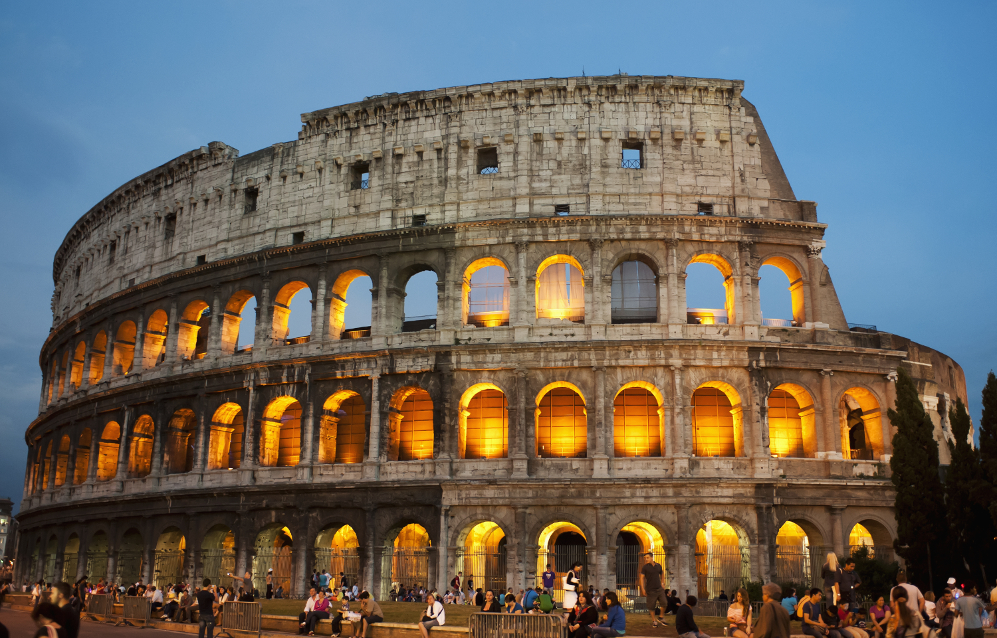
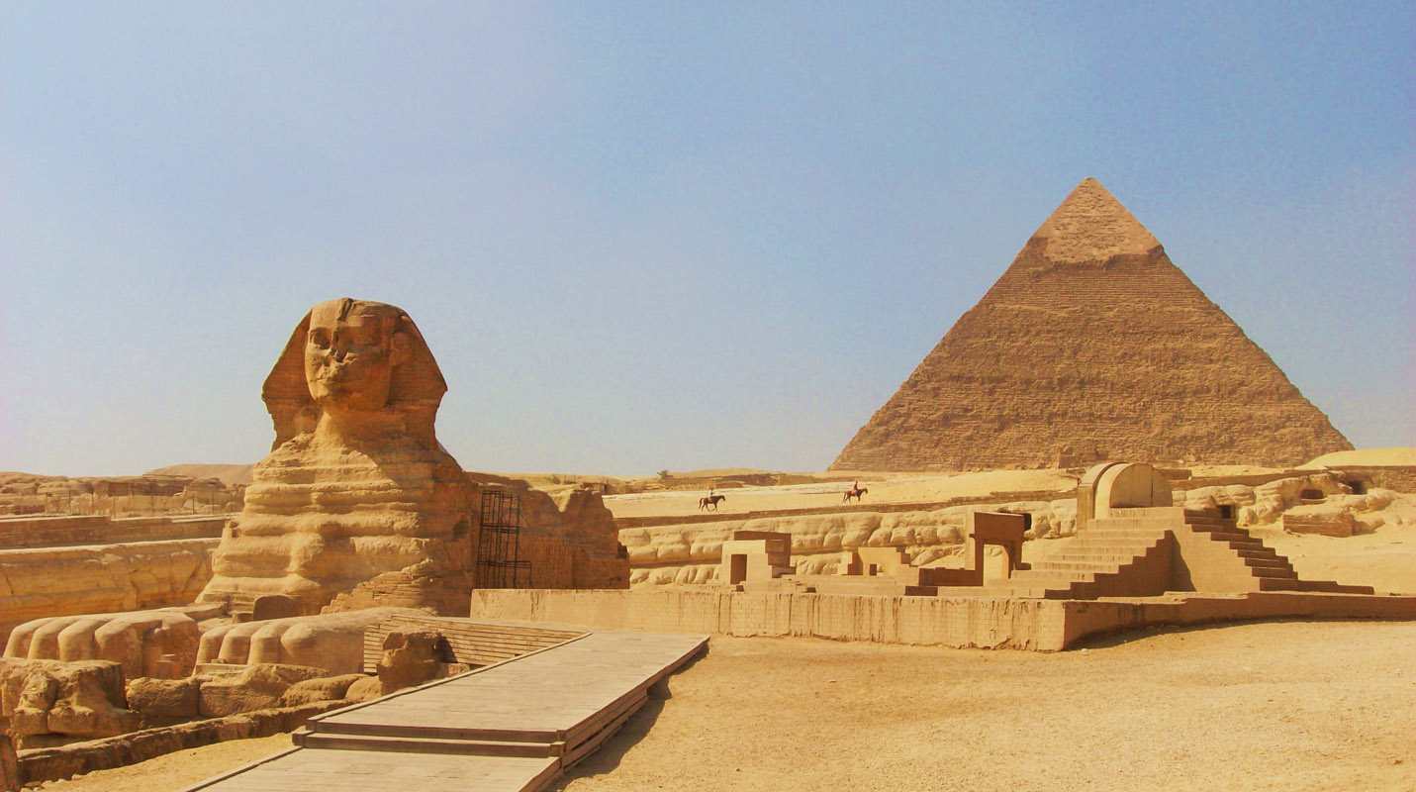
SIG-ISM 6th Workshop: spring 2018
November 20-21, 2017: CLAW workshop, Malaga
June 11 – 15, 2018, TNC18, Trondheim
Spring 2018: SIG-ISM, ????

